Slide 1
Mark Whitehorn
MDX vs. DAX
biSCIENCE
Consultant, Writer
Professor of Analytics at University of Dundee

Slide 2
biSCIENCE
We will finish on time…….

Slide 3
The School of Computing has a major interest in Business Intelligence and runs a Masters in BI
biSCIENCE

Slide 4
Much of this material in this talk comes from an assignment I set the students this year. We teach an entire module on MDX but very little on DAX – hence the assignment. So, the students get the credit for the detailed material here, I get the blame if any of it is incorrect.
biSCIENCE

Slide 5
The students provided great examples of compare and contrast, the only problem is that they make a poor talk…..
biSCIENCE

Slide 6
MDX
DAX
Multi-selects not handled well (though better if a front-end tool is used)
Supports Actions
Supports conditional logic and Ifs
Supports custom aggregations on sets of data
Multi-selects return a table of values representing a selection
Ability to work with and manipulate leaf-level data
Possible to perform data cleansing and transformation type activities during the data load.
Some indications that DAX, which was designed to run efficiently on modern processors, may perform better than MDX for certain calculations
No equivalent to Actions
Supports conditional logic and Ifs
Supports custom aggregations on sets of data

Slide 7
What I tried to add was a framework which explains WHY the languages are different (when the do differ) and similar in the ways they are similar.
In other words, if you understand the pattern, you know so much more about the domain and you can often predict what you haven’t been told.
Along the way we will answer the questions as promised:
biSCIENCE

Slide 8
Why are they so different?
What fundamental features make them so different?
Who are they aimed at?
Given my interests and current skill set, which one should I learn first?
How can a single company come up with two such different languages?
Who is to blame?
Who can I sue about this?
Was it anything to do with the phone hacking scandal?
biSCIENCE

Slide 9
Languages
Human
Computer

Slide 10
Languages
Human
Computer
Alien
Klingon

Slide 11
Languages
Human
Computer

Slide 12
Computer Languages
C#
Java
C++
VB
et al.

Slide 13
Computer Languages
Declarative
Procedural
Prolog
SQL
VB
C++

Slide 14
Declarative
Most Database
Languages

Slide 15
Most? Well, some aren’t, particularly the early ones like PAL, but ‘most’ is accurate.
unassigned = False
FOR i FROM 1 to ARRAYSIZE(A)
IF NOT(ISASSIGNED(A[i]))
THEN
unassigned = True
QUITLOOP
ENDIF
ENDFOR

Slide 16
Most Database
Languages
Transactional
Analytical

Slide 17
Most Database
Languages
Transactional
Analytical
MDX
DAX
SQL

Slide 18
Transactional
DDL
DQL
Query columns and rows
Insert rows
Update rows
Delete rows

Slide 19
Analysis
All analysis, and hence all analytical languages, involves the manipulation of:
Measures
Dimensions
What are these?

Slide 20
Analysis
Measures
Numerical values
Effectively meaningless on their own

Slide 21
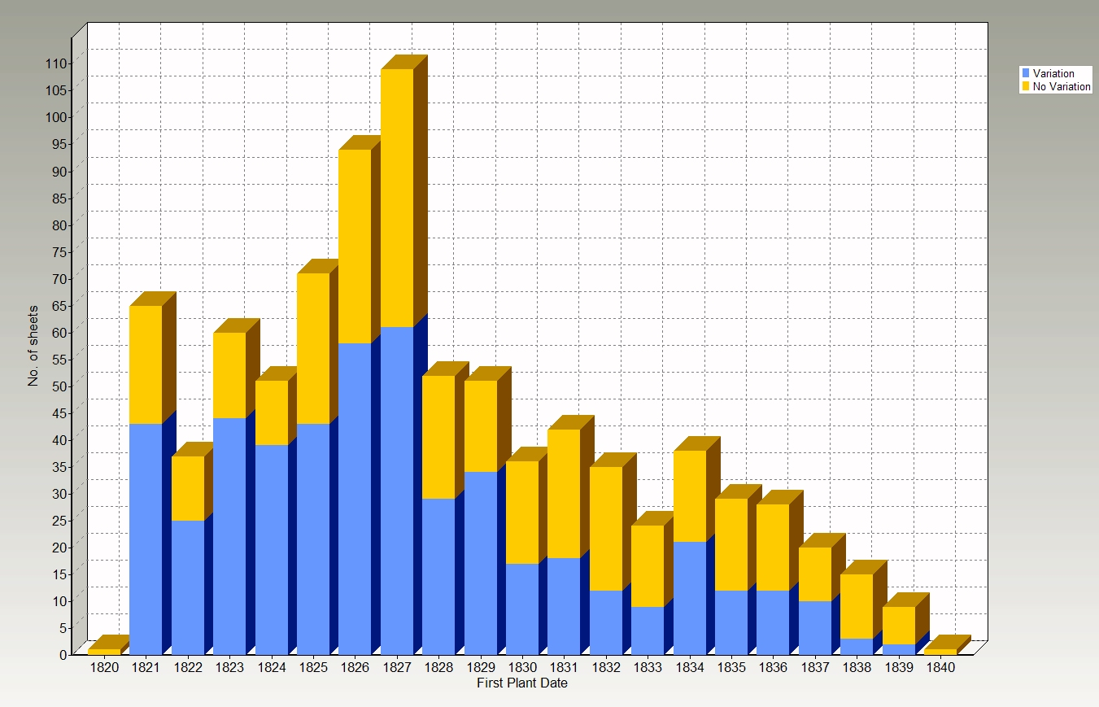
Analysis
User Model
Graphs
Mark Whitehorn

Slide 22
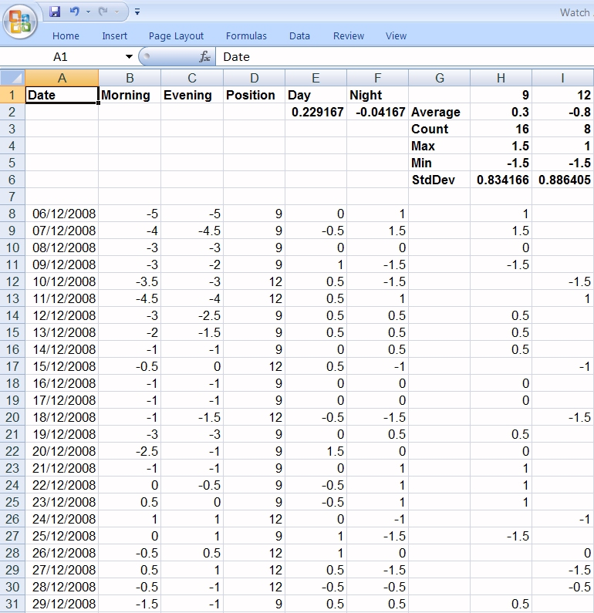
Analysis
User Model
Grids (spreadsheets)
Mark Whitehorn

Slide 23
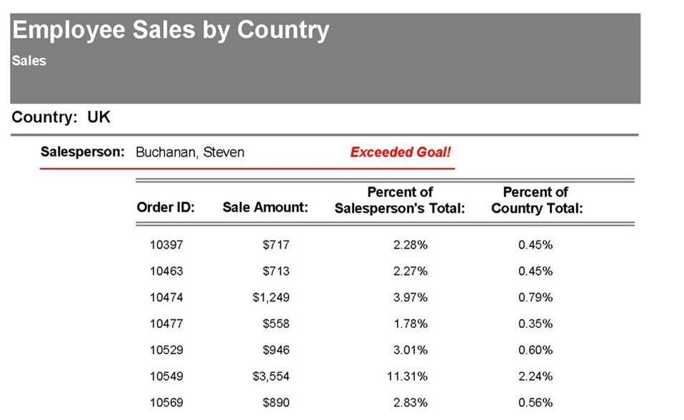
Analysis
User Model
Reports (printed or web-based)
Mark Whitehorn

Slide 24
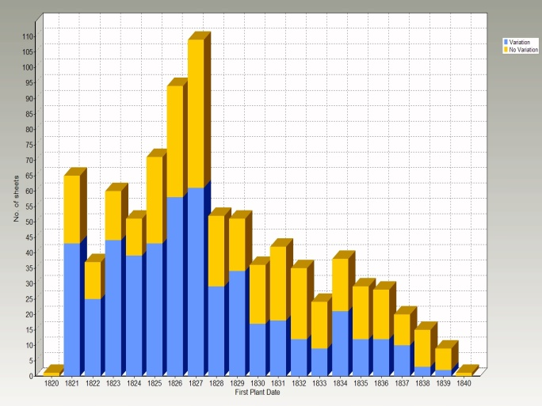
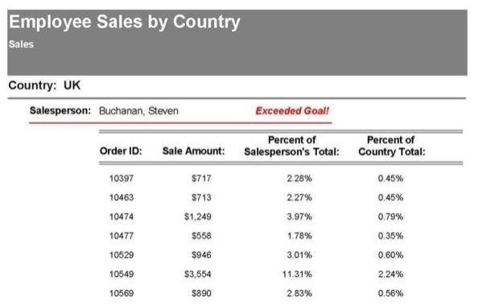
Analysis
User Model
Common to all three are measures and dimensions
Mark Whitehorn

Slide 25
The two languages share many characteristics – they are both database languages, they are both declarative. The fact that they are both analytical tells us a great deal about the similarities.
But now we can look at the differences between them and most of the differences have their origins in the data structures each is designed to address.

Slide 26
Analytical
Cube
Flat Files

Slide 27
Analytical
Cube
Flat Files
DAX
MDX

Slide 28
So, what is a cube?

Slide 29
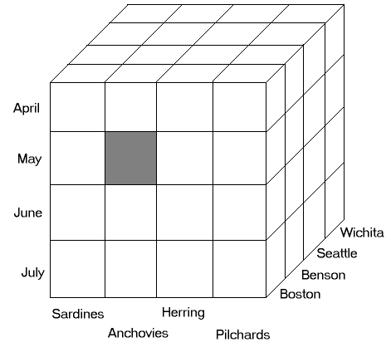
So, what is a cube?

Slide 30
MDX
Numerical measures sit in the cells.
Each ‘side’ of the cube is a dimension, for example, Store. A Store can have multiple attributes, such as location (town) and type (hardware, grocery etc.).
Some attributes (such as town) are hierarchical (This is important!)
Hierarchies have levels and members

Slide 31
MDX
Levels and Naming conventions
Store Dimension, StLoc hierarchy
[Store].[StLoc].[All].[Massachusetts].[Leominster]

Slide 32
MDX
Order, Order…..
Consider a relatively common analytical requirement calculating sales to date
SQL
Horrible (recursive SQL)
MDX
There is a function called YTD which does precisely this.
This is no accident.......

Slide 33
MDX
So MDX requires an understanding of:
Dimensions
Measures
Members
Cells
Hierarchies
Aggregations
Levels
Tuples
Sets

Slide 34
MDX
Suppose we have a requirement to extract these data from an 8 dimensional cube?
Female Male
Black $4,406,097.62 $4,432,314.34
Blue $1,177,385.57 $1,101,710.71
Grey (null) (null)
Multi $53,708.30 $52,762.44
NA $216,262.84 $218,853.85
Red $3,880,734.87 $3,843,595.65
Silver $2,639,659.69 $2,473,729.39
Silver/Black (null) (null)
White $2,472.25 $2,634.07
Yellow $2,437,297.54 $2,419,458.09

Slide 35
MDX
SQL would essentially be:
SELECT [These columns]
FROM [This table]
WHERE [this Row constraint is true]
But the inherent assumption here is that the data structure from which we are extracting the data is two dimensional. It isn’t, it has 8 dimensions – there are no rows and columns in the underlying data structure.
Female Male
Black $4,406,097.62 $4,432,314.34
Blue $1,177,385.57 $1,101,710.71
Grey (null) (null)
Multi $53,708.30 $52,762.44
NA $216,262.84 $218,853.85
Red $3,880,734.87 $3,843,595.65
Silver $2,639,659.69 $2,473,729.39
Silver/Black (null) (null)
White $2,472.25 $2,634.07
Yellow $2,437,297.54 $2,419,458.09

Slide 36
MDX
SELECT
[Customer].[Gender].[All].Children ON COLUMNS,
{[Product].[Color].[All].Children} ON ROWS
FROM [Adventure Works]
WHERE [Measures].[Internet Sales Amount]
Female Male
Black $4,406,097.62 $4,432,314.34
Blue $1,177,385.57 $1,101,710.71
Grey (null) (null)
Multi $53,708.30 $52,762.44
NA $216,262.84 $218,853.85
Red $3,880,734.87 $3,843,595.65
Silver $2,639,659.69 $2,473,729.39
Silver/Black (null) (null)
White $2,472.25 $2,634.07
Yellow $2,437,297.54 $2,419,458.09

Slide 37
MDX
SELECT
[Customer].[Gender].[All].Children ON COLUMNS,
{[Product].[Color].[All].Children} ON ROWS
FROM [Adventure Works]
WHERE [Measures].[Internet Sales Amount]
(note the hierarchical references and the positional ones)
Female Male
Black $4,406,097.62 $4,432,314.34
Blue $1,177,385.57 $1,101,710.71
Grey (null) (null)
Multi $53,708.30 $52,762.44
NA $216,262.84 $218,853.85
Red $3,880,734.87 $3,843,595.65
Silver $2,639,659.69 $2,473,729.39
Silver/Black (null) (null)
White $2,472.25 $2,634.07
Yellow $2,437,297.54 $2,419,458.09

Slide 38
So, what about flat-file data structures?

Slide 39
Are flat files hierarchical?
For the moment, I’m taking the stance that DAX addresses only flat files and that flat files are not hierarchical. I think that this is ‘true enough’ to be a useful point of comparison, but we will return to the subject before the end of the talk.

Slide 40
Are flat files hierarchical?
Well, flat-files are tables (more or less) …….

Slide 41
Data is stored in tables
LicenseNo | Make | Model | Year | Color
CER 162 C | Triumph | Spitfire | 1965 | Green
EF 8972 | Bentley | Mk. VI | 1946 | Black
YSK 114 | Bentley | Mk. VI | 1949 | Red

Slide 42
Data is stored in tables
Each table has a name
Car
LicenseNo | Make | Model | Year | Color
CER 162 C | Triumph | Spitfire | 1965 | Green
EF 8972 | Bentley | Mk. VI | 1946 | Black
YSK 114 | Bentley | Mk. VI | 1949 | Red

Slide 43
Data is stored in tables
Columns
Car
LicenseNo | Make | Model | Year | Colour
CER 162 C | Triumph | Spitfire | 1965 | Green
EF 8972 | Bentley | Mk. VI | 1946 | Black
YSK 114 | Bentley | Mk. VI | 1949 | Red

Slide 44
Data is stored in tables
Columns
Car
Each
of which
has
a unique
name
LicenseNo | Make | Model | Year | Colour
CER 162 C | Triumph | Spitfire | 1965 | Green
EF 8972 | Bentley | Mk. VI | 1946 | Black
YSK 114 | Bentley | Mk. VI | 1949 | Red

Slide 45
Data is stored in tables
Columns
Car
LicenseNo | Make | Model | Year | Colour
CER 162 C | Triumph | Spitfire | 1965 | Green
EF 8972 | Bentley | Mk. VI | 1946 | Black
YSK 114 | Bentley | Mk. VI | 1949 | Red
Rows

Slide 46
Data is stored in tables
Columns
Car
LicenseNo | Make | Model | Year | Colour
CER 162 C | Triumph | Spitfire | 1965 | Green
EF 8972 | Bentley | Mk. VI | 1946 | Black
YSK 114 | Bentley | Mk. VI | 1949 | Red
Rows
Primary
Key
Which
May
Only
Contain
Unique
Values

Slide 47
Data is stored in tables
Car
LicenseNo | Make | Model | Year | Color
CER 162 C | Triumph | Spitfire | 1965 | Green
EF 8972 | Bentley | Mk. VI | 1946 | Black
YSK 114 | Bentley | Mk. VI | 1949 | Red
Any piece of data in the database can be unequivocally located by using the:
Table name
Primary Key Value
Column Name

Slide 48
But a flat file can contain denormalised data
Order No | Title | First Name | Last Name | Post Code | Post Town | County | EmpFirst Name | EmpLast Name | Order Date | Dispatch Date | Item No | Book Title | Cost Price | Sale Price | Quantity | Delay
1 | Mrs | Jean | Robertson | CB7 4AL | ELY | CAMBS | Robert | Vaughan | 01-Apr-95 | 01-Apr-95 | 60 | Not again | £0.47 | £0.48 | 1 | 0
1 | Mrs | Jean | Robertson | CB7 4AL | ELY | CAMBS | Robert | Vaughan | 01-Apr-95 | 01-Apr-95 | 89 | Follow me | £15.86 | £16.51 | 1 | 0
1 | Mrs | Jean | Robertson | CB7 4AL | ELY | CAMBS | Robert | Vaughan | 01-Apr-95 | 01-Apr-95 | 100 | One hundred best titles | £24.92 | £25.77 | 1 | 0
1 | Mrs | Jean | Robertson | CB7 4AL | ELY | CAMBS | Robert | Vaughan | 01-Apr-95 | 01-Apr-95 | 140 | Great tailgate trombonists | £12.36 | £13.56 | 1 | 0
1 | Mrs | Jean | Robertson | CB7 4AL | ELY | CAMBS | Robert | Vaughan | 01-Apr-95 | 01-Apr-95 | 146 | City Foxes | £16.43 | £17.16 | 1 | 0
2 | Ms | Annie | Ferrie | BA13 3PY | WESTBURY | WILTS | Gladys | Pandolfi | 01-Apr-95 | 12-Apr-95 | 94 | Music for pleasure | £24.84 | £25.17 | 1 | 11
2 | Ms | Annie | Ferrie | BA13 3PY | WESTBURY | WILTS | Gladys | Pandolfi | 01-Apr-95 | 12-Apr-95 | 138 | Nothing but a wart-hog | £1.94 | £2.03 | 1 | 11
3 | Mr | Robert | McFee | AB55 U | KEITH | BANFFSHIRE | William | McCash | 03-Apr-95 | 19-Apr-95 | 3 | Eating well | £7.55 | £8.13 | 2 | 16
3 | Mr | Robert | McFee | AB55 4DU | KEITH | BANFFSHIRE | William | McCash | 03-Apr-95 | 19-Apr-95 | 46 | Database design vol. 2 | £12.84 | £13.44 | 1 | 16
3 | Mr | Robert | McFee | AB55 4DU | KEITH | BANFFSHIRE | William | McCash | 03-Apr-95 | 19-Apr-95 | 53 | Zip Scarlet runs away | £6.43 | £6.84 | 1 | 16

Slide 49
DAX
DAX requires an understanding of:
Flat files
Tables
Columns
Essentially has no inherent understanding of hierarchies

Slide 50
Who will use them and for what?
MDX
DAX
Targeted at OLAP specialists
For data professionals not end users
Part of a corporate BI strategy
Closely but certainly not exclusively associated with Microsoft’s SQL Server Analysis Services
Targeted at Excel power users
“Self-service BI” – up to a point
DAX can only be stored in individual workbooks so less suitable for calculations that should be centrally controlled.
Potential for Excel hell only more so. But there is SharePoint, Microsoft’s current answer to everything including global warming.
Exclusively associated with Microsoft PowerPivot/Excel 2010

Slide 51
Usage
MDX
DAX
Used for querying
Used for writing expressions
Creating calculated members
Cannot be used for querying (although…..)
It’s an expression language
For creating calculated columns
For creating custom measures
These can only be added to columns

Slide 52
Physical
MDX
DAX
Operates on multi-dimensional data stored on disk
Speed hit
Large data volume
Operates on flat file data stored in-memory
speed gains
but limited data volume

Slide 53
Syntax
MDX
DAX
Seems similar to SQL but isn’t because they query very different underlying data structures (relational/multi-dimensional)
Very bracketty code, very bracket-sensitive
SQL similarity is probably a negative point: apparent similarities cause confusion for new users and fuel the perception that MDX is difficult.
Concepts harder to grasp
A mature, rich language in which complex and powerful calculations can be written
Has been developed and refined over time
Syntax derived from Excel formulae
Very bracketty code, very bracket-sensitive
Relatively easy to learn for Excel users
Concepts easier to grasp
A recent language without the benefit of years of development – improvements in functionality are expected in future versions

Slide 54
On the subject that DAX is easier to grasp…
MDX
DAX
DAX can also be used to build ‘sophisticated dimension-navigating, time-aware functions that return in-memory table objects for further, nested, functionality’ (Donald Farmer)
But at this advanced level DAX becomes complex and difficult

Slide 55
DAX
Only one line in a DAX expressions
Chris Webb – as soon as you need a carriage return, learn MDX
http://sqlbits.com/Sessions/Event7/Implementing_Common_Business_Calculations_in_DAX

Slide 56
Coming up…
Speaker | Title | Room
Quest | Trivia Quiz: Test Your SQL Server and IT Knowledge and Win Prizes | Aintree
SQL Server Community | SQL Server Community presents : The A to Z of SQL Nuggets | Lancaster
SQLSentry | Real Time and Historical Performance Troubleshooting with SQL Sentry | Pearce
Attunity | Data Replication Redefined – best practices for replicating data to SQL Server | Empire
#SQLBITS

Slide 57
Summary
Why are they so different?
What fundamental features make them so different?
Who are they aimed at?
Given my interests and current skill set, which one should I learn first?
How can a single company come up with two such different languages?
Who is to blame?
Who can I sue about this?
Was it anything to do with the phone hacking scandal?
biSCIENCE

Slide 58
MDX
DAX
Aware of hierarchies and order
Whilst dimensions do not have to be hierarchical, the majority are
Can address cells and ranges of cells
No awareness of hierarchies, levels or attributes -
except for built-in time functions
But because these aren’t based in an underlying hierarchy, developing financial year or other variations is difficult.
DAX functions understand relationships between tables, therefore if a table exists with a product key column that references a table of product attributes, it is possible to produce hierarchical-type aggregations
Although the PowerPivot model is multidimensional, the analyst is abstracted from this by using relational concepts, so DAX provides functions that implement relational database concepts
it cannot address cells or ranges of cells, only columns and tables
To achieve complex calculations, it may be necessary to create several explicit measures referencing each other
Intermediate explicit measures will be exposed to the end users

Slide 59
MDX
DAX
able to perform complex calculations within the context of the cells being viewed
Can apply advanced security features
User Defined Functions (UDFs)
Has ‘Row context’ and ‘Filter context’ expressions giving a powerful ability to perform dynamic complex calculations whilst dimensions are being sliced. However, because of this necessary complexity, the calculations may take self-service BI beyond the capabilities of all but the most advanced Excel users
Tabular layout may be easier to understand than multi-dimensional
No security functions
suppported
Limited built-in statistical functions
No User Defined Functions (UDFs)

Slide 60
MDX
DAX
Both MDX and DAX will be used in the upcoming release of the Microsoft BI platform
DAX is an attempt to simplify a naturally complex model

Slide 61
MDX
DAX
Multi-selects not handled well (though better if a front-end tool is used)
Supports Actions
Supports conditional logic and Ifs
Supports custom aggregations on sets of data
Multi-selects return a table of values representing a selection
Ability to work with and manipulate leaf-level data
Possible to perform data cleansing and transformation type activities during the data load.
Some indications that DAX, which was designed to run efficiently on modern processors, may perform better than MDX for certain calculations
No equivalent to Actions
Supports conditional logic and Ifs
Supports custom aggregations on sets of data

