Slide 1
Designing an SSIS Framework
Andy Leonard
SQLBits 9
1 Oct 2011

Slide 2



Europe’s Premier Community
SQL Server Conference
#SQLBITS

Slide 3

Platinum Sponsor

Slide 4


Premium Sponsor

Slide 5






Please visit our Gold Sponsor stands,
we couldn't do it without you…

Slide 6




Silver, Bronze and Exhibitors
All of you…

Slide 7


Community Corner
Don’t forget to check out Community Corner
Find out about User Groups in your area!

Slide 8
Housekeeping
Health and Safety
Fire assembly point is outside near Mount Pleasant Car Park
There is no fire drill today
Breaks
A.M. - 10:30, 11:50
Lunch - 13:10-13:40
P.M. - 14:30,15:40
Smoking
Don’t do it mate - it’s not worth it…
Prayer Room – Ask at Hotel Reception

Slide 9
Exhibitor Competitions
You have to be in it to win it!
SQL Sentry – Powersuite
Microsoft – Xbox and Arc Touchmouse
Quest – Amazon Voucher
Red Gate – Amazon Kindle and Red Gate Developer Bundle
Coeo – Full MCM Booklist
Attunity – Echo Livescribe Smart Pen
Idera – Amazon Kindle

Slide 10

It’s a STAMPede!
Collect 6 stamps on the front of your Agenda and you could win a XBOX Gears of War…
Bring your card to community corner at the last break to be entered int the draw at 17:15

Slide 11
Agenda change
At 14:40 in the Boardroom:
Reporting Services and Sharepoint Integration with Rob Carrol
is now:
RoboDBA with Andre Kamman

Slide 12
Feedback Win an XBOX 360
Help us make SQLBits better
Enter your feedback online at:
http://www.sqlbits.com/SQLBits9Thursday
http://www.sqlbits.com/SQLBits9Friday
http://www.sqlbits.com/SQLBits9Saturday
http://www.sqlbits.com/SQLBits9feedback

Slide 13
Thank you for coming, enjoy the day
#SQLBITS

Slide 14
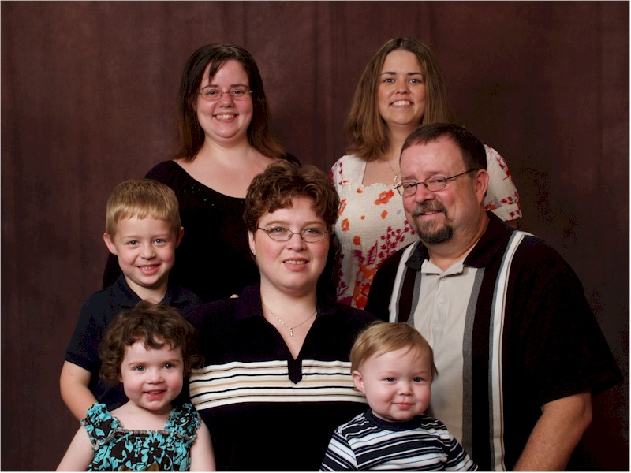
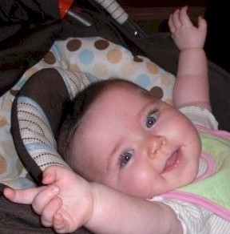
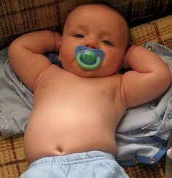
The History of Andy, Part 1
SQL Server MVP
SQLPeople Person
CSO, Linchpin People
Author
Blogger
Husband
Father
Grandfather!

Slide 15
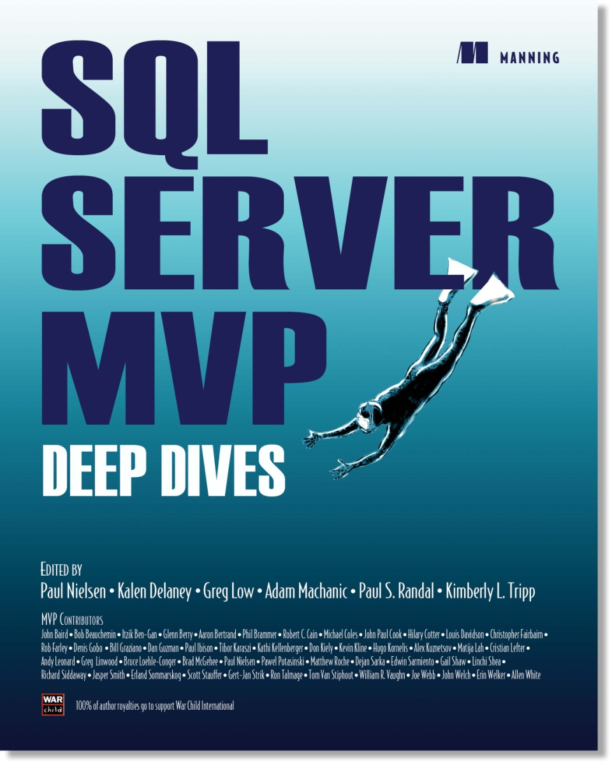

War Child International
http://www.warchild.org
http://www.SQLServerMVPDeepDives.com

Slide 16
Contact Information
Twitter.com/AndyLeonard
Andy.Leonard@gmail.com
SqlBlog.com/blogs/andy_leonard
Rate This Session at SpeakerRate.com!
http://speakerrate.com/andyleonard

Slide 17
Agenda
What’s an SSIS Framework?
Demos!

Slide 18
What’s an SSIS Framework?
Three Components:
Execution Control
Connections and Configurations Management
Centralized Logging

Slide 19
Execution Control
SSIS Applications
SSIS Packages

Slide 20
Connections and Configurations Management
Connections Management
Configurations

Slide 21
Centralized Logging
Custom Logging
Event / Error Logging
Instance Logging
Other Logging

Slide 22
Questions?

Slide 23
Thank You!
Twitter.com/AndyLeonard
Andy.Leonard@gmail.com
SqlBlog.com/blogs/andy_leonard
Rate This Session at SpeakerRate.com!
http://speakerrate.com/andyleonard

Slide 24
Demos!

Slide 25

Coming up…
Speaker | Title | Room
Ola Hallengren | Inside Ola Hallengrens Maintenance Solution | Aintree
Mark Pryce-Maher | Building a SSMS Add-in; The Agony and Ecstasy | Lancaster
Marco Russo | Vertipaq vs OLAP: Change Your Data Modeling Approach | Pearce
Gert Drapers | Database Development with SQL Server Juneau | Boardroom
Satya Jayanty | SQL Server Upgrade: take help from tools and best practices | Empire
Emil Glownia | Advanced SSRS. Find out what you have been missing. | Derby
#SQLBITS

