Slide 1
SQL Bits October 2011 - Liverpool
The forgotten DBA daily essential checklist
Francesco Quaratino
francescoquaratino@gmail.com

Slide 2
Who am I
Francesco Quaratino
From Italy but currently working in UK
Work with SQL Server since 2000 as
DB Administrator
DB Designer/Developer
MCDBA, MCTP: SQL 2005, MCTP: SQL 2008, MCT until 2010
Contributor of UGISS (Italian SQL Server UG)
www.ugiss.org
Notes:
Hello everybody, my name is Francesco Quaratino, I’m from Italy and currently I’ve been living and working in London as DBA/Developer for a betting company.
I’ve been working with SQL Server since 2000 initially as DB Designer and Developer, then as DBA. During this period I have earned some Microsoft certifications about SQL Server 2000, 2005 and 2008.
You can find some articles that I wrote on the Italian SQL Server UserGroup Web site and on my blog, which are available only in Italian. However, my presentation today is clear and well organized… unlike my English. I will try to make my presentation as clear as I can, despite my English.
So let's start.

Slide 3
Agenda
Do we need actually a daily checklist?
An answer
My best friends that help me to do this boring job
In theory: logging everytime
In practice: T-SQL based free solutions
My Top 10 daily check list
This is the “in my view” check list
Pheraps 10 checks are not enough in the real world
but too much for an hour of speech ☺
Notes:
This is what I’m going to tell you in this presentation today.
first of all, I’m going to answer the question "why we need a daily check list", even if it’s actually a boring activity, I think it is at the same time a useful and vital activity that we must perform on daily basis
Second point. Then I'm going to present you my best friends in this daily job.
From a conceptual point of view, my best friend is the log of every changes that happen in the system. Probably, this is the only way to know if our system is growing up in the best way or not.
From a practical point of view, my best friends are some free solutions based on T-SQL that help me to perform my daily checks and help me to log the health state of the database system.
Third Point. So I’m going to present you my top 10 daily check list but please be aware that
this TOP10 is subjective: it is based on my personal experiences
that probably 10 checks are not enough in the real world to monitor a complex database system
anyway they are quite enough for a presentation that takes 1 hour when I’m trying to explain my point of view.

Slide 4
Do we need actually a daily check list?
Absolutely Yes, if we don’t like having nightmares
We need models, guide lines, best practices, a daily check list
Notes:
A very important part of our job consists of a set of duties that are oriented to look after the database servers, to look after all their databases and all related software and hardware component around them. We often need a model to accomplish our jobs, we forget it many times and we do our job as it comes, instinctively without any kind of guide lines, perhaps because we are not happy to do a boring job or perhaps because we love being artists. I am sure that this way of thinking the DBA job is very dangerous. We need models, we need guide lines, we need best practices, we need a boring daily check list to be sure that all the things are going to be in the right way, in the better way.

Slide 5
My best friends
In theory: log before to analyze after
preferably in SQL tables – easier and faster to analyze
Log only what you know how to analyze
In practice: T-SQL based free solutions
SYS2 DMVs
http://sys2dmvs.codeplex.com/
SQL Maintenance Solution
http://ola.hallengren.com/
DBCC CHECKDB for Very Large Databases
http://www.sqlmag.com/article/tsql3/dbcc-checkdb-for-very-large-databases
Notes:
- SYS2 DMVs
A collection of scripts that simplify the usage of DMVs, avoiding the user to write queries with tons of joins and allowing him to get directly the results he needs.
- SQL Maintenance Solution
A well know T-SQL based solution to do backups, indexes and statistics maintenance.
- DBCC CHECKDB for Very Large Databases
A T-SQL based solution to do CHECKDB for Very Large Databases

Slide 6
SYS2 DMVs
Author: Davide Mauri (www.davidemauri.com)
A collection of functions, views and stored procedures that simplify the usage of DMVs
Example
SELECT * FROM sys2.databases_backup_info(3)
Returns the last 3 days backups of each database
EXEC sys2.stp_get_databases_space_used_info
Returns a list of all databases along with the relativ space used, space available, max space and growth.
SYS2 DMVs Setup
Notes:
With these scripts we don’t need anymore to write queries with tons of joins and we can have directly the results we actually need.
Is there anyone among you that is using this solution?

Slide 7
SQL Maintenance Solution
Author: Ola Hallengren (ola.hallengren.com)
DatabaseBackup
Backup databases
DatabaseIntegrityCheck
Check the integrity of databases
IndexOptimize
Rebuild and reorganize indexes and update statistics
SQL Maintenance Solution Setup
Notes:
Is there anyone among you that is using this solution for some of these tasks?
Is there anyone in this room that attended the session of Ola Hallengren about his solution?
So you will probably know that
Fundamentally this solution is composed of three stored procedures that automate very quickly these activities:
Database Backup
Integrity Check
Indexes and updates maintenance
In my view the work that Ola has done is really impressive, so I definitely advice you to use it instead of using the Maintenance Plan available inside the Managemente Studio.

Slide 8
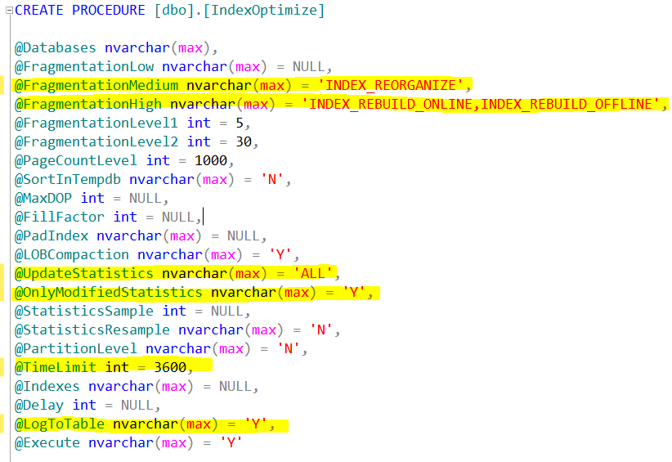
SQL Maintenance Solution
IndexOptimize
dbo.CommandLog
Notes:
As you can see, the setup is quite simple but just let's keep in mind that we can change some really important value parameters of these stored procedures. First of all the @LogToTable parameter that you can switch ON (its default value is OFF). By doing that, all maintenance operations will be logged into a table called dbo.CommandLog in the Master database. This is one of the last updates just introduced one month ago and it is present in all the three stored procedure of the maintenance solution.
The @TimeLimit parameter can be a crucial element for the very large databases, because you can limit the indexes and statistics optimization and avoid that it heavily affects the system performances.

Slide 9
DBCC CHECKDB for VLDB
Author: David Paul Giroux
CHECKDB is
a really important task
a huge task
very complex task to do with VLDBs
DBCC CHECKDB for VLDB Setup
Notes:
I found this solution few years ago in an article on the SQL Server Magazine and at that time I would have kept it in mind for the future. Just few months ago I started working with some very large databases involved in database mirroring and snapshots too and I found out that doing a consistency check of these databases was very difficult. So I recalled that script about the CHECKDB of VLDB and started working with it. I did just few modifications such as moving the objects from MSDB to Master database, and calling the function “dbo.DatabaseSelect” that is used inside the Maintenace Solution of Ola Hallengren.
I’m going to show you how to install it and how it works.
First of all I create the dbo.DatabaseSelect in the master.
Then I create these two stored procedure.
At the end I create a SQL Agen job called “Server Daily Maintenance”.
Now I’ll show you what this job will do:
execute the stored procedure dbo.mnt_DBCC where now I’ll change the @VLDB parameter value to “1” that means I want to spread the load in this number of days.
This stored procedure will create a job called “Maintenance_DBCC_CHECKDB”or will modify his steps according the values parameters.
For instance, now I’ll run the job and we’ll see a new running job.

Slide 10
My Top 10 daily check list
Jobs activity
Backup / Restore
Consistency check (DBCC CHECKDB)
Error log inspection
Free disk space
Data and log file size
File auto grow
Indexes (Fragmentation level, Unused indexes, Duplicated indexes, Missing indexes)
Database property settings
...ace in the ole...
Notes:
This is my TOP 10 daily check list.
I’ll show you each point starting from “Job Activity”

Slide 11
1. Jobs activity
What I wouldn't like to hear
probably some SQL Jobs have failed during the night
Notes:
“Jobs activity” is the first check of my list. When something usually gets wrong … some SQL Jobs have failed during the night. So if we want to avoid situations like this (point the picture), we must check Job actvities before our boss comes and tells us “we have a problem”.

Slide 12
1. Jobs activity
Job activity monitor
Log file viewer
SQL job manager 1.1
http://www.idera.com/Products/Free-Tools/SQL-job-manager/
T-SQL
Notes:
How can we check the jobs activity of a SQL Server? There is a well known monitor tool available inside the Management Studio called “Job activity monitor”. I assume all of you know it very very well. But we sometimes forget that it shows only the last run outcome, while the previous ones can be viewed by the “Log file viewer”. Anyway, even if it’s a free tool and it’s very simple to use, it becomes almost unuseful when you have to monitor a lot of servers.
In this case we could use a free tool called “SQL job manager 1.1”, even though is a bit instable and it doesn’t work all the times. For example, on a Win7 workstation that I use to monitor just 10 servers (from Sql Server 2K to 2K8) it stops working after few minutes it is opened.
So, this is why I prefer monitoring the jobs activity using T-SQL.
But first of all, keep in mind to setup a Database Mail and configure the SQL Agent Alert System to receive e-mails when the jobs fail/complete/succeed.

Slide 13
1. Jobs activity
DEMO
Find failed sql agent jobs

Slide 14
2. Backup / Restore
What I wouldn't like to find out
I’ve no backup available when this is the last chance to have data available after a disaster

Slide 15
2. Backup / Restore
Check backups
[dbo].[backupmediafamily]
[dbo].[backupset]
Or
[sys2].[databases_backup_info]
Backups restore
Building an automated test server
Notes:
Either we can check if backups are completed by querying the system tables [dbo].[backupmediafamily] and [dbo].[backupset] of MSDB database.
Or we could query this function [sys2].[databases_backup_info] of SYS2 DMVs project.
However, I still would like to know if I’m missing some backups according to my backup strategy. For instance, if my backup strategy consists of a weekly full backup, a daily differential one and a transaction log backup every 15 minutes, I would like to know exactly every 15 minutes that a full backup in the last 7 days was done, likewise a differential backup in the last 48 hours and a t-log backup in the last 15 minutes.
I can do this check simply querying the previous tables of MSDB, as I will show you in the next demonstration.
Last but not least, we need to test these backups restoring them in a automated test server. Ideally, just after a backup is completed, we must test its restore.

Slide 16
2. Backup / Restore
DEMO
Find missing backups

Slide 17
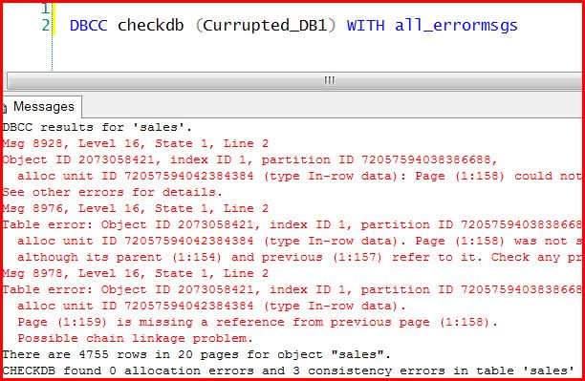
3. Consistency check (DBCC CHECKDB)
What I would never like to see
But unfortunately it could happen

Slide 18
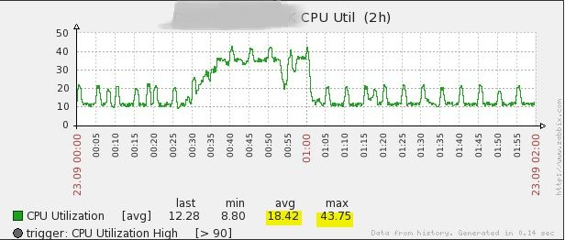
3. Consistency check (DBCC CHECKDB)
As much as possible (every day/week)
Monitoring CPU usage
PHYSICAL_ONLY run faster
Useful for large databases and not powerful server
CHECKTABLE against tables subsets
Very useful for VLDB
Notes:
So we should do CHECKDB as much as possibile (in my opinion I would suggest “every day”), paying attention at the CPU usage because is well known that the consistency check is a huge activity for the CPU as well as the Disk I/O operations.
Use the PHYSICAL_ONLY option to run faster CHECKDB.
Run CHECKTABLE against tables subsets like in the solution I have previously shown.

Slide 19
4. Error Log Inspection
Starting point for server trobleshooting
EXEC sp_readerrorlog
Deadlock information
DBCC TRACEON (1222, 1204, -1)
Increase the Error Log files number (6..99)
EXEC xp_instance_regwrite
N'HKEY_LOCAL_MACHINE',
N'Software\Microsoft\MSSQLServer\MSSQLServer',
N'NumErrorLogs',
REG_DWORD,
99
sp_cycle_errorlog
create a new Error Log file
Notes:
This is probably the starting point for the tipical Sql server troubleshooting activity.
We can run this system stored procedure called “sp_readerrorlog” to query the Errolog text files.
It is particularly useful to look into deadlock issues and consistency errors.
Bear in mind to switch on these TraceFlag to collect these kind of information in the ErrorLog file.

Slide 20
5. Free disk space
xp_fixeddrives
Returns the free space in MB of each drive
Using Powershell
Returns free space and capacity of each drive
Get –WmiObject -ComputerName ‘<server name>‘
-Class Win32_Volume -Filter 'DriveType = 3' |
select name,capacity,freespace | foreach
{$_.name+'|'+$_.capacity/1048576+'%'+$_.freespace/1048576+'*'}
Notes:
How can we automate this check?
First option: using the system stored procedure “xp_fixeddrives” that returns the free space in MB of each local drive
Second option: using powershell to get information about free space and capacity of each local drive.

Slide 21
5. Free disk space
DEMO
Check the drives free space

Slide 22
6. Data and log file size
Knowing database size we can analyze and predict the future in terms of space needed

Slide 23
7. File Auto Grow/Shrink
What I wouldn't like to see
Notes:
This chart shows the recent files auto-grow and auto-shrink on my notebook. As I said this is a personal notebook, not a server, but on many production servers I experienced this kind of situation: lots of auto grows and auto shrinks that heavily affect the server performances.

Slide 24
7. File Auto Grow/Shrink
A well known Best Practice says
Keep lowest possible the grow and shrink of database files
They cause external fragmentation
How can we achieve this goal
SET AUTO_SHRINK OFF
Sizing data and log files properly
BACKUP LOG for databases in Full/Bulked logged Recovery Model
Daily check auto grow/shrink

Slide 25
7. Data and log file size and File Auto Grow/Shrink
DEMO
Check files size and auto grow/shrink

Slide 26
8. Indexes
Fragmentation level
Unused indexes
Duplicated indexes
Missing indexes
Notes:
Indexes (Fragmentation level, Unused indexes, Duplicated indexes, Missing indexes, Unused tables)

Slide 27
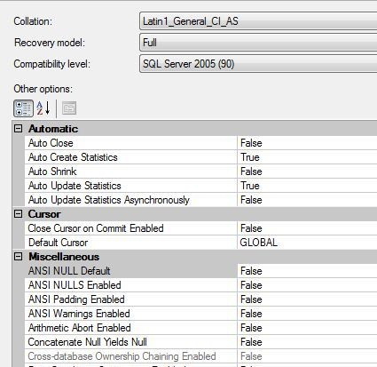
9. Database property settings

Slide 28
7. Indexes and Database property settings
DEMO
Check indexes and database property settings changes

Slide 29
10. ace in the hole
A really good coffee

Slide 30
Conclusions
We can
Build our checklist
Do our checks using T-SQL only
Collect information to analyze after
Use free T-SQL based solutions
Perhaps, a starting point to monitor the system
Notes:
So let’s summarize what we have seen so far in this presentation.

Slide 31
References
SYS2 DMVs (by Davide Mauri)
http://sys2dmvs.codeplex.com/
SQL Maintenance Solution (by Ola Hallengren)
http://ola.hallengren.com/
DBCC CHECKDB for Very Large Databases (by David Paul Giroux)
http://www.sqlmag.com/article/tsql3/dbcc-checkdb-for-very-large-databases
Photos (by Carmelo Eramo)
http://10dicembre.500px.com

Slide 32
SQL Bits October 2011 - Liverpool
Keep in touch
Email
francescoquaratino@gmail.com
WebSite
https://sites.google.com/site/francescoquaratino
Blog
http://community.ugiss.org/blogs/sgainz
Twitter
@fquaratino

Slide 33
SQL Bits October 2011 - Liverpool
Thanks!
BUON APPETITO!
Notes:
I hope you have found this presentation interesting. Enjoy your meal and the next sessions to come.

Slide 34
Coming up… in this room
TBD-FUSION IO (1:40 – 2:40)
Fusion IO
Creating a Meta Data Driver SSIS Solution with Biml (2:40 – 3:40)
Marco Shreuder
T-SQL: Bad Habits to Kick ( 4:00 – 5:00)
Aaron Bertrand
#SQLBITS

