Slide 1
Around the world (of query plan operators) in 50 minutes
David Morrison
BI Consultant

Slide 2
Before we start, a little about me . . . .
BI Consultant for, you guessed it, Adatis
I have worked in development and databases for around 12 years
My main specialisations are T-SQL, performance tuning and database design
I am lucky enough that this is my second SQLBits session
(see my last session “The Dark Arts” from SQLBits 8 on the website)
I like to keep a flow in my presentations so if you any questions please make a note and I’ll try and answer them at the end, thanks! ☺
I’ll show these at the end again
Twitter: @TSQLNinja
Blog: http://blogs.adatis.co.uk/blogs/david/default.aspx
Email: david.morrison@adatis.co.uk
Web: www.adatis.co.uk

Slide 3
Pre flight check (what we’re going to cover) . . .
Is this an all inclusive trip? (no, we’re not going to cover)
Parallelism, in any depth anyway, as this is a subject all of its own
Statistics, again I’ll touch on the importance of stats but not going to go into a lot of detail
Meet and greet (An overview of query plan operators we’ll be looking at, the different types and their various properties)
So, what do you do? (What they do and briefly how they do it)
What are you doing!? (Why they are chosen, rightly or wrongly)
80% of my query, really!?! (Why sometimes certain operators *cough* Sort *cough* perform badly)
These are not the operators you are looking for, move along … (“Persuading” the query optimizer to change its mind and use the right tool for the job)
Follow the arrows, not the Indians! (Following the flow of the plan and ways to spot when things are going wrong)

Slide 4
Logical Vs Physical – A brief overview
Logical operators are ‘Conceptually’ how the query optimizer will run your query
Physical operators are how it actually preforms the actions
Physical operations can implement many logical operations (Can be the other way round in rare occasions)
The query optimizer creates a logical plan ‘tree’, then for each logical operator it choses the most appropriate physical operation using a cost based system
So as an example, the logical operation might be an inner join and the physical operator could be a “Nested Loop Join”, “Hash Match” or “Merge Join”

Slide 5
The Meet and Greet
Scans
Table (Heap)
Clustered Index
Non Clustered Index
Joins
Nested Loop
Hash Match
Merge
Checks & Filters
Assert
Top
Filter
Bitmap
The bad & the ugly
Sort
RID Lookup
Key Lookup
No Join Predicate
Seeks
Clustered Index
Non Clustered Index
Creators
Compute Scalar
Stream Aggregate
Spools
Lazy
Eager
Parallel Gubbins
Just FYI really, we’re not looking at this today
Denotes an operator is being executed in parallel

Slide 6
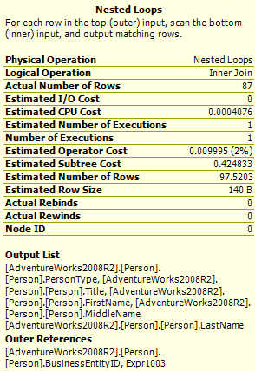
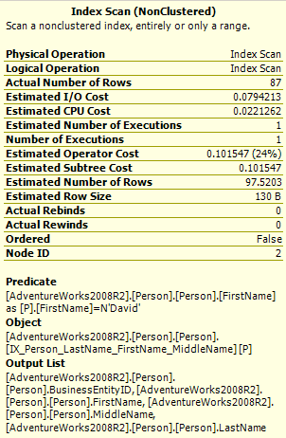
Properties, some examples
Physical vs Logical from Earlier
Estimated vs Actual
IMPORTANT!
Ordered can help
avoid the dreaded
Sort

Slide 7
Scans & Seeks
These are methods of getting data from the tables. Which one is chosen depends mainly on predicates (or lack there of), any indexes available, how well those indexes match any predicates, the required output columns and finally available statistics and their accuracy.
In most cases these operators will constitute all the leaf level operators of your query plan tree. There are a few exceptions, some of which I’ll come onto in a minute!
NB: Data is read in pages, NOT ROWS
Table Scan
Clustered Index Scan
Non Clustered Index Scan
Clustered Index Seek
Non Clustered Index Seek

Slide 8
Joins
The type of join chosen effectively depends on the number of rows that the query optimizer thinks it needs to join
Merge
Quickest for large numbers of rows but both inputs have to be sorted
Can cause sorts
Nested loop
Quickest for a small number of rows
A cause of Rebinds & Rewinds
Background - Init(), GetNext(), Close()
Hash Match
Kind of a middle point, better for a large number of rows but where the inputs are unsorted and sorting them would out weigh the benefits a merge join would offer
Watch out for this guy, he’s trouble!

Slide 9
Hash Match .. The whys and wherefores!
Executed in two phases
Build
Probe
In the build phase all rows from the first input, which is normally the smallest of the two tables, are read (this is a blocking operation) and turned into a hash table based on the join keys and then stored in memory
In the probe phase the rows from the second input are read, hashed in the same way as the build phase and then compared to the hash table.
Memory for this operation is pre allocated based on a estimate and this can cause issues
If the amount of memory required goes over what is allocated the overspill is placed onto disk in tempdb
The operation is then preformed on what is in memory, once this is completed the overspill is read into memory, hashed and processes starts again

Slide 10
Under the bonnet!
Rewinds & Rebinds only apply to the inner side of a loop join
Rewinds & Rebinds basically count the number of Init() calls made
Rebinds are counted when the outer reference changes and the inner reference has to be re-calculated
Rewinds are when the outer reference changes but the inner reference can be reused
For query plans rewinds & rebinds are only populated for these physical operators
Nonclustered Index spool
Remote Query
Row Count Spool
Sort
Table Spool
Table-valued Function
Init()
At least one, maybe many
Sets up the operator & required data structures
GetNext()
None or many
Gets the next (or first) row of data
Close()
Always once
Tidy’s up & shuts the operator down

Slide 11
Let there be data .. the creators
Compute Scalar
Stream Aggregate
‘Creators’ are the main methods of creating values on the fly. They are both used in different circumstances and both have a couple of requirements
For example, the stream aggregate requires the data to be sorted by the columns you’re aggregating over

Slide 12
Spools
Lazy spool
Eagar spool
Non clustered index spool
Table spool
Row count spool
Spools are mainly used for a couple of things
When your query requires a ‘complex’ action to be preformed (normally on a high density column)
To maintain transactional consistency for some update operations (Halloween protection)
Avoid re hitting tables & indexes which optimizes rewinds
The rows are stored either in memory or chucked onto disk in tempdb and indexed. This, amongst other things, enables something called ‘common sub expression spools’
Spools are another operator that may exist at the leaf level of your plan
An important property of spool operators is the ‘Primary Node ID’
Eagar spools are a ‘Blocking’ operator, lazy spools are a ‘Non Blocking’ operator

Slide 13
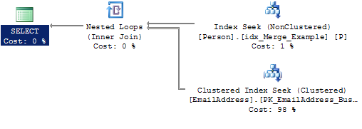
Blocking & Non Blocking Operators
Non Blocking Operators
Deals with one row at a time, pulls it in, deals with it and then passes the result on
A row comes in
from the outer input
The loop join requests just the
matching rows from the inner input
Rinse and Repeat for
all rows in the outer (top) input
The result is output
To the next operator
The seek returns the
matching rows

Slide 14
Blocking & Non Blocking Operators (Continued..)
Blocking Operators
Reads all rows in one go, the preforms is action, then passes the result on
A good example is a “Sort” operation
The sort reads in all rows
It then returns the sorted result

Slide 15
Checks & Filters
Bitmap
Designed to improve warehouse “star schema” style joins
Effectively it creates additional predicates to apply to the fact table based on the available values from a dimension table
Fact tables are expected to have at least 100 pages. The optimizer considers smaller tables to be dimension tables.
Only inner joins between a fact table and a dimension table are considered
The join predicate between the fact table and dimension table must be a single column join, but does not need to be a primary-key-to-foreign-key relationship. An integer-based column is preferred
Joins with dimensions are only considered when the dimension input cardinalities are smaller than the input cardinality from the fact table
Assert
Verifies a condition and generates an error if this condition fails
Returns null if condition is passed or a non null value if not
Top
Exactly what it says on the tin, scans the rows and only returns the top n rows or n percent rows
Used in Update queries to enforce row count limits
Filter
Pretty self explanatory, only outputs rows that match its filter expression.
In some cases can be a sign that things have gone wrong (we’ll see why in a bit)

Slide 16
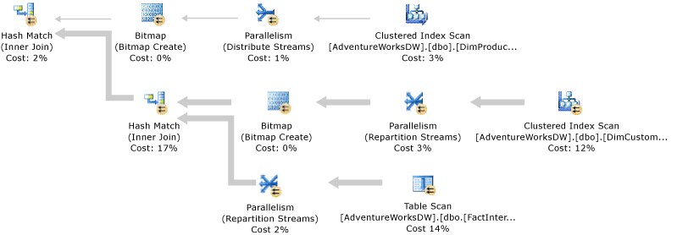
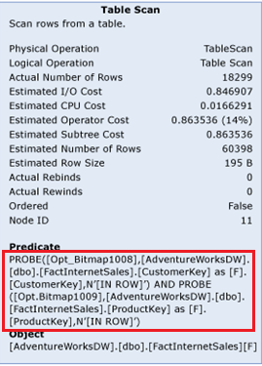
Bitmap Example

Slide 17
The Good, the Bad & the Ugly
You will, generally speaking, see at least one of these little trouble makers in most slow running queries
They all have their purpose and are required to be an option to the optimizer, however in most cases they are avoidable
Sort
I’d say this is the most common culprit in most slow running queries
It comes into play for a lot of reasons and most of them can be avoided
No Join Predicate
Classed (incorrectly so in my opinion) as a ‘Warning’
In a nutshell this means its going to create a Cartesian product of the outer and inner inputs
RID Lookup
Used to return columns from a heap when the optimizer uses a non clustered index that doesn’t contain all the required output columns for the query
Always accompanied by nested loop join to join the columns from the used index to the columns returned from the RID Lookup
Key Lookup
Pretty much Identical to the RID lookup but used when the table is a clustered rather than a heap. Can be a bit quicker due to the nature of a clustered index

Slide 18
“Persuading” the query optimizer to change its mind
What does have an impact however:
The way you write your code
Correct statistics (I mean correct, not “up to date”, as this is a very important distinction)
Keeping your plans as small as possible
Indexing
Covering indexes
Clustering on the appropriate columns. Don’t just blindly cluster on surrogate key identity columns. Cluster on what's appropriate
Maintaining SARGability
Correct Joining strategies
Unfortunately the threat of violence doesn’t seem to work!

Slide 19
Follow the arrows, not the Indians
Plans are executed from right to left, so the operator from the right sends its output to the operator on the left
The arrows that join the operators can be indicators of what’s going on, the wider the arrow the more rows it is ‘transferring’ between the operators
Beyond the first operation after the leaf level of your plan, the query optimizer is really ‘guessing’ at the number of rows its going to get. These are really educated guesses, but guesses none the less
The bigger the plan is, the less educated the guesses become and any incorrect estimations in the numbers get exponentially worse the further in you go

Slide 20
Questions?
Twitter: @TSQLNinja
Blog: http://blogs.adatis.co.uk/blogs/david/default.aspx
Email: david.morrison@adatis.co.uk
Web: www.adatis.co.uk

