Slide 1
Creating a Meta Data Driven SSIS Solution with Biml
Marco Schreuder

Slide 2
Who I am
Name: Marco Schreuder
Nationality: Dutch
Company: in2bi
Datawarehousing sql server
SSIS
SSAS
SSRS (limit)
Tweet: @in2bi
Mail: marco@in2bi.nl
Comment: http://blog.in2bi.com

Slide 3
Biml
Business Intelligence Markup Language
Invention of Varigence (varigence.com)
(Partly) donated to the (open source)BIDS helper project bidshelper.codeplex.com
Describes BI Solution in a simple xml format
Biml script to automate package creation
Notes:
Biml is a way of describing your bi solution in a simple xml format.
And next creating that Bi solution based on that xml.
And as you will see in this session you can use it to automate the creation of your bi-solution.
Biml is an abbrevation of ...
It’s invented by US company Varigence.
And a large part of their product has been donated to bidshelper.
(that is the creation of ssis packages based on biml)
So that’s free!
You can also us biml to describe your ssas solution.
Dimensions, Hierarchies, Cubes etc..
(if you want that you need to by their product.. Mist)
In a few weeks At Pass they have this action

Slide 4
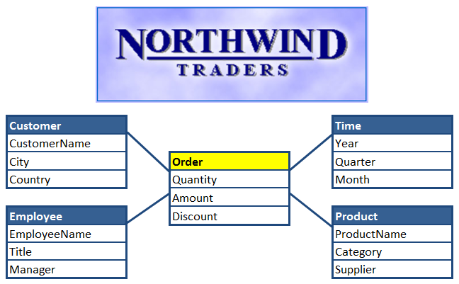
Solution
Notes:
In this session we are going to create an ssis solution in short increments (sprints)
Adding functionality with every sprint.
There will be a total of 8 sprints in which we will build our etl solution ...
for a simple datawarehouse based upon the Northwind database.
As you can see we will use only 4 dimensions (Customer, Employee, Product and Time)
And 1 factTable Order

Slide 5
The Boss
Notes:
To complete this solution in time I hired a boss..
He will help me by providing some feedback and steer me into the right direction.

Slide 6
Meta data
Sql
Sys.
dtsx xml file describing
Control Flow
Data Flow
Lay-out in BIDS
.biml
Notes:
Let’s talk a bit about meta data ...
It’s everywhere ... IN SQL Server:
Sys views
SSIS stores the meta data

Slide 7
Solution
source
staging
dwh
BIML
META DATABASE
Notes:
In this session we are going to create a solution.
We will build an ETL solution that uses meta data stored in some tables in the meta database.
These will describe the source and targets in our solution.
We will use biml to creat the ssis packages that transform the data from source to staging to the data warehouse.

Slide 8
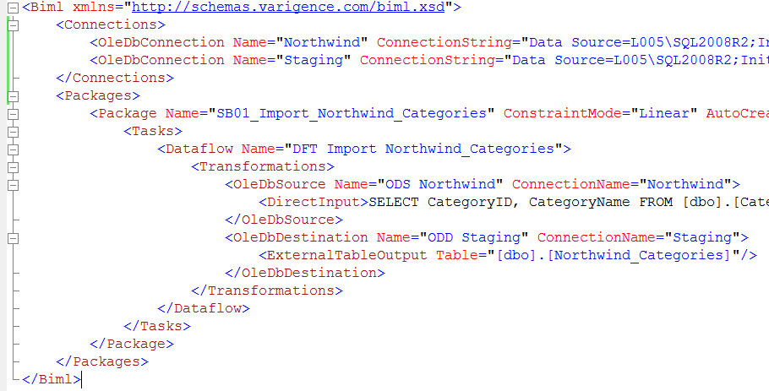
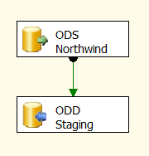
SB01 Simple Package
Notes:
But first let’s create a simple package with a biml file.
This is an example of a simple biml file that defines an ssis package with one data flow.
As you can see it has an understandable structure with (in this case) 2 main nodes:
Connections with two OleDbConnection node
Packages (you can define more packages in one biml file)
With tree Package-Tasks-DataFlow-Transformations
And two dataflow sources that describe the transfomation.
Type example...
So there is some meta data checking going..
So what are the advantages of using biml...
Isn’t it easier to just drop tasks and transformations on the ssis canvas ...
Yes it is but the advantage lies in repeatability
Repeatability in the form of code snippets ... That you add to your file and
Repeatability by using biml script >>

Slide 9
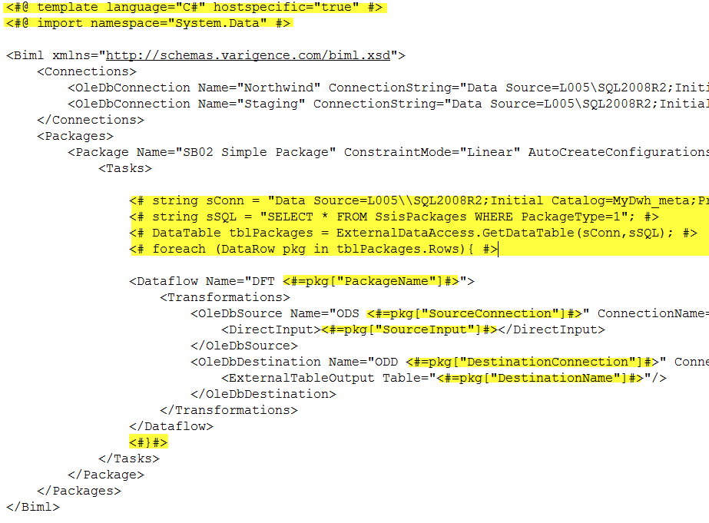
SB02 Simple packages
Notes:
Here you see the magic combining
Analogy with succesfull asp (html&code: database driven websites)
Start Code block with <#
Less then symbol and a hash
End with: #>
A hash and a greater then symbol
\\ double back-slash is escape sequence for a single back-slash
{} curly brackets for the foreach loop

Slide 10
SB02 How it works
BIML SCRIPT | EXPAND | GENERATE
xml
xml
Notes:
So how does it work..
Since where looping through all the rows in the dataset ...
The xml code describing the package is repeated for each row
.. Injecting the values we need
So it works in two steps:
Expand .. In memory a larger biml file is created (repeating the xml block in the foreach statement)
Next Generate .. the file is send to the compiler that creates the package

Slide 11
GREAT!! ... But ...
Shouldn’t you TRUNCATE the destination ...
And what if bulk inserts fails?
You better take a MODULAR approach
Notes:
Well ... That’s some great positive feedback ... Ain’t it?
And well it makes sence
For these staging tables we should truncate them first.
In fact in the SsisPackages table there is a column “TruncateDestination” we can use this value when we loop through the dataset.
And maybe we can redirect the dataflow if the ‘bulk-insert’ fails.
And yes modular approach with a package for each source-destination combination is a good option.
Of course we will need a masterpackage to start each modular package but ... Le’t’s do that later.
So how can we do that...

Slide 12
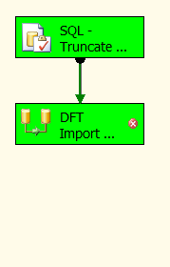
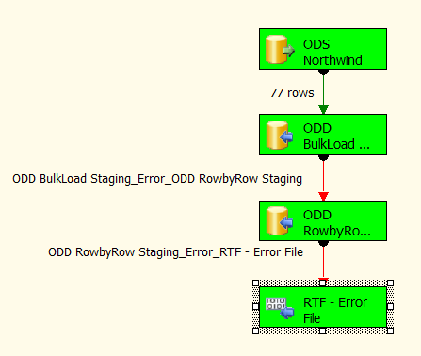
SB03 Modular Packages
Control Flow
Data Flow
Notes:
Discuss this based on the demo:
So we want to create this control flow with SQL Execute Task: Truncating the destination
And a Data Flow Task that handles errors:
First try bulk loading with the fast-load (default) option
Try a row by row insert if bulk load fails
If there are any rows that can’t be insert write them to an error-file

Slide 13
SB03 What CHanged
<#@ include file="SB00_Connections.biml" #> that Is used to import another biml file (or part) to optimise reuse
We changes the start and end position of the for each loop Making it possible to create more than one file
Next we added a condition to check if we should truncate the destination file a setting in the meta data table
We added two extra destinations to the data flow and used the error path as input path (explain: default = name.output but there are others like name.error and later we’ll see some more)
Of course we have to define errorhandling in the destination components <ErrorHandling ErrorRowDisposition="RedirectRow" TruncationRowDisposition="RedirectRow" />
Notes:
A short recap on the thinks we changed.

Slide 14
WOW!! ... But ...
Shouldn’t we do some logging and execution lineage?
Please log:
# rows in destination before and after
# rows inserted
# errorrows (in errorfile)
Start- and EndDate
Notes:
Discuss execution lineage
To facilitate these whises we implemented in SSMS:
SSISAudit Table
Stored Procedures to insert and update this table

Slide 15
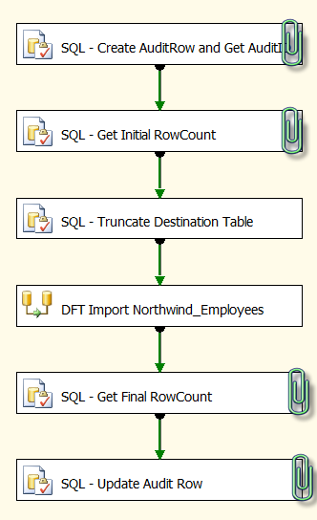
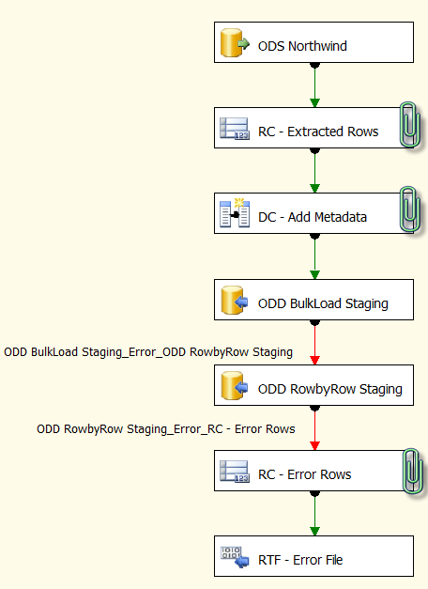
SB04 Packages with Logging
Control Flow
Data Flow
Notes:
In the packages and biml file we added:
Variables to hold recordcounts
Execute SQL Task in Control Flow to start audit row (discuss parameters)
Execute SQL Task in Control Flow to get #rows at start
Row Count in the Data Flow
A Derived Column Transformation to add Meta data to the data flow
Row Count (for errors) in the Data Flow
Execute SQL Task in Control Flow to get Final Row Count
Execute SQL Task in Control Flow to update Audit row with rowcounters

Slide 16
SB04 Logging
SQL: Audit Table
SQL: 2 Stored Procedures
uspNewAuditRow
uspupdateAuditRow
BIML: Add Variables
BIML: 2 Execute SQL Tasks (start and end)
Counters:
BIML: 2 Execute SQL Tasks (getting #rows)
BIML: 2 Row Count components in dataflow
Notes:
A short recap on the thinks we changed.

Slide 17
Almost there ...
Let’s discuss:
Configurations
Logging error messages
Logging execution of tasks
Should they be included in our ETL framework?
Notes:
You would typically use configurations to move packages from:
Development – Q&A – Production
Without the need to change configurations (mostly)
With biml you could just change the configurations (SB00 ..file) and create the packages for each environment.
In fact beeing able to recreate packages after you make changes to the biml file because of:
Changing requirments for your ETL framework
Changing to a new version of SQL (Denali)
Is one of the advantages of using BIML
Logging error messages makes sense
and the execution of tasks (when we get to more complicated packages)
So how do we do that?...

Slide 18
SB05 Configurations
<PackageConfigurations>
<PackageConfiguration Name="META" >
<EnvironmentVariableInput EnvironmentVariable="Northwind_Config“ />
<ConfigurationValues>
<ConfigurationValue DataType=“String"
PropertyPath="\Package.Connections[META].Properties[ConnectionString]"
Name="META"
Value="Data Source=.;Initial Catalog=MyDwh_meta;Provider=SQLNCLI10.1;Integrated Security=SSPI;">
</ConfigurationValue>
</ConfigurationValues>
</PackageConfiguration>
<PackageConfiguration Name="<#=pkg["SourceConnection"]#>" ConnectionName="META">
<ExternalTableInput Table="[dbo].[SsisConfiguration]" />
</PackageConfiguration>
<#if (pkg["SourceConnection"].ToString()!=pkg["DestinationConnection"].ToString()) {#>
<PackageConfiguration Name="<#=pkg["DestinationConnection"]#>" ConnectionName="META">
<ExternalTableInput Table="[dbo].[SsisConfiguration]" />
</PackageConfiguration>
<#}#>
</PackageConfigurations>
Notes:
There are several ways you can use Configurations.
In this case we opted for an environment variable that defines the meta database
And there we defined the other connections

Slide 19
SB05 Logging errors / TASK
 | Errors | Task
Events: | OnError | OnPreExecute OnPostExecute
Table | SsisErrorLog | SsisTaskLog
Stored Procedures | uspNewErrorLogRow | uspNewTaskLogRow uspUpdateTaskLogRow
Notes:
To log errors and tasks we are using the event handling features of SSIS.
For this purpose we created two tables and three stored procedures.
Since we also want to track the time for each task.
Therefore we need two events ..OnPreExecute and OnPostExecute

Slide 20
InterMEZZo / QA
We discussed:
Need for automation in datawarehousing
Biml – how it works
Bimlscript
ETL Framework
Responding to changes with Biml
Next:
Dimension table loading
Factable loading
Masterpackage

Slide 21
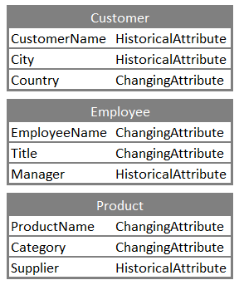
I discussed dimensions with the business

Slide 22
SB06 Dimension packages
We use views to join staging tables
An extra table in the meta database with column information
SCD Transformation (Wizard)

Slide 23
SCD Wizard? ...
I thought that didn’t perform?

Slide 24
SB07 FactTable packages
We use a view to join staging tables
An extra table in the meta databse with column information
Lookup component to lookup keys of dimension tables
Notes:
What’s wrong with the sql statements

Slide 25
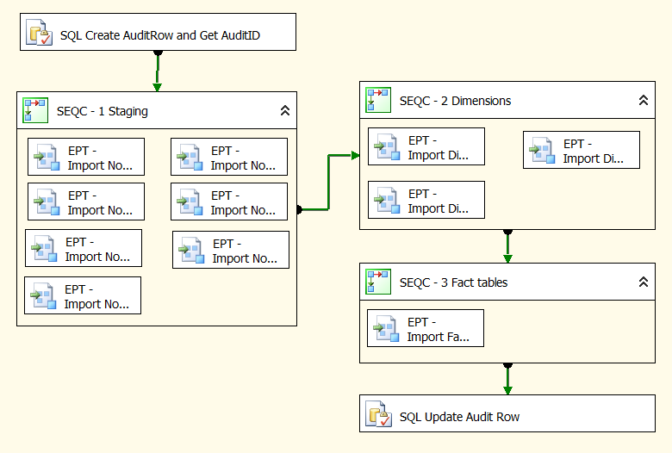
SB08 Master package

Slide 26
THank you
Goal: Get them interested in Biml to start using it
So please:
Tweet: @in2bi
Mail: marco@in2bi.nl
Comment: http://blog.in2bi.com

