Slide 1
PowerPivot & QlikView 101
Alex Whittles
Business Intelligence Consultant
Purple Frog Systems
Alex@PurpleFrogSystems.com
www.PurpleFrogSystems.com
www.PurpleFrogSystems.com/blog
Twitter: @PurpleFrogSys

Slide 2
Alex Whittles
Runs SQL Server User Group in Birmingham www.SQLMidlands.com
Studying MSc in Business Intelligence
Runs Purple Frog BI Consultancy
Business Intelligence Consultancy
Dimensional Modelling Data Quality
Data Warehousing ETL Systems OLAP Cubes Reporting Systems

Slide 3
Self Service BI
PowerPivot
QlikView
Why?
Why Not?
Puts user in control
Greater agility
Faster results
Lack of data governance
Different versions of truth
Complex source systems

Slide 4
Self Service BI
PowerPivot
QlikView

Slide 5
Demo
PowerPivot
Vs
QlikView

Slide 6
Which One’s Best?
 | PowerPivot | QlikView
Getting Started | Very Quick | Slow
Data Layer | Great | Poor
Intuitive? | Yes (It’s Excel!) | No
Formatting | Conditional Formatting | Expressions required
Expressions | DAX | QlikView Expressions
Dashboard Capability | Limited | Extensive
Server Hosting | SharePoint | QlikView Server

Slide 7
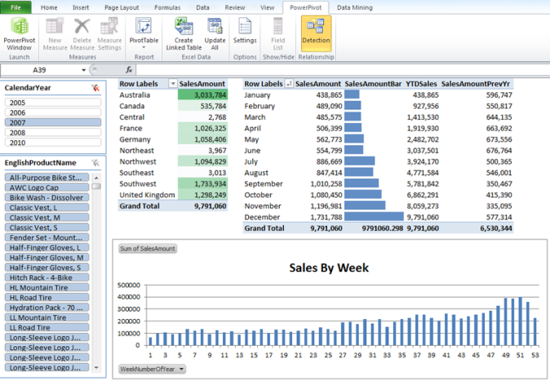
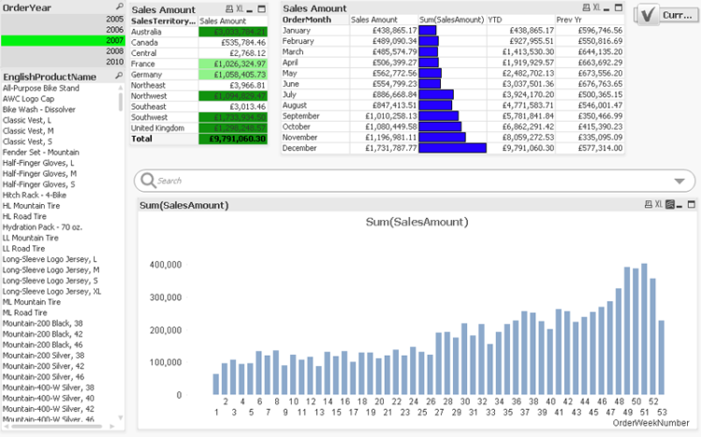
Download Code
http://www.purplefrogsystems.com/blog/2011/10/sqlbits-9-session-powerpivot-and-qlikview-101

Slide 8
PowerPivot & QlikView 101
Alex@PurpleFrogSystems.com www.PurpleFrogSystems.com
Twitter: @PurpleFrogSys www.PurpleFrogSystems.com/blog

