Slide 1
Building a Dynamic OLAP Environment
Dr. John Tunnicliffe
Independent BI Architect
Mobile: 07771 818770
john@bovi.co.uk www.bovi.co.uk
Notes:
Talk about products and features of the Microsoft technology with a focus on BI. Lot’s of demos and a few Sparks from the Anvil.
Not talking about SQL relational database or SSIS
Just want to know who is in my audience. So let’s have a show of hands by all of those people who considers themselves to be
DBA
Developer
BI consultant?

Slide 2
Sparks from the Anvil
Blog URL
http://sqlblogcasts.com/blogs/drjohn
See speaker profile on www.SQLBits.com
Tiny URLs in presentation to specific blog entries
e.g. tinyurl.com/4yolm6k

Slide 3
Agenda
Why build an dynamic OLAP environment?
Technical architecture
The build sequence
Tools & techniques deep dive:
SSIS infrastructure
Creating the relational database structure
Handling extension tables
OLAP cube deployment
Modifying cube attributes
Dealing with unnatural hierarchies
Warning!!!
400 level session

Slide 4
Introducing the OLAP data mart
Data Mart = subset of data to meet specific business needs
OLAP = specific technology allowing users to access data
OLAP data mart = specific subset of data to meet specific business needs
+ presented using correct business terminology and attributes
+ delivered using OLAP: allows data to be analysed using familiar tools such as Excel or 70+ other client tools (see www.ssas-info.com: client tools)
KIS – keep it simple!

Slide 5
Why build a Dynamic OLAP Environment?
Market Data / Market Research Providers
Sell data specific to each client or research group
Require cube to support analysis by special attributes
Add value to data by providing better analysis tools
e.g. IMS Health
Portfolio Analysis in Financial Services
Institutional investors
Private clients / high net worth individuals
Traders
e.g. Bank of America / Merrill Lynch

Slide 6
Why build a Dynamic OLAP Environment? Characteristics of the need
Common core data model
Common analysis needs
Ultimately can design and build
Basic database structure
Basic cube ‘template’
Users with specific need to extend core data model
Multiple core data models
Multiple ‘templates’
Specific security concerns

Slide 7
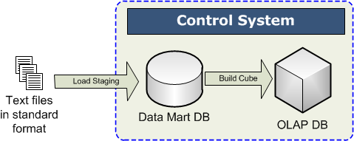
Technical Architecture
All databases created on-the-fly by control system
Single database used for staging and data mart

Slide 8
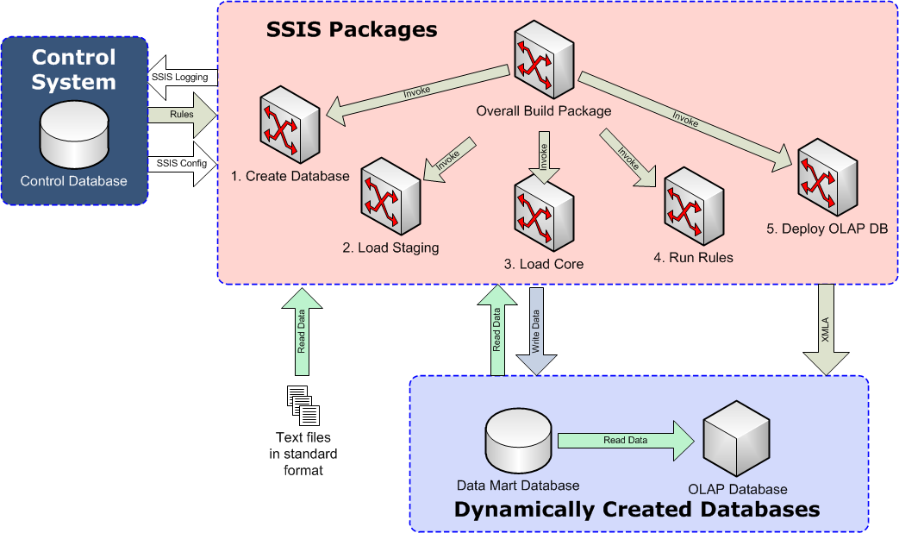
ETL Architecture

Slide 9
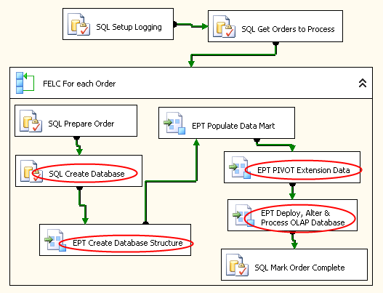
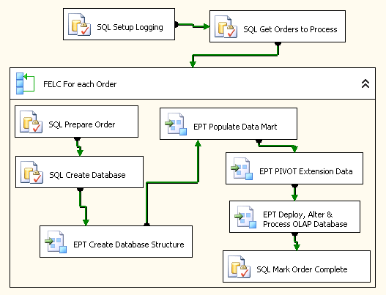
Overall Build Package

Slide 10
Build Sequence SSIS Package Logic
Setup Logging
Generate key for all packages to use in logging
Get Orders to Process
Client name
Order name
Location of data files
Defines ‘template’ to use for OLAP data mart
See my blog: tinyurl.com/447ac9k

Slide 11
Build Sequence SSIS Package Logic
Step 1: Prepare Order
Set database names as per customer order
Modify SSIS package connection strings
Step 2: Create relational database
Create data mart database
Set database recovery mode to SIMPLE
Step 3: Create database structure
Execute SQL script to build all database objects
tables, views, functions and stored procedures etc.
See my blog: tinyurl.com/447ac9k

Slide 12
Build Sequence SSIS Package Logic
Step 4: Populate data mart
Load data from files
Apply business logic
Step 5: PIVOT extension data
Dynamically create target table based on metadata
Dynamically create PIVOT statement to insert records
Alter views which underpin cube dimensions to add attributes
See my blog: tinyurl.com/447ac9k

Slide 13
Build Sequence SSIS Package Logic
Step 6a: Deploy OLAP Cube
Deploy OLAP database to server directly from .asdatabase file
Step 6b: Modify cube attributes
Extension attributes added based on metadata
Data Source View modified
Relevant dimension modified
Standard attributes added or removed based on metadata
Hide unwanted dimensions & measures
Step 6c: Process OLAP database
Step 7: Mark order as complete
Return to step 1 if any other orders need to be processed
See my blog: tinyurl.com/447ac9k

Slide 14
Building a Dynamic OLAP Environment Preparation
Identify common core data model
Define file format for input data files
Design and build
Basic relational database
Basic cube structure
SSIS packages to populate database
apply specific business rules to core data
process OLAP cube
Create ‘template’ from above comprising
Relational database (data mart) template
OLAP database (cube) template
SSIS packages

Slide 15
Tools & techniques deep dive
SSIS infrastructure
Creating the relational database
Handling extension tables
name/value pairs
OLAP cube deployment
Modifying OLAP cube attributes
Dealing with unnatural hierarchies

Slide 16
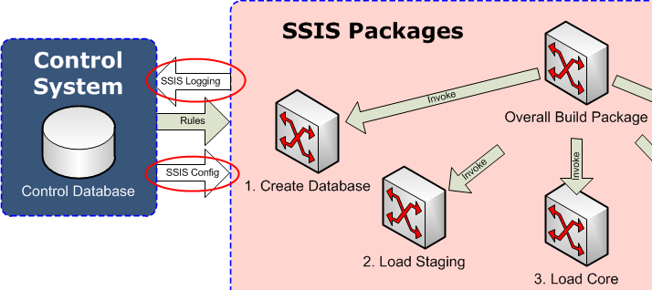
SSIS Infrastructure SSIS Logging
Log activity to control database
Implement custom logging using event handlers
Write customer order number to log to allow analysis
See Jamie’s blog: tinyurl.com/3c4dg2g

Slide 17
SSIS Infrastructure Setting Package Configurations - Options
Use dtexec.exe command line options
Problem with overly long and complex command lines
Use standard package configurations held in database
Easy to alter connection strings using SQL
Limited to one simultaneous build
Invoke SSIS using custom C# program
Use SSIS API to set connection strings etc.
Provides fully scalable solution – multiple simultaneous builds
Allows for full logging (see dtloggedexec.codeplex.com)

Slide 18
SSIS infrastructure Package configurations
Local dtsConfig file provides connection to control database
All others read from SSISConfiguration table in control database
Connection strings altered by PrepareOrder SQL stored proc

Slide 19
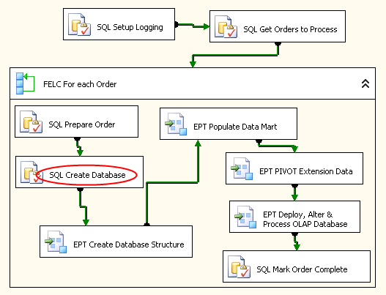
Creating databases with SSIS

Slide 20
Creating databases with SSIS
Use connection manager to master database
Connect with sysadmin privileges
Create database in SIMPLE recovery mode
Point of failure recovery is unnecessary
Unwilling to incur overhead of fully recoverable transaction log
Use expression on SSIS variable to create SQL
IF EXISTS (SELECT name FROM sys.databases WHERE name = 'MyDatabase')
DROP DATABASE MyDatabase;
GO
CREATE DATABASE MyDatabase
GO
ALTER DATABASE MyDatabase SET RECOVERY SIMPLE
GO

Slide 21
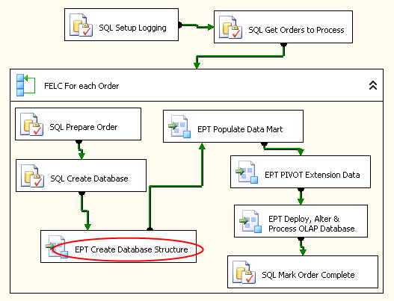
Creating the database structure

Slide 22
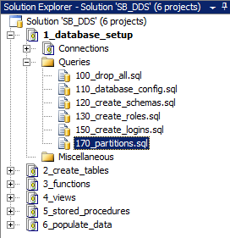
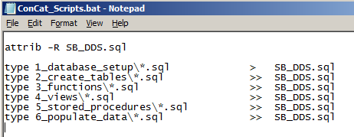
Creating the database structure Managing the SQL Scripts
Using SSMS database projects
Use numbers in file names to set order
Use batch file to concatenate files
Use type command
Ensure files have carriage return at end!
Write to file using redirection > and >>
See my blog: tinyurl.com/67wueu5

Slide 23
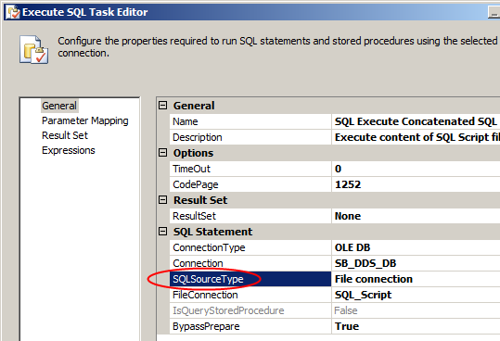
Creating the database structure Executing the SQL Script using SSIS
Use Execute SQL task to execute concatenated script
Set SQL Source Type to File connection
Set package configuration on FileConnection manager
Script creates all
Schemas
Tables
Views
Stored procs
etc.
See my blog: tinyurl.com/67wueu5

Slide 24
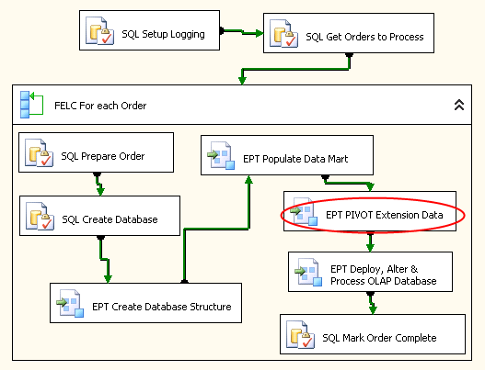
Handling extension tables

Slide 25
Handling extension tables The design problem
The Problem
Users want an extensible data model
i.e. add attributes to any dimension
SSIS ‘breaks’ whenever the input file or table schema changes
Solution 1:
Dynamically generate SSIS package in memory using C#
Costly development & hard to maintain
Solution 2:
Import data as name/value pairs
PIVOT data using dynamically generated SQL
Hold pivoted data in separate tables, linked to core table by ID
‘Sit’ cube on views and dynamically change views

Slide 26
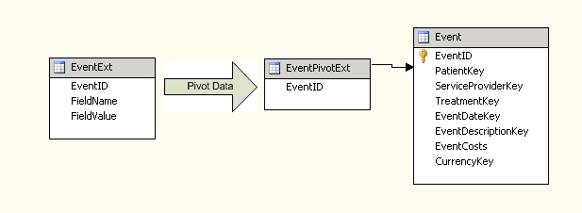
Handling extension tables Target table structure

Slide 27
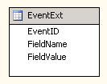
Handling extension tables Importing name/value pairs
Use Unicode file formats for international support
Input file & matching table contains three columns
ID
Name
Value
ID identifies record from core table
Does not ‘break’ SSIS

Slide 28
Handling extension tables Metadata
Table metadata identifies:
extension table
pivot table
ID column name
dimension view
dimension name
Field metadata identifies:
extension table
field names
data type of each field
include in cube
include as cube property

Slide 29
Handling extension tables Table to hold pivoted data
Option 1:
Dynamically create CREATE TABLE statement
Option 2:
‘Stub’ table already exists e.g.
Dynamically create ALTER TABLE statement

Slide 30
Handling extension tables Pivoting name/value pairs
Option 1:
Use stored proc to read metadata & dynamically generate INSERT statements
Write INSERT statements to a SQL script file
Have SSIS execute the generated SQL script file
Option 2:
Use stored proc to read metadata & dynamically generate INSERT INTO … SELECT … PIVOT statements

Slide 31
Handling extension tables Pivoting name/value pairs
Query metadata and dynamically generate PIVOT SQL
Note: MAX function works with strings too!
Generate SQL dynamically or hold stub of PIVOT query in table
INSERT INTO dbo.EventPivotExt (EventID, FIELD_LIST)
SELECT EventID, FIELD_LIST
FROM dbo.EventExt ps
PIVOT ( MAX(FieldValue) FOR FieldName IN ( FIELD_LIST )) AS pvt;

Slide 32
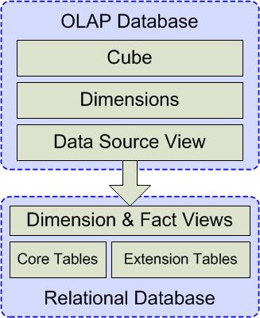
Handling extension tables Data architecture
Cube ‘sits’ on views
One view for each dimension & fact
Use vwDim & vwFact prefixes
Dimension views
Denormalise table structure
Views can be dynamically changed to include extension attributes

Slide 33
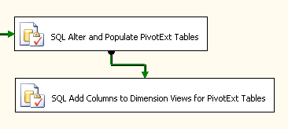
Handling extension tables Dynamically altering views
Obtain current view definition
Read metadata tables to obtain FIELD_LIST
Insert FIELD_LIST before FROM operator
Add LEFT JOIN to pivoted extension table
Run commands
DROP VIEW
CREATE VIEW
SELECT @cmd=[definition] FROM sys.sql_modules WHERE OBJECT_NAME([object_id])=@DimensionViewName;

Slide 34
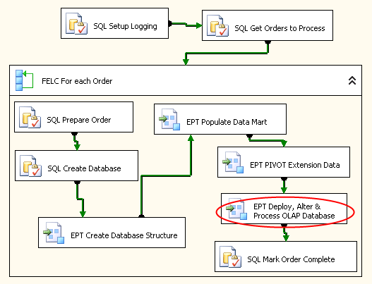
OLAP cube manipulation

Slide 35
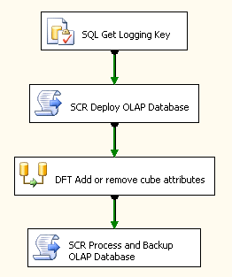
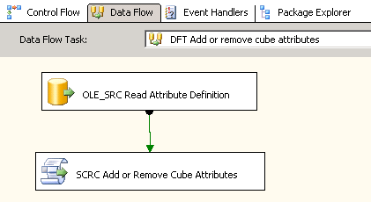
OLAP cube manipulation SSIS package to Deploy, Alter and Process OLAP database

Slide 36
OLAP cube manipulation Deploying the OLAP database
Background
Visual Studio (BIDS) solution consists of lots of small XML files
.dim .cube .partitions
Visual Studio (BIDS) builds a single .asdatabase file
Use Analysis Services Deployment Wizard to deploy
Deploy using C# Script Task
No examples on internet of deploying OLAP database using C#
Thomas Kejser’s blog had only example of automating process
Run Deployment Wizard in “answer mode”
Use Deployment Wizard to generate XMLA
Use Ascmd command to deploy
See Thomas Kejser’s blog: tinyurl.com/5wjjlke

Slide 37
OLAP cube manipulation Deploy using C# Script Task
Option 1:
Preparation: Developer to create XMLA file using Analysis Services Deployment Wizard during ‘release’ process
SSIS tasks reads XMLA and modifies XML to change server and database names
Deploy XMLA using AMO Execute
Option 2:
SSIS tasks reads .asdatabase file, adds XMLA wrapper and modifies XML to change server and database names
Deploy XMLA using AMO Execute

Slide 38
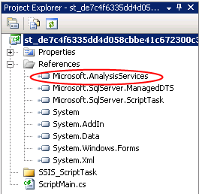
OLAP cube manipulation Deploy using C# Script Task
Working with AMO in SSIS Script Task
Add reference to Microsoft.AnalysisServices.dll
C:\Program Files\Microsoft SQL Server\100\SDK\Assemblies\
Select File->Save All from menu!!!!!
Connect to OLAP server
using Microsoft.AnalysisServices;
…
using (Server svr = new Server())
{
svr.Connect(olapServerName);
if (svr.Connected)
{
See my blog: tinyurl.com/6jqta8q

Slide 39
OLAP cube manipulation Deploy using C# Script Task
Create XMLA command wrapper in XmlDocument
Read .asdatabase file into XmlDocument
Merge into XMLA command
Remove read-only attributes
CreatedTimestamp
LastSchemaUpdate
LastUpdate
LastProcessed
State
ImpersonationInfoSecurity
CurrentStorageMode
ProcessingState
ConnectionStringSecurity
See my blog: tinyurl.com/6jqta8q

Slide 40
OLAP cube manipulation Deploy using C# Script Task
Modify XML to change
database name
connection string to relational data mart
Execute XMLA command
Do not process cube yet!
XmlaResultCollection oResults = svr.Execute(xmlaCommand.InnerXml);
See my blog: tinyurl.com/6jqta8q

Slide 41
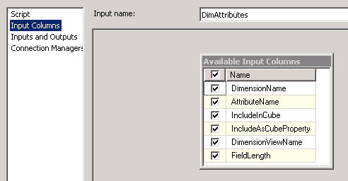
OLAP cube manipulation Adding attributes to dimensions
Read attribute metadata with OLE DB source component
Use script component as destination transformation
Simplifies data access
Input columns

Slide 42
OLAP cube manipulation Adding attributes to dimensions
PreExecute() method
Connect to OLAP server
ProcessInputRow(AttributeBuffer Row)
Add / Remove attributes
PostExecute() method
Disconnect from OLAP server

Slide 43
OLAP cube manipulation ProcessInputRow logic
Check if the attribute appears in the DSV
DataSourceView dsv = db.DataSourceViews[0];
…
string tableName = "dbo_" + Row.DimensionViewName;
DataTable dataTable = dsv.Schema.Tables[tableName];
…
DataColumn dataColumn = dataTable.Columns[Row.AttributeName];
…
dataColumn = dataTable.Columns.Add(Row.AttributeName);
dataColumn.MaxLength = Row.FieldLength;
dsv.Update();

Slide 44
OLAP cube manipulation ProcessInputRow logic
Find dimension
Check if the attribute appears in dimension
Dimension dim = db.Dimensions.FindByName(Row.DimensionName);
DimensionAttribute attr = dim.Attributes.FindByName(attrName);
…
attr = dim.Attributes.Add(attrName);
attr.OrderBy = OrderBy.Name;
attr.KeyColumns.Add(new DataItem(dataTable.TableName, Row.AttributeName,
OleDbTypeConverter.GetRestrictedOleDbType(dataColumn.DataType)));
dim.Update(UpdateOptions.ExpandFull | UpdateOptions.AlterDependents);

Slide 45
OLAP cube manipulation ProcessInputRow logic
Removing attributes
DimensionAttribute attr = dim.Attributes.FindByName(attrName);
…
dim.Attributes.Remove(attr);
dim.Update(UpdateOptions.ExpandFull | UpdateOptions.AlterDependents);

Slide 46
OLAP cube manipulation Process & backup OLAP database task
Process OLAP database
Backup OLAP database
Database db = svr.Databases.FindByName(olapDatabaseName);
…
db.Process(ProcessType.ProcessFull);
db.Backup(olapBackupFilePath, true); // allow overwrite

Slide 47
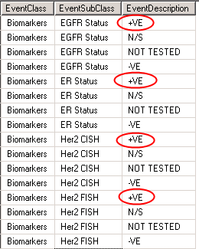
Dealing with unnatural hierarchies
Problem:
SSAS user hierarchies easily broken by ‘bad’ data
Often caused by same child having multiple parents
Hierarchy seems logical to user as child taken in context with parents
Solution 1:
Use key collection in SSAS
Solution 2:
Use CHECKSUM to generate key
Solution 3:
Use RANK() to generate key

Slide 48
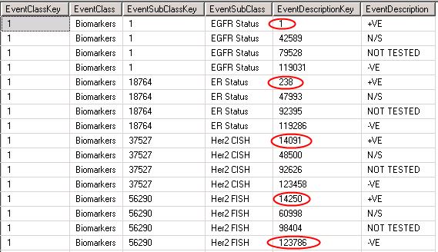
Dealing with unnatural hierarchies Using RANK()
SELECT DISTINCT
RANK() OVER (ORDER BY EventClass) AS EventClassKey,
EventClass,
RANK() OVER (ORDER BY EventSubClass, EventClass) AS EventSubClassKey,
EventSubClass,
RANK() OVER (ORDER BY EventDescription, EventSubClass, EventClass)
AS EventDescriptionKey,
EventDescription
FROM dbo.Event

Slide 49
Building a Dynamic OLAP Environment
Dr. John Tunnicliffe
Independent BI Architect
Mobile: 07771 818770
john@bovi.co.uk www.bovi.co.uk
Notes:
Talk about products and features of the Microsoft technology with a focus on BI. Lot’s of demos and a few Sparks from the Anvil.
Not talking about SQL relational database or SSIS
Just want to know who is in my audience. So let’s have a show of hands by all of those people who considers themselves to be
DBA
Developer
BI consultant?

