Slide 1
Relational Modeling for Extreme DW Scale
Thomas Kejser
Principal Program Manager
Tkejser@microsoft.com
Alexei Khayako
Program Manager II
alexeik@microsoft.com
Notes:
According to the analysts, the world has an unlimited appetite for data storage - and SQL Server customers are no exception. While the architects are hyping on about Cloud, Map/Reduce, MPP and Complex Event Processing– there is still an old school of businesses that rely on good old fashioned relational databases for analysis and storage. Telco, banking and manufacturing are good examples of this – the players who still live profitably inside the constraints of the tens to hundreds of TB databases. Though we by now know what works and what doesn’t in this space – it seems we insist on repeating the fallacies and wishful thinking of the past: again and again failing implementations on the most trivial data sizes.
On this stage of “magic” solutions and silver bullets for tame werewolves, some SQL CAT team members still hold the banner high on good old data modeling. This session is your chance to meet a few of those men, who have grown grumpy before their time. We will walk you through hard earned field lessons, doing TB sized installations. We will let you know what our experience shows will work, and what doesn’t, if you are going to build a large data warehouse. We will talk about how you go from a Kimball logical model to something that will actually work inside SQL Server. And since we are at it, we won’t be able to hold back on the usual bile about the laws of physics and what they mean to YOUR environment. Because we have not yet gone completely nostalgic, we will also include some modern thinking on how to transform an existing, batch style DW to a real-time reporting system.
We have no hope that you will be able to prevent failure of existing projects building TB sized systems after this session. But it IS our hope that when you design a new system you will avoid the worst pitfalls. If we are lucky, you may even join the growing army of architects, throwing buckets of cold reason on the fires of wishful thinking in the Data Warehouse.

Slide 2
Decisions That Matter
Depending on which author you read, different names are thrown around for the ”same” thing
Staging/ODS/Archive
EDW/DW/Hub
Data Mart, Exploration Mart, Report Layer
Etc... ad nauseum
Let’s cut to the chase and cut out the theoretical bollox.
We will have two major types of objects in our diagrams
Storage – Where data is PHYSICALLY stored (it is on disk!)
Transformations – where data is moved from one storage area to another
A storage object has a ”model” of the data

Slide 3
Fundamental Architecture – ”Staging”
”Staging”
Source
A
”ODS”
Source
B
Staged
Tables
Staged
Tables
Source
C
Source
D
Magic Memory Pipeline
Notes:
Source D is the ”magic” no staging approach

Slide 4
Staging/ODS/Achive (SODA)
Two Purposes
Store Extracts of the source system
Temporary or semi-permanent?
Physical (disk) storage of intermedia result sets
Sometimes, more than one layer of source system storage
Different teams will often invent a new name for every new layer (for example: will call it ODS if the name staging is already taken)
Infrastructure tend to fight this notion of multiple copies of data
But: ”One Version of the Truth” != one storage model of all data
Intermedia Results:
Serves as an extended tempdb that survives server failure
Will say no more about this – the occasional benefits of intermediate result stores obvious to people who have written large scale ETL
Staging/ODS/Archieve = SODA (Silly Org Driven Abyss)

Slide 5
More about Source Extracts
Source Extracts can be either temporary or Semi-Permanent
Semi-Permanent has BIG advantages
Granularity choices can be reversed
Source system may ”forget” data, but we will not
Can ”replay” a source if deciding to change model, WITHOUT disturbing the source system again
Permanent Source Extracts protect business users against under specification
And lets us talk seriously about the data model that delivers the value
Agree on data rentention contracts with each source – but don’t over design

Slide 6
Cost of SODA
Storage CAN be cheap
SATA or tape for source extracts
Agree with source on retention policy
A single, well known access pattern (no users here)
Easily distributed between servers, no need for a ”mega base”
Can use cheap DAS on each machine
”OK, so you cannot guarantee that you will keep 3 years of data around for easy access? No problem – we will store it for you at price X. We can always clean it up if you change your mind. Get you money back any time”
Do NOT fall into the trap of modelling the source!
Bare minimum effort. Sources are silly, but let later phase ETL deal with that
Do NOT try to over optimize data source – use data types that are guaranteed to hold the source extract that yield no errors
Save money on source re-extracts. You will most likely have to do it several times
Agily to remodel during development and growth of data

Slide 7
Fundamental Architecture – To the User!
Mart
M1
”EDW”
Mart
M2
M3
”Inmon”
Mart
M1
”Kimball”
SODA
Mart
M2
M3

Slide 8
To EDW or not to EDW?
Don’t fall into the ”Inmon trap”:
Step 1: Overplan the EDW, make it a company wide effort
Step 2: Recite: ”one version of the truth” = one database to rule them all
Step 3: Evaluate enormous database requirements that protect your investment long term, can handle that your business is expected to grow 100% every year the next 5 years, with no futher capatial expenditure on hardware
If rational thinking kicks in, go to step 2
Repeast 2-3 until you get fired or end up executing on a politically motivated/compromised, idiotic and useless model...
This is often motivated by the fear of losing data
Recall: We no longer need to fear that we throw away data
The SODA has a copy for ”quick replay”
Our copy is a ”stupid” copy that is versioned with the ETL
Should we desire data expansion, we will rewrite an rerun the ETL to support it

Slide 9
Collect Business Requirements
Examples:
Data must be queryable in … seconds
Reports contain users activity from the last hour
In case of legal inquiry, data from last year must be accesible
Or: Keep older (up to 7 years) online but slow
In case of disaster at least last 3 days must be queryable shortly after recovery
Note the deeper specification
Key takeaways:
Agree on latencies, data loss and retention policy up front
The model must serve data fast, if you can’t serve it, why build it?
Notes:
VimpelCom, Turkish Telcom, Comcell, TDC, Telmore
**In case of legal inquiry data from 5 years ago must be restored –
Here we are going to talk about following: customers using kind of sliding window scenario for keeping “actual” data – like legal requirement 4 years. However, it could happen that they will need to restore data, which already out of the “normal” time window (like 5 years ago in this case). You can restore the backup in different DB.

Slide 10
The ”mini EDW”
There are often design advantages of physically storing the ”agreed subset of the truth”
Certain subsets of data are commonly re-used
Example: Dimensions, especially typical view of history
Materialising these common data source will often lead to storage and ETL efficiency
A tactical data mart (with any EDW) – can often be used as a prototype that allows you to explore what those common subsets are
There are also advantages to storing ”looked up” versions of facts.... More about this later

Slide 11
Business Queries
Key Question: How is the data used?
Identify key queries that the business run in day-to-day work.
Telco Examples:
Report: One subscriber behavior within period of time ( e.g. billing for specific service)
Report: One subscriber behavior with specific pattern ( e.g. validation query)
Report: All subscribers activities within specific time ( feeding billing system or AS)
Report: all subscribers with specific pattern ( like outgoing calls into other cell networks)
Report: All subscribers activity in specific area code / switch network
Notes:
Show me your queries and I will give you your data model

Slide 12
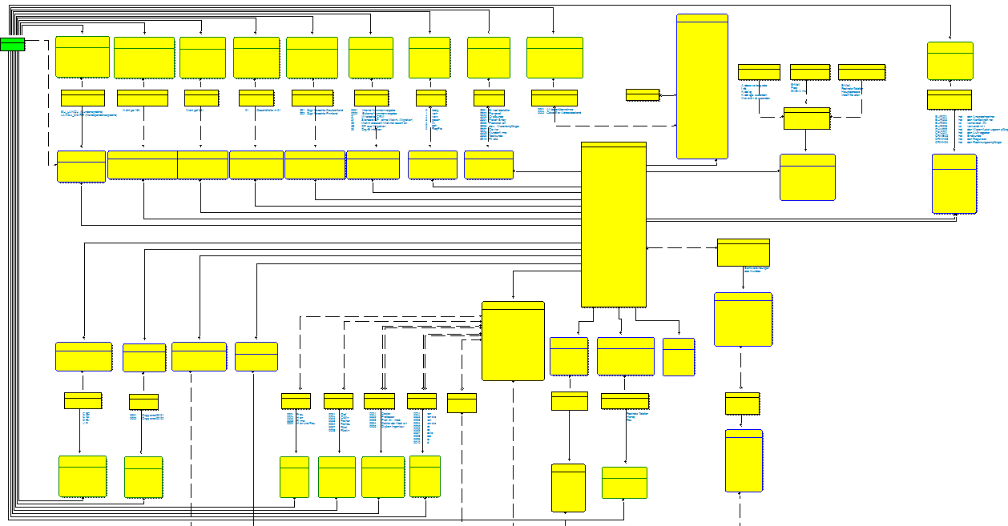
“IT Driven approach”
Does it look like a bad design?
Customer “Dimension”
Does it look like a bad design?
Product “Dimension”
Sales “Dimension”
SELECT ALL Customers from Geography = 'Country' WHERE PRODUCT = 'Product' and SalesAmount > '$100USD'

Slide 13
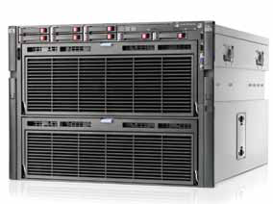
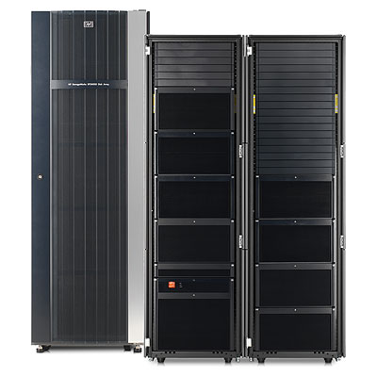
Sizing for madness!
Storage cache 4GB-512 GB
200K IOPS sec
Up to 2 PB storage
Remember: growth unlimited
Server 8 CPU with 8 cores
each
2TB memory
How can you be confident
this will support the model?

Slide 14
Sizing HW for Data Warehousing
You can’t model the HW until you modeled the data

Slide 15
Logical Partitioning Strategy
Three different options
Functional Partitioning – partition by subject area
Example: Seperate Call Detail Records and Customer Invoices
Date partitioning – By some time interval.
Example: Split by 2010, 2009, 2008 record
Key/User partitioning – By some key that is queried together
Example: Partitiong by area code or customer
These are ALSO business requirements

Slide 16
Keys to Partitioning
Central challenge: Data locality
Used together = stored together
Network traffic is expensive
Logical partitioning must map properly to physics
Avoid pie in the sky architectures
c = 300K km/s no matter what you do
Example:
Latency of I/O operation: 1-5ms (best case)
Latency of network link: 1ms
Latency of memory access: 300ns

Slide 17
Partitioning Functionality in SQL
Local Partitioned View
Table Partitioning
Pro:
Online ”switching”
”Online” Index Rebuild
Statistics Smaller
Con:
Have to manage views
Have to manage constraints
Limited number of partitions (255)
Mix: Partitioned View and Partitioning
Pro:
Less objects in database
More partitions (1000 or 15K)
Con:
No online switch (SCH-M locks)
Index rebuild only online on full table
Statistics only per table (Though filtered stats help)
Notes:
This slide needs a bit more fleshing out
Need to check : Table partition index rebuild ( per partition) – Fixed: Rebuilding a partitioned index cannot be performed online. The entire table is locked during this operation
Pro: Optimiser is very good at Partition elimination if constaint in the where clause!
Also: cost based optimiser may give bad plan on th epartition and ignore NC Indexes
To add: this is a third category – combined solution, which is basicaly having both PRO’s and CON’s from both ☺

Slide 18
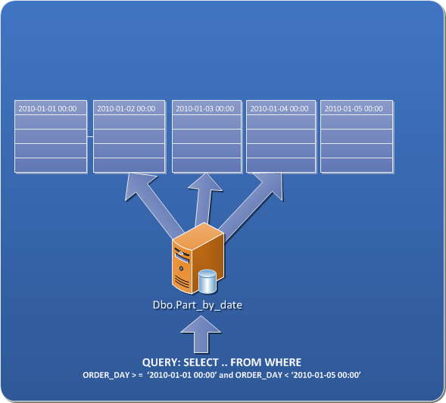
Partitioning On Date
Partitioned fact table based on date
Sliding window scenario
Notes:
Need more notes on this slide. Not sure what is the general idea here. I think sliding window?

Slide 19
Customer example: Telco scenario
Telecom companies with requirements
Loading up to 1 TB data a day
Need to load data in parallel streams due to the limited loading window or due to the data availability requirements
Refresh data in analytical systems 4 times a day
Long history should be on-line (3-5 years). Typically legal restrictions
Most of the data consumed by analytical and reporting tools
Big and long running SELECTs
Some ad-hoc query against current period of time
Fraud detection queries

Slide 20
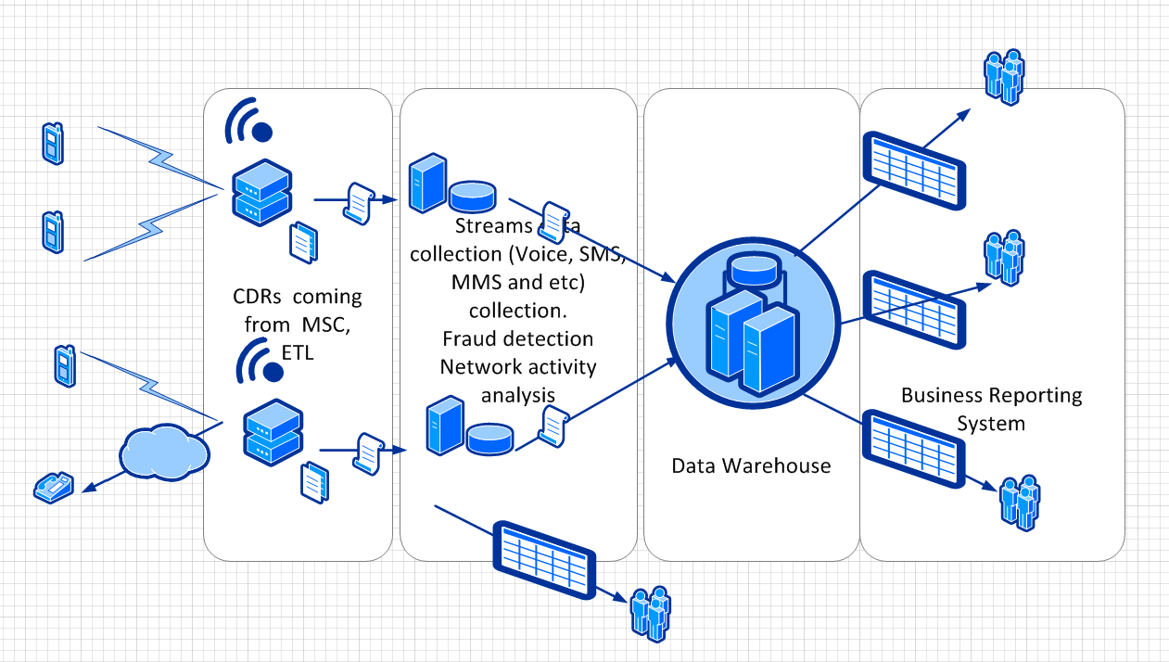
Data movement

Slide 21
Designing multi level partitioning
MSCFY2009
SELECT ...
FROM FactCDR
WHERE
PhoneNumber = 425314159265
AND
ChargingDateTime = 20090125
CSV
Area Code: 150
Area Code: 151
CSV
Area Code: 152
CSV
Area Code: 153
CSV
CREATE CLUSTERED INDEX CIX_Date
ON MSCFY2009(ChargingDateTime, CarrierCode,PhoneNumber)

Slide 22
Example: Multi Level Partitoning
FactMSC (view)
SELECT ... FROM ALTER dbo.FactCDR_2010
UNION ALL
SELECT ... FROM ALTER dbo.FactCDR_2009
MSCFY2009
FactCDR_2010
ALTER TABLE
dbo.MSCFY2009
ADD CONSTRAINT
CK_DATE CHECK (
[ChargingDateTime]
>= '2009-01-01'
and
[ChargingDateTime]
<'2010-01-01')
Area Code: 150
Area Code: 150
ALTER TABLE
dbo.MSCFY2010
ADD CONSTRAINT
CK_DATE_2010 CHECK
(
[ChargingDateTime]
>='2010-01-01‘
and
[ChargingDateTime]
<'2011-01-01')
GO
Area Code: 151
Area Code: 151
Area Code: 152
Area Code: 152
Area Code: 153
Area Code: 153
CREATE CLUSTERED INDEX CIX_Customer
ON MSCFY2009(SCarrierCode, PhoneNumber)

Slide 23
Multi layer partitioning DEMO

Slide 24
How quickly can you get it there?
t0
t1
t3
t4
t2
Mart
M1
”EDW”
T(data visible to end user)=
Δt1 +Δt2 +Δt3 +Δt4
Mart
M2
M3
”Inmon”
t0
t1
t2
”Kimball”
SODA
Mart
M1
T(data visible to end user)=
Δt1 +Δt2
Mart
M2
M3

Slide 25
Where do we Spend the Load Time?

Slide 26
What is a ”good Key”?
Characteristic | WHY?
It is small | Because you can fit more of them in memory and do less I/O when you cannot
It is an integer | Because CPUs work (A LOT) faster with integers and this is not going to change anytime soon
Once assigned to an entity, it never changes | Because we want to be able to change the entity without walking a massive dependency tree of other entities that depend on it (the normalization argument)
It is never re-used | Because we don’t like to see new entities magically inherit data that we thought was deleted.
Corrolary: It is big enough to never be reused | As per above. And we know that bit packing helps us.
It is ”stupid”, containing no information about the entity it refers to | Because even though he entity may change, they key should not. (exception: Time does not change!)
Is should NOT be remembed by users | We want users to know the key exists, but not to access it directly. The key is only meant to be joined on by users and requested by machines

Slide 27
The Problem with Source Systems
We need good keys, especially as data grows larger
Source systems often fail to provide good keys
Because they are often made by programmers, not data modelers
Because sometimes, having a key be memorable is useful to a source system
We may be tempted to trust a source system for good keys
But that would be like trusting a source system to deliver clean data
... Which is never going to happen
Do not rely on source system to deliver good keys.
No seriously – don’t!

Slide 28
The Problem with Surrogate Keys
Surrogate keys serve two main purposes:
They act as small, integer keys
They act as ”history trackers”
Because we may change our mind about how we track history, they are not good keys
Observe: this is only relevant when we want to display type-2 dimensions to the user

Slide 29
From the Source to the End-User
Assumptions:
Source does not deliver ”good keys”
End users want dimensional models or at least model with history tracking
We need:
To map the source key to a ”good key”
because only good keys are worth storing
To map the ”good key” to a surrogate key (which is ”not good”)
To reduce the time we spend on doing key lookups

Slide 30
Life of a Fact Table
Product
History
ID_Product
SK_Product
Stage.Order Lines
Product
Column | Type
ProductKey | CHAR(10)
Amount | DECIMAL(10,2)
OrderKey | INT
Price | DECIMAL(15,2)
ID_Product
Order
Lines
Copy
Mart
Reload
Lookup
+ Agg
Lookup
+ Join
+ Project
Sales
Column | Type
ID_Product | INT
ID_Customer | INT
ID_Date | INT
Sale | MONEY
Column | Type
SK_Product | INT
SK_Customer | INT
SK_Date | INT
Sale | MONEY
Stage.Order Headers
Order
Headers
Column | Type
CustomerKey | CHAR(10)
OrderKey | INT
Date | DATETIME
Internal_ID | VARCHAR(20)
Copy
Customer
ID_Customer
Customer
History
ID_Customer
SK_Customer
Source
SODA
”EDW”
Data Mart

Slide 31
BETWEEN two Worlds
Consider again the join needed to the right:
SELECT ...
FROM Sales S
JOIN Product_History P
ON S.ID_Product = P.ID_Product
AND ID_Date BETWEEN P.Valid_From
AND Valid_To
Product
History
ID_Product
SK_Product
Valid_From
Valid_To
Product
ID_Product
Column | Type
SK_Product | INT
SK_Customer | INT
Sale | MONEY
Sales
What is this going to do to our optimizer?
There are no useful statistics to serve this “BETWEEN” estimate
Do you REALLY want to let users lose on a model like this?
Column | Type
ID_Product | INT
ID_Customer | INT
ID_Date | INT
Sale | MONEY

Slide 32
High Level Architecture - Summary
EDW may be useful as intermediate storage of ”agreed results”
Perform as many operations as possible
Rely on SODA to do ”replay”
Fast ETL replay is not that hard to design! (Get the slides from my pre-con)
Do not rely on source systems for keys, optimize for optimal data types
Assumptions we can make now:
All key are integers
Data is never lost = We can model, and throw away data that is not needed. Optimize for fastest possible access
All data is joined on just one key
Tables are ”pre projected” – only the columns we need are present

Slide 33
To Normalize or not to Normalize
Normalize
Dimensionalize
Less Storage
More flexibility/maintainability
Less impact of data model changes
Can join in many interesting ways
Easier to maintain
Easier to load (really?)
“History is never lost”
The EDW engine should handle it for me
i.e. Teradata/PDW/Hadoop etc..
Faster queries/joins
More column store friendly
Understandable by users
Less chances for optimizers to make mistakes
Predictable performance

Slide 34
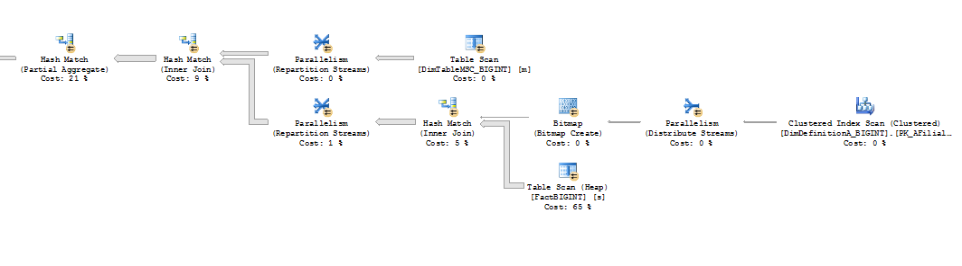
Magic Fairy Dust Joins!
Get the predictable plan!

Slide 35
Sizing when you know the model
Prototype system
Identify main system load through the set query types
Scan queries balance vs. look up queries
If you do dimensional, you will normally get good scan
Use the approach from Fast Track core calculator

Slide 38
Partitioning for Online Access
FactMSC_Online
MSCFact
(View)
INSERT / UPDATE
2010-08
FactMSC_History
SELECT ...
FROM FactCDR
2010-01 to 2010-07
ALTER VIEW +
SWITCH
2009
2008
2007
Notes:
Use slide from Stuarts ComCell deck combining DPV and Partitioning

