Slide 1

Business Rules and
SharePoint Workflow with
Master Data Services (MDS)
Jeremy Kashel
BI 200

Slide 2
Agenda
Master Data & Master Data Management
The Need for Business Rules
Master Data Services Introduction
Business Rules in MDS
Business Rules Architecture & Model Validation
Basic Business Rules Demo
SharePoint Workflow and MDS Demo
Summary
Questions

Slide 3





What is Master Data?
The reference data or nouns of the business, e.g. Product, Customer, Supplier
Non-Transactional Data of the business
Resides in:
  ERP Systems
  Fulfilment Systems
  Other LOB Systems / Databases
  SharePoint Lists
  Spread sheets

Slide 4
What Problems Can Occur With Master Data?
No enterprise business has a single system
The same master data entities must exist across different systems, e.g. Customer
This can cause problems:
  Systems may hold the same data in different ways, e.g. first name/surname Vs. full name
  Different customers in different system, e.g. banks or CRM/sales
  No single version of the truth
Reporting Requirements
  Assign a product to a hierarchy
Notes:
-Use Customer needs to be in Sales, CRM, Marketing
-No single version of the truth – this just increases exponentially for each new system that gets added over the years

Slide 5
Master Data Management
Master Data Management (MDM) is a set of tools and processes that aim to deliver a single clean and consistent view of each master data entity that exists within the organization.
Centralise data
  ETL from source systems
  Using MDM tool as a source
Clean and confirm data
Policies and procedures
Notes:
Each system needs master data entities – that can’t change – but something must provide a control layer to stop the problems that I mentioned earlier.
Analytical and Operational MDM
David Loshin book on MDM worth reading

Slide 6
Master Data Services Overview
Microsoft's Master Data Management product
Introduced in 2008 R2 (Enterprise & Data Centre editions)
SQL Server database
Web front end – Master Data Manager
Modelling capability
Data entry for master data entities
Business rules & workflow
SharePoint integration
Versioning
Security
Notes:
Mention that Master Data Manager serves two purposes – an Admin Tool and a front end for the User.

Slide 7
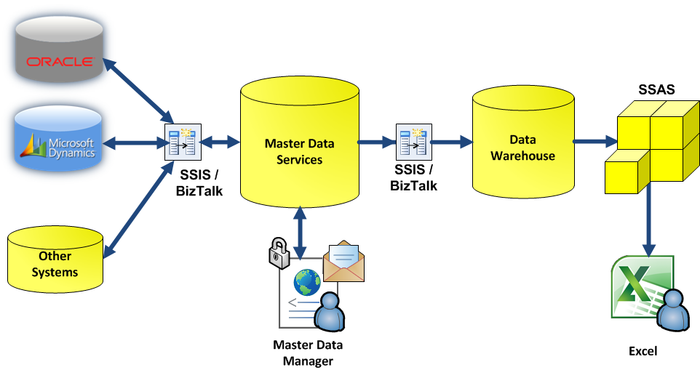
MDS – Typical Architecture

Slide 8
The Need for Business Rules
Data quality
  Validation in a front end, e.g. preventing blank fields
  Cleaning and conforming, e.g. default values
Generating data
  E.g. Auto classifying customers
Workflow and notifications
  Flag up to a specific person based on a condition
Notes:
Primarily designed to ensure the data quality:
People could be directly entering data into the MDM hub, e.g. the MDM tool can be used to create a new attribute that doesn’t exist in the source system. A user can then be prompted to enter data, but we want to validate that they do fill this in, and put it in the correct format.
Cleaning and conforming – this may be applying defaults.
Generating data – so that new attribute that I mentioned – we may be able to use some logic to say that we can auto fill that in
Workflow – If the user enters a value of an attribute that meets certain criteria, then we may want initiate an approval process.

Slide 9
Business Rules in MDS
Created in Master Data Manager
Expressions IF….THEN
Conditions and Actions – can change values
Notifications and Workflow
Priority
Fired when:
  Users make certain changes in the front end
  Data is loaded into MDS from an external data source
Notes:
As Master Data Manager serves as the admin tool and front end, this is where the business rules are created
Simple expressions – note there is no ELSE, just an IF…THEN

Slide 10
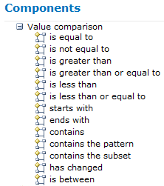
Conditions
Simple Logical Statements
Operate on Attributes or Constants
  E.g. Product Category = Bikes
Multiple conditions can be joined together with AND, OR

Slide 11
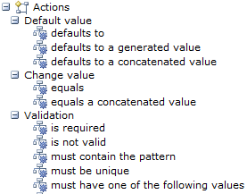
Actions
Fire when a condition is true
Four Rule Types:
  Default Value
  Change Value
  Validation
  External Action
Notes:
Say that default value and change value are more or less the same
The Validation rule type is the important one
The External Action rule types can kick off a SharePoint workflow

Slide 12
Business Rules Architecture
Start as expressions in the front end
A stored procedure is created per entity, per model
Service Broker is used to run the stored procedure
This happens when:
  A member is edited
  A member is created
  The version is validated
Notes:
--UI actually generates a stored procedure
--Kicked off by Service Broker

Slide 13
Demo 1
Creating an MDS business rule
Validating a model to see the business rule work
Notes:
Create the Store Size Large business rule
Validate the model

Slide 14
SharePoint Workflow Introduction
Based on Windows Workflow Foundation (WWF)
Created in Visual Studio 2010 or SharePoint Designer
Can be used for long-running processes
Sequential workflows
State machine workflows
Useful for:
  Multi-tiered approval
  Task delegation and collaboration
  Customisation and complex workflow
Notes:
State machine workflows - activities are called on the basis of 'state' of different parameters

Slide 15
Demo 2
Create a SharePoint Workflow
Binding the Workflow to MDS
Kicking off the SharePoint Workflow via MDS

Slide 16
Summary
Master Data – reference data or nouns of the business
Business Rules used to enforce data quality
IF…..THEN statements created in Master Data Manager
SharePoint integration – kick off a SharePoint workflow
Business Rules can run from the front end or when data is loaded from an external source

Slide 17
Resources
David Loshin – Master Data Management - http://mdmbook.com/
Adatis - Master Data Services - http://www.packtpub.com/microsoft-sql-server-2008-r2-master-data-services/book
Master Data Services TechNet - http://technet.microsoft.com/en-us/library/ee633763.aspx
MDS Team Blog - http://sqlblog.com/blogs/mds_team/
Adatis Blogs - http://blogs.adatis.co.uk

Slide 18
Questions
?

