Slide 1
SQL Consolidation Planning
8th April 2011
Bob Duffy
Database Architect
Prodata SQL Centre of Excellence

Slide 2
Speaker Profile – Bob Duffy
SQL Server MVP
Microsoft Certified Architect and Certified Master
18 years in database sector, 250+ projects
Senior SQL Consultant with Microsoft 2005-2008
Regular speaker for TechNet, MSDN, Users Groups, Irish and UK Technology Conferences
Database Architect at Prodata SQL Centre Excellence, Dublin
Blog http://blogs.prodata.ie/bob
(deck and demos up there)

Slide 3
Agenda
Consolidation Overview
Pre-Planning
Service Planning and Design
Storage Considerations

Slide 4
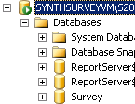
SQL Server Consolidation Today
Currently a variety of consolidation strategies exist and are utilized
Typically, as isolation goes up, density goes down and cost goes up
Higher Isolation, Higher Costs
Higher Density, Lower Costs
IT Managed
Environment
HOST CONSOLIDATION
DATABASE CONSOLIDATION
Virtual
Machines
Instances
Databases
Multi-Tenant (2 flavours)
MyServer
Sales_1
Consolidate_1
Marketing_1
Online_Sales
ERP_10
DB_1
DB_2
ERP_11
DB_3

Slide 5
Virtualization v Multiple Instances Debate Comparison of system qualities for Host Consolidation
System Quality | Feature | Hyper-V \ESX | SQL Inst.
Manageability | Ability to build and provide canned environment | Yes | No
 | Deploy/Rollback Benefits | Yes | No
 | End-to-End (development through production) use | Yes | No
 | Simple migration to new host during server retire/replacement | Yes | No
 | Simplicity for Instance scale up | Yes | No
 | Simplicity for cloning a production environment (e.g. to Test) | Yes | No
 | Less operating systems to manage | No | Yes
Security | Transparent to accomplish same level of security as with a dedicated host? | Yes | No
Scalability | Dynamic sharing of processor resources | Yes | Yes
 | Processors Supported per environment | 4 \ 8 | 256
 | NUMA / affinity benefits in guest | No* | Yes
Performance | Acceptable Performance | Yes | Yes
Availability | Sql Clustering Option | Not Easy | Yes
 | Supports Sql Business Continuity features? | Yes | Yes
 | Live Migration or VMotion | Yes | No
 | Protected from OS failures in guests | Not Easy | Yes
Supportability | SQL 2005 and 2008 CSS Support | Yes | Yes
Migration | Fast and efficient migration from old to new environment | Yes | No

Slide 6
Some Practical Guidance
Usually Virtualisation trumps Instance consolidation
Often it is already a company strategy
Edge cases are:
High compute unit workloads > 4 cores
Ultra low IO latency requirements
Protection from OS failure (RTO Coverage in SLA)
Avoidance of shared storage
Most large firms NEED to look at database consolidation
Migrating old server is expensive
Green Fields approach is cheap
Operating System “Sprawl” can be an issue

Slide 7
High Level Planning
Envision
Plan
Build
Deploy
Support

Slide 8
SQL Discovery & Inventory
Envision
Plan
Build/Test
Deploy
Support/Monitor
SQL Discovery/Inventory

Slide 9
SQL Discovery & Inventory Tools
Discovery Tools
MAP (Microsoft Assessment & Planning) Toolkit
System Centre (config or operations manager)
Free Tools
SqlPing
SqlRecon
Inventory Tools
MAP (Microsoft Assessment & Planning) Toolkit
System Centre (config or operations manager)
SQLH2 (on codeplex)
SQL Tools

Slide 10
What you should now know
Server Names and specs
How many SQL Servers
What Editions and Versions
How much memory
How many CPU and what type
How much disk space
How much data and log space

Slide 11
Envision – Environment Assessment
Envision
Environment Assessment
Plan
Build/Test
Deploy
Support/Monitor
SQL Discovery /Inventory

Slide 12
Environment Assessment Overview
Determine Technical Factors
Throughput (IOPS)
CPU Compute Units used
Disk Space Used
Memory Used
Some Performance Base lining
Check for problem children
Determine Business Factors
Location
Criticality
Owners
SLA’s
Sensitivity
Applications*

Slide 13
Technical factor Perform Counters
Object | Counter | Why
Logical Disk | Disk Reads/Sec(Total) Disk Writes/Sec(Total) | Disk Throughput in IOPS
Processor | %Processor Time(Total) | CPU Throughput
Network | Bytes Total/Sec(Total) | Network Throughput
What tools to use to capture
MAP Tool
SCOM
Manually in perfmon
SQLH2 Tool (codeplex)
Consolidation Planning Toolkit

Slide 14
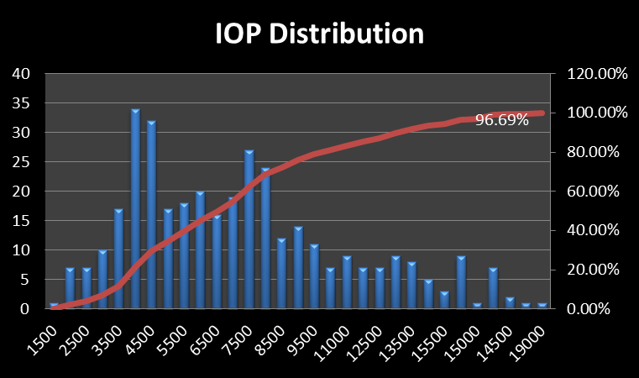
Analysing IOPS distribution
Group IOPS to nearest 50, 100 or 500 step
Plot out all data for 15 min to 60 min intervals
Count occurrences of each range
Don’t for get about SLA hours
http://blogs.prodata.ie/post/Using-MAP-Tool-and-Excel-to-Analyse-IO-for-SQL-Consolidation-Part-I-e28093-basic-distribution.aspx

Slide 15
Analysing CPU Requirements
Comparing disparate processors is difficult
Enter the compute unit (www.spec.org)
CPU can have the same distribution issues as IOPS
May need to replace the “avg” with a higher figure:
High Average. The highest avg sustained for an hour.
The 80% percentile
The best tool here is the SQL Consolidation Planning Toolkit (CPT)
Plugs into Excel
Imports MAP Data

Slide 16
Performance Perfmon Counters
Object | Counter | Target
Logical Disk | Disk Secs/Read(*) Disk Secs/Write(*) Disk Queue Length | <20ms for OLTP <50 for DWH
Processor | %User Time(Total) %Privileged Time (Total) | %Privileged < 20% of %user Time
System | Processor Queue Length Context Switches/Sec | Queue <1 Switches < 10k per core
SQL Server:Buffer Manager | Page Life Expectancy | > 300 avg
SQL Server:SQL Statistics | Batch Requests/sec | < 1,000 per core avg
SQLServer:General Statistics | User Connections Logins / Sec | <10
Databases | Transactions/sec
SQL Server:SQL Statistics | Compilations/Sec | < 20% of Batch Requests per Sec

Slide 17
What you should now know
Disk IOPS Required
CPU resources required
“Problem” workloads

Slide 18
Goals Principles and Constraints
Project Goals and Success Factors
Big bang, phased strategy or green fields
Upgrade Scope
consolidation Strategy (Host v Database)
Isolation v Shared resources
Cost, time and other constraints
Overcommit strategy (CPU)

Slide 19
Identify Target Platform
SQL Server 2008R2 or mixed
Windows 2008R2 or mixed
Virtualisation Platform (Hyper-V or ESX)
Hardware Platform Choices
2 x six core or bigger..
Chargeback approach
Storage Platform
Discussed later

Slide 20
Designing the New Platform
Envision
Plan
Plan Migrations
Plan Monitoring
Design new Platform(s)
Use technical factors to estimate resources
Use business factors to exclude and isolate
Use both to plan allocation

Slide 21
Consolidation Planning Goals
CPU Compute Units Required
IOPS Required
Memory Required
Disk Space Required
Mapping of workloads to new hosts

Slide 22
Microsoft Consolidation Planning Tool for SQL Server Excel Add-In (CPT)
CPT Add In: http://www.microsoft.com/downloads/en/details.aspx?FamilyID=eda8f544-c6eb-495f-82a1-b6ae53b30f0a

Slide 23
SQL Shared Storage Planning How to Specify Requirements
Latency
8-20ms for Data files
AND
1-5ms for Log files
Throughout
Avg IOPS
Max IOPS
%write ratio
Service Levels
Latency and throughout during events:
Backup
Disk failure
Site failure
Hours of Coverage
http://blogs.prodata.ie/post/How-to-Specify-SQL-Storage-Requirements-to-your-SAN-Dude.aspx
http://blogs.prodata.ie/post/How-to-Specify-IO-Requirements-Part-II.aspx

Slide 24
Common Storage Questions
Can we mix SQL Server and Non SQL Workloads?
At Disk Group Level
At CFS or NFS Level
Can we mix data and log and TempDb?
Many disk groups or one large one?
How many disks do we need and what RAID Type?
How much cache do I need?
Should pay the big bucks for 128GB Tier 0 SSD Cache?
SSD, SAS, FC or SATA?

Slide 25
Yin and Yang Approach to Storage
The Bad stuff
Using a Shared Disk Group
Using Clustered Shared Volumes (or NFS on ESX)
Use of filing system on host instead of “pass through”
Multiple VM guests on a single host
Use of RAID 5/6
Sharing Log spindles
Dynamic Disks
The good stuff
8 Gbit /10 Gbit controllers
Load balanced HBA cards and controllers
Lots of IOPS and spindles
Low latency disk subsystem
SSD
Lots of cache for writes
http://blogs.msdn.com/b/boduff/archive/2010/03/31/general-guidance-for-sql-server-on-virtualisation.aspx

Slide 26
Wrap Up
Generally Virtualisation Trumps Sql Instances
Its hard to avoid database consolidation
MAP will help gather resource requirements
CPT Tool with help design new environment
Good Storage subsystem is essential

Slide 27
Questions ?

Slide 28
Additional References
Microsoft® Consolidation Planning tool for SQL Server 1.0
http://www.microsoft.com/downloads/en/details.aspx?FamilyID=eda8f544-c6eb-495f-82a1-b6ae53b30f0a
Tools for SQL Discovery & Inventory
https://blogs.msdn.com/boduff/archive/2009/09/16/tools-for-sql-discovery.aspx
SQL Server Workload Consolidation (ESX 3.5)
http://www.vmware.com/pdf/SQL_Server_consolidation.pdf
SQL Server Consolidation in Microsoft IT
http://www.msarchitecturejournal.com/pdf/Journal18.pdfhttp://msdn.microsoft.com/en-us/architecture/dd393309.aspx
SQL Server 2008 Consolidation White Paper
http://download.microsoft.com/download/6/9/D/69D1FEA7-5B42-437A-B3BA-A4AD13E34EF6/SQLServer2008Consolidation.docx
Free eBook – The case for SQL Server Consolidation
http://media.techtarget.com/digitalguide/images/Misc/sqlsc_ebook.pdf
SPEC – Standard Performance Evaluation Corporation (Compute Unit Definition) http://www.spec.org/

Slide 29
Thank You!

