Slide 1
SSIS Custom Components
Dave Ballantyne
dave.ballantyne@live.co.uk
@davebally
Notes:
I took a number of false starts with custom components, but after a bug fix to a script used in multiple packages ( and multiple times in each) enough was enough.
We are not going to dive to deep into the process, but I want you to go away with enough confidence , and a bit of code, to try for yourselves.
If you are uncomfortable with .NET development , that’s fine , being a data professional im not either.
Going to concentrate on the Flow of a component and the SSIS interfaces not .NET development per se.
So at work you may need to buddy up with a developer,

Slide 2
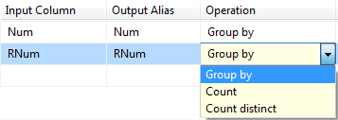
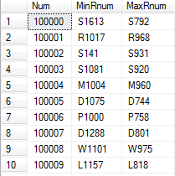
Why ?
Provide new functionality not provided as standard
Notes:
Why script in the first place ?, although very rich in functionality , it would me impossible for Msoft to deliver 100% of the functionality that we all need as standard. I will need different tasks to you…
A simple example, for something that is not provided as standard and would be a good candidate for scripting.
The aggregate transformation

Slide 3
Why ?
Reusability
Component is a DLL
Single code base
Can be used multiple times in a single project
Can be shared across multiple projects
Easy to test Component version
Performance
Faster than scripting
Well documented
Though not a how-to guide
Notes:
Why would you choose a component over scripting ?
Reusability is the BIG win
Performance : Generally faster , I havent made a component run slower that the equiv. script
Documentation is good on msdn , though not a howto guide. Documentation tells you in isolation what each method /member does and its expected inputs but not a guide guide of the whole process.

Slide 4
Types Of Component
Data Connections
Log Providers
For Each Loops
Control Flow Tasks
Data Flow Pipeline Component
Custom User Interface

Slide 5
Pipeline Component Types
Sources
Transforms
Destinations

Slide 6
Design/Run Time
Design Time
Work done in BIDS
attachments / detachments
Validation
Column usage
Run Time
Metadata interrogation
DTEXEC
Flow of data

Slide 7
Demo 1
Reuse and Performance
Notes:
1-Scripting.
String min max , the standard aggregate on support numerics and date/times.
1-MinmaxScr - Show input data in grid and output in grid and step thro code.

Slide 8
Performance Comparison
 | 100,000 | 500,000 | 1,000,000 | 5,000,000 | 10,000,000 | 20,000,000 | 31,999,680
Custom | 261 | 900 | 1,667 | 7,867 | 16,375 | 32,852 | 51,426
Script | 684 | 2,069 | 3,949 | 19,214 | 38,690 | 76,755 | 123,243
Notes:
1 mil , 5 mill , 10 , 20 31.8 mill rows , not much difference in the relative speed of execution
Thru DTExec average ms of 20 runs each.
Startup costs ? Custom very slightly quicker (75 vs 89 ms for 10 row input) TBH, probably doing something wrong if you care!
Im not making the outright statement that a custom component is faster , slightly faster I have seen in this case a lot faster , in others same cost.
I very much doubt you could create a component that runs slower though, obviously assuming that the guts of it is performant.

Slide 9
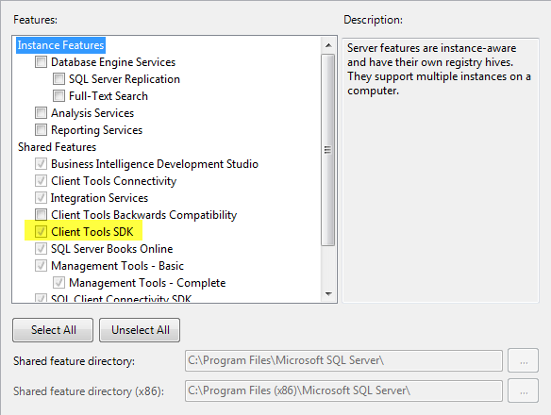
Requirements
Visual Studio – BIDS is not enough
Or Visual Basic / C# Express
Client Tools SDK
Notes:
Express is fine but does not support post-build events which can be a pain for us.
Debugging will also be a pain.

Slide 10
Starting Out
Target Framework 3.5 (Advanced compile options)
Sign the assembley
Add References(Program file(x86)/<SqlServer>/100/sdk/Assemblies)
Microsoft.SqlServer.DTSPipelineWrap
Microsoft.SqlServer.DTSRuntimeWrap
Microsoft.SqlServer.ManagedDTS
Microsoft.SqlServer.PipeLine Host

Slide 11
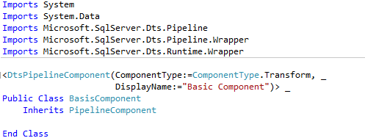
Class Creation
Inherits PipelineComponent
Uses attribute DtsPipelineComponent

Slide 12
Post Build
Copy DLL to “C:\Program Files (x86)\Microsoft SQL Server\100\DTS\PipelineComponents”
Register to Global Assembley Cache using GACUTIL
Must Restart BIDS
For first use “Choose Items”,”SSIS Data Flow Components” ,tick Component
Notes:
Use a post build event to call a batch file to copy the dll file and then install in the gac.
Means that visual studio must run in administrative mode to do this.

Slide 13
MetaData
IDTSComponentMetaData100
PipelineComponent.ComponentMetaData
Describes the Component to the engine
Inputs, Outputs
Custom data held within IDTSCustomProperty100
Most level s of object
Notes:
100 = 10.0 = 2008
90 = 9.0 = 2005
BOL Still list denali as 100 , changes??
Metadata = Data about data, in the case the inputs and outputs. The number of them and the definitions of their columns
Virtual

Slide 14
MetaData
Inputs – IDTSInput100
Exposed via InputCollection member in MetaData
One instance for each attached input
Contains virtual column collection
Accessed with GetVirtualInput() member
View of the IDTSOutput100 of the Upstream component
IDTSVirtualInputColumn100
Input Column Collection
Accessed with InputColumnCollection
Those that are used in the component
IDTSInputColumn100
SetUsageType used to add the virtual column to the input column
Notes:
100 = 10.0 = 2008
90 = 9.0 = 2005
Metadata = Data about data, in the case the inputs and outputs. The number of them and the definitions of their columns

Slide 15
MetaData
Outputs – IDTSOutput100
Exposed via OutputCollection member in MetaData
One class for each output
output Column Collection
Accessed with OutputColumnCollection
IDTSOutputColumn100
Dispositions – Errors
Set IsErrorOut on IDTSOutput100

Slide 16
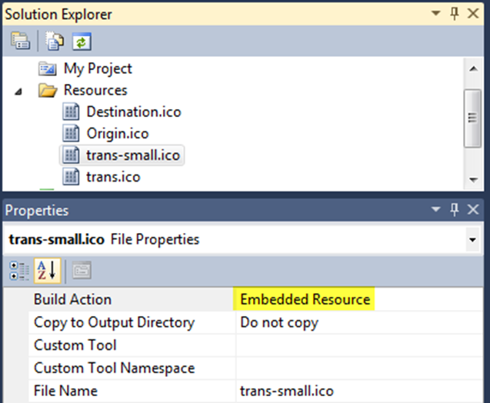
Icons
Size
16*16 For ToolBox
32*32 For Design Surface
Order of “IconResources” is important
Build action must be “Embedded Resource”
Notes:
There are default icons , so not essential. But does make the data flow easier to understand if a meaningful icon can be used
256 Colours works

Slide 17
Errors and warnings
FireError
At design or run time

Slide 18
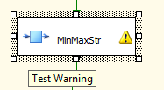
Errors and warnings
FireWarning

Slide 19
Design Time Methods
Methods
ProvideComponentProperties
Define initial metadata of component
Validate
Tests the metadata is correct
ReinitializeMetaData
Fix the metadata
Notes:
With design time methods we are generally responding to user actions within the Bids environment.
ProvideComponentProperties , initial metadata of the component.
Validate – Check that the metadata is clean and the code that will execute at run time will operate as expected.
VS_ISVALID – All is ok , the component can and will run with this meta data
VS_ISBROKEN – Metadata is ‘wrong’ the user need to do some work in BIDS to resolve.
2 Severe errors
VS_NEEDNEEDMETADATA – Contains Errors that can be fixed in ReinitializeMetaData
VS_CORRUPT – Calls ProvideComponentsProperties, Start Over….

Slide 20
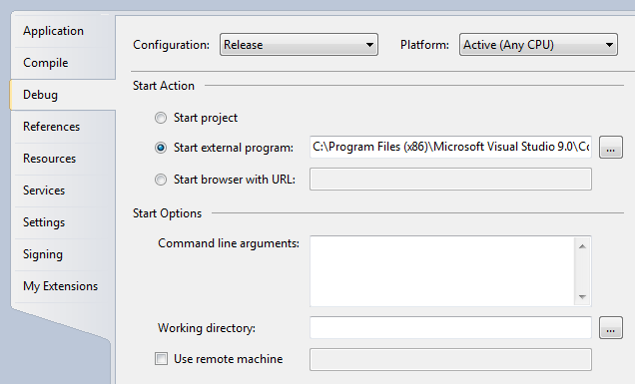
Debug
Notes:
Can use MessageBox’s , which is simple though a pain.
To debug design time functionality run BIDS as the “Start external program”
Run time , run dtexec with a package that is setup to execute you component, don’t run bids. It doesent capture the runtime events properly.
Bug in VS2010 , step over is treated as run to completion with 3.5 framework components

Slide 21
Demo 2
Build a simple component

Slide 22
Run-Time Processing
Pre-Execute
PrimeOutput
ProcessInput
PostExecute
Notes:
Within your class that has overridden PipelineComponent
PreExecute – Interrogate Metadata
PrimeOutput – passes in references to the output buffers , in this case only one which is copied to outputbuffer
ProcessInput – loop while NextRow() returns true , If the last buffer has been sent then buffer.EndOfRowset set True
You must call SetEndOfRowSet on each buffer else wont complete , will stay ‘yellow’ forever.
PostExecute – HouseKeeping , tidying up , closing connections etc.

Slide 23
PreExecute
Setup the runtime objects
Interrogate the Metadata and buffer manager
Find the colindex(s) in buffers based on metadata
BufferManager.FindColumnByLineageID(InputId,InputCol.LineageId)
PrimeOutput
Notes:
Pre – execute – Interrogate the MetaData to build any required runtime objects , also find the BufferColumnID’s based upon the LineageId’s of the inputcolumn metadata using FindColumnByLineageID in the BufferManager component.
Prime output , capture reference to the outputbuffer(s) , of type PipelineBuffer, for reference later.

Slide 24
Process Input
Loop on buffer.NextRow
If buffer.EndOfRowset is true set outputBuffer.SetEndOfRowset()
MetaData functions are not optimized for performance.
Notes:
Avoid referencing meta data within the process input function , they are not optimized for performance.
Do all the interogation within the preexecute function.
Very important to set SetEndOfRowset when done , otherwise the task will not finish. Downstream will still be expecting rows.

Slide 25
PipelineBuffer
Used for both input and output buffer
Get<DataType> and Set <DataType>
SetString / GetString
SetInt32 / GetInt32
AddRow
Insert and move to new row
SetEndOfRowset
After final row has been poplulated
Notes:
Pipeline buffer class methods

Slide 26
Sync Or Async ?
Sync
Add columns to existing data flow
SynchronousInputID of output = ID of input
Async
Create new data flow buffer
SynchronousInputID =0
Notes:
Taking a really simplistic view….
Async ‘create’ a new dataset , sync adds columns to an existing one.
SynchronousInputID ‘ties’ the input and output together if synchronous
We still write to the outputbuffer as an async component , SSIS handles the tying of the output and input together to allow for the one-2-one nature.

Slide 27
Demo 3
RunTime execution

Slide 28
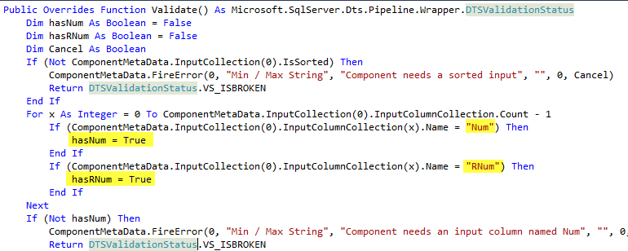
User Interface
Notes:
Why do you need a UI, you don’t.
Consider the code we have been talking about, we have hardcoded the columns we need.
Our Key column is called NUM the column that we want the min MAX of is called RNUM
It works but very limiting….

Slide 29
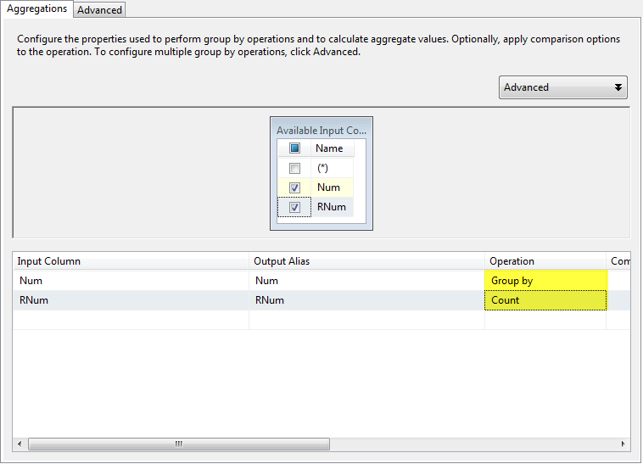
User Interface
Notes:
Going back to the aggregation component we pick our columns and the operation on each of them

Slide 30
User Interface
A Class that implements IDtsComponentUI
Registered to the component class with UITypeName
PublicKeyToken is found with GACUTIL
Notes:
We need a class that implements the IDTSComponentUI interface.
This class is then registered into the main component by using the UITypeName Property
GACTUIL –L to find public key or using explorer in \windows\assembly

Slide 31
User Interface
Notes:
If defining within a separate DLL from the component class , then needs signing and installing in GAC as the main class
Within the class that implements IDTSComponentUI,
2 Most important functions
Intialize , store the metadata to a local var .
Pass that to the dialog to update on OK.
Edit , actually do the editing, Must return true if the metadata has changed , else false.
Typically , and simply , fire a standard win form that will modify accept the input and upon OK update it

Slide 32
User Interface
Demo 4
User interface
UI Code Step Through

Slide 33
Conclusion
Like SSIS , large learning curve
Reusability
Potentially Faster ?
.Net skills are required
Notes:
Like SSIS , we have a steep learning curve. Its not a simple ABC process , a whole solution is required to even start to run test and play with the functionality. Updating the metadata is all very well , but if you arent processing that at runtime can you be sure you are doing it right ?
Reusability – Unlike scripting which has to be debugged fixed updated cut pasted copied many time repeatedly , we have a single point of code.
One update will fix all instances on that machine
Potentially Faster – as demonstrated , in this case it is faster by a significant margin , but that cant be guaranteed.
.Net Skills – Data professionalls may find it tricky in the early stages, but one we understand the concepts and flow of the engine then will become easier. Hopefully you can find a friendly developer to help you out.

Slide 34
SSIS Custom Components
Dave Ballantyne
dave.ballantyne@live.co.uk
@davebally
Notes:
Any questions ?

