Slide 1
8 Steps to Securing
Azure Sql PaaS
March 1st 2019 at 10:20
Janusz Rokicki

Slide 2
Is CLOUD
more secure
or less secure?

Slide 3
Attack Defence

Slide 4
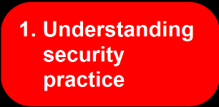
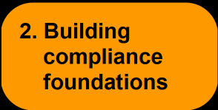
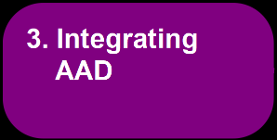
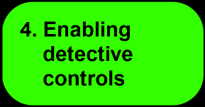
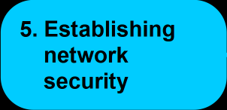
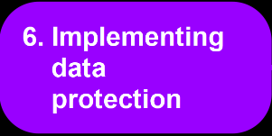
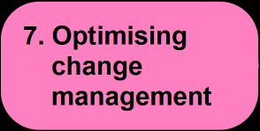
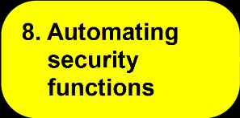
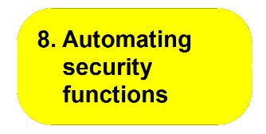
Agenda

Slide 5
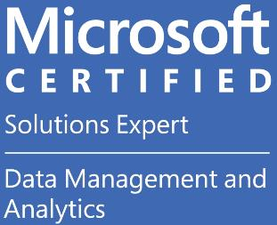
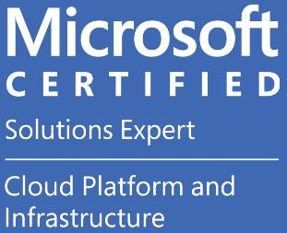
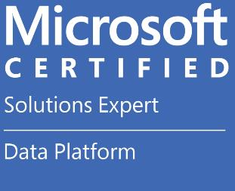
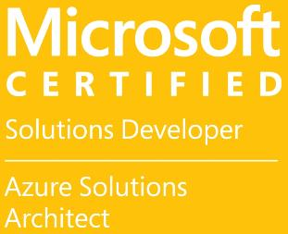
>whoami

Slide 7
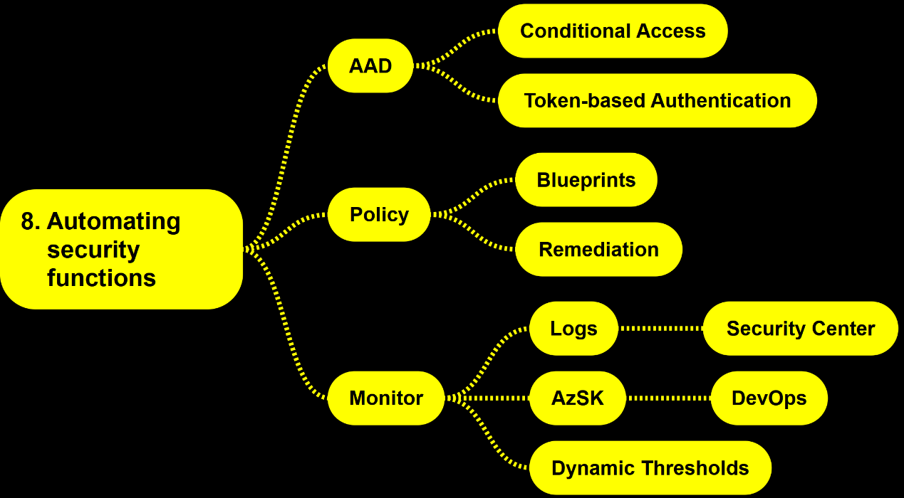

Slide 8
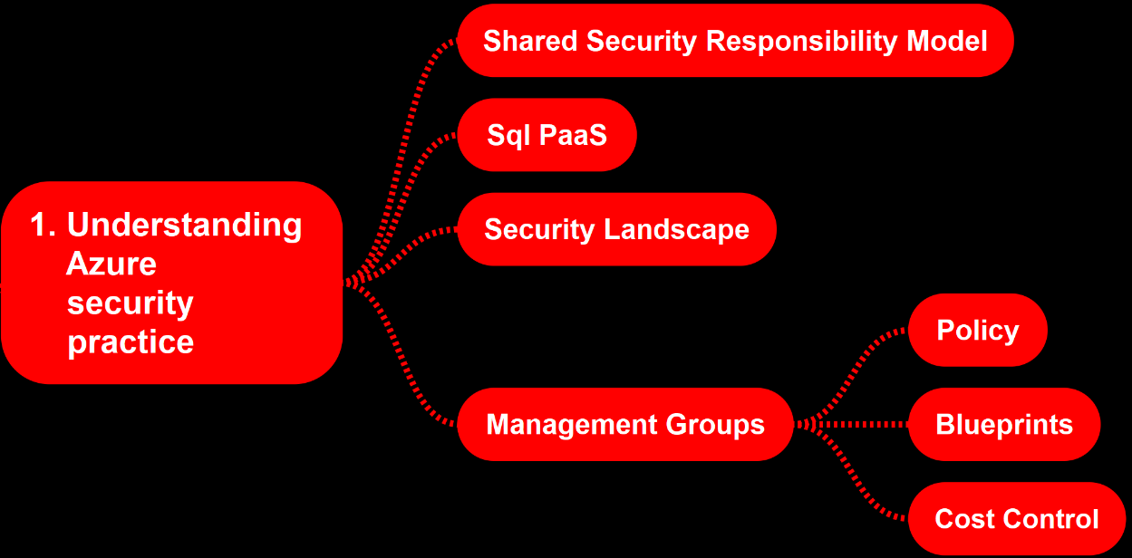

Slide 9
Shared responsibility model
 | Prem | IaaS | PaaS | SaaS
Data classification & accountability
Client and end-point protection
Identity & access management
Application level controls
Network controls
Host infrastructure
Physical Security

Slide 10
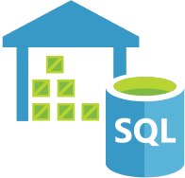
Azure Sql PaaS
SQL Database
DB for PostgreSQL
SQL Data Warehouse
DB for MySQL
SQL Elastic pool
DB for MariaDB
SQL Managed Instance

Slide 11
DEMO 1
Azure Security Landscape

Slide 12
DEMO 2
Management Groups

Slide 13
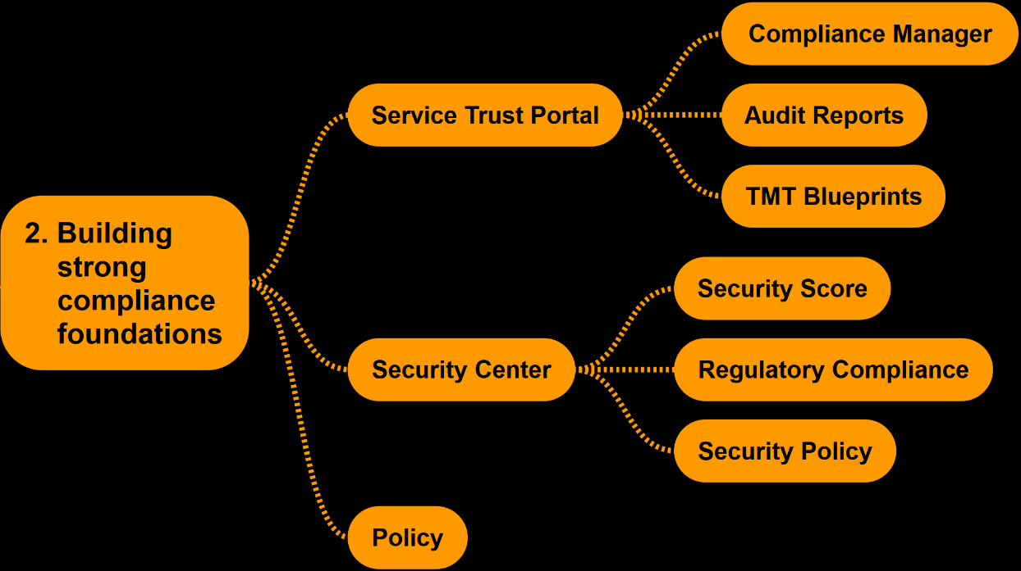

Slide 14
DEMO 3
STP
Compliance Manager

Slide 15
DEMO 4
STP Blueprint
TM : DW for NIST 800-171

Slide 16
DEMO 5
Security
Center [sic!]

Slide 17
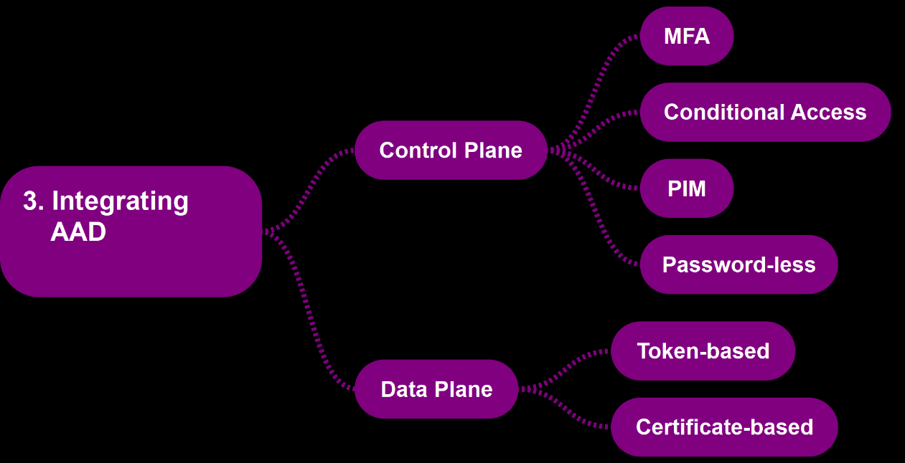

Slide 18
DEMO 6
AAD PIM
for
RBAC

Slide 19
DEMO 7
Token-based Authentication

Slide 20
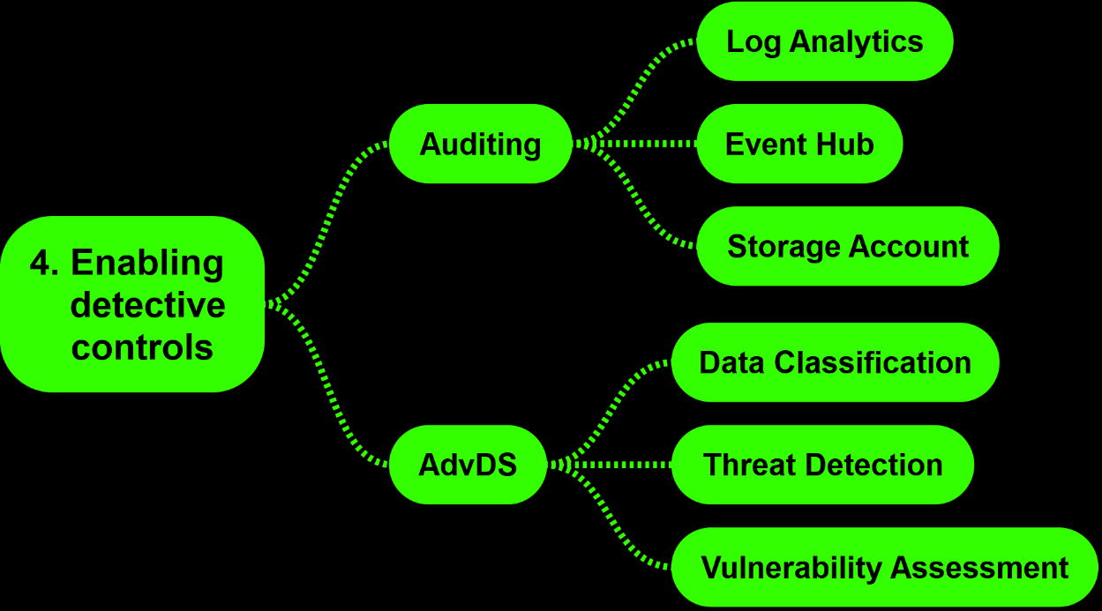

Slide 21
DEMO 8
Vulnerability Assessment

Slide 22
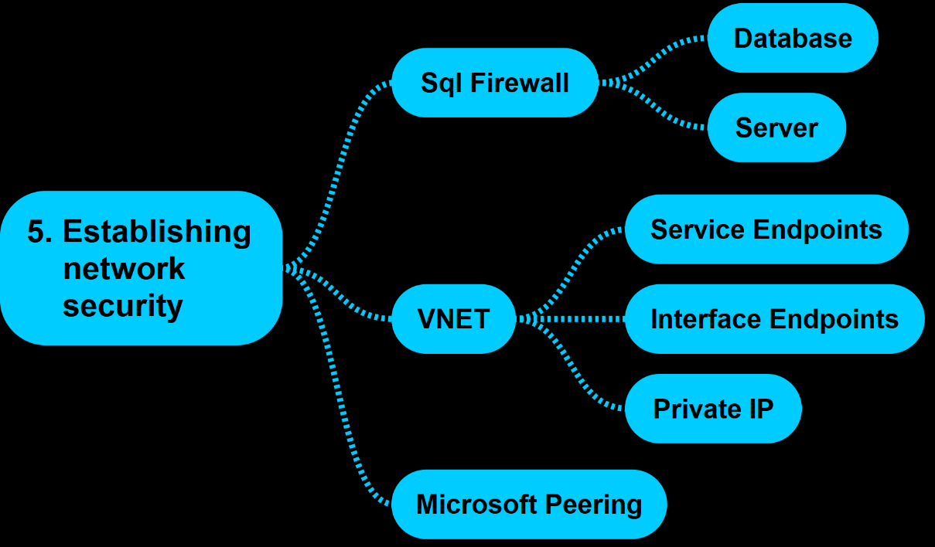

Slide 23
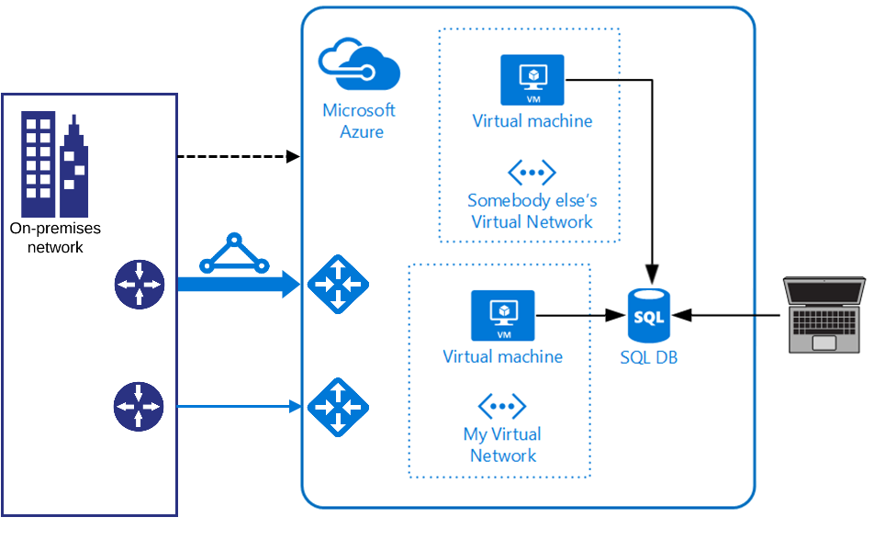
Sql DB/DW

Slide 24
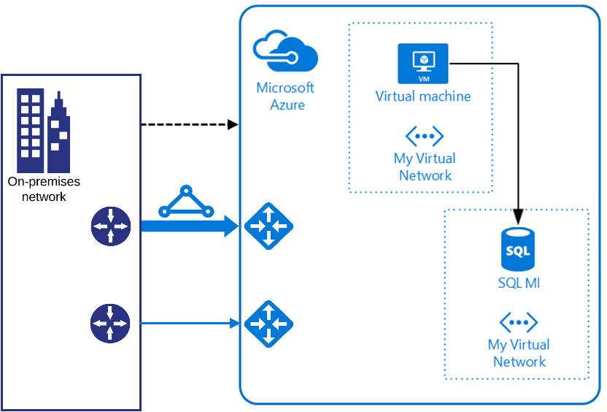
Azure Sql Managed Instance

Slide 25
Interface
Endpoint
Service
Endpoint
YES
YES
YES
NO
NO
NO
VNET support
PUBLIC IP
VPN/ER
OUTBOUND pIP
iDNS support
GA
YES
YES
NO
YES
YES
YES

Slide 26
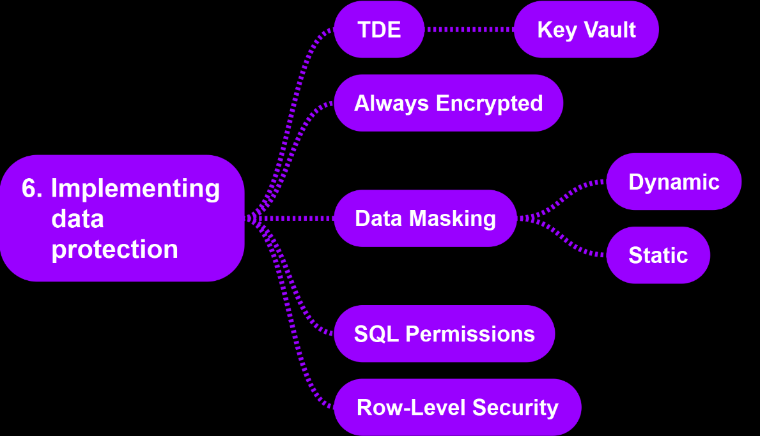

Slide 27
DEMO 9
Static
Data
Masking

Slide 28
DEMO 10
Azure
Sql DB/DW Permissions

Slide 29
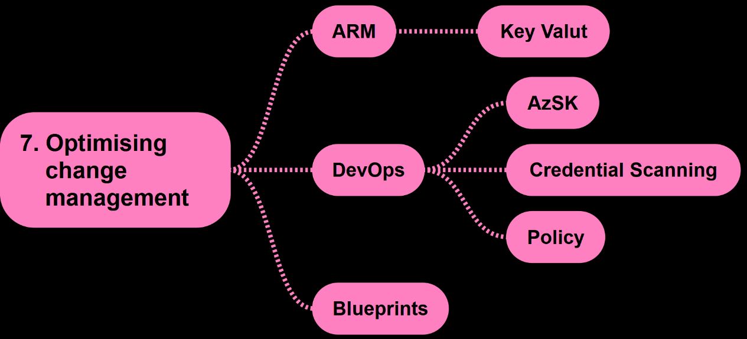

Slide 30
DEMO 11
AzSK
and
DevOps

Slide 31
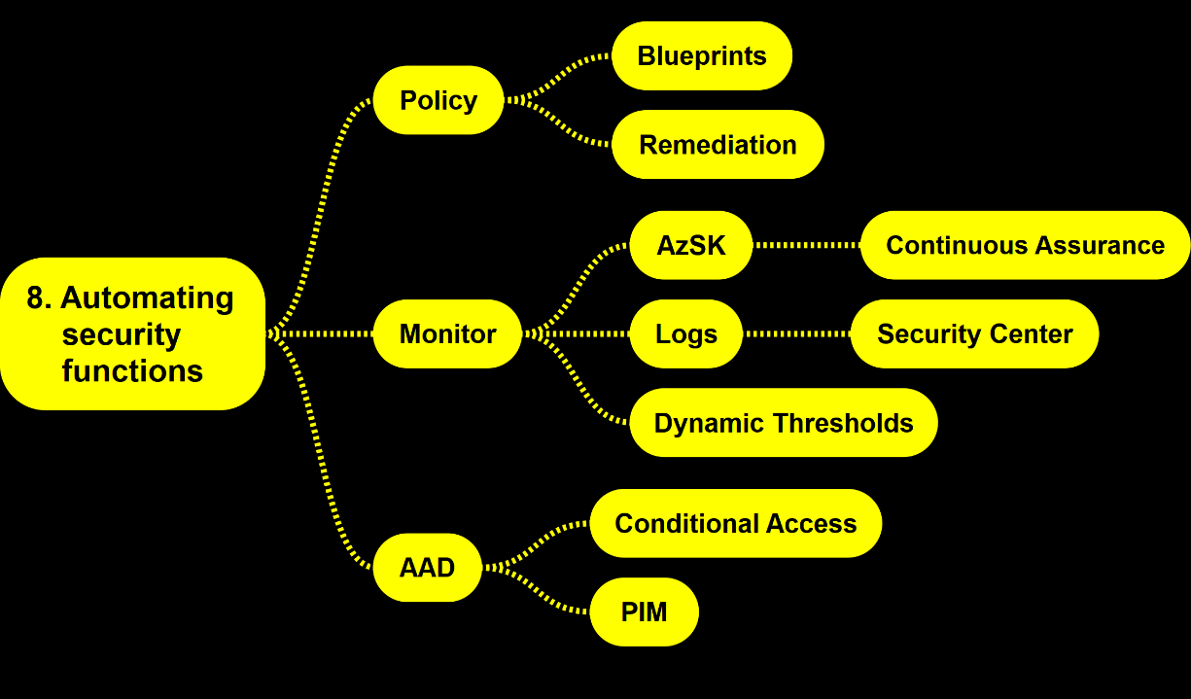

Slide 32
DEMO 12
Policy
Remediation

Slide 33
Call To Action
Cloud is different
Zoom out
N-step Impact Model
Security champion

Slide 34
THANK YOU
/in/jrokicki
@DATAsic
www.DATAsic.com

