Slide 1
Design patterns for metadata-first ETL process control
Richard Swinbank

Slide 2
Introduction
About me
About this talk
Coming up
Unpacking
Choices have consequences
Making good choices
Getting more out

Slide 3
Metadata-first ETL process control
ETL
Batch processing
Set of processes
Process control
What runs when, in what order
What happens when things go wrong
What happens after things go wrong
Metadata-first
Object dependencies
Process state
Execution history

Slide 4
A very small example

Slide 5
A very small example
Set of ten processes
We’ll be using SPs, on-prem SQL in this example
Set of process dependencies
Represented in metadata
How we represent them has consequences
A
B
C
D
E
F
G
H
I
J

Slide 6
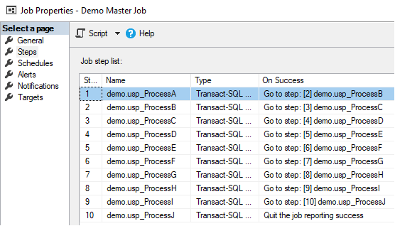
SQL Agent as ETL process controller
Call each process in a separate job step
Process dependencies expressed via On Success action
For each step, there is a single next step
In this model, dependency is an attribute of process

Slide 7
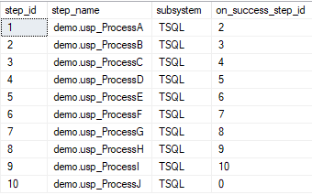
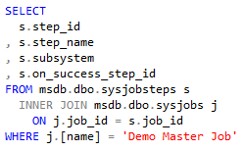
SQL Agent as ETL process controller
Call each process in a separate job step
Process dependencies expressed via On Success action
For each step, there is a next step
In this model, dependency is an attribute of process

Slide 8
Process dependencies
A
B
C
D
E
F
G
H
I
J

Slide 9
Denormalised process dependencies
A
B
C
D
E
F
G
H
I
J

Slide 10
Running the agent job
A
B
C
D
E
F
G
H
I
J

Slide 11
Running the agent job
A
B
C
D
E
F
G
H
I
J

Slide 12
Running the agent job
A
B
C
D
E
F
G
H
I
J

Slide 13
Running the agent job
(btw, process E is broken)
A
B
C
D
E
F
G
H
I
J

Slide 14
Running the agent job
A
B
C
D
E
F
G
H
I
J

Slide 15
Running the agent job
Dependency metadata model has consequences
A
B
C
D
E
F
G
H
I
J

Slide 16
Running the agent job
Dependency metadata model has consequences
Unnecessary roadblocks after process failure
No opportunity for parallel processing
What about process state?
A
B
C
D
E
F
G
H
I
J

Slide 17
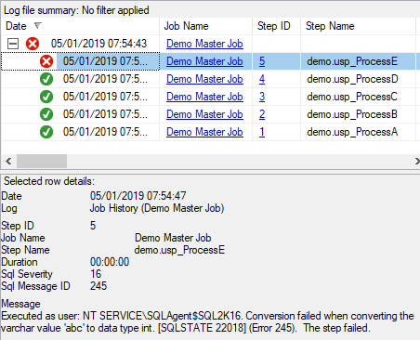
Process state
Recorded in job history

Slide 18
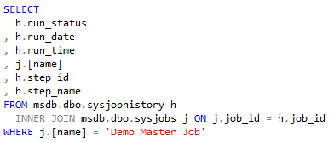
Process state
Recorded in job history
State metadata model has consequences
Lightweight state means the controller doesn’t know much about processes

Slide 19
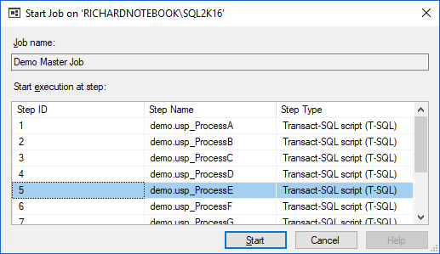
Process state
Process state recorded in job history
State metadata model has consequences
Lightweight state means the controller doesn’t know much about processes
No need for additional information at restart

Slide 20
Recap
Influence of dependency metadata on process execution
Denormalised process dependencies cause roadblocks, prevent parallelism
Influence of state metadata on restartability
Lightweight state metadata makes restart easier
We can’t change the behaviour of this controller
It’s the out-of-the-box SQL Agent!
Not a criticism
So let’s write one
Start with the metadata we want
Look for opportunities to gather more (and use it!)
We’ll use the same example set of processes
Run SPs in on-prem SQL Server ETL
Write the controller in TSQL

Slide 21
Process controller components
1. Lightweight
state
Process | Status
demo.usp_ProcessA | Ready
demo.usp_ProcessB | Ready
demo.usp_ProcessC | Ready
demo.usp_ProcessD | Not ready
demo.usp_ProcessE | Ready
demo.usp_ProcessF | Not ready
demo.usp_ProcessG | Not ready
demo.usp_ProcessH | Not ready
demo.usp_ProcessI | Not ready
demo.usp_ProcessJ | Not ready

Slide 22
Process controller components
1. Lightweight
state
2. Normalised
dependencies
3. Process handler
TSQL SP
Runs processes
Process | Status
demo.usp_ProcessA | Ready
demo.usp_ProcessB | Ready
demo.usp_ProcessC | Ready
demo.usp_ProcessD | Not ready
demo.usp_ProcessE | Ready
demo.usp_ProcessF | Not ready
demo.usp_ProcessG | Not ready
demo.usp_ProcessH | Not ready
demo.usp_ProcessI | Not ready
demo.usp_ProcessJ | Not ready
Process | RunsAfter
demo.usp_ProcessD | demo.usp_ProcessA
demo.usp_ProcessF | demo.usp_ProcessB
demo.usp_ProcessG | demo.usp_ProcessB
demo.usp_ProcessG | demo.usp_ProcessC
demo.usp_ProcessH | demo.usp_ProcessC
demo.usp_ProcessI | demo.usp_ProcessE
demo.usp_ProcessI | demo.usp_ProcessF
demo.usp_ProcessJ | demo.usp_ProcessG

Slide 23
Process handler
WHILE (anything’s ready)
BEGIN
SELECT ready process
EXECUTE selected process
UPDATE ProcessList
SET process status = ‘Done’
, process’s dependants = ‘Ready’
END
Pseudo-TSQL

Slide 24
Process handler
A
B
C
WHILE (anything’s ready)
BEGIN
SELECT ready process
EXECUTE selected process
UPDATE ProcessList
SET process status = ‘Done’
, process’s dependants = ‘Ready’
END
D
E
F
G
H
I
J
Process | Status
demo.usp_ProcessA | Ready
demo.usp_ProcessB | Ready
demo.usp_ProcessC | Ready
demo.usp_ProcessD | Not ready
demo.usp_ProcessE | Ready
demo.usp_ProcessF | Not ready
demo.usp_ProcessG | Not ready
demo.usp_ProcessH | Not ready
demo.usp_ProcessI | Not ready
demo.usp_ProcessJ | Not ready

Slide 25
Process handler
A
B
C
WHILE (anything’s ready)
BEGIN
SELECT ready process
EXECUTE selected process
UPDATE ProcessList
SET process status = ‘Done’
, process’s dependants = ‘Ready’
END
D
E
F
G
H
I
J
Process | Status
demo.usp_ProcessA | Done
demo.usp_ProcessB | Ready
demo.usp_ProcessC | Ready
demo.usp_ProcessD | Ready
demo.usp_ProcessE | Ready
demo.usp_ProcessF | Not ready
demo.usp_ProcessG | Not ready
demo.usp_ProcessH | Not ready
demo.usp_ProcessI | Not ready
demo.usp_ProcessJ | Not ready

Slide 26
Process handler
A
B
C
WHILE (anything’s ready)
BEGIN
SELECT ready process
EXECUTE selected process
UPDATE ProcessList
SET process status = ‘Done’
, process’s dependants = ‘Ready’
END
D
E
F
G
H
I
J
Process | Status
demo.usp_ProcessA | Done
demo.usp_ProcessB | Ready
demo.usp_ProcessC | Done
demo.usp_ProcessD | Ready
demo.usp_ProcessE | Ready
demo.usp_ProcessF | Not ready
demo.usp_ProcessG | Not ready
demo.usp_ProcessH | Ready
demo.usp_ProcessI | Not ready
demo.usp_ProcessJ | Not ready

Slide 27
Process handler
A
B
C
WHILE (anything’s ready)
BEGIN
SELECT ready process
EXECUTE selected process
UPDATE ProcessList
SET process status = ‘Done’
, process’s dependants = ‘Ready’
END
D
E
F
G
H
I
J
Process | Status
demo.usp_ProcessA | Done
demo.usp_ProcessB | Ready
demo.usp_ProcessC | Done
demo.usp_ProcessD | Ready
demo.usp_ProcessE | Ready
demo.usp_ProcessF | Not ready
demo.usp_ProcessG | Not ready
demo.usp_ProcessH | Ready
demo.usp_ProcessI | Not ready
demo.usp_ProcessJ | Not ready

Slide 28
Better process handler
WHILE (anything’s ready)
BEGIN
BEGIN TRY
SELECT ready process
EXECUTE selected process
UPDATE ProcessList
SET process status = ‘Done’
, process’s dependants = ‘Ready’
END TRY
BEGIN CATCH
UPDATE ProcessList
SET process status = ‘Errored’
END CATCH
END

Slide 29
Better process handler
A
B
C
WHILE (anything’s ready)
BEGIN
BEGIN TRY
SELECT ready process
EXECUTE selected process
UPDATE ProcessList
SET process status = ‘Done’
, process’s dependants = ‘Ready’
END TRY
BEGIN CATCH
UPDATE ProcessList
SET process status = ‘Errored’
END CATCH
END
D
E
F
G
H
I
J
Process | Status
demo.usp_ProcessA | Done
demo.usp_ProcessB | Ready
demo.usp_ProcessC | Done
demo.usp_ProcessD | Ready
demo.usp_ProcessE | Ready
demo.usp_ProcessF | Not ready
demo.usp_ProcessG | Not ready
demo.usp_ProcessH | Ready
demo.usp_ProcessI | Not ready
demo.usp_ProcessJ | Not ready

Slide 30
Better process handler
A
B
C
WHILE (anything’s ready)
BEGIN
BEGIN TRY
SELECT ready process
EXECUTE selected process
UPDATE ProcessList
SET process status = ‘Done’
, process’s dependants = ‘Ready’
END TRY
BEGIN CATCH
UPDATE ProcessList
SET process status = ‘Errored’
END CATCH
END
D
E
F
G
H
I
J
Process | Status
demo.usp_ProcessA | Done
demo.usp_ProcessB | Ready
demo.usp_ProcessC | Done
demo.usp_ProcessD | Ready
demo.usp_ProcessE | Errored
demo.usp_ProcessF | Not ready
demo.usp_ProcessG | Not ready
demo.usp_ProcessH | Ready
demo.usp_ProcessI | Not ready
demo.usp_ProcessJ | Not ready

Slide 31
Better process handler
A
B
C
WHILE (anything’s ready)
BEGIN
BEGIN TRY
SELECT ready process
EXECUTE selected process
UPDATE ProcessList
SET process status = ‘Done’
, process’s dependants = ‘Ready’
END TRY
BEGIN CATCH
UPDATE ProcessList
SET process status = ‘Errored’
END CATCH
END
D
E
F
G
H
I
J
Process | Status
demo.usp_ProcessA | Done
demo.usp_ProcessB | Done
demo.usp_ProcessC | Done
demo.usp_ProcessD | Ready
demo.usp_ProcessE | Errored
demo.usp_ProcessF | Ready
demo.usp_ProcessG | Ready
demo.usp_ProcessH | Ready
demo.usp_ProcessI | Not ready
demo.usp_ProcessJ | Not ready

Slide 32
Better process handler
A
B
C
WHILE (anything’s ready)
BEGIN
BEGIN TRY
SELECT ready process
EXECUTE selected process
UPDATE ProcessList
SET process status = ‘Done’
, process’s dependants = ‘Ready’
END TRY
BEGIN CATCH
UPDATE ProcessList
SET process status = ‘Errored’
END CATCH
END
D
E
F
G
H
I
J
Process | Status
demo.usp_ProcessA | Done
demo.usp_ProcessB | Done
demo.usp_ProcessC | Done
demo.usp_ProcessD | Done
demo.usp_ProcessE | Errored
demo.usp_ProcessF | Ready
demo.usp_ProcessG | Ready
demo.usp_ProcessH | Ready
demo.usp_ProcessI | Not ready
demo.usp_ProcessJ | Not ready

Slide 33
Better process handler
A
B
C
WHILE (anything’s ready)
BEGIN
BEGIN TRY
SELECT ready process
EXECUTE selected process
UPDATE ProcessList
SET process status = ‘Done’
, process’s dependants = ‘Ready’
END TRY
BEGIN CATCH
UPDATE ProcessList
SET process status = ‘Errored’
END CATCH
END
D
E
F
G
H
I
J
Process | Status
demo.usp_ProcessA | Done
demo.usp_ProcessB | Done
demo.usp_ProcessC | Done
demo.usp_ProcessD | Done
demo.usp_ProcessE | Errored
demo.usp_ProcessF | Ready
demo.usp_ProcessG | Done
demo.usp_ProcessH | Ready
demo.usp_ProcessI | Not ready
demo.usp_ProcessJ | Ready

Slide 34
Better process handler
A
B
C
WHILE (anything’s ready)
BEGIN
BEGIN TRY
SELECT ready process
EXECUTE selected process
UPDATE ProcessList
SET process status = ‘Done’
, process’s dependants = ‘Ready’
END TRY
BEGIN CATCH
UPDATE ProcessList
SET process status = ‘Errored’
END CATCH
END
D
E
F
G
H
I
J
Process | Status
demo.usp_ProcessA | Done
demo.usp_ProcessB | Done
demo.usp_ProcessC | Done
demo.usp_ProcessD | Done
demo.usp_ProcessE | Errored
demo.usp_ProcessF | Done
demo.usp_ProcessG | Done
demo.usp_ProcessH | Ready
demo.usp_ProcessI | Not ready
demo.usp_ProcessJ | Ready

Slide 35
Better process handler
A
B
C
WHILE (anything’s ready)
BEGIN
BEGIN TRY
SELECT ready process
EXECUTE selected process
UPDATE ProcessList
SET process status = ‘Done’
, process’s dependants = ‘Ready’
END TRY
BEGIN CATCH
UPDATE ProcessList
SET process status = ‘Errored’
END CATCH
END
D
E
F
G
H
I
J
Process | Status
demo.usp_ProcessA | Done
demo.usp_ProcessB | Done
demo.usp_ProcessC | Done
demo.usp_ProcessD | Done
demo.usp_ProcessE | Errored
demo.usp_ProcessF | Done
demo.usp_ProcessG | Done
demo.usp_ProcessH | Ready
demo.usp_ProcessI | Not ready
demo.usp_ProcessJ | Done

Slide 36
Better process handler
A
B
C
WHILE (anything’s ready)
BEGIN
BEGIN TRY
SELECT ready process
EXECUTE selected process
UPDATE ProcessList
SET process status = ‘Done’
, process’s dependants = ‘Ready’
END TRY
BEGIN CATCH
UPDATE ProcessList
SET process status = ‘Errored’
END CATCH
END
D
E
F
G
H
I
J
Process | Status
demo.usp_ProcessA | Done
demo.usp_ProcessB | Done
demo.usp_ProcessC | Done
demo.usp_ProcessD | Done
demo.usp_ProcessE | Errored
demo.usp_ProcessF | Done
demo.usp_ProcessG | Done
demo.usp_ProcessH | Done
demo.usp_ProcessI | Not ready
demo.usp_ProcessJ | Done

Slide 37
Pattern features
WHILE (anything’s ready)
BEGIN
BEGIN TRY
SELECT ready process
EXECUTE selected process
UPDATE ProcessList
SET process status = ‘Done’
, process’s dependants = ‘Ready’
END TRY
BEGIN CATCH
UPDATE ProcessList
SET process status = ‘Errored’
END CATCH
END
While loop
Blocking call to execute
Error handling

Slide 38
Parallel processing
Run multiple handlers at the same time
Must prevent different handlers from running the same process
Make handler reserve a process before executing it
(and set status of processes in execution to ‘Running’)
Reserve by inserting details into reservations table
Catch PK violation, continue
Process
demo.usp_ProcessA
demo.usp_ProcessC
demo.usp_ProcessE
demo.usp_ProcessB
demo.usp_ProcessD
Primary key

Slide 39
Parallelisable process handler
WHILE (anything’s ready)
BEGIN
BEGIN TRY -- for process execution
SELECT ready process
BEGIN TRY -- for process reservation
INSERT ready process details
INTO ProcessReservations
END TRY
BEGIN CATCH
CONTINUE
END CATCH
UPDATE ProcessList
SET process status = ‘Running’
EXECUTE selected process
UPDATE ProcessList
SET process status = ‘Done’ [...]

Slide 40
Pattern features
WHILE (anything’s ready)
BEGIN
BEGIN TRY -- for process execution
SELECT ready process
BEGIN TRY -- for process reservation
INSERT ready process details
INTO ProcessReservations
END TRY
BEGIN CATCH
CONTINUE
END CATCH
UPDATE ProcessList
SET process status = ‘Running’
EXECUTE selected process
UPDATE ProcessList
SET process status = ‘Done’ [...]
Handler mutual exclusion
Non-blocking handler start

Slide 41
Here’s one I made earlier
Influence of dependency metadata on process execution
Normalised process dependencies enable parallelism, avoid roadblocks
Influence of state metadata on restartability
Lightweight state metadata makes restart easier
Influence of execution metadata
Calculate average duration from recent execution history
Use branch weight to predict good execution order adaptively

Slide 42
Making dependency metadata work harder
A
B
C
D
E
F
G
H
I
J

Slide 43
Making dependency metadata work harder
A
B
C
D
E
F
G
H
I
J

Slide 44
Resource dependencies
T01
T02
T03
A
B
C
T07
T04
T06
D
E
F
G
H
T11
T05
T08
T09
T10
I
J
T12
T13
T14

Slide 45
Resource dependencies
Store
T02
T03
A
B
C
T07
DIM_Store
Sales
D
E
F
G
H
T11
T05
T08
FACT_Sales
T10
I
J
T12
T13
T14

Slide 46
Resource dependencies
Store
T02
T03
A
B
C
T07
DIM_Store
Sales
D
E
F
G
H
T11
T05
T08
FACT_Sales
T10
I
J
T12
T13
T14

Slide 47
Resource dependencies
Store
T02
T03
A
B
C
T07
DIM_Store
Sales
D
E
F
G
H
T11
T05
T08
FACT_Sales
T10
I
J
T12
T13
T14

Slide 48
Resource dependencies in metadata
Resource dependencies stored as process inputs/outputs
Process | Resource | Input/output
demo.usp_ProcessB | Store | Input
demo.usp_ProcessB | DIM_Store | Output

Slide 49
Resource dependencies in metadata
Resource dependencies stored as process inputs/outputs
Process | Resource | Input/output
demo.usp_ProcessB | Store | Input
demo.usp_ProcessB | DIM_Store | Output
demo.usp_ProcessG | DIM_Store | Input
demo.usp_ProcessG | Sales | Input
demo.usp_ProcessG | FACT_Sales | Output

Slide 50
Resource dependencies in metadata
Resource dependencies stored as process inputs/outputs
Process dependencies inferred by handlers
uvw_ProcessDependency
Process | Resource | Input/output
demo.usp_ProcessB | Store | Input
demo.usp_ProcessB | DIM_Store | Output
demo.usp_ProcessG | DIM_Store | Input
demo.usp_ProcessG | Sales | Input
demo.usp_ProcessG | FACT_Sales | Output

Slide 51
Resource dependencies in metadata
Resource dependencies stored as process inputs/outputs
Process dependencies inferred by handlers
uvw_ProcessDependency
Process | Resource | Input/output
demo.usp_ProcessB | Store | Input
demo.usp_ProcessB | DIM_Store | Output
demo.usp_ProcessG | DIM_Store | Input
demo.usp_ProcessG | Sales | Input
demo.usp_ProcessG | FACT_Sales | Output
Process | RunsAfter
demo.usp_ProcessG | demo.usp_ProcessB

Slide 52
Benefits of resource dependencies
Clarify meaning of process dependencies
Can be read directly from process definition
A
B
C
Where does my new process go?
D
E
F
G
H
I
J

Slide 53
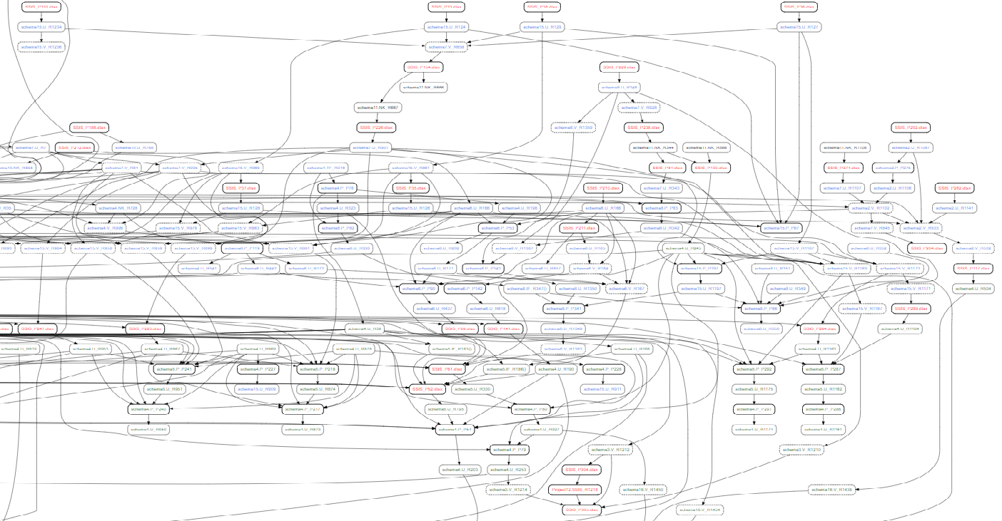
Benefits of resource dependencies
Clarify meaning of process dependencies
Can be read directly from process definition

Slide 54
Benefits of resource dependencies
Clarify meaning of process dependencies
Can be read directly from process definition
Easier to add new processes
Finer grain allows devolution of resource maintenance

Slide 55
Benefits of resource dependencies
Clarify meaning of process dependencies
Can be read directly from process definition
Easier to add new processes
Finer grain allows devolution of resource maintenance
e.g. make process handlers perform index maintenance
DIM_Store
Sales
G
FACT_Sales

Slide 56
What have we found?
Metadata choices determine what’s easy/hard/impossible
Choose models carefully for core concepts
Normalised dependencies remove roadblocks, enable parallelism
Resource dependencies are easier to manage, finer-grained
Lightweight state makes for easy restart, rewind
Gather metadata proactively
Facilitates fault diagnosis
Execution history can drive adaptive self-organisation
Store it accessibly
i.e. in database tables!
Code available at http://RichardSwinbank.net/sprockit
Thanks for listening!

Slide 57
Questions?
...and feedback forms please!
richard@RichardSwinbank.net
@richardswinbank
http://RichardSwinbank.net/sprockit

