Slide 1

Revenge: THE SQL!
Extended Director’s Cut
  Like you’ve never seen it before
  In Widescreen Hi-Definition Blu-Ray
  In 3D
  With Director’s commentary
  In 7.1 Surround Sound
  In Certified Recyclable Packaging
Rob Volk

Slide 2
Un Film de…
Rob Volk
SQL Server DBA since v6.5
  ...and even older DBs...
SQL Saturday Atlanta Organizer
SQLTeam moderator & blogger
  http://weblogs.sqlteam.com/robv/
  Twitter: @sql_r
  Email: sql_r@outlook.com
I do deranged things in SQL Server, so you don’t have to!
Notes:
Shocking as it may seem, my Bachelor’s degree is in filmmaking. I’ve never formally studied computers or databases.

Slide 3
DISCLAIMER
Not practical to use
This may not be a good session for you
  I won’t be offended if you leave!
Don’t try this at work
  Keep your résumé updated if you do
OK, there's some stuff that may be applicable in a production environment, but it's pretty sketchy and there are better ways, both in practice and documentation, to accomplish the same thing, which I won't go into since the theme of this presentation is essentially unconventional ways to do normal or absurd things (with an undercurrent of vengeance for past wrongs) hence the title "REVENGE: The SQL", which is also much shorter and punchier than "Unconventional Ways to Do Normal or Absurd Things In SQL Server…" and I haven't even gotten to the Vengeance part yet, so I'll stop here.

Slide 4
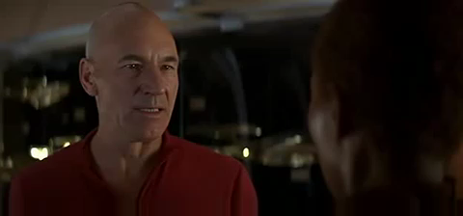
Jean-Luc Picard, DBA
Calmly Discusses SA Permissions with Dev Team

Slide 5
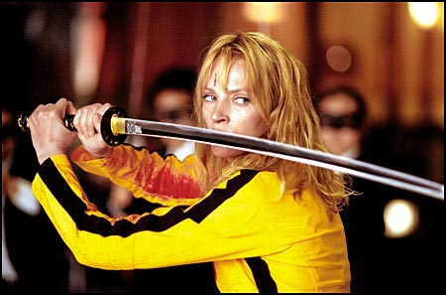
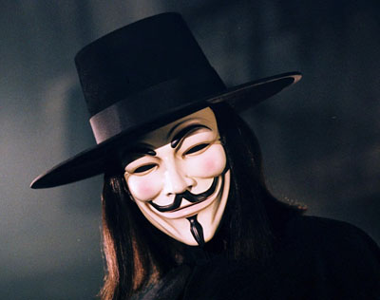
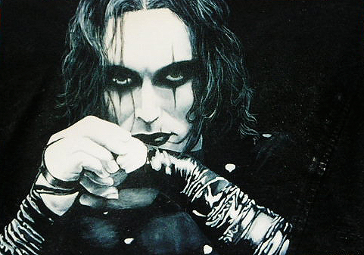
Levels of Revenge
Reciprocation
People annoy you
You’re annoying them back
It may seem excessive, but really isn’t*
Reprisal
Yes, you’re still getting even
You’re attacking a corrupt system
Your goals ultimately benefit society
And Natalie Portman LOVES this stuff
Retribution
You’ve endured genuine loss
From those with selfish motives
They deserve punishment
Notes:
Actually The Bride totally overreacted, she wasn’t killed and <SPOILER ALERT> neither was her baby </SPOILER ALERT>

Slide 6
Forms of Revenge
SSMS Tricks
Naming Conventions
SA & Sysadmin abuse
Prevent “bad” things
Cause “bad” things (time permitting)

Slide 7
SSMS Tricks
Batch Separator
Execution & Result settings, implicit
Session settings
Toolbars & Menus (prior to 2012) (Teamview)

Slide 8
Naming Conventions
Reserved
Blanks
Hidden
Duplicate
Unicode

Slide 9
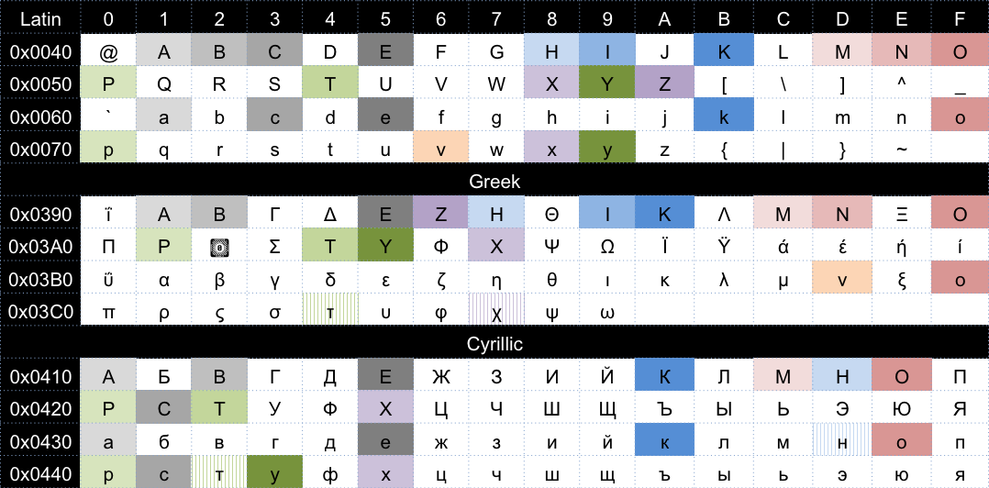
Duplicate Unicode

Slide 10
Sysadmin & sa Abuse
Standard (disable, rename, password)
Logon Triggers
Resource Governor
Event Notifications
DML Triggers
Table Constraints

Slide 11
Prevent Bad Things*
Ad-hoc SQL
Cursors
Truncate Table
Too many rows (trigger, WHERE clause)
Too many columns (SELECT *)
Dropping/altering objects
Dropping databases
WARNING:
Not entirely vengeful!

Slide 12
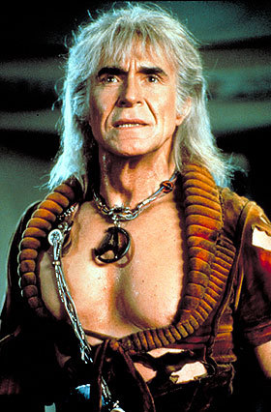
Wrath
Brilliant and cunning, but…
...just a wee bit crazed, obsessed, insane
Save these for your last day at a job you really hate
You're Ahab, they're Moby Dick*
  Or, maroon them for all eternity in the center of a dead planet
    Buried alive…
      Buried alive…
Notes:
Nicholas Meyer, the writer/director of Star Trek II: The Wrath of Khan, included themes from Moby Dick in his screenplay, and directed Ricardo Montalban to study Ahab as inspiration.

Slide 13
Cause “Bad” Things
Trigger mayhem
  WAITFOR, self-dropping
“Duplicate” data
Constraints
SA + domain admin service = MWUHAHAHA

Slide 14
Yummy Take-aways
SQL Server is fun! And diabolical!
  Or maybe it's just me that's diabolical.
Use everyday features in new ways
Learn new features for novel uses
Indulge your Dark Side
  ...just NOT IN PRODUCTION
    Dev, however, is the perfect place upon which your vengeance be wrought

Slide 15
References
Books Online/MSDN
  My Blog: http://weblogs.sqlteam.com/robv/
Other Blogs
  Simple Talk (Rodney Landrum, Phil Factor)
  SQLBlogs (Aaron Bertrand, Alex K., everyone)
  SQLSkills (Paul R., Jonathan K., everyone)
  SQLPerformance.com (Aaron B., everyone)
  T-SQL Tuesday (#tsql2sday)
Books
  Inside SQL Server series
  The Guru's Guide to SQL Server series

Slide 16
Thanks!
Sponsors!
Organizers!
Volunteers!
YOU!

