Slide 1
Creating a Business Continuity Plan
Buck Woody
Sr. Technical Specialist
Microsoft
buck.woody@microsoft.com
http://blogs.msdn.com/buckwoody
http://facebook.com/buckwoody
http://twitter.com/buckwoody
Notes:
http://www.informit.com/guides/content.aspx?g=sqlserver&seqNum=167

Slide 2
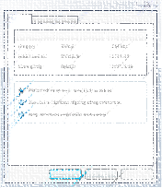
Text
Text

Slide 3
Step One: Business Process Identification

Slide 4
Step Two: Data Map

Slide 5
Step Three: Impact Analysis
= £ ?

Slide 6
Step Four: Develop RPO/RTO

Slide 7
Step Five: Mitigation Options Selection

Slide 8
Step Six: Documentation and Communication

Slide 9
Coming up…
P/X001
The Developer Side of the Microsoft Business Intelligence stack
Sascha Lorenz
P/L001
Understanding SARGability (to make your queries run faster)
Rob Farley
P/L002
Notes from the field: High Performance storage for SQL Server
Justin Langford
P/L005
Service Broker: Message in a bottle
Klaus Aschenbrenner
P/T007
Save the Pies for Lunch - Data Visualisation Techniques with SSRS 2008
Tim Kent
#SQLBITS

Slide 10
