Slide 1
10 Things Not To Do With SQL
SQLBits 7

Slide 2

Some things you shouldn’t do

Slide 3

Others you can but will be messy

Slide 4
Simon Sabin
Principal Consultant for SQL Know How
  Training and Development for SQL Server
  Database design and development, Business Intelligence, Performance tuning and troubleshooting
SQL Server MVP since 2006
Email: Simon@SqlKnowHow.com
Blog: http://Sqlblogcasts.com/blogs/simons
Twitter: @simon_sabin

Slide 5
Truncating transaction Log

Slide 6

Truncating transaction log

Slide 7
Reasons why
No going back
  Transaction log provides point in time recovery
Without transaction log
  Can only go back to a full/differential backup
Running with full/ bulk logged recovery
  Your transaction log will grow
  Unless you back it up
  In Full All operations are fully logged (slower)

Slide 8
Truncating transaction log
Actions
  Decide on your recovery
  If you want point in time then backup your log
    Mirroring does not backup your log
  If your log grows then back it up more frequently
  If you don’t then use simple recovery

Slide 9
reindexing

Slide 10
??**##@@~%?
You probably have extent fragmentation in your clustered and not clustered indexes due to LOB allocations and forward pointers
I’ve read all the inside sql books and once had an email from Karen Beleeney and so I know what I’m taking about
You need to setup a daily maintenance plan that re-indexes all the tables in your database. That will remove fragmentation and performance will be great
My queries are suddenly running slow what do I do?
What do I do?
Ah you sure ?

Slide 11
Re-indexing isn’t Magic

Slide 12

It just generates a lot of work

Slide 13
Re-Index to solve all problems
Re-indexing causes
  Statistics to be updated
  Plans to be purged
This means you get a new query plan
So it appears it solves your problems
But…

Slide 14
Re-Index to solve all problems
But…
  It Just causes a pile of work
  Slows down mirroring, and log shipping
And you may have only needed to update statistics
Only needed when
  Lots of scanning
  Help prevent page splits

Slide 15
Re-Index to solve all problems
Actions
  Consider if fragmentation is a problem
    Do your query plans have scans in them
    Are they for large tables
    Does the data in those tables change so much
  Is it that your just getting bad plans
    What my SQLBits 5 session on car crash queries
  Reduce to weekly/monthly
  Implement reorganisations
  Implement statistics

Slide 16
Shrinking Files

Slide 17

You got a nice big ladder
Notes:
http://commons.wikimedia.org/wiki/File:Leiter_ladder.jpg

Slide 18
Its too big so you make it smaller

Slide 19

Your ladder is now too short

Slide 20
Shrinking files
A file has grown for a reason
Regular shrinking is wrong
  The file will just have to grow again
For transaction log, growing blocks transactions
For Data files
  growth can if “instant file initialisation” is not on
  shrinking causes fragmentation

Slide 21
Shrinking files
Actions
  If its big, its big for a reason, re-indexing perhaps, a large batch job
  Understand why and resolve that
  Ensure operations are minimally logged
  Back up the log more frequently
  Pre size files and stick with them

Slide 22
Scalar User Defined Functions

Slide 23

Scalar functions are Evil

Slide 24
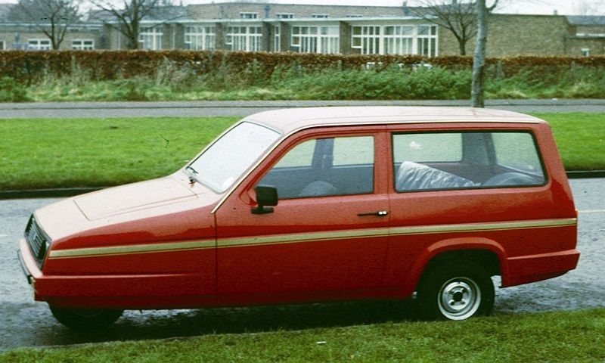
Poor Performance

Slide 25
User defined functions
Interpreted code
Prevent parallelism
Perform awfully
Especially for large queries

Slide 26
User defined functions
Actions
  Implement as inline table valued functions
  Change to CLR functions
  Watch my SQLBits 6 session on high performance functions

Slide 27
Indexing lots of columns

Slide 28
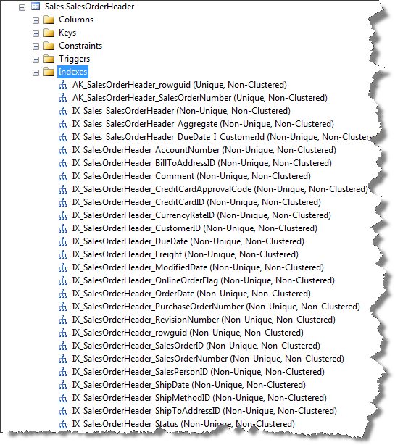
Over index

Slide 29
Over index
Indexing is great for reading
Indexes only useful for certain queries
Bad for writing
Each index can result in 3+ IOs, worst case 20+ IOs
  10 indexes = 30-200 IOs
  That’s 1 disk’s worth of IO

Slide 30
Over indexing
Actions
  Consider indexes carefully
    If you need lots do you have the correct table design
    Split tables to reduce problem
  Don’t implement ALL the missing indexes from the DMV
    They will be overlapping greatly
  Document what queries use them and how (seek/scan)

Slide 31
Not using parameters

Slide 32

Not using Parameters - SQL Injection

Slide 33
Don’t use parameters
SQL Injection
Don’t get plan reuse
  Compilation every time
SQL can’t optimise the plan

Slide 34
Parameters in queries
Actions
  Change your app to use parameters
  Can’t change your app
    Enable optimise for adhoc workloads
    Turn on forced parameterisation
    Make sure your database is secure
  Watch my car crash query session from SQLBits 5

Slide 35
Using the INSERT UPDATE PATTERN

Slide 36
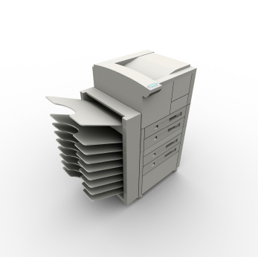
Duplicates write effort

Slide 37
The insert and update pattern
Updates are expensive
  You have to build your data set
  The find the row to update
  Is likely to cause page splits
  SQL may have to prevent Halloween effect
  No such thing as a minimally logged UPDATE

Slide 38
Insert Update pattern
Actions
  Change to a INSERT, INSERT … pattern
    Turn Trace flag 610 on
  If not pre assign fields
  Potentially SELECT INTO
  Consider your indexes carefully
  Use temp tables or table variables & hints

Slide 39
Applying Functions to FILTER Columns

Slide 40

Apply functions to filter columns

Slide 41
Apply functions to columns when being used to filter
Index generally can’t be used
  Bad performance
Applies to WHERE clause AND the ON clause
Also applies to data type conversions
  Seen as implicit conversions

Slide 42
Apply functions to columns when being used to filter
Actions
  Rewrite queries so column is left alone
  Use the correct data types
    http://tinyurl.com/FindImplicitConversions

Slide 43
Not indexing foreign key columns

Slide 44

Not Indexing foreign keys

Slide 45
Not indexing foreign key columns
Only applies when you can delete parent
Engine has to see is the parent is being used
Will check ALL the child tables

Slide 46
Not indexing foreign key columns
Actions
  Apply indexes where you are deleting
  If you have a batch process
    Consider indexing only during the process
    Reduces write overhead during normal time
  Disabling FKS is not the thing to do

Slide 47
Duplicates

Slide 48
Use distinct to get rid of duplicate
Causes really bad performance
  Often reading/processing more than needed
  Predicates not considered
  Simplification prevented
  Is very CPU intensive
Makes query optimisation hard
  Especially when nested in views

Slide 49
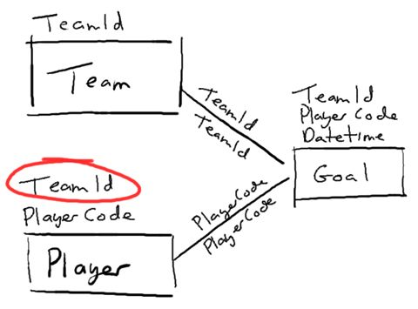
Get your joins right

Slide 50
Use distinct to get rid of duplicate
Actions
  Identify why you have duplicates
    Is your use of DISTINCT valid
  Amend your query
  Amend your schema
  http://tinyurl.com/MultiJoinPerf

Slide 51
Clustered Index on Date Columns

Slide 52
The 10 things you shouldn’t do
Truncating transaction log
Re-indexing frequently
Shrinking Files
User defined functions
Over index
Don’t use parameterised SQL
Use the Insert Update coding pattern
Apply functions to columns in a where clause
Not index foreign keys
Use DISTINCT to remove duplicates

Slide 53
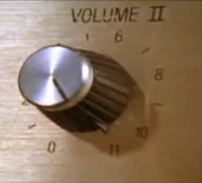
Can always do 1 more

Slide 54
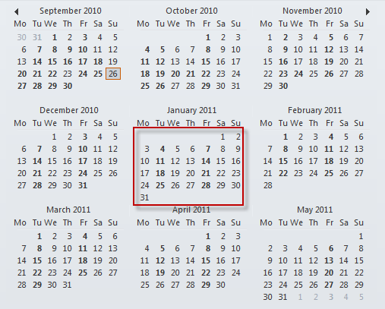
Clustered index on a date column

Slide 55
Clustered index on a date column
Indexing 101 you were taught
  Clustered index on a range column
  Wrong
  sort of
Non-clustered and Clustered indexes are the same
Clustered keys are included in ALL NC indexes
Additional Uniqueifier is added if not unique
If range column is first key column
  Other key columns are pointless

Slide 56
Clustered index columns
Actions
  Make clustered index small unique
  Consider a covering non clustered index
    Use included columns
  Put equality keys before range keys
    Examine the index DMVs and look at the equality

Slide 57
Summary
Don’t take everything you hear as true
Situations change with each release
Keep up to date from blogs, forums, twitter
Engage with user groups
Ask questions

Slide 58
Q&A
Now
Later
any time afterwards
Email: Simon@SqlKnowHow.com
Blog: http://Sqlblogcasts.com/blogs/simons
Twitter: @simon_sabin

