Slide 1

End to End
Master Data Management
With SQL Server Master Data Services (MDS)
Jeremy Kashel
BI 200

Slide 2
Agenda
Master Data Defined
Problems With Master Data
Master Data Management
Master Data Services Overview
Master Data Services Architecture
Data Import Process
Product Features
Product Demo
Questions

Slide 3





What is Master Data?
The reference data or nouns of the business, e.g. Product, Customer, Supplier
Non-Transactional Data of the business
Resides in:
  ERP Systems
  Fulfilment Systems
  Other LOB Systems / Databases
  SharePoint Lists
  Spread sheets

Slide 4
What Problems Can Occur With Master Data?
No enterprise business has a single system
The same master data entities must exist across different systems, e.g. Customer
This can cause problems:
  Systems may hold the same data in different ways, e.g. first name/surname Vs. full name
  Different customers in different system, e.g. banks or CRM/sales
  Sometimes data gets re-entered manually
  No single version of the truth
Notes:
-Use Customer needs to be in Sales, CRM, Marketing
-No single version of the truth – this just increases exponentially for each new system that gets added over the years

Slide 5
What Problems Can Occur With Master Data?
Mergers and acquisitions – duplicate Customers – “ABC Ltd” and “ABC Limited”
Reporting
  Data required for reporting may be missing e.g. Customer Industry Classification, Customer Segment
  Lack of hierarchies
  Sorting
Notes:
-If a large company buys another and they exist in similar markets, then its quite possible that they could have the same customers. If those customers are held in slightly different ways, e.g. ABC Ltd and ABC Limited, then it becomes difficult to get a single view of the customer at the group level because we have duplicates
-How easy is to add a missing attribute to your ERP system? E.g. categorise correctly
-What about sorting of data?

Slide 6
How can the Problems be Addressed?
A control layer is needed
Master Data Management (MDM) is a set of tools and processes that aim to deliver a single clean and consistent view of each master data entity that exists within the organization.
Analytical and Operational MDM
Three Approaches:
  Transaction Hub
  Registry
  Hybrid
Notes:
Each system needs master data entities – that can’t change – but something must provide a control layer to stop the problems that I mentioned earlier.
Analytical and Operational MDM
David Loshin book on MDM worth reading

Slide 7
Transaction Hub
Points to a centralised MDM database
Involves physically changing operational systems
Prevents problems with synchronisation and multiple updates of data
More of a idealistic approach to MDM
Notes:
Mention that this is open to interpretation, and you could argue its largely theoretical
Check in / Check Out
Could still get duplicates in theory. So there can be a de-duplication process

Slide 8
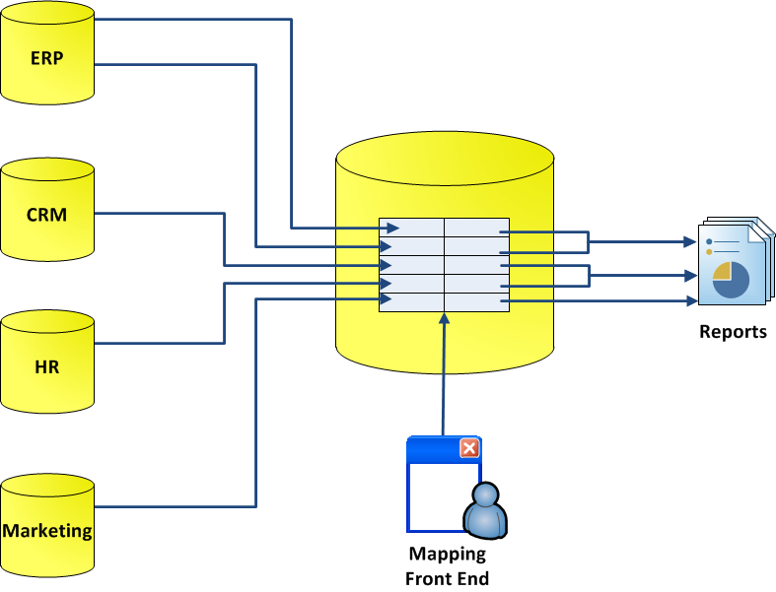
Registry
Avoids changes in operational systems
Maintains a mapping system
Involves distributed queries
Can be slow on large amounts of data
Cleaned data is only available for reporting systems

Slide 9
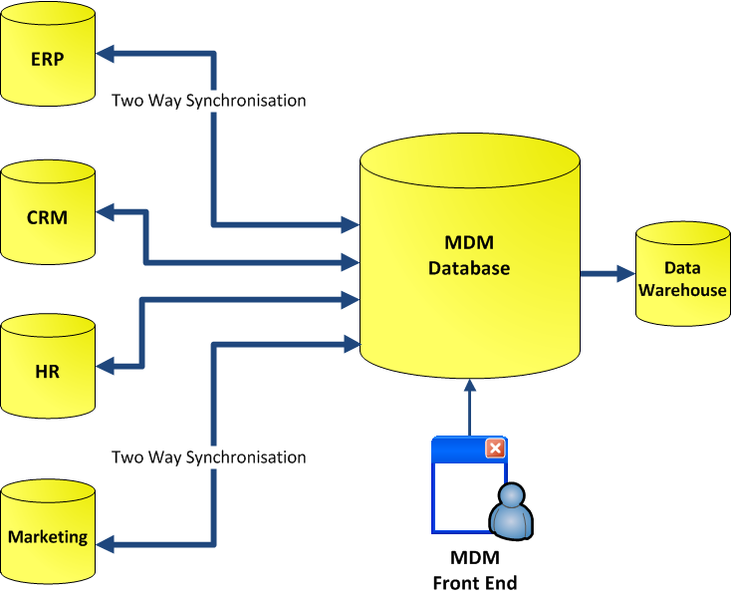
Hybrid
Central database captures and holds master data entities
Other systems (e.g. DW) are fed from the central database
Can synchronise correct data back to operational systems

Slide 10
Master Data Services Overview
Microsoft's Master Data Management product
New in 2008 R2 (Enterprise & Data Centre editions)
SQL Server database
Web front end
Modelling capability
Data entry for master data entities
Business rules & workflow
SharePoint integration
Versioning
Security

Slide 11
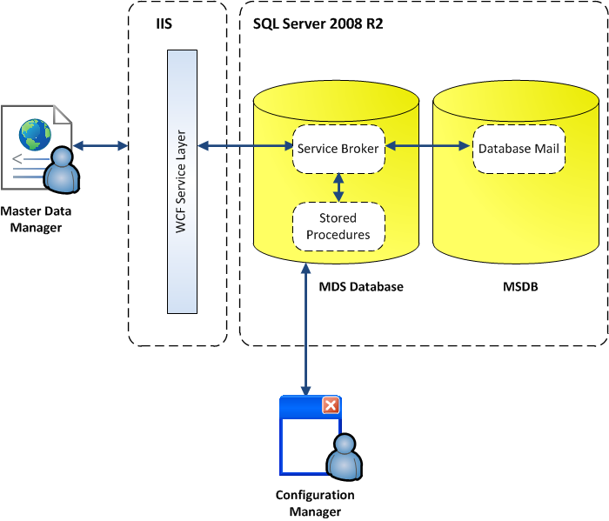
Architecture

Slide 12
Front End Demo
Overview
Explorer Area
Entity Add/Update
Notes:
-We create a model per entity that we manage. A model can have multiple versions, both of which we select at the top of the screen
-The explorer is the main window that users will use
-The members that we’re seeing here within the customer entity have been imported from a source system, in this case Adventure Works
-Enter a member

Slide 13
Data Entry and Hierarchies
Data is entered for Entities:
  e.g. Customer, Product
Data can be:
  Entered from scratch
  Sourced from other systems
Two types of hierarchies:
  Derived hierarchies
  Explicit hierarchies

Slide 14
Business Rules
Created via front end
If….Then….Else
Simple
  Set the value of an Entity attribute
  Default an attribute value
  Prevent blank attribute values, e.g. Product Price
More complex – fail validation

Slide 15
Notifications and Workflow
Notifications occur when:
  Business rules fail validation
  Versions change status (Unlocked, Locked, Committed)
Notifications are email alerts
Workflow
  Basic workflow with business rules and notifications
  More complex, multi-tiered, workflow with SharePoint

Slide 16
Security
Supports Windows Users and Windows User Groups
Prevent access to the 5 MDS functions:
  Explorer, Versions, Data Integration, Permissions and System Admin
Prevent access to different models
Prevent access to individual entity attributes:
  E.g. user can update Product Category but not Price

Slide 17
Demo Scenario
Customer data exists in a source system
The source system is missing Industry Classification
A manager wants a report of Customer sales by Industry Classification
Customer data is imported into MDS
A user is alerted when a new Customer arrives, to enter the Industry Classification
Once this has been done, the Data Warehouse is fed from MDS

Slide 18
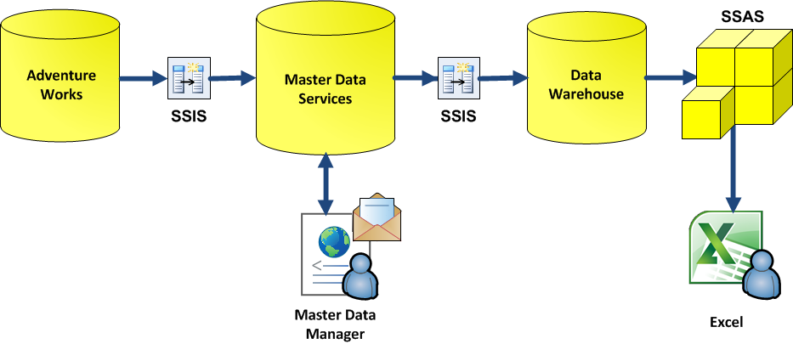
Demo Scenario

Slide 19
Data Import and Export Process
SSIS takes data in from external sources
SSIS loads data into the MDS staging area
Staging data loaded into the model:
  Manually via the web front end;
  Automatically via SQL or the web services
Validation will occur at this point:
  Business rules will fire;
  Notifications will fire on validation failure.
Subscribing systems extract only valid data

Slide 20
Data Integration Demo

Slide 21
Summary
Master Data – reference data or nouns of the business
Three Approaches – Transactional Hub, Registry & Hybrid
Powerful business rules with notifications
SharePoint integration
Versioning – take copies of master data
Security – member and attribute level permissions
Use SSIS for importing data

Slide 22
Questions
?

Slide 23
Resources
Master Data Management, David Loshin
Master Data Services TechNet - http://technet.microsoft.com/en-us/library/ee633763.aspx
Adatis Blogs http://blogs.adatis.co.uk

Slide 24


Coming up…
In the exhibition area:
17:30 Prize draws
till 19:30 Group by - After event part
Games
Beer
Food
more Beer
X Boxes
Networking
more Beer
#SQLBITS

