Slide 1
Chatbots for Dummies
José Mendes| @ZeMiguelMendes
15/02/2018

Slide 2
Agenda
Chatbots for Dummies
Senior Business Intelligence Consultant
blogs.adatis.co.uk/josemendes/
@ZeMiguelMendes
Notes:
Pattern Matching list of possible input patterns

Slide 3
Agenda
Agenda
Chatbot and the Human
Azure Bot Service
Language Understanding Intelligent Service (LUIS)
QnA Maker Service
Demo

Slide 4
Agenda
Agenda
Chatbot and the Human
Azure Bot Service
Language Understanding Intelligent Service (LUIS)
QnA Maker Service
Demo

Slide 5
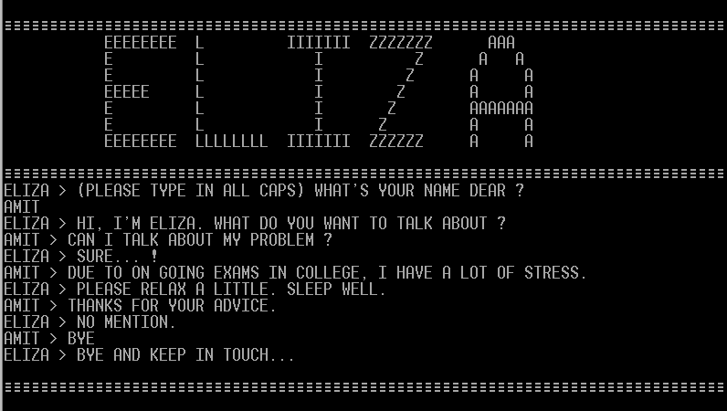
Notes:
Eliza (1966) – parodies a therapist, largely by rephrasing many of the patient's statements as questions
Global market reach $88.3million in 2016. $1billion thru 2023

Slide 6
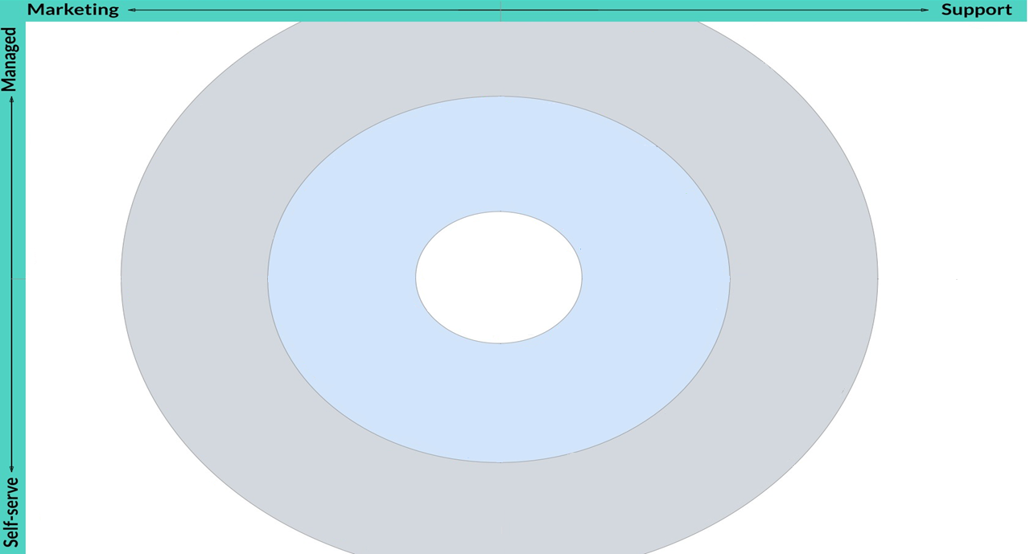
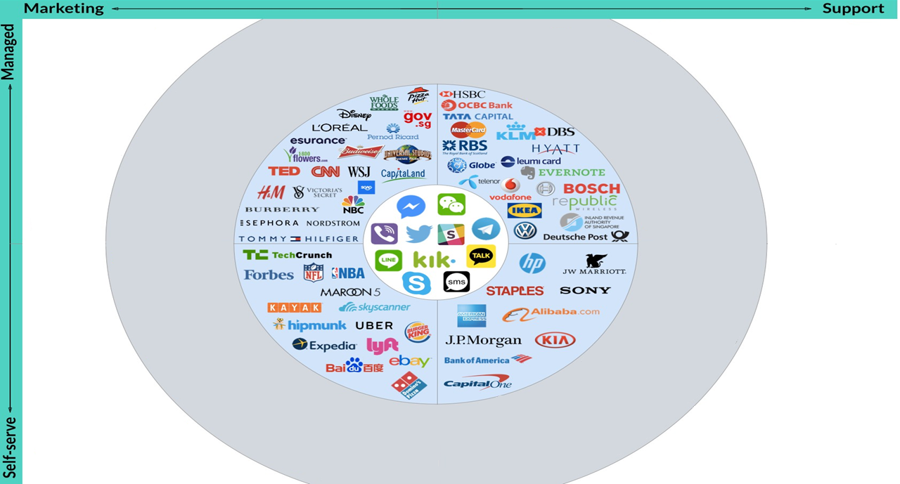
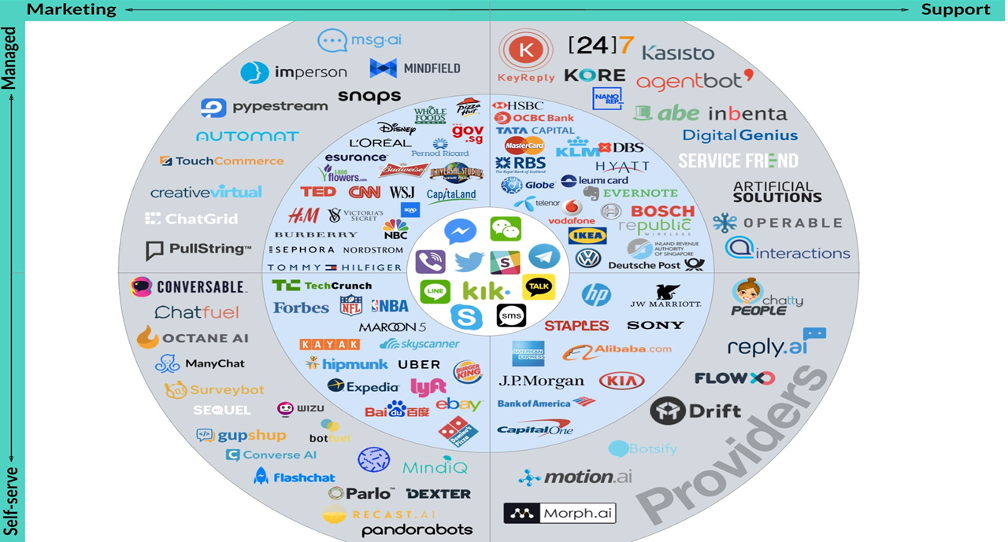
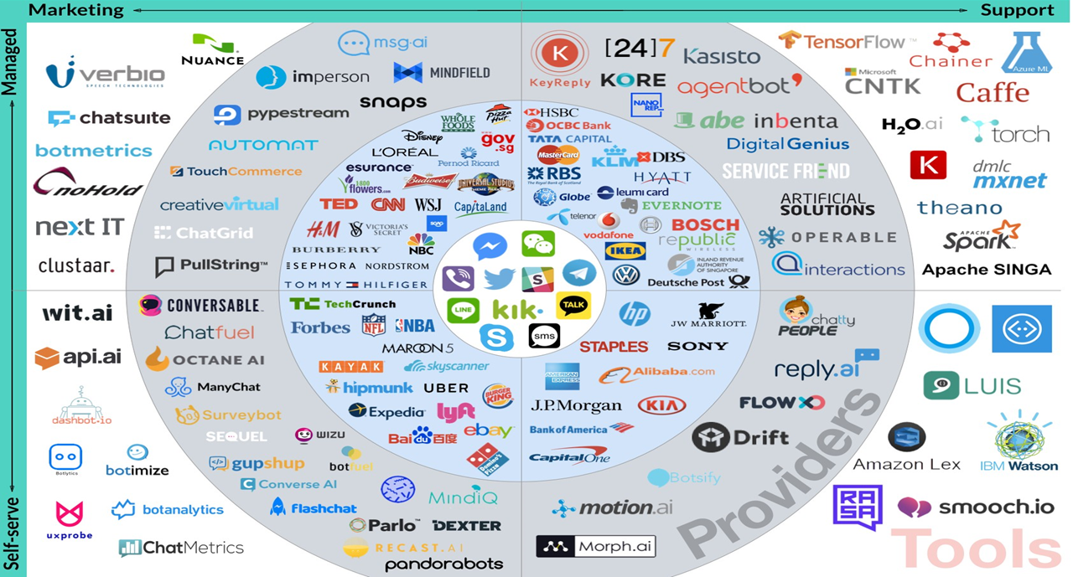
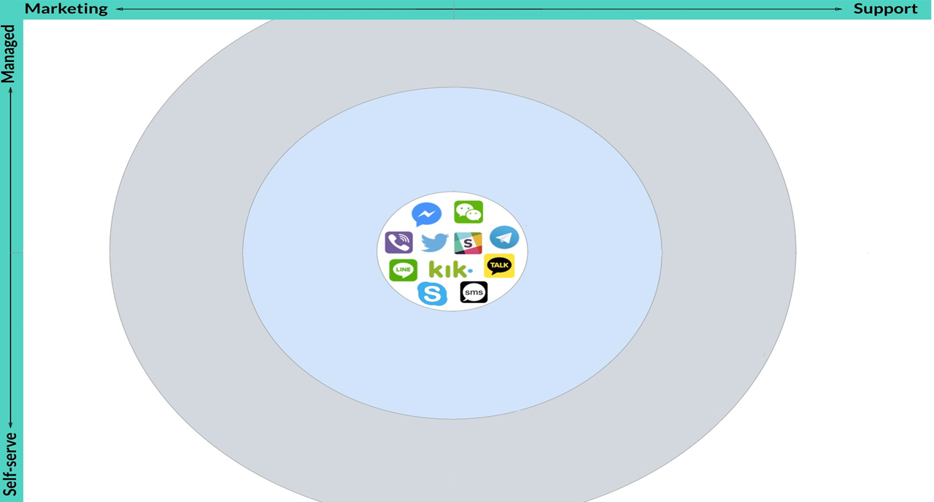
*credit KeyReply
Notes:
Anna - IKEA bot (2005) – covers 120.000 individual products and can reply to personal questions
Kindred (2016) – speech enabled app streams over 30,000 live events a year. Using Natural Language Processing players can place bets
www.chatbots.org

Slide 7
Agenda
Chatbot and the Human
INPUT

Slide 8
Agenda
Chatbot and the Human
Book 2 tickets to watch Star Wars tomorrow at 1pm at ODEON Whiteleys
Pattern Matching
Intent Classification
Notes:
Two techniques to understand the input. Pattern Matching and Intent Classification

Slide 9
Agenda
Chatbot and the Human – Pattern Matching
Book 2 tickets to watch Star Wars tomorrow at 1pm at ODEON Whiteleys
Notes:
Pattern Matching list of possible input patterns

Slide 10
Agenda
Chatbot and the Human – Pattern Matching
Book <number> tickets to see <movie> <datetime> at <location>
Notes:
Patterns are read by the humans and the modelling phase is easy

Slide 11
Agenda
Chatbot and the Human – Intent Classification
Book 2 tickets to see Star Wars tomorrow at 1pm at ODEON Whiteleys
Notes:
Relies upon machine learning techniques.
Need a set of examples to train a classifier that will choose the best matching intent

Slide 12
Agenda
Chatbot and the Human – Intent Classification
<book movie tickets>

Slide 13
Agenda
Chatbot and the Human
RESPONSE

Slide 14
Agenda
Chatbot and the Human – Response
Static Responses
Your reservation for Star Wars: The Last Jedi is confirmed
Dynamic Responses
How many tickets you want to book?
What is the movie you want to see?
Generated Responses
Notes:
Dynamic responses – use knowledge base to get the list of potential responses and score them
Millions of examples, it uses deep learning technique to train a generative model. Still ongoing research

Slide 15
Agenda
Chatbot and the Human
CONTEXT

Slide 16
Agenda
Chatbot and the Human – Context
How many tickets are still available for Star Wars?
Notes:
Current input is not enough to give a correct answer.
Each bot has to model its own notion of context

Slide 17
Agenda
Chatbot and the Human
PLATFORMS

Slide 18
Agenda
Chatbot and the Human – Platforms
No programming platforms
Chatfuel
ManyChat
Conversational platforms
Pandorabots
Platforms backed by tech giants
LUIS (Microsoft)
API.ai (Google)
Watson (IBM)
Wit.ai (Facebook)
Lex (Amazon)
Notes:
1 – No programming skills needed, NLP or ML expertise
2 – Platforms use Artificial Intelligence Markup Languages to model the interactions
3 – Already represent a standard
http://www.dailymail.co.uk/sciencetech/article-4620654/Facebook-accidentally-invents-new-machine-language.html

Slide 19
Agenda
Agenda
Chatbot and the Human
Azure Bot Service
Language Understanding Intelligent Service (LUIS)
QnA Maker Service
Demo

Slide 20
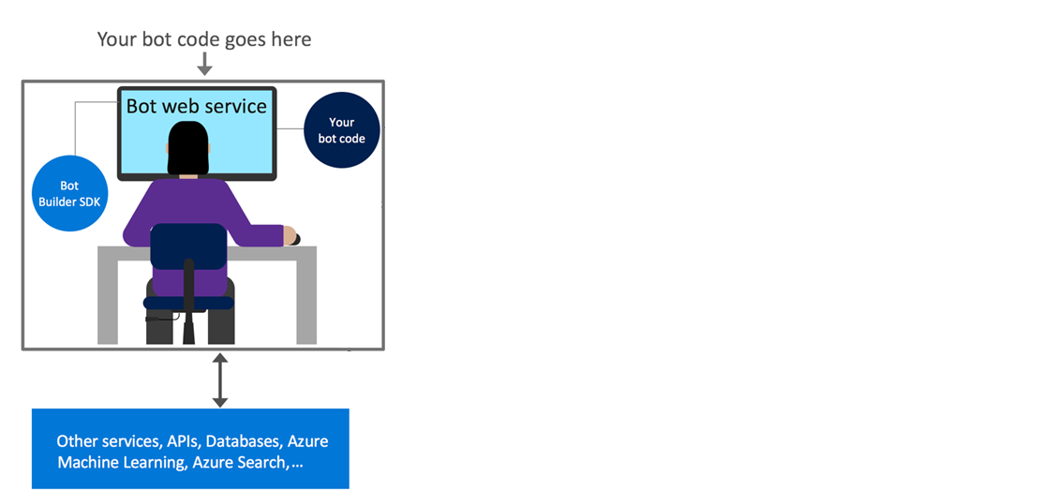
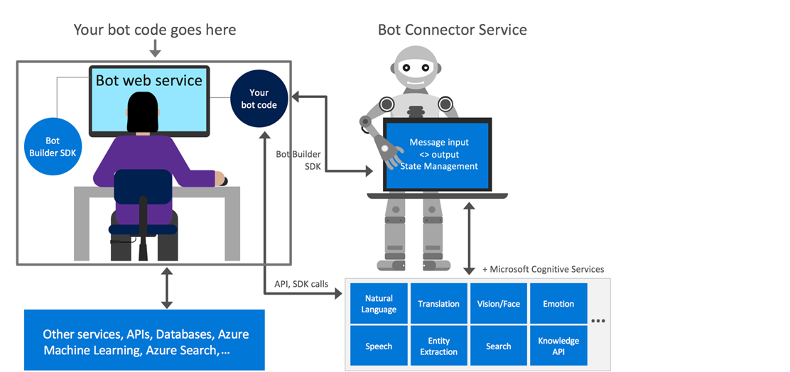
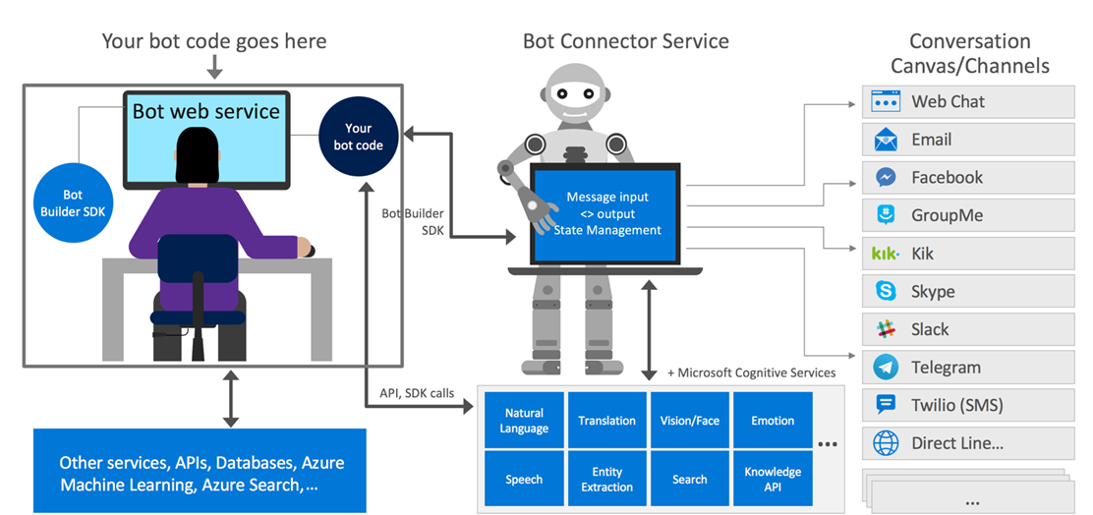
Azure Bot Service
*credit Microsoft
Notes:
Azure Bot Service went to GA in December and will replace the previous Bot Framework dashboard.
Cloud hosted bot platform. Host bots with serverless compute resources
https://docs.microsoft.com/en-us/bot-framework/bot-service-overview-introduction

Slide 21
Agenda
Agenda
Chatbot and the Human
Azure Bot Service
Language Understanding Intelligent Service (LUIS)
QnA Maker Service
Demo

Slide 22
Agenda
Language Understanding Intelligent Service (LUIS)
Helps your bot understand what the users are saying
A couple of examples are enough to deploy an application
Active Learning
Define Model
Provide Examples
Deploy Active Learning
Notes:
Luis is the teacher of our bots
The output of LUIS is a web service with an http endpoint that we reference from our app to add natural language understanding
Went to GA in December

Slide 23
Agenda
LUIS – Key Concepts
Utterance
Book 2 tickets to see Star Wars tomorrow at 1pm at ODEON Whiteleys
Intents
Book Tickets
Entities
Number, movie, datetime and location
Notes:
Uterance is the textual input the user enters
Intents are like verbs from the sentence. It represents actions the user wants to perform. It’s the end goal
Entities are nouns

Slide 24
Agenda
Agenda
Chatbot and the Human
Azure Bot Service
Language Understanding Intelligent Service (LUIS)
QnA Maker Service
Demo
Notes:
The result is an endpoint which takes a query and returns a json response containing the matching content
Can also embed your QnA bot directly into a web page using the hosted html endpoint

Slide 25
Agenda
Agenda
Chatbot and the Human
Azure Bot Service
Language Understanding Intelligent Service (LUIS)
QnA Service
Demo

Slide 26
Agenda
Demo
Integration with LUIS
Good Manners (BestMatchDialog NuGet)
Hero/ Receipt Cards
Logic App
Text to Speech

Slide 27
Agenda
Chatbots for Dummies
Just like Jimi Hendrix …
We love to get feedback
Please complete the session feedback forms

Slide 28
Agenda
Chatbots for Dummies
SQLBits - It's all about the community...
Please visit Community Corner, we are trying this year to get more people to learn about the SQL Community, equally if you would be happy to visit the community corner we’d really appreciate it.

