Slide 1
The
Geospatial
Shapes
of
Things to Come
SQLBits - The 7 Wonders of SQL
Simon Munro – EMC Consulting
simonmunro.com

Slide 2
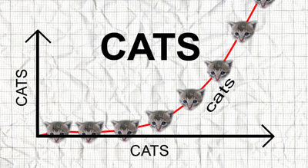
rathergood.com – the internet is made of cats

Slide 3
Spatial Ubiquity
People who don’t have problems with location privacy
Old people
Johnathan Ross and Stephen Fry

Slide 4
Spatial Data Skills
Spatial Data and GIS Experts
SQL Server Experts
MS SQL Spatial Employees

Slide 5
The Geography Spatial Datatype
Point
Polygon
Latitude
Altitude
Distance from Start
Projection
Accuracy
Bearing
Longitude

Slide 6
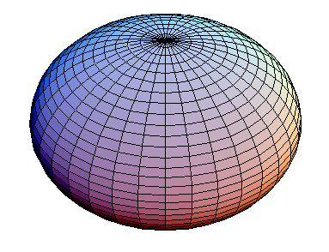
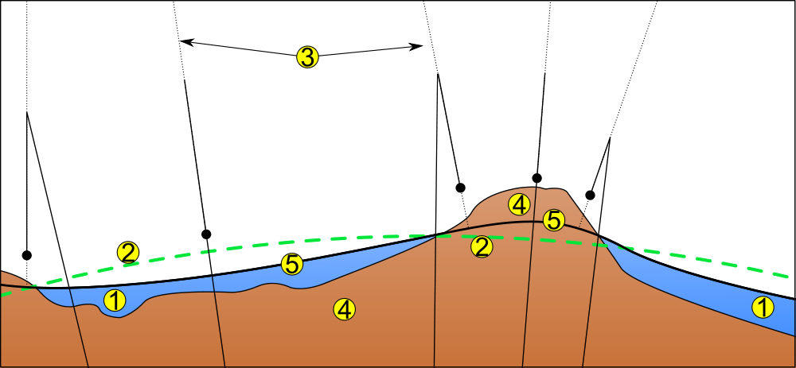
Spheroids, Ellipsoids & Geoids

Slide 7
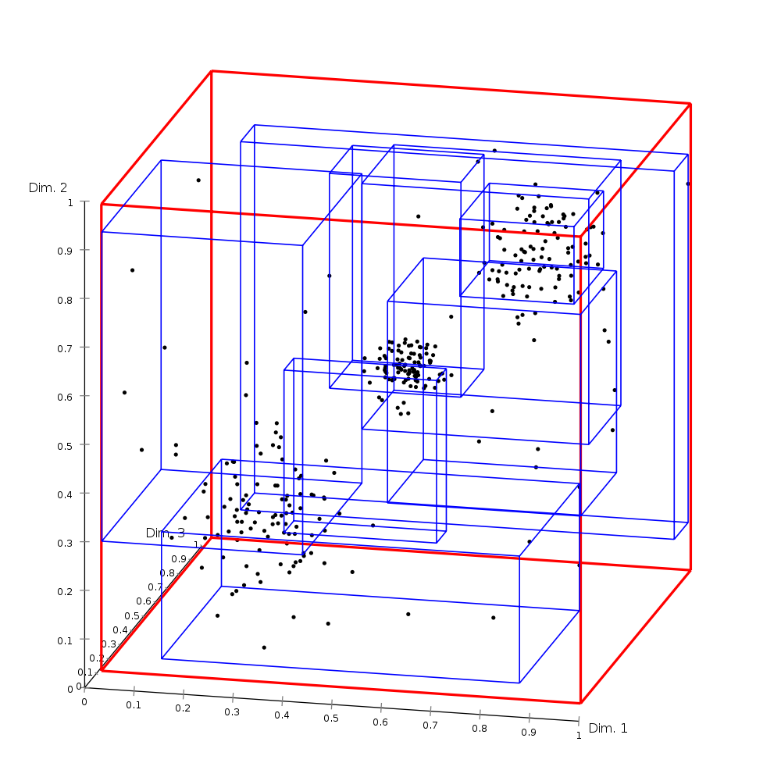
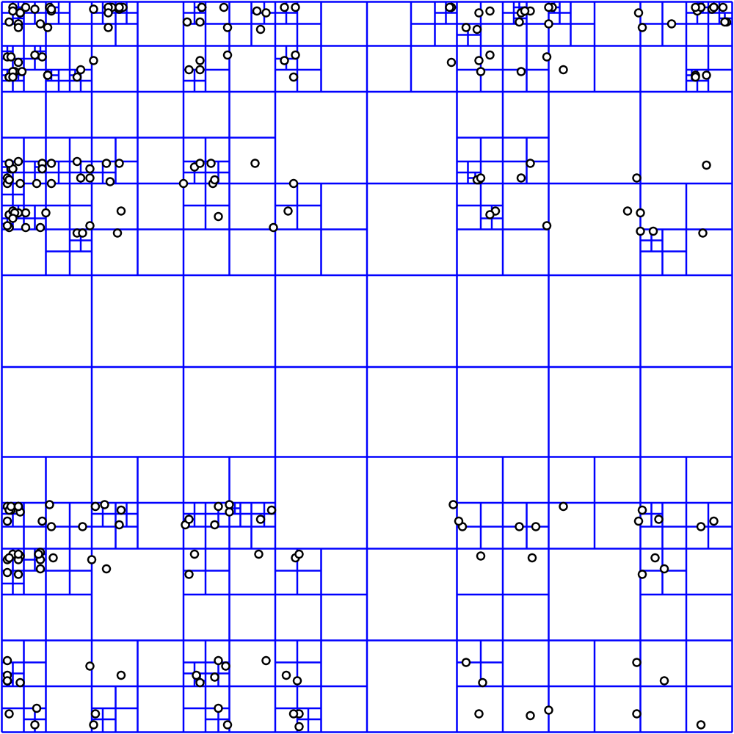
Spatial Indexes
Quadtree
RTree

Slide 8
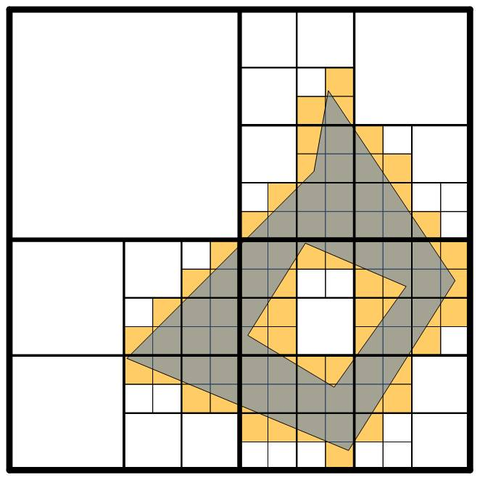
Spatial Indexes
4 level quad grid
(As used in SQL Server)
(Isaac Kunen)

Slide 9
Geocoding
Lookup a geographic coordinate from :
Existing geographic scheme
Place Name
Advert?
Individual Location?

Slide 10
Microsoft and Spatial Data
SQL Server
No standalone spatial
indexing services
Report Builder
No support in
Entity Framework
Bing
Maps
No native .NET
class library
Map Control
No support in SSIS
for spatial
Geocoding

Slide 11
SQL Server as a Spatial Tool
Storage
Persisted
Spatial Indexes
Updatable
Combination of spatial and
transactional data
Lower TCO than traditional GIS
Close to BI environment

Slide 12
SQL Server as a Spatial Tool
Bottleneck
May couple with transactional
data too tightly
Incomplete feature set
String conversions in T-SQL

Slide 13
What does this mean to me?
No app developer tools
(or interest)
BI bigger than UI
(for now)
SQL is good enough
Spatial data will be added
to existing schemas

Slide 14
Lets look at it a bit

Slide 15
Aggregating Spatial Data
What do we GROUP BY?
political
geographic
postal
grid
Correct?
Relevant?
Transferable?

Slide 16
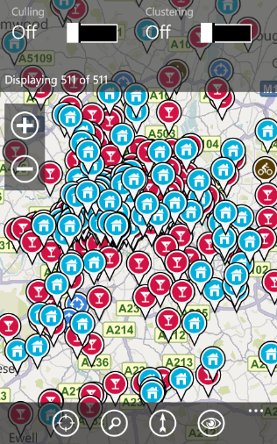
An Arbitrary Grouping Grid
1
Determine the grid
2
Convert grid into geospatial polygons
90°
0°
180°
-90°

Slide 17
Culling Spatial Data
Remove less relevant points

Slide 18
Culling inside a polygon
All Points
Ranked Points
Top3 Points
Map Tile 111
11
Map Tile 111
Map Tile 111
4
1
1
9
5
2
2
7
10
3
3
6
8
12

Slide 19
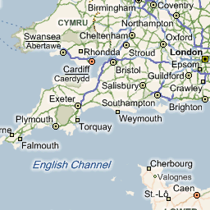
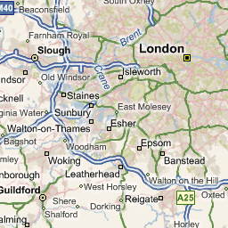
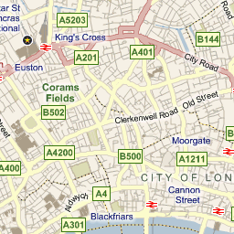
Bing Maps Quadkeys
ZoomLevel = 6, Quadkey = 031313
http://ecn.t3.tiles.virtualearth.net/tiles/r031313.jpeg?g=563&mkt=en-gb&n=z
ZoomLevel = 9, Quadkey = 031313131
http://ecn.t3.tiles.virtualearth.net/tiles/r031313131.jpeg?g=563&mkt=en-gb&n=z
ZoomLevel = 13, Quadkey = 0313131311123
http://ecn.t3.tiles.virtualearth.net/tiles/r0313131311123.jpeg?g=563&mkt=en-gb&n=z

Slide 20
Links
Busses in Chicago
Marine Traffic
Prime Meridian at the O2
Antonin Guttman (84): R-Trees - A Dynamic Index Structure for Spatial Searching
Howard’s GB Postcode Data
Spatial Functions (Javascript)
Aviation Formulas
How to convert OS Grid References
Bing Maps Tile System
Isaac Kunen - Basic Multi-Level Grids

Slide 21
Are you in shape?

