Slide 1
Continuous Integration and the Data Warehouse
Dr. John Tunnicliffe Decision Analytics
Independent BI Architect & Hands-On Developer
Email: john@bovi.co.uk
UK: +44 7771 818770
NL: +31 6387 28139
Blog: http://sqlblogcasts.com/blogs/drjohn/

Slide 2
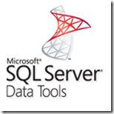
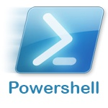
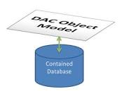
Agenda
What is CI?
SQL Server Data Tools (SSDT)
TeamCity Build Server
PowerShell and psake build tools
Nbi Test framework
SSDT and T4 Templates

Slide 3
Two approaches to SQL database development
Migration Scripts
Declarative Model
Manually prepare upgrade scripts
Must be run in correct order
Scripts are combination of DDL and data fixes
Manual deployment
Define what we want
Tool creates migration scripts
Still need data fixes
Automated deployments

Slide 4
Hands up
Who has entire BI solution under source code control?
Including SQL databases, all SSIS packages, all SSAS cubes
SSDT and the declarative model approach?
Who already uses CI in a data warehouse context?
Does CI also deploy & test your code?

Slide 5
What is Continuous Integration?
Continuous Integration is a development practice that requires developers to integrate code into a shared repository several times a day.
Each check-in is verified by an automated build, deploy and test cycle which allows errors to be detected and thereby corrected quickly.

Slide 6
Benefits of Continuous Integration
Eradication of manual integrations and deployments
Catches issues fast
Reduces production & staging errors
Automated testing provides quality assurance
CI allows developers to proceed with confidence
CI provides reporting on quality of the code base
Facilitates Continuous Delivery
CI accelerates delivery of a
quality, tested system
to the business

Slide 7
Applying CI to the Data Warehouse Why is it so difficult?
BI developers are not familiar with CI
Never seen it in action in a DWH context
Not familiar with the tools and techniques
Cannot comprehend how it can be applied
Data is a BIG barrier
PROD data is different to DEV
Problems often only manifest themselves in PROD data
Time taken to load data
Perception: it is hard to do
“My DWH is too complex!”

Slide 8
Data Warehouse
Project started 2010
SQL 2008 R2 – tools & techniques have remained static
Various “initiatives” have resulted in a confused data architecture
Three competing data streams and lots of data marts
Overly complicated and complex!
100,000 files in the code-base!
14 database, 200 SSIS packages, 4 multidimensional cubes
7 developers, 4 testers, 3 BAs, 1 S2T, 1 DBA, 1 PM
Each database had 2 VSDT projects – split “storage” and “code”
Configuration scattered across code base
Manual build and very manual deploy – 1 guy, 4 days per month!
Each production release was getting longer, complex and error prone!

Slide 9
Data Warehouse
Imported all databases into SQL Server Data Tools
New SCC repository with simplified structure: only 8,900 files
PowerShell script written to do local build & deployment
Development tools
Visual Studio 2013 for SQL Server Data Tools (SSDT)
Visual Studio 2008 for SSIS and SSAS (servers still SQL 2008R2)
TeamCity build server
Creates single Nuget package containing all 14 databases, 200+ SSIS package and SSAS cubes plus deployment scripts
Automatically deploys and tests everything
Automatic deployment to test, UAT and other environments!

Slide 10
Key Considerations for CI
Deployable artifacts
What is generated from the code that I can deploy?
Deployment
How do I deploy the artifact?
Configuration
How can I set up the environment so that everything works?
Configuration is King!

Slide 11
Tools and techniques for CI Source Code Control (SCC)
ALL code MUST be under Source Code Control
SQL Server, SSIS, BIML, SSAS, SSRS, Test Suites etc. etc.
Recommend Using Three Branches
Development branch
Release branch
Prod branch
SCC Locking strategy:
Use optimistic locking for SQL, C#
Use pessimistic locking for SSIS, SSAS and SSRS

Slide 12
SQL Server Data Tools
Declarative model design environment for SQL Server
Requires Visual Studio 2012+
Supports SQL Server 2005+
Very easy to import an existing database
Must replace hard-coded database names with variables
Add references to other databases and setup SQLCmd variables
Don’t upgrade VSDT projects
Instead start a new SSDT project and import a deployed database instance
Then transfer over pre- and post-deploy scripts

Slide 13
SQL Server Data Tools

Slide 14
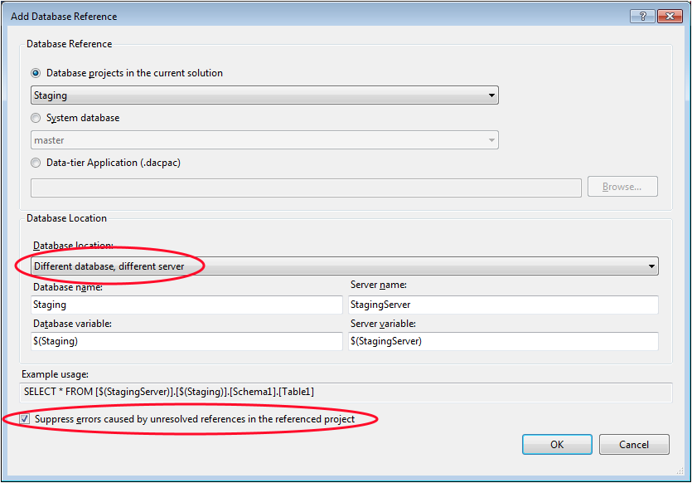
SQL Server Data Tools Adding a Database Reference

Slide 15
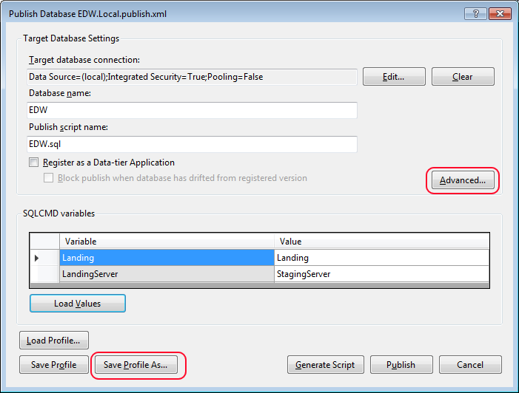
SQL Server Data Tools Publishing your database

Slide 16
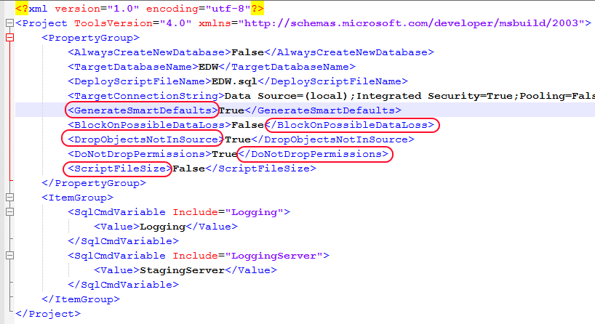
SQL Server Data Tools DAC Publish Profile

Slide 17
SQL Server Data Tools
Build generates a DACPAC => “deployable artifact”
Contains entire database model
Conforms to Open Packaging Convention = ZIP file!
Use MsBuild to create DACPAC from solutions
Use SQLPackage.exe to deploy DACPAC

Slide 18
The many actions of SQLPackage.exe
Publish
Deploys a DACPAC
Script
Generates a T-SQL deployment script from a DACPAC
Extract
Creates a DACPAC from a database
Export
Creates a BACPAC
Import
Imports a BACPAC
DeployReport
List of changes new deploy will make
DriftReport
List of changes since last deploy

Slide 19
Architecture

Slide 20
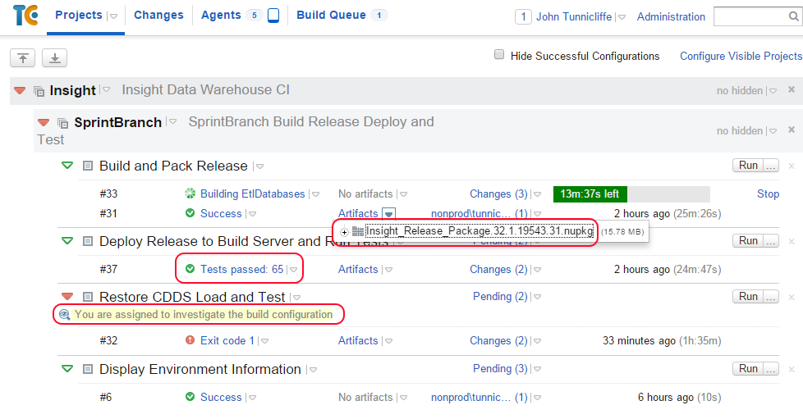
Projects

Slide 21
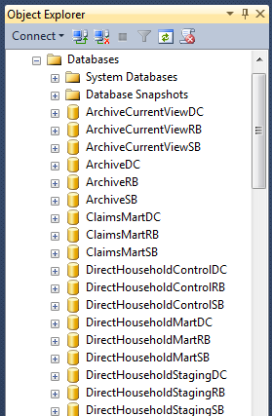
Workflow
Build Release Pack – Nuget package containing
SQL databases, SSIS packages, SSAS cubes, etc.
Deploy Release Pack to Build Server
Run post-deployment tests
Unit tests on stored procs, functions, triggers
Check database model, cube model, defaults
Restore Cut-Down dataset and Load
Execute SSIS Packages / Load Cube
Run Post-Load Tests
Reconcile SSAS cube with SQL database
Regression tests
Fixed data set data checks

Slide 22
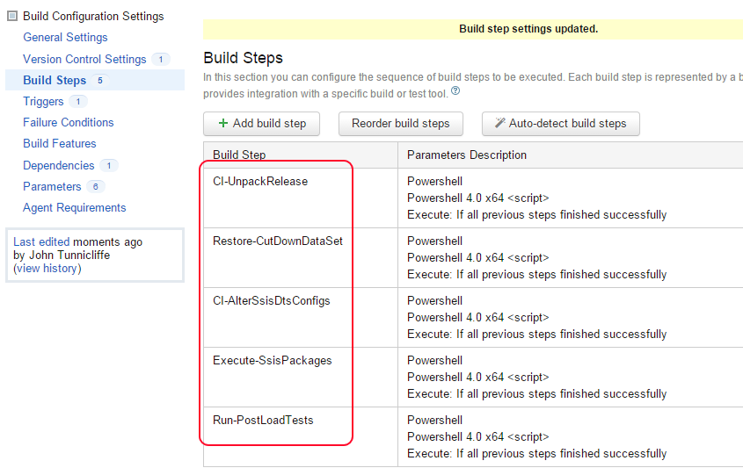
Build Configuration

Slide 23
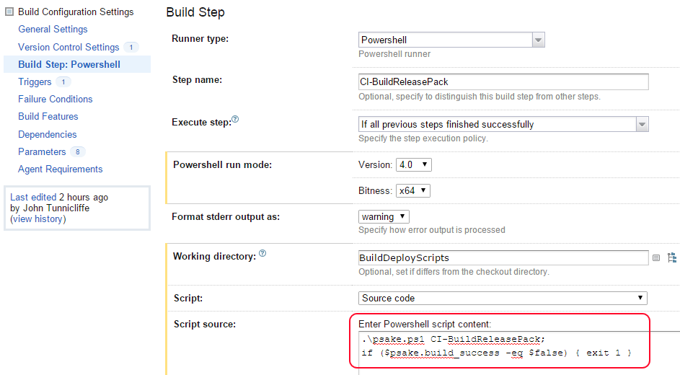
Build Step

Slide 24
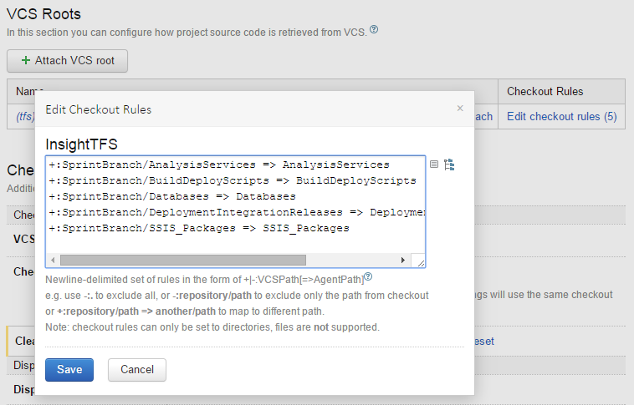
Version Control Settings

Slide 25
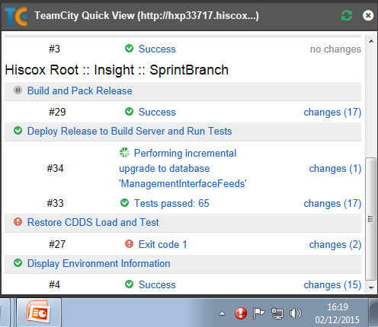
Notifier
Tray icon
Notifies developers of broken builds
Pops up dialog
Links to TeamCity web site

Slide 26
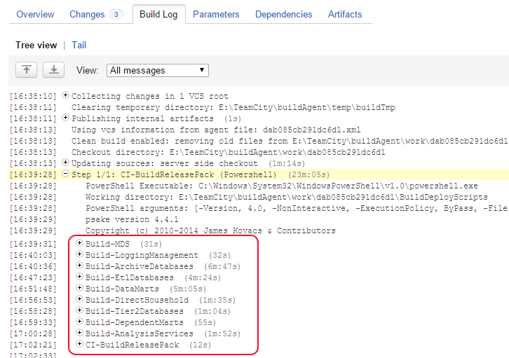
Build Log

Slide 27
PowerShell
PowerShell is the “glue” for your CI project
Part of Windows Management Framework
4.0 built into Windows Server 2012 R2 and Windows 8.1
Download and install WMF 4.0 for prior OS versions
Advanced scripting
Proper error handling Try-Catch
Easy to read/write XML
Ideal for dynamically generation of config files
CmdLets
Invoke-SQLCmd
Invoke-ASCmd & SQLAS

Slide 28
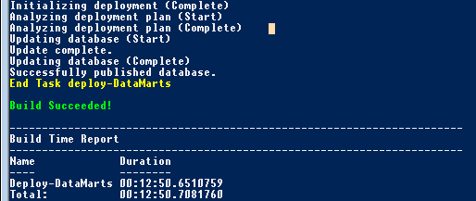
psake
Task-orientated build tool written in PowerShell
Uses a dependency pattern similar to MSBuild or Make
Download from https://github.com/psake/psake
Build script consist of Tasks
Each task can depend on other tasks

Slide 29
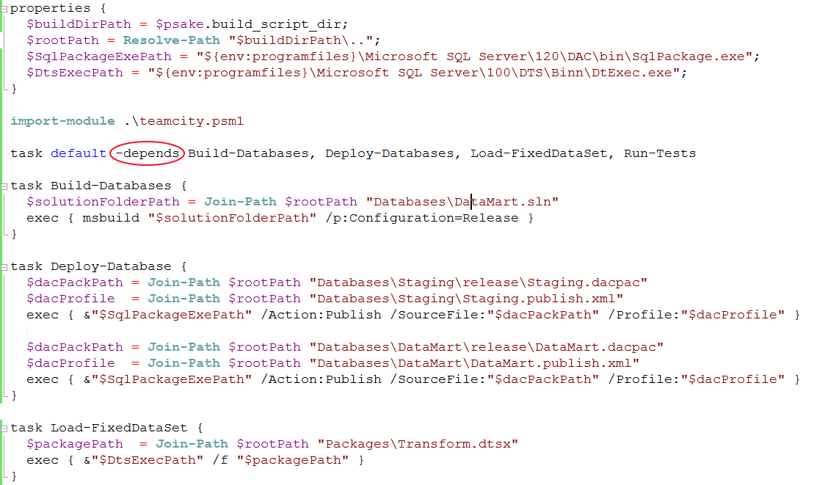
Tools and techniques for CI psake

Slide 30
PowerShell Where to Start
Create a DeployConfig.xml file
Describes your server environment
Maps databases to servers, solutions to databases
Develop PowerShell functions to read config file
Dynamically build SQLCmd variables to pass into:
DAC Publish profiles
Invoke-SQLCmd
Post-Load Data Fix Scripts
User permission scripts
SSIS Configurations / SQL Agent Jobs
Dynamically create Nuget spec XML
Package your build

Slide 31
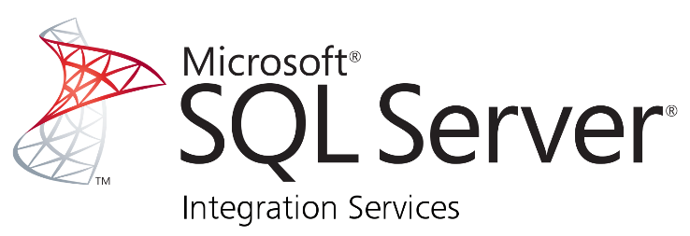
Tools and techniques for CI SSIS Artifacts
File Mode Deployment (pre-2012)
Build does nothing useful!
SSIS package => “deployable artifact”
Deployment simply copies packages into target location
File Mode Configuration
Update Package Configurations using PowerShell to:
Update XML config
Set SQLCmd variables and run a SQLCmd script which updates the SSIS configuration table

Slide 32
Tools and techniques for CI SSIS Artifacts
Project Mode Deployment (SQL Server 2012+)
Build generates an ISPAC => “deployable artifact”
Use IsDeploymentWizard.exe to deploy the packages
Project Mode Configuration
Use SSISDB catalog stored procedures to:
Create Projects & Folders
Create Environments & Variables
etc.
Run as SQLCmd script from PowerShell

Slide 33
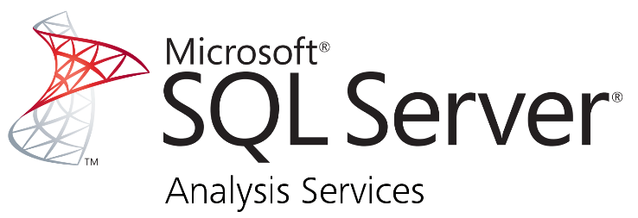
SSAS Artifacts
Build
Cannot be done with MsBuild!
Must invoke Visual Studio (devenv.exe) to perform build
Windows EXE => so pipe to Out-Null to force PowerShell to wait
Generates a .AsDatabase file => “deployable artifact”
Deploy
Microsoft.AnalysisServices.Deployment.exe /s
PowerShell to generate XML config files defining target server etc.
Windows EXE => so pipe to Out-Null to force PowerShell to wait
SSAS Partition Manager
Deploys using AMO and also dynamically creates partitions
SsasPartitionManager.codeplex.com

Slide 34
NBi Test Suite
Open source framework to test your BI solutions
Tests run using NUnit GUI or command-line runner
Tests written in XML
Can be dynamically manipulated using PowerShell
Automatic generation of tests via:
Tools provided with NBi suite – GenBI and GenBIL
SELECT … FOR XML
PowerShell etc.
Run SQL, MDX and DAX queries
Extract queries from SSRS reports
Run SSIS packages and check “side effects”
Check model structure

Slide 35
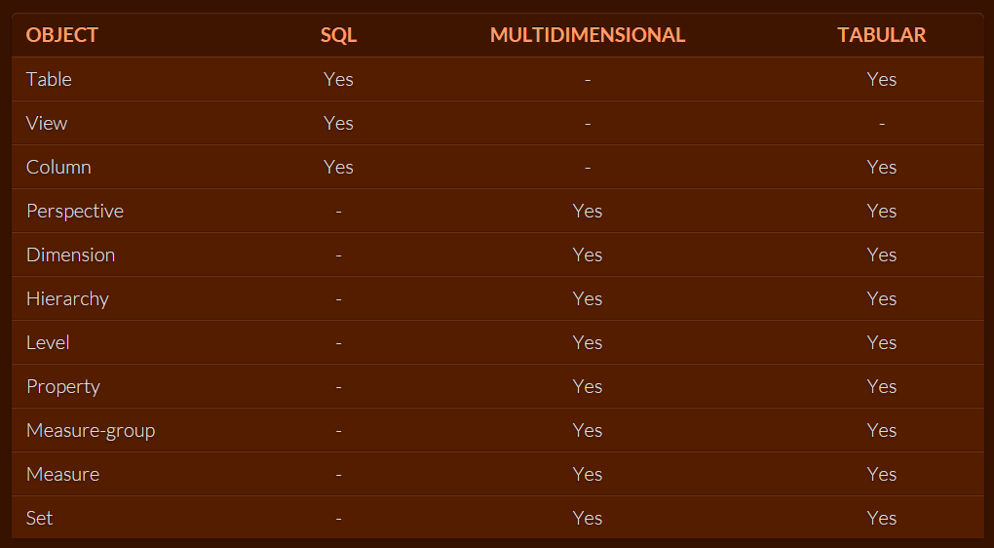
NBi Test Suite
Extensive support for testing the model structure

Slide 36
NBi Test Suite
Compare results of a query
Static data set
CSV
Results of another query
Check datatypes, nulls, empty strings, format etc.
Apply tolerance and rounding
Validate SQL query syntax
Performance tests
Clear the cache in test setup
Check cube member count, ordering, existence etc.

Slide 37
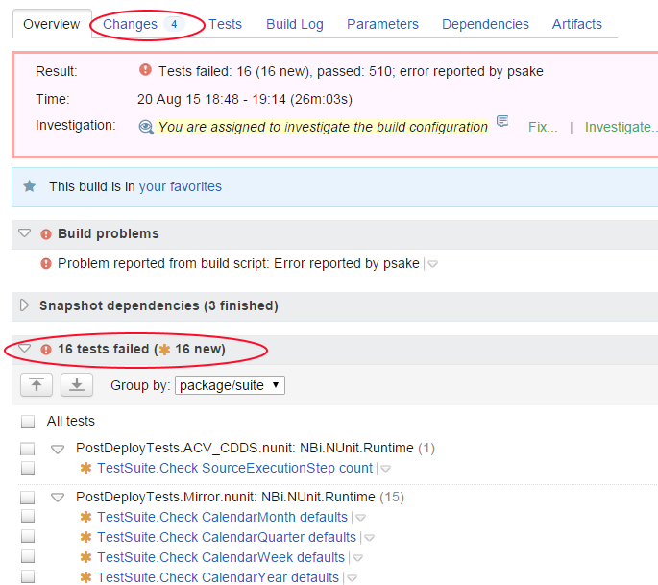
Failing Tests

Slide 38
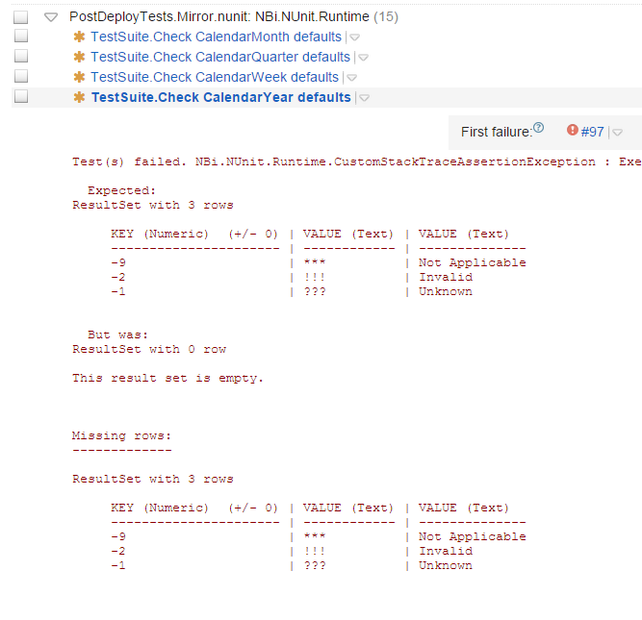
Failed Test

Slide 39
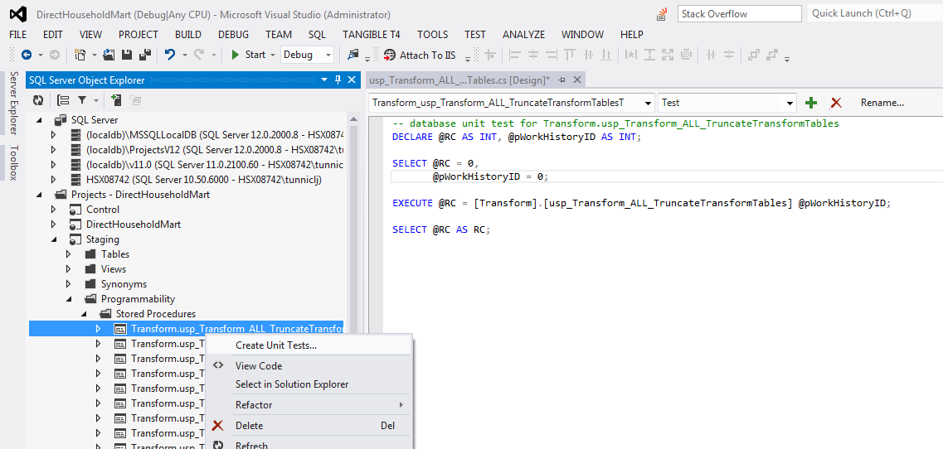
Unit Testing with SSDT
Add a Unit Test C# project to your SSDT solution

Slide 40
Code Analysis with SSDT
T-SQL Design Issues
Checks for code that might not behave the way you expect
Deprecated syntax
Issues that could cause problems in the design
T-SQL Naming Issues
Naming issues arise when a database object violates generally accepted conventions
T-SQL Performance Issues
Code that might noticeably reduce speed of database operations
Extensible model
Write your own Code Analysis

Slide 41
Top tips to using SSDT & CI
No User Permissions
Database roles only
Assign Windows Groups to Roles in a post-deploy script
Don’t deploy SQL Agent Jobs to CI server
Use PowerShell to call the commands instead
Hold SSIS configuration scripts outside SSDT
Hold pre- and post-deploy data fix scripts external to SSDT in a “release” folder

Slide 42
SSDT + T4 Templates
T4 = Text Template Transformation Toolkit
Built into Visual Studio 2005+
Code generation tool – creates code from code
Not well documented – because it is SOOO simple!
Typical examples show C# or HTML generation
Example: History tables and triggers
Old data should be written to a history table every time an update done to the main table
Problem: 200 main tables = 200 history tables + 200 triggers

Slide 43
SSDT + T4 Templates
Three ways you could implement T4 Templates
Use ADO.NET to query catalog views on a materialized (deployed) copy of the database
Use the Data-tier Application Framework (DACFx) to query the content of the DACPAC generated by SSDT on your last build
Use the Data-tier Application Framework (DACFx) to query the in-memory content of your SSDT project
Very few examples
Download my toolkit from t4dacfx2tsql.codeplex.com
Read my blog on http://sqlblogcasts.com/blogs/drjohn/

Slide 44
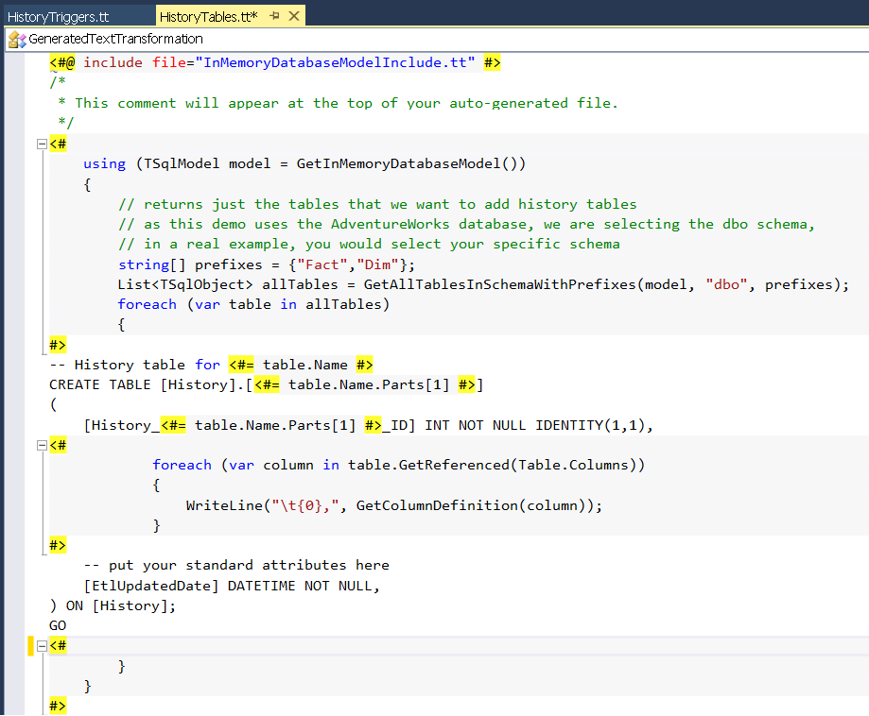
Download my toolkit from t4dacfx2tsql.codeplex.com

Slide 45
What we covered
What is CI?
SQL Server Data Tools (SSDT)
TeamCity Build Server
PowerShell and psake build tools
Nbi Test framework
SSDT and T4 Templates

Slide 46
Continuous Integration and the Data Warehouse
Dr. John Tunnicliffe Decision Analytics
Independent BI Architect & Hands-On Developer
Email: john@bovi.co.uk
UK: +44 7771 818770
NL: +31 6387 28139
Blog: http://sqlblogcasts.com/blogs/drjohn/

