Slide 1
Extreme Scaling with SQL Azure
SQL Bits 7, York, October 2010
Martin Schmidt – Miracle A/S
Denmark

Slide 2
Subtitle: The Safetrack story

Slide 3
Agenda
Speaker Info
Safetrack facts & system info
Safetrack architecture
Database design
Issues with current setup
The Azure platform
Sharding
Solution Walkthrough
Moving Exsisting Data to SQL Azure

Slide 4
Speaker info
Name: Martin Schmidt
Email: msc@miracleas.dk
Blog: www.performanceduo.com
Twitter: @ms1333

Slide 5
Agenda
Speaker Info
Safetrack facts & system info
Safetrack architecture
Database design
Issues with current setup
The Azure platform
Sharding
Solution Walkthrough
Moving Exsisting Data to SQL Azure

Slide 6
Safetrack facts
Danish Company – started 2005
GPS tracking of trucks and excavators
Started out as an insurance service against theft
Today: A complete platform for fleet management
Tracks more than 25.000 units
Website: http://www.safetrack.dk

Slide 7
Unit Types

Slide 11
How does this Work?

Slide 12
How does this Work
All units are equipped with a GPS transmitter
Sends binary packages over GPRS
Built-in SIM card
Sends a package every 2 min when running
Sends a package every 15 min when parked
Data is sent using UDP Protocol

Slide 13
ME - 301
Length = 75 mm
Width = 45 mm
Height = 18 mm

Slide 14
Package data
Reporttime
Longitude
Latitude
Speed
KM Status
Inputs status information
Is the lift up / down
Is the engine running
Timecounter info on inputs
For how long has the engine been running
How long has the lift been in use

Slide 15
Agenda
Speaker Info
Safetrack facts & system info
Safetrack architecture
Database design
Issues with current setup
The Azure platform
Sharding
Solution Walkthrough
Moving Exsisting Data to SQL Azure

Slide 16
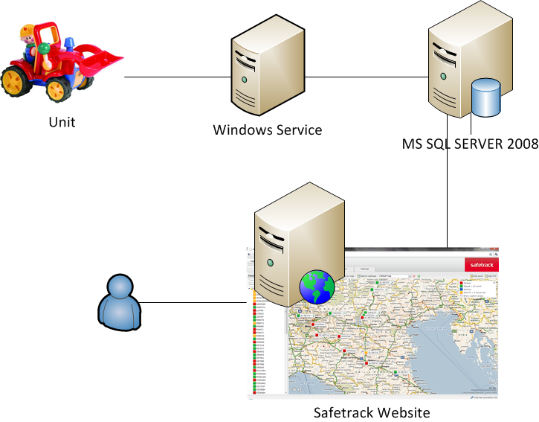
System Archietecture

Slide 17
Agenda
Speaker Info
Safetrack facts & system info
Safetrack architecture
Database design
Issues with current setup
The Azure platform
Sharding
Solution Walkthrough
Moving Exsisting Data to SQL Azure

Slide 18
Database Design

Slide 19
Agenda
Speaker Info
Safetrack facts & system info
Safetrack architecture
Database design
Issues with current setup
The Azure platform
Sharding
Solution Walkthrough
Moving Exsisting Data to SQL Azure

Slide 20
Issues ?
Database and application on same box
Everything runs on the same single server
Single Point of Failure
Hardware
Database
Services / Website
No HA solution
Limited scaling options (Buy bigger HW)

Slide 21
Issues ?
All elements are independend
Easy to split things
No ”secret” data
No personal or banking information
Not breaking the Danish data law

Slide 22
Issues ?
SQL Azure in the future?
Windows Azure in the future?
Why Not ☺

Slide 23
Agenda
Speaker Info
Safetrack facts & system info
Safetrack architecture
Database design
Issues with current setup
The Azure platform
Sharding
Solution Walkthrough
Moving Exsisting Data to SQL Azure

Slide 24
SQL Azure
High Availibity = Free
1 DB = 3 DB’s (automatic failover)
Size limitations
1 – 50 GB
Safetrack database > 250 GB ☹
Get the database off the current box
Release more power to the Windows service

Slide 25
SQL Azure
Let Microsoft be your primary DBA!
SQL Azure = Black boks
Running your database with other unknown applications

Slide 26
Windows Azure
Moving the website to Windows Azure
Easy peasy
The Windows Service is not compatible with Azure at present
No support for UDP – TCP Only ☹

Slide 27
SQL Azure
Lets move the database to the Cloud
Latency from the local Windows service to SQL Azure is not a big issue.
Size is a issue, we will have to Shard the data across multiple databases
Sharding gives us scalability

Slide 28
Agenda
Speaker Info
Safetrack facts & system info
Safetrack architecture
Database design
Issues with current setup
The Azure platform
Sharding
Solution Walkthrough
Moving Exsisting Data to SQL Azure

Slide 29
Sharding facts
Partition data across multiple databases
Each database holds a subset of the data
A query needs only to look in one database
Sharding is no silver bullet, you still need to think
Important to choose the correct sharding key
Try to avoid fan-out queries, if possible

Slide 30
Agenda
Speaker Info
Safetrack facts & system info
Safetrack architecture
Database design
Issues with current setup
The Azure platform
Sharding
Solution Walkthrough
Moving Exsisting Data to SQL Azure

Slide 31
Solution walkthrough
Shard key candidates
UnitID
CustomerID
The winner is:
CustomerID
All reports on the web front end is based on customerID. This gives the customer the option to se the status of all his units.

Slide 32
Data Syncronisation
MS Data sync Framework
Requires SQL Agent to do scheduling
SQL Azure Data Sync (Dev Preview)
The winner so far
We will have a look in a minute
Pretty Slow ☹
SQL Server Integration Services
Still no scheduler
Windows Azure worker role
We need to test this

Slide 33
Database Design

Slide 34
DEMO
Enough Power Pointing ☺

Slide 35
Agenda
Speaker Info
Safetrack facts & system info
Safetrack architecture
Database design
Issues with current setup
The Azure platform
Sharding
Solution Walkthrough
Moving Exsisting Data to SQL Azure

Slide 36
Loading data into Azure
Task: Load existing data into SQL Azure
265.000.000 Rows (ReportMessage)
150 GB
Possible solutions
BCP Utility
SSIS

Slide 37
Loading data into Azure

Slide 38
Loading data into Azure
Slow, poor performance
Still working on improving performance
Tested throughput (Laptop)
1000 Rows / sec

Slide 39
SQL Azure Ressources
SQL Azure webfrontend
http://sql.azure.com
SQL Azure Labs
http://www.sqlazurelabs.com
SQL Azure team Blog
http://blogs.msdn.com/b/sqlazure/

Slide 40
More Ressources
PerformanceDUO
http://www.performanceduo.com
Miracle A/S
http://www.miracleas.dk
MiracleDB
http://Miracledb.codeplex.com
Safetrack
http://www.safetrack.dk

Slide 41
Q & A
Questions?

Slide 42
Thank You ☺

Slide 43
Coming up…
P/X001
Understanding and Preventing SQL Injection Attacks
Kevin Kline
P/L001
SSIS Fieldnotes
Darren Green
P/L002
The (Geospatial) Shapes of Things to Come
Simon Munro
P/L005
End to End Master Data Management with SQL Server Master Data Services
Jeremy Kashel
P/T007
Understanding Microsoft Certification in SQL Server
Chris Testa-O'Neill
#SQLBITS

