Slide 1
Designing Highly Scalable OLTP Systems
Thomas Kejser
Senior Program Manager
Microsoft
Notes:
With the combination of Windows Server 2008 R2 and SQL Server 2008 R2 it has now become possible to run SQL Server on up to 256 Cores. Recently, the SQL CAT team had a customer in the lab to test a banking application at high scale-up. Previously, we had test runs for the same application on 32-cores – but now the time had come to stress the app to 128 Cores. In this session, I will talk about the lessons we learned from stress testing an OLTP workload at this scale. You will see some interesting bottlenecks and get an idea of what sort of numbers are achievable on a big SQL Server box. Of course, I will also provide you with the guidance on how to get those numbers.

Slide 2
Agenda
Windows Server 2008R2 and SQL Server 2008R2 improvements
Scale architecture
Customer Requirements
Hardware setup
Transaction log essentials
Getting the code right
Application Server Essentials
Database Design
Tuning Data Modification
UPDATE statements
INSERT statements
The problem with NUMA and what to do about it
Final results and Thoughts

Slide 3
Upping the Limits
Previous (before 2008R2) windows was limited to 64 cores
Kernel tuned for this config
With Windows Server 2008R2 this limit is now upped to 1024 Cores
New concept: Kernel Groups
A bit like NUMA, but an extra layer in the hierarchy
SQL Server generally follows suit – but for now, 256 Cores is limit on R2
Currently, largest x64 machine is 128 Cores
And largest IA-64 is 256 Hyperthread (at 128 Cores)

Slide 4
The Path to the Sockets
Windows OS
Hardware
NUMA 6
Kernel
Group 0
CPU
Socket
NUMA 0
NUMA 2
NUMA 4
NUMA 6
CPU Core
CPU Core
HT
HT
HT
HT
NUMA 1
NUMA 3
NUMA 5
NUMA 7
CPU
Socket
Kernel
Group 1
CPU Core
CPU Core
NUMA 8
NUMA 10
NUMA 12
NUMA 14
HT
HT
HT
HT
NUMA 9
NUMA 11
NUMA 13
NUMA 15
Kernel
Group 2
NUMA 6
NUMA 16
NUMA 18
NUMA 20
NUMA 22
CPU
Socket
NUMA 17
NUMA 19
NUMA 21
NUMA 23
CPU Core
CPU Core
HT
HT
HT
HT
Kernel
Group 3
NUMA 24
NUMA 26
NUMA 28
NUMA 30
CPU
Socket
CPU Core
CPU Core
NUMA 25
NUMA 27
NUMA 29
NUMA 31
HT
HT
HT
HT

Slide 5
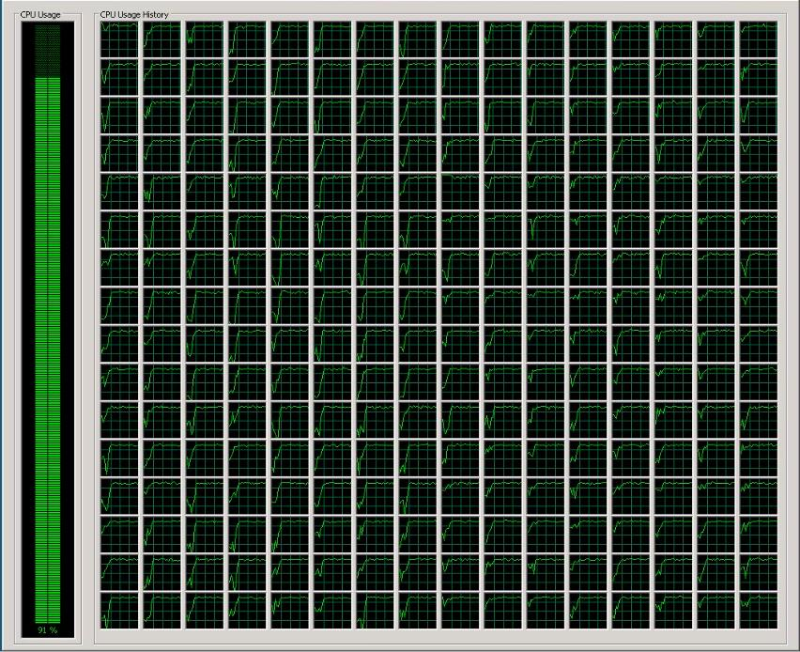
And it Looks Like This...

Slide 6
Customer Requirement
Building core banking application
Load simulation test harness
Credit Card transactions from ATM and Branches
Requirement: 10.000 Business Transactions / sec
Application Servers to be build in .NET 3.5

Slide 7
Hardware Setup – Database files
Database Files
# should be at least 25% of CPU threads
In our setup: 128 Data Files
There is no signficant point of diminishing returns up to 100% oif CPU threads
But manageability, is an issue...
Though Windows 2008R2 is much easier
TempDb
# files shoudl be exactly 100% of CPU Threads
Presize at 2 x Physical Memory
Data files and TempDb on same LUNs
It’s all random anyway
For our use: Dedicated XP24K SAN
Around 500 spindles in 128 LUN (RAID5)
No more than 4 HBA per LUN via MPIO
Key Takeaway: Script it! At this scale, manual work WILL drive you insane
Notes:
There is a lot os scripts available to do this. Some of these can be had by mailing me your Live Account

Slide 8
Special Consideration: Transaction Log
Transaction log is a set of 32 linked buffers
Each buffer is 60KB
Multiple transactions can fit in one buffer
BUT: Buffer must flush before log manager can signal a commit OK
Transaction log through was only around 80MB/sec
But we consistently got <1ms latency, no spikes!
Initial Setup: 2 x HBA on dedicated storage port on RAID10 with 4+4
When tuning for peak: SSD on internal PCI bus (latency: a few µs)
Key Takeway: For Transaction Log, dedicate storage components and optimize for low latency

Slide 9
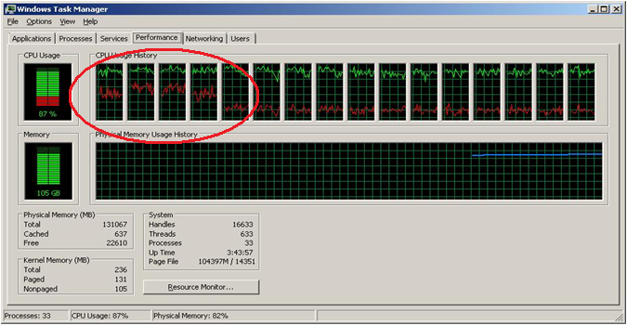
Network Cards – Rule of Thumb
At scale, network traffic will generate a LOT of interrupts for the CPU
These must be handled by CPU Cores
Must distribute packets to cores for processing
Rule of thumb (OTLP): 1 NIC / 16 Cores
Watch the DPC activity in Taskmanager
Remove SQL Server (with affinity mask) from the NIC cores

Slide 10
SQL Server Memory Setup
For large CPU/Memory box, Lock Pages in Memory really matters
We saw more than double performance
Use gpedit.msc to grant it to SQL Service account
Consider TF834 (Large page Allocations)
On Windows 2008R2 previous issues with this TF are fixed
Around 10% throughput increase
Beware of NUMA node memory distribution
Set max memory close to box max if dedicated box available
Notes:
Interestingly, the default configuration of the server is generally quite good. Even at very high scale there is not much additional work that can be done.
The closest you get to a magic: make SQL Server go faster traceflag is 834.

Slide 11
SQL Server Configuration Changes
As we increased number of connections to around 6000 (users had think time) we started seeing waits on THREADPOOL
Solution: increase sp_configure ‘max worker threads’
Probably don’t want to go higher than 4096
Gradually increase it, default max is 980
Avoid killing yourself in thread management – bottleneck is likely somewhere release
Use affinity mask to get rid of SQL Server for cores running NIC traffic
Well tuned, pure play OLTP
No need to consider parallel plans
Sp_configure ‘max degree of parallelism’, 1

Slide 12
Getting the Code Right
Designing Highly Scalable OLTP Systems

Slide 13
Remote Calling from WCF
Original client code: Synchronous calls in WCF
Each thread must wait for network latency before proceeding
Around 1ms waiting
Very similar to disk I/O – thread will fall asleep
Lots of sleeping threads
Limited to around 50 client simulations per machine
Instead, use IAsyncInterface
Notes:
Synchronous and Asynchronous Operations
http://msdn.microsoft.com/en-us/library/ms734701.aspx
How to: Implement an Asynchronous Service Operation
http://msdn.microsoft.com/en-us/library/ms731177.aspx
How to: Call WCF Service Operations Asynchronously
http://msdn.microsoft.com/en-us/library/ms730059.aspx

Slide 14
Things to Double Check
Connection pooling enabled?
How much connection memory are we using?
Monitor perfmon: MSSQL: Memory Manager
Obvious Memory or Handle leaks?
Check perfmon Process counters in perfmon for .NET app
Can the application handle the load?
Call into dummy procedures that do nothing
Check measured application throughput
Typical case: Application breaks before SQL

Slide 15
Database Schema – Credit Cards
UPDATE … SET Balance
UPDATE ..
SET LastTransaction_ID = @ID + 1
LastTransactionDate = GETDATE()
Account
INSERT .. VALUES (@amount)
INSERT .. VALUES (-1 * @amount)
Account_ID
LastUpdateDate
Balance
…
ATM
ID_ATM
ID_Branch
LastTransactionDate
LastTransaction_ID
…
Transaction
Transaction_ID
Customer_ID
ATM_ID
Account_ID
TransactionDate
Amount
…
10**5 rows
10**3 rows
10**10 rows
Notes:
In this slide I am trying to illustrate what it is that i ”see” when I look at a database schema that needs to run fast. There are certain concerns that I will immediately raise. If adressed early in the design process – they can save us a lot of trouble and code changes later.

Slide 16
Summary of Concerns
Transaction table is hot
Lots of INSERT
How to handle ID numbers?
Allocation structures in database
Account table must be
transactionally consistent with Transaction
Do I trust the developers to do this?
Cannot release lock until BOTH are in sync
What about latency of round trips for this
Potentially hot rows in Account
Are some accounts touched more than others
ATM Table has hot rows.
Each row on average touched at least ten times per second
E.g. 10**3 rows with 10**4 transactions/sec
ATM
ID_ATM
ID_Branch
LastTransactionDate
LastTransaction_ID
…
Transaction
Account
Account_ID
LastUpdateDate
Balance
…
Transaction_ID
Customer_ID
ATM_ID
Account_ID
TransactionDate
Amount
…

Slide 17
Tuning Data Modification
Designing Highly Scalable OLTP Systems

Slide 18
Generating a Unique ID
Why wont this work?
CREATE PROCEDURE GetID
@ID INT OUTPUT
@ATM_ID INT
AS
DECLARE @LastTransaction_ID INT
SELECT @LastTransaction_ID = LastTransaction_ID
FROM ATM
WHERE ATM_ID = @ATM_ID
SET @ID = @LastTransaction_ID + 1
UPDATE ATM
SET @LastTransaction_ID
WHERE ATM_ID = @ATM_ID

Slide 19
Concurrency is Fun
ATM
ID_ATM = 13
LastTransaction_ID = 42
…
SELECT @LastTransaction_ID = LastTransaction_ID
FROM ATM
WHERE ATM_ID = 13
SET @ID = @LastTransaction_ID + 1
UPDATE ATM
SET @LastTransaction_ID = @ID
WHERE ATM_ID = 13
(@LastTransaction_ID = 42)
SELECT @LastTransaction_ID = LastTransaction_ID
FROM ATM
WHERE ATM_ID = 13
SET @ID = @LastTransaction_ID + 1
UPDATE ATM
SET @LastTransaction_ID = @ID
WHERE ATM_ID = 13
(@LastTransaction_ID = 42)

Slide 20
Generating a Unique ID – The Right way
CREATE PROCEDURE GetID
@ID INT OUTPUT
@ATM_ID INT
AS
UPDATE ATM
SET LastTransaction_ID = @ID + 1
, @ID = LastTransaction_ID
WHERE ATM_ID = @ATM_ID
And it it is simple too...

Slide 21
Hot rows in ATM
Initial runs with a few hundred ATM shows excessive waits for LCK_M_U
Diagnosed in sys.dm_os_wait_stats
Drilling down to individual locks using sys.dm_tran_locks
Inventive readers may wish to use Xevents
Event objects: sqlserver.lock_acquired and sqlos.wait_info
Bucketize them
As concurrency increases, lock waits keep increasing
While throughput stays constant
Until...

Slide 22
Spinning around
Diagnosed using sys.dm_os_spinlock_stats
Pre SQL2008 this was DBCC SQLPERF(spinlockstats)
Can dig deeper using Xevents with sqlos.spinlock_backoff event
We are spinning for LOCK_HASH

Slide 23
LOCK_HASH – what is it?
More Threads
Lock Manager
ROW
LOCK_HASH
Thread
LCK_U
- Why not go to sleep?

Slide 24
Locking at Scale
Ratio between ATM machines and transactions generated too low.
Can only sustain a limited number of locks/unlocks per second
Depends a LOT on NUMA hardware, memory speeds and CPU caches
Each ATM was generating 200 transactions / sec in test harness
Solution: Increase number of ATM machines
Key Takeway: If a locked resource is contended – create more of it
Notice: This is not SQL Server specific, any piece of code will be bound by memory speeds when access to a region must be serialized

Slide 25
Hot rows in Account
Two ways to update Account table
Let application servers invoke transaction to both insert in TRANSACTION and UPDATE account
Set a trigger on TRANSACTION
Option 1 has two issues:
App developers may forget in all code paths
Latency of roundtrip: around 1ms – i.e. no more than 1000 locks/sec possible on single row
Option 2 is better choice!

Slide 26
Hot Latches!
LCK waits are gone, but we are seeing very high waits for PAGELATCH_EX
High = more than 1ms
What are we contending on?
Latch – a light weight semaphore
Locks are logical (transactional consistency)
Latches are internal SQL Engine (memory consitency)
Because rows are small (many fit a page) multiple locks may compete for one PAGELATCH
Page (8K)
PAGELATCH_EX
ROW
ROW
LCK_U
ROW
ROW
LCK_U

Slide 27
Row Padding
In the case of the ATM table, our rows are small and few
We can ”waste” a bit of space to get more performance
Solution: Pad rows with CHAR column to make each row take a full page
1 LCK = 1 PAGELATCH
Page (8K)
PAGELATCH_EX
ROW
LCK_U
CHAR(5000)
ALTER TABLE ATM ADD COLUMN Padding CHAR(5000) NOT NULL DEFAULT (‘X’)

Slide 28
INSERT throughput
Transaction table is by far the most active table
Fortunately, only INSERT
No need to lock rows
But several rows must still fit a single page
Cannot pad pages – there are 10**10 rows in the table
A new page will eventually be allocated, but until it is, every insert goes to same page
Expect: PAGELATCH_EX waits
And this is the observation

Slide 29
Hot page at the end of B-tree with increasing index

Slide 30
Waits & Latches
Dig into details with:
sys.dm_os_wait_stats
sys.dm_os_latch_waits
wait_type | % Wait Time
PAGELATCH_SH | 86.4%
PAGELATCH_EX | 8.2%
LATCH_SH | 1.5%
LATCH_EX | 1.0%
LOGMGR_QUEUE | 0.9%
CHECKPOINT_QUEUE | 0.8%
ASYNC_NETWORK_IO | 0.8%
WRITELOG | 0.4%
latch_class | wait_time_ms
ACCESS_METHODS_HOBT_VIRTUAL_ROOT | 156,818
LOG_MANAGER | 103,316
Notes:
High-volume SQL Service Broker apps have the latch contention problem too!
LATCH_<X> are diagnosed in deeper detail by going to sys.dm_os_latch_waits

Slide 31
How to Solve INSERT hotspot
Hash partition the table
Create multiple B-trees
Round robin between the B-trees create more resources and less contention
Do not use a sequential key
Distribute the inserts all over the B-tree
ID
hash
0
0,8,16
1
1,9,17
2
2,10,18
0
-1000
3
1001
- 2000
2001
- 3000
3001
- 4000
3,11,19
4
4,12,20
5
INSERT
INSERT
INSERT
INSERT
5,13,21
6
6,14,22
7
7,15,23

Slide 32
Design Pattern: Table “Hash” Partitioning
hash
Create new filegroup or use existing to hold the partitions
Equally balance over LUN using optimal layout
Use CREATE PARTITION FUNCTION command
Partition the tables into #cores partitions
Use CREATE PARTITION SCHEME command
Bind partition function to filegroups
Add hash column to table (tinyint or smallint)
Calculate a good hash distribution
For example, use hashbytes with modulo or binary_checksum
0
1
2
3
4
5
6
253
254
255
Notes:
Using hash partitioning like this has to be handled with care. Data warehouse fact tables can benefit from this optimization as it allow you to maintain and build indexes with DOP 1 (for better scan rates). It also allows you to work around healp limitation (See later)
But be careful about the extra work that can be introduced from hash partitioning. Opening many partitions has a CPU cost to it. Index seeks will have to touch every single partition (unless the seek includes the hash column)
In other words: Test this both for the loading speed and for query performance

Slide 33
Pick The Right Number of Buckets

Slide 34
B-Tree Page Split
Virtual Root
SH
SH
LATCH
(ACCESS_METHODS
HBOT_VIRTUAL_ROOT)
SH
EX
PAGELATCH
SH
SH
EX
PAGELATCH
SH
EX
PAGELATCH
EX
EX
EX
Prev
Next
X
LCK

Slide 35
NUMA and What to do
Remember those PAGELATCH for UPDATE statements?
Our solution: add more pages
Improvemnet: Get out of the PAGELATCH fast so next one can work on it
On NUMA systems, going to a foreign memory node takes at least 4-10 times more expensive

Slide 36
How does NUMA work in SQL Server?
The first NUMA node to request a page will ”own” that page
Ownership continues until page is evicted from buffer pool
Every other NUMA node that need that page will have to do foreign memory access
Additional (SQL 2008) feature is SuperLatch
Useful when page is read a lot but written rarely
Only kicks in on 32 cores or more
The ”this page is latched” information is copied to all NUMA nodes
Acquiring a PAGELATCH_SH only requires local NUMA access
But: Acquiring PAGELATCH_EX must signal all NUMA nodes
Perfmon object: MSSQL:Latches
Number of SuperLatches
SuperLatch demotions / sec
SuperLatch promotions / sec
See CSS blog post
Notes:
http://blogs.msdn.com/psssql/archive/2009/01/28/hot-it-works-sql-server-superlatch-ing-sub-latches.aspx
http://blogs.msdn.com/psssql/archive/2008/01/24/how-it-works-sql-server-2005-numa-basics.aspx

Slide 37
Effect of UPDATE on NUMA traffic
ATM_ID
NUMA 0
0
UPDATE ATM
SET LastTransaction_ID
NUMA 1
1
UPDATE ATM
SET LastTransaction_ID
NUMA 2
2
UPDATE ATM
SET LastTransaction_ID
App Servers
NUMA 3
3
UPDATE ATM
SET LastTransaction_ID

Slide 38
Using NUMA affinity
ATM_ID
NUMA 0
Port: 8000
0
UPDATE ATM
SET LastTransaction_ID
NUMA 1
Port: 8001
1
UPDATE ATM
SET LastTransaction_ID
NUMA 2
Port: 8002
2
UPDATE ATM
SET LastTransaction_ID
NUMA 3
Port: 8003
3
UPDATE ATM
SET LastTransaction_ID
How to: Map TCP/IP Ports to NUMA Nodes

Slide 39
Final Results and thoughts
120.000 Batch Requests / sec
100.000 SQL Transactions / sec
50.000 SQL Write Transactions / sec
12.500 Business Transactions / sec
CPU Load: 34 CPU cores busy
We ran out of time...
And of NIC, we only had two and they were loading two CPU at 100%

