Slide 1
Query Optimizer Overview
Conor Cunningham
Principal Architect, SQL Server Query Processor

Slide 2
Who Is This Guy?
I work on the SQL Server Query Processor team
Most of my time was spent working on the Optimizer
12+ years at Microsoft in various positions
My current role is “architect”
I’ve also been development lead, individual contributor, and I even went outside the company for awhile and played with startups. I also had my own SQL consulting business
I know a fair amount about a lot of areas and how they fit
I spend a lot of time talking with customers to see how to improve the product
I like coming to conferences like SQLBits because the audience knows where our product needs improvement.

Slide 3
Administration
Disclaimers
We change the QP each release.
That includes most of the topics covered in this talk
So, please understand that I am talking beyond the documented/supported portion of the product.
All of the information in this talk is “public”, but that does not mean “fully supported” as far as CSS is concerned
Questions
If you are completely lost, ask a question right away.
If you have more specific questions that won’t apply to everyone, please hold them to the end – time is short and the topic is large
I promise to stay as long as necessary to answer your questions, even if I have to stand in the hallway to do it

Slide 4
Query Optimization In A Nutshell
SQL Statement
Magic Happens
Awesome Query Plan
Commercial Query Optimizers do not try to find the “best” plan.
Instead, they try to find a “good enough” plan quickly.
Most of the time, SQL Server does this well. Most of the time…
An hour isn’t enough time to completely learn this topic
This talk is a practical overview of an academic topic
I will show you enough details to hopefully ask the right questions when you are working on your next SQL plan problem

Slide 5
Next Level of Detail
Parse
Bind
Optimize
SQL
Tree
Bound Tree
Query Plan
“Optimize” takes a valid query tree and generates a valid query plan
If compilation takes awhile, this is almost always the place where it happens
Different plans are considered and the one thought to be the best is returned
Heuristics guide that search so keep the time as small as is reasonably possible.

Slide 6
What’s a Query Tree?
The output query plan is a tree
Inside the optimizer, there are logical and physical trees.
Logical Tree Concepts:
JOIN, WHERE, GROUP BY
Physical Tree Concepts:
Hash/Loop/Merge Join, Filter, …
GROUP BY (B.d)
WHERE (A.c = 5)
JOIN (A.a = B.b)
A
B

Slide 7
Another Level Deeper…
(This is simplified)
We perform operations in a specific order to reduce complexity and runtime cost
“Simplification” scrubs the tree based on rules into a shape we prefer. (Predicate Pushdown, Contradiction Detection)
Cardinality and Costing provide ranking for each plan
“Exploration” examines many plans at once to find the least-cost plan

Slide 8
Properties
The Optimizer actually derives a LOT of information over each node in the tree
We call these “Properties”.
This is done over both logical and physical trees
Example Logical Property: Key columns, valid ranges for each column used in a query
Example Physical Property: Sort columns
There are properties for almost everything of interest (partitioning, distributed query, Halloween protection)
Properties help drive which transformations are considered to search the set of possible plans

Slide 9
Contradiction Detection Example
SQL derives domain constraint properties on each column in each query at each node
When you do a join, we do a join of the valid domains
We can detect when conditions are always false and then convert that whole tree to a zero-row fake table.
(Note – no row locks are needed to run this query)

Slide 10
Rules
Join Commute
Plans are explored using “Rules” that transform the tree from one form to another
Rules match patterns in the tree and create new patterns. Patterns describe top-down tree fragments but not complete query trees
Rules can go logical -> logical or logical -> physical
We have many, many rules
join
join
a
b
b
a
Join to Hash Join
join
Hash Join
b
a
b
a

Slide 11
Memo
The Optimizer does not fully materialize every single alternative.
The Memo quickly identifies and stores equivalent sub-trees
Stored in “groups”
Groups point to other groups so we can share trees
The top-down rule framework makes this “easy” to do
This allows us to search many more plans in the same amount of time/space

Slide 12
Encoding of alternatives
table of alternatives (MEMO)
input tree
0 – 1 join 4
1 – 2 join 3
2 – {a}
3 – {b}
4 – {c}
join
insert
join
c
a
b
SELECT * FROM A INNER JOIN B ON A.a=B.b INNER JOIN C on A.a = C.c;

Slide 13
Example Rule Transformation
table of alternatives
join
0 – 1 join 4
1 – 2 join 3
2 – {a}
3 – {b}
4 – {c}
extract
1
4
transform
0 – 1 join 4; 4 join 1
1 – 2 join 3
2 – {a}
3 – {b}
4 – {c}
join
insert
4
1

Slide 14
Cardinality Estimation
Statistics objects + table cardinalities feed the cardinality estimation process. They include:
Histograms
Multi-column frequencies/densities
Trie trees for LIKE estimation
Cardinality derived “bottom-up” for each operator
There are many very hard problems in this space
Example: cross-table predicates with highly correlated data
Simplifying assumptions
Statistical independence
Uniform data distributions within ranges
Containment – if you query something in a range, it is likely in that range.
Try SET STATISTICS PROFILE ON – I start with this for most query performance issues to determine if the cardinality estimates are good

Slide 15
Costing
Based on Cardinality Estimation (so, that needs to be right for this to make sense)
We do costing for each _physical_ tree
Things we include in costing:
How much IO (sequential, random), CPU, space in memory for buffer pages
DOP/Partitioning data
Things we do NOT include in costing:
CPU Speed, IO Subsystem Speed
The costing formulas were originally the # of seconds on Nick’s machine
Assumptions:
We didn’t cost CPU/IO separately for each installation to simplify debugging queries
Cold buffer pool cache – we assume rows are not in the buffer pool when the query starts
Uniformity – IO from a series of seeks are distributed randomly across a B-Tree

Slide 16
Dynamic Search/Stages
The optimizer does fancy things to reduce compilation time
We stop looking at alternatives that we know cost more than our best solution found so far
We split rules into groups based on cost vs. reward (Expensive or domain-specific rules are run in later stages). We end optimization if we’ve found a “good enough” plan
We limit the optimizer to stop optimization after a certain number of rules
(You can see some of this information in XML Showplan)

Slide 17
Index Matching
SQL converts predicates into Index operations (Seeks). These predicates are called “SARGable”
Some predicates can’t be converted – Non-SARGable
Some Non-SARG predicates are evaluated within the Storage Engine for Speed. (“Pushed Non-SARG Predicates”)
This optimization reduces instruction counts by evaluating some expressions within the Storage Engine while holding the latch on the page
Only “cheap” expressions can be done this way
We do rewrite rules to move operations as close as possible towards the leaves of the tree to allow index matching
Examples
SARGable: WHERE col = 5
Non-SARGable: WHERE convert(col, string) = ‘5’

Slide 18
More Index Matching
Just indexing is usually insufficient – you also want to evaluate whether an index is “covering”.
Example
CREATE INDEX i1 on T(col1)
SELECT col1, col2 FROM T
(Index i1 is not covering → scan)
Non-covering indexes typically need to do fetches to the base table (random IO is slow)
SQL 2005 added INCLUDE clause to allow you to add columns to make indexes covering
To avoid/reduce this cost, the Optimizer considers strategies like this when picking indexes for plans:
1. Seek the Clustered Index
2. Seek NC1 and join with other NCIs
3. Do 2 and then fetch back to the Heap/CI to get the rest of the needed columns (so, fetch last)
Missing Index DMVs can help suggest covering indexes (best for repeated OLTP-like workloads)

Slide 19
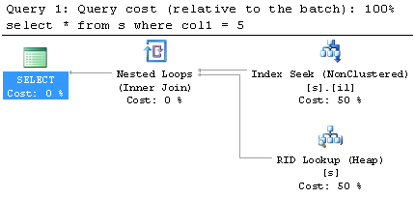
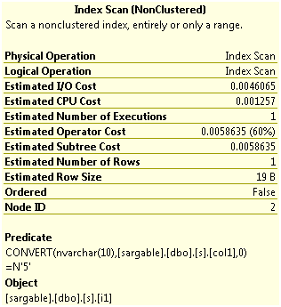
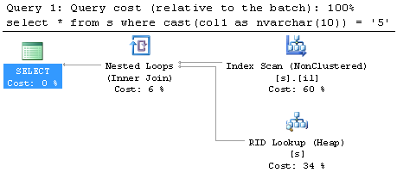
Index Matching Examples
First Example – Basic SARGable Seek + Fetch to get columns from Heap
Second case – NOT SARGable – notice the pushed predicate → Scan

Slide 20
Parallel Queries
Considered for “expensive” queries (> 5 cost units)
Implemented as a property (top-down requirement in our engine)
Considered in later optimization phases
We generate the best serial and best parallel plan and take lowest cost result in 2nd Stage
Not all operators support parallelism
Ex: GROUP BY supports parallelism only on GB cols
Not all scalar functions support parallelism
If you see that a query is not parallel that should be, try compiling it in slight variations until you find out if any of the predicates are causing the plan to go non-parallel.

Slide 21
Update Processing
Updates do:
Read/Qualify source data
Compute new values (ComputeScalar)
Apply Changes
There are two patterns of Update Plan:
Narrow/Per-Row (apply changes for a row to each index, then do next row)
Wide/Per-Index (apply all changes to each index, then do the next index)
Narrow works better for small updates. Wide is the general form.
(There are physical optimizations on each model so you might not see only two plans)

Slide 22
Updates
For “Wide” (Per-Index) Plans, we often use this pattern:
Split Updates into Delete, Insert
Sort by key, operation code
Collapse the result to remove no-ops
This shape is useful because it:
Puts changes in the order of each index (sequential IO instead of random IO)
Can find cases where some changes are not needed and (greatly) reduce the IO + Log needed to complete a query
I cover Update plan generation in my book chapter (SQL 2008 Internals) – that’s probably the best place to learn about this.

Slide 23
Where to Learn More
SQL Server 2008 Internals – Query Optimizer chapter
I wrote a chapter on the Optimizer, but there are lots of great things in that book from the other authors
My Blog:
http://blogs.msdn.com/conor_cunningham_msft/default.aspx “Conor vs. SQL”

Slide 24
Conclusion
Thank you very much for attending the talk
Any questions?

