Slide 1
Supercharge MDX Using MDX Studio Level 300
Ashwani Roy
Senior Consultant –Information Management Group

Slide 2
Speaker Intro
Microsoft SQL Server MVP
Senior Consultant with IMGROUP www.imgroup.com
Specialising in Data Modelling , SSIS and SSAS ,Performance tuning (SQL,MDX) , C# , F#
Speaker at various Community events including SQL Bits www.sqlbits.com
Answerer on http://social.msdn.microsoft.com/Forums/en-US/sqlanalysisservices
Member of Authoring Team – SQL Server 2008 MCP exams 70-451 Questions
Blogger on www.csentities.wordpress.com and http://ashwaniroy.spaces.live.com
I Tweet @ http://twitter.com/ashwani_roy

Slide 3
Agenda
What is MDX Studio
Why and How to use MDX Studio
Parser and Formatter
Performance Analysis
Query Tuning
Performance Counter Analysis
Profiling using MDX Studio
Debugging MDX Query
Questions

Slide 4
There is an app for..MDX
Built By Mosha Pashumansky inventor of MDX
MDX query Analyser
Debugger for MDX
Performance Monitoring and Optimization
Perfmon Counter viewer
And lots of other tools and utility that Management studio lacks
An Online Version as well http://mdx.mosha.com/
http://cid-74f04d1ea28ece4e.skydrive.live.com/browse.aspx/MDXStudio/v0.4.14

Slide 5
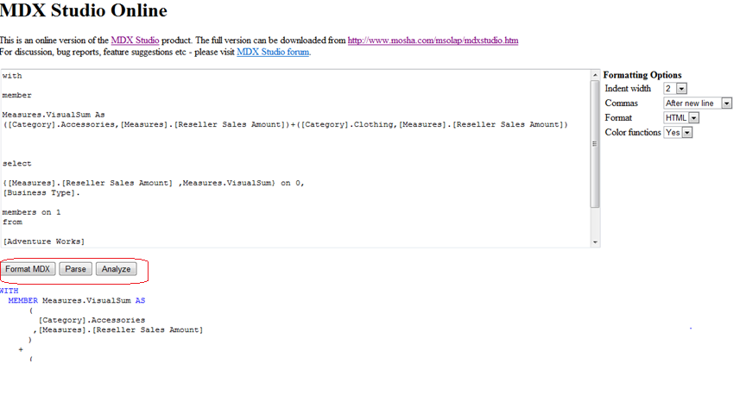
The Online Version Cool consultants working at customer site, where software installations are not allowed

Slide 6
Why and How to use MDX Studio

Slide 7
Most popular feature ever !!
One Click Formatting
Parsing → Produces a Intuitive parse tree with Code Snippet highlighting
Clear Cache in one click

Slide 8
DEMO 1:- Parser and Formatter
DEMO..Sorry have to skip
Notes:
FORMAT THIS and PARSE and SHOW the PARSE TREE
---------------------
WITH
MEMBER Measures.VisualSum AS
( [Product].[Product Categories].[Category].&[4],[Measures].[Internet Sales Amount])+ ( [Product].[Product Categories].[Category].&[3],[Measures].[Reseller Sales Amount])
SELECT {[Measures].[Reseller Sales Amount],Measures.VisualSum} ON 0,[Business Type].MEMBERS ON 1 FROM [Adventure Works] WHERE [Product].[Product Categories].[Category].MEMBERS;

Slide 9
Performance Analysis MDX Studio

Slide 10
Performance Tuning –Analyse and Tune

Slide 11
Under the Hood
FE Query plan
Formula Engine
FE Cache
SE Cache
Storage Engine
SE Query plan

Slide 12
Steroids for MDX
Formula engine Caching
Dynamic Sets
Bulk Evaluation Mode
Not Discussed in this Session
Aggregations
Attribute Relationships
Cache Warming
Many More (Refer the SSAS performance Whitepaper)

Slide 13
What is formula engine caching
A Scenario
Calculation 1 - {f(x)}/{g(x)}
Calculation 2 - {h(x)}/{g(x)}
g(x) is being computed in both times

Slide 14
What is formula engine caching
Can be Optimized to
Calculation 0- {g(x)}

Slide 15
DEMO 2:- FE caching
WITH
MEMBER [Measures].CALCULATION1 AS
[Measures].[Internet Sales Amount]
/
Count
(
BottomSum
(
[Account].[Account].[Account].MEMBERS*
[Date].[Date].[Date].MEMBERS
,10
,[Measures].[Internet Sales Amount])
)
MEMBER [Measures].CALCULATION2 AS
[Measures].[Internet Tax Amount]
/
Count
(
BottomSum
(
[Account].[Account].[Account].MEMBERS*
[Date].[Date].[Date].MEMBERS
,10
,[Measures].[Internet Sales Amount])
)
SELECT
{
[Measures].CALCULATION1
,[Measures].CALCULATION2
} ON 0
,[Customer].[Gender].[Gender].MEMBERS ON 1
FROM [Adventure Works];
WITH
MEMBER [Measures].CALCULATION0 AS
Count
(
BottomSum
(
[Account].[Account].[Account].MEMBERS * [Date].[Date].[Date].MEMBERS
,10
,[Measures].[Internet Sales Amount]
)
)
MEMBER [Measures].CALCULATION1 AS
[Measures].[Internet Sales Amount] / [Measures].CALCULATION0
MEMBER [Measures].CALCULATION2 AS
[Measures].[Internet Tax Amount] / [Measures].CALCULATION0
SELECT
{
[Measures].CALCULATION1
,[Measures].CALCULATION2
} ON 0
,[Customer].[Gender].[Gender].MEMBERS ON 1
FROM [Adventure Works];
Notes:
MOVE THE CALCULATION TO DENIMINATOR
---------------------------------------
WITH
MEMBER [Measures].CALCULATION0 AS
Count
(
BottomSum
(
[Account].[Account].[Account].MEMBERS * [Date].[Date].[Date].MEMBERS
,10
,[Measures].[Internet Sales Amount]
)
)
MEMBER [Measures].CALCULATION1 AS
[Measures].[Internet Sales Amount] / [Measures].CALCULATION0
MEMBER [Measures].CALCULATION2 AS
[Measures].[Internet Tax Amount] / [Measures].CALCULATION0
SELECT
{
[Measures].CALCULATION1
,[Measures].CALCULATION2
} ON 0
,[Customer].[Gender].[Gender].MEMBERS ON 1
FROM [Adventure Works];

Slide 16
DEMO 3 :- Dynamic Sets !!
WITH
MEMBER MEASURES.MYRANK AS
Rank
(
[Date].[Date].CurrentMember
,Order
(
[Date].[Date].[Date].MEMBERS
,[Measures].[Internet Sales Amount]
,BDESC
)
)
SELECT
MEASURES.MYRANK ON 0
,[Date].[Date].[Date].MEMBERS ON 1
FROM [Adventure Works];
WITH
SET MYSET AS
Order
(
[Date].[Date].[Date].MEMBERS
,[Measures].[Internet Sales Amount]
,BDESC
)
MEMBER MEASURES.MYRANK AS
Rank
(
[Date].[Date].CurrentMember
,MYSET
)
SELECT
MEASURES.MYRANK ON 0
,[Date].[Date].[Date].MEMBERS ON 1
FROM [Adventure Works];
Notes:
TUNED With Dynamic SETS
---------------------------
WITH
SET MYSET AS Order
(
[Date].[Date].[Date].MEMBERSS
,[Measures].[Internet Sales Amount]
,BDESC
)
MEMBER MEASURES.MYRANK AS
Rank
(
[Date].[Date].CurrentMember
,MYSET
)
SELECT
MEASURES.MYRANK ON 0
,[Date].[Date].[Date].MEMBERS ON 1
FROM [Adventure Works];

Slide 17
Bulk Computation
Most important optimization technique with MDX in Analysis Services is to rewrite MDX in such a way that makes block computations possible. …Mosha
Cell-by-cell
Subspace
vs.

Slide 18
DEMO 4 : - Bulk Computation “How Many” satisfy a “condition”
WITH
MEMBER [Measures].[ProductsONInternet] AS
IIF
(
[Measures].[Internet Order Quantity] > 0
,1
,NULL
)
SELECT
//Geographically
[Customer].[Customer Geography].[Country].MEMBERS ON 0
,[Date].[Calendar].[Date].MEMBERS ON 1
FROM [Adventure Works]
WHERE
[Measures].[ProductsONInternet];
WITH
MEMBER [Measures].[ProductsONInternet] AS
Count
(
Filter //Products Ordered On Internet
(
[Product].[Product].[Product]
,
[Measures].[Internet Order Quantity] > 0
)
)
SELECT
[Customer].[Customer Geography].[Country].MEMBERS ON 0 //Geographically
,[Date].[Calendar].[Date].MEMBERS ON 1
FROM [Adventure Works]
WHERE
[Measures].[ProductsONInternet];
Notes:
OPTIMIZED CODE
----------------------------------
WITH
MEMBER [Measures].[ProductsONInternet] AS
IIF
(
[Measures].[Internet Order Quantity] > 0
,1
,0
)
SELECT
//Geographically
[Customer].[Customer Geography].[Country].MEMBERS ON 0
,[Date].[Calendar].[Date].MEMBERS ON 1
FROM [Adventure Works]
WHERE
[Measures].[ProductsONInternet];

Slide 19
Quiz-Spot what can go wrong
WITH
MEMBER [Measures].AvgProductSales AS
Avg
(
NonEmpty
(
[Product].[Product].[Product].MEMBERS
,[Measures].[Sales Amount]
)
,[Measures].[Sales Amount]
)
SELECT
[Measures].AvgProductSales ON 0
,[Date].[Date].[Date].MEMBERS ON 1
FROM [Adventure Works];
Notes:
TUNE THIS
--------------
WITH
MEMBER [Measures].AvgProductSales AS
Avg
(
NonEmpty
(
[Product].[Product].[Product].MEMBERS
,[Measures].[Sales Amount]
)
,[Measures].[Sales Amount]
)
SELECT
[Measures].AvgProductSales ON 0
,[Date].[Date].[Date].MEMBERS ON 1
FROM [Adventure Works];

Slide 20
Bulk Computation Demo
WITH
MEMBER [Measures].AvgGrowingProducts AS
Avg
(
Filter
(
[Product].[Product].[Product].MEMBERS
,
[Measures].[Sales Amount]
>
(
[Measures].[Sales Amount]
,ParallelPeriod([Date].[Calendar].[Month])
)
)
,[Measures].[Sales Amount]
)
SELECT
[Measures].AvgGrowingProducts ON 0
,Descendants
(
[Date].[Calendar].[Calendar Year].&[2003]
,[Date].[Calendar].[Date]
) ON 1
FROM [Adventure Works];
WITH
MEMBER [Measures].[SalesGrowth] AS
IIF
(
Measures.[Sales Amount]
>
(
[Measures].[Sales Amount]
,ParallelPeriod([Date].[Calendar].[Month])
)
,[Measures].[Sales Amount]
,NULL
)
MEMBER [Measures].AvgGrowingProducts AS
Avg
(
[Product].[Product].[Product].MEMBERS
,[Measures].[SalesGrowth]
)
SELECT
[Measures].AvgGrowingProducts ON 0
,Descendants
(
[Date].[Calendar].[Calendar Year].&[2003]
,[Date].[Calendar].[Date]
) ON 1
FROM [Adventure Works];
Notes:
TUNE THIS
--------------
WITH
MEMBER [Measures].[SalesGrowth] AS
IIF
(
Measures.[Sales Amount]
>
(
[Measures].[Sales Amount]
,ParallelPeriod([Date].[Calendar].[Month])
)
,[Measures].[Sales Amount]
,NULL
)
MEMBER [Measures].AvgGrowingProducts AS
Avg
(
[Product].[Product].[Product].MEMBERS
,[Measures].[SalesGrowth]
)
SELECT
[Measures].AvgGrowingProducts ON 0
,Descendants
(
[Date].[Calendar].[Calendar Year].&[2003]
,[Date].[Calendar].[Date]
) ON 1
FROM [Adventure Works];

Slide 21
Profiling and Debugging Using MDX Studio

Slide 22
MY PAIN with Management Studio
Which Perfmon Counters I want to catch
Running Perfmon AND Profiler Trace AND Query Window at same time .. Annoying
Logs of “Unwanted” events logged in trace
Events for other queries running on server might impact your collected trace counter
Notes:
----------------
Show Cache Insert there
----------------
WITH
MEMBER [Measures].RunMonthSales AS
Sum
(
NULL : [Date].[Calendar].CurrentMember
,[Measures].[Sales Amount]
)
MEMBER [Measures].RunSales AS
([Measures].RunMonthSales, [Date].[Calendar].Parent.PrevMember)
+
Sum
(
[Date].[Calendar].FirstSibling : [Date].[Calendar].CurrentMember
,[Measures].[Sales Amount]
)
SELECT
[Measures].RunSales ON 0
,[Date].[Date].[Date].MEMBERS ON 1
FROM [Adventure Works];

Slide 23
MDX Profiler and Debugger
DEMO
Notes:
WITH
MEMBER Measures.[Total Number Of Products] AS
Count(
Descendants(
[Product].[Product Categories].CurrentMember
,[Product].[Product Categories].[Product]))
MEMBER Measures.[Number Of Sold Products Increasing] AS
Count(
Filter(
NonEmpty(
Descendants(
[Product].[Product Categories].CurrentMember
,[Product].[Product Categories].[Product])
,[Measures].[Internet Sales Amount])
,
([Date].[Calendar].CurrentMember ,[Measures].[Internet Sales Amount])
- ([Date].[Calendar].PrevMember ,[Measures].[Internet Sales Amount])
> 0
)
)
SELECT
{ [Measures].[Total Number Of Products] ,[Measures].[Number Of Sold Products Increasing]} ON 0
,[Date].[Calendar].[Month].MEMBERS ON 1
FROM [Adventure Works];

Slide 24
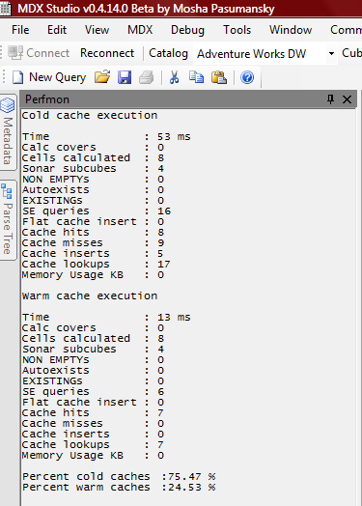
PerfMon Counters..what do they stand for

Slide 25
PerfMon Counters..what do they stand for
Time- Time taken to execute MDX
Cells Calculated – No. Of cells evaluated to arrive at result set
High Number Indicates cell-by-cell computation
Calc Covers –No of Calculation Covers(sub cube over which calculation is applied)
High Number Indicates cell-by-cell computation
Sonar Sub cube-Number of sub cubes generated by Formula engine (SONAR algorithm)
High Number Indicates cell-by-cell computation
SE Queries – Number of queries answered by Storage Engine
High Number Indicates less data from cache. Cache warming will help
Please refer SSAS Performance Whitepaper for more
Notes:
Total autoexist
This counter reports the total number of times that autoexist is performed.
Total calculation cache registered
This counter reports the total number of calculation caches registered. A calculation cache is registered for each calculated member resolved in a query.
Total Calculation covers
This counter reports the total number of calculation covers generated by the query execution engine. A calculation cover is a subcube for which a common set of calculations can be applied. An MDX query may cover a large subcube, with a wide range of calculations applying to different areas of the subcube. As a result, the formula engine may require that many calculation covers be generated in order to properly compute all of the calculations that are required by the MDX query.
A high value for this counter for a single query indicates that the formula engine resolved cell values for the query on a cell-by-cell basis rather than performing block-oriented evaluation.
Total cells calculated
This counter reports the total number of cells calculated. A high value for this counter for a single query indicates that the formula engine resolved cell values for the query on a cell-by-cell basis rather than performing block-oriented evaluation.
Total EXISTING
This counter reports the total number of times the EXISTING set operator executed.
Total Flat Cache Inserts
This counter reports the total number of cell values inserted into the flat calculation cache. Formula engine caches use either flat space or subcubes to store data and calculations during query execution. A high value for this counter indicates that cell-by-cell evaluation was used to calculate cell values and that these cell values were inserted into the flat cache on a cell-by-cell basis.
Total NON EMPTY
This counter reports the total number of NON EMPTY operations performed. To determine the total number of fast NON EMPTY operations for a given MDX query, subtract the values for Total NON EMPTY unoptimized and Total NON EMPTY for calculated members from the value for this counter.
Total NON EMPTY for calculated members
This counter reports the total number of times the NON EMPTY algorithm is looping over calculated members. The slow NON EMPTY code path is used for calculated members, while a fast code path is used for members that are not calculated.
Total NON EMPTY unoptimized
This counter reports the total number of times the unoptimized NON EMPTY algorithm is used. A high value for this counter indicates that the slow NON EMPTY code path is used to evaluate nonempty cells on a cell-by-cell basis.
Total recomputes
This counter reports the total number of cells recomputed due to cell errors in an MDX expression or calculation, or from recursion errors.
Total Sonar subcube
This counter reports the total number of subcubes generated by the formula engine (also called the query optimizer or the Sonar algorithm within the formula engine).
A high number for this counter indicates that the formula engine resolved cell values for the query on a cell-by-cell basis rather than performing block-oriented evaluation or that an excessive number of subcube requests were generated even though block-oriented evaluation was used. The number of Sonar subcubes is smaller when the formula engine is able to retrieve data from the caches rather than from disk.
The smaller number of Sonar subcubes when the formula engine is able to retrieve the necessary data from cache represents the optimum number of Sonar subcubes required to resolve a query; however, the formula engine cannot always read far enough ahead in the query to generate the optimum number of subcubes when data is not in cache. The number of subcubes depends upon the complexity of the MDX query and the state of the data cache.
----------------------------------STORAGE ENGINE------------------
Total bytes sent
This counter reports the total bytes returned to clients, including bytes used to populate trace information. For example, when using the Query Subcube Verbose event in a SQL Server Profiler trace, the number of bytes may increase significantly.
Total dimension queries
This counter reports the total number of dimension queries answered by the storage engine. This number does not necessarily match the number of dimension queries reported by the Query Dimension event in SQL Server Profiler.
Total measure group queries
This counter reports the total number of queries to a measure group answered by the storage engine.
Total queries answered
This counter reports the total number of number of queries answered by the storage engine.
Total queries from cache direct
This counter reports the total number of queries derived directly from the measure group cache by the storage engine.
Total queries from cache filtered
This counter reports the total number of queries answered by filtering existing measure group cache entries by the storage engine.
Total queries from file
This counter reports the total number of queries answered from disk (either aggregations or fact level data) by the storage engine.
Total rows sent
This counter reports the total number of rows returned to the client (ignoring any rows returned in a trace).

Slide 26
Summary
Watch out for High cells evaluation
Try to use the formula engine caching
Use functions optimized for bulk evaluation
Use MDX studio to help you analyze and suggest improvements
Use it and give feedback http://www.ssas-info.com/forum/3-mdx-studio/
Debug you MDX . It is the easiest way to find out bugs with dataset reported
Read the performance optimization whitepaper on SSAS. It is the best and most reliable source of performance optimization techniques

Slide 27
Questions
THANK YOU

