Slide 1
Notes & Queries on
SQL Server 2008 R2
SQL Bits Goes West

Slide 2




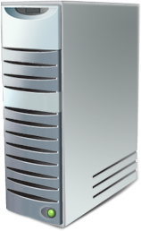



THE MARKETING SLIDE
Managed Self-Service BI
Multi-Server Management
Virtualization & Live Migration
MPP support for 10s to 100s TB DW
Highly scalable appliances
Seamlessly integrated with Microsoft BI
Scalable relational database platform
Consistent, familiar model & tools
Self-managed, highly available

Slide 3
Windows Server 2008 R2
A better home for SQL Server

Slide 4
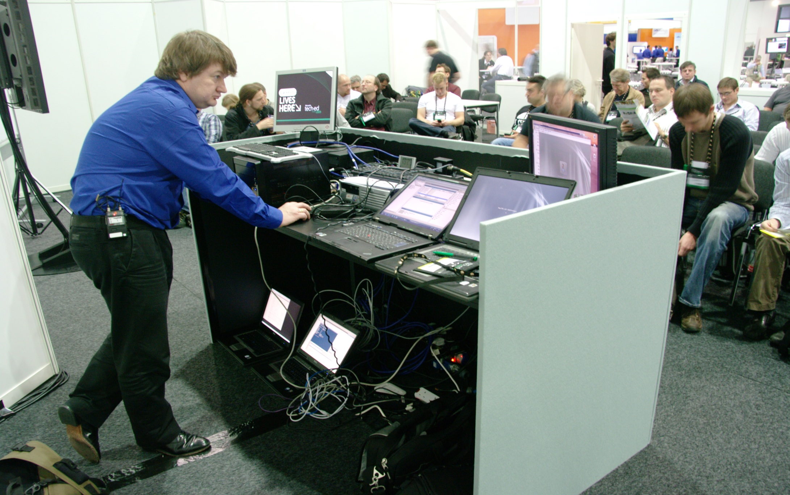
Scrap heap cluster
Binky
Wallace-R2
Grommit-R2
Hub

Slide 5
Intermission
Live Migration

Slide 6
Live Migration in Hyper-v
Built on Windows Failover clustering
New for Windows Server 2008 R2
Uses Clustered Shared Volumes (CSV)
Gives you freedom to move workloads
to the most appropriate hardware,
without loss of service

Slide 7

Live Migration does not improve high availability

Slide 8
Server Core
Lightweight install of Windows Server 2008/R2
Great for IIS7.5 (now supports asp.net)
But not for SQL Server ..yet

Slide 9
But HERE’s HOW
OPEN THE FIREWALL
netsh [enter]
advfirewall firewall [enter]
set rule group=”remote administration” new enable=yes [enter]
add rule name=”Open Port 1433” dir=in action=allow protocol=TCP localport=1433 [enter]
JOIN the CORE MACHINE TO YOUR DOMAIN
Use netdom join ComputerName /domain:DomainName /userd:UserName /passwordd: (yes there are 2 dd s here)
or the powershell configurator we used (from http://psconfig.codeplex.com)
ADD .NET FRAMEWORK
Dism /online /enable-feature /featurename: NetFx2-ServerCore /featurename: ServerCore-WOW64 /featurename:NetFx3-ServerCore-WOW64 /featurename:NetFx2-ServerCore-WOW64 /featurename: NetFx3-ServerCore
and optionally /featurename:MicrosoftWindowsPowerShell
INSTALL SQL SERVER FROM THE COMAND LINE
This needs to be on one line but is shown like this to make it clearer
SETUP.EXE
/QS
/ACTION=Install
/FEATURES=SQL ONLY SQL Works on CORE so no Reporting Services etc.
/INSTANCENAME=MSSQLSERVER
/SQLSVCACCOUNT="domain\sqlserviceaccount"
/SQLSVCPASSWORD="sqlserviceaccountpassword"
/SQLSYSADMINACCOUNTS="domain\sqladminusername"
/AGTSVCACCOUNT="NT AUTHORITY\Network Service“
/IACCEPTSQLSERVERLICENSETERMS
/TCPENABLED=1
/SECURITYMODE=SQL
/SAPWD=“******"

Slide 10
Intermission
A short video on SysPrep

Slide 11
SysPrep in SQL Server 2008 R2
Similar to Windows SysPrep
Use the install UI or the command prompt
For stand alone
          DB engine and reporting services only
For Clusters
          DB engine and Analysis Services

Slide 12
Prepare SQL Instance
SETUP
/QS
/IAcceptSQLServerLicenseTerms
/ACTION=PrepareImage /FEATURES=SQLENGINE,REPLICATION,FULLTEXT,RS /INSTANCEID=“INSTANCEID”
Notes:
InstanceID is a string you’ll need to remember when you want to complete the image

Slide 13
Complete SQL Instance
SETUP
/QS
/ACTION=CompleteImage
/INSTANCEID=“from prepare image step”
/INSTANCENAME=TECHNET
/SQLSVCACCOUNT=“domain\sql service account" /SQLSVCPASSWORD=“*******"
/SQLSYSADMINACCOUNTS="domain\sysadminuser"
/AGTSVCACCOUNT= =“domain\sql agent service account"
/AGTSVCPASSWORD=“******“
/IACCEPTSQLSERVERLICENSETERMS /BROWSERSVCSTARTUPTYPE=AUTOMATIC
/SECURITYMODE=SQL /SAPWD=“******"
/SQLSYSADMINACCOUNTS=“domain\user"
/TCPENABLED=1
/RSSVCACCOUNT="CONTOSO\SQLService" /RSSVCPASSWORD="Pa55word"
Notes:
Setup
/QS
/ACTION=CompleteImage
/INSTANCEID= the id you prepared SQL with from the previous slide
/INSTANCENAME=“InstanceName” e.g. MSSQLSERVER
/SQLSVCACCOUNT=“domain\sql service account"
/SQLSVCPASSWORD=“*******"
/SQLSYSADMINACCOUNTS="domain\sysadminuser“ you can have more than one here
/AGTSVCACCOUNT= =“domain\sql agent service account"
/AGTSVCPASSWORD=“******“
/IACCEPTSQLSERVERLICENSETERMS
/BROWSERSVCSTARTUPTYPE=AUTOMATIC so you can remotely manage
/SECURITYMODE=SQL If you want mixed mode
/SAPWD=“******" sa password required for mixed mode – Make it a strong one!!
/SQLSYSADMINACCOUNTS=“domain\user"
/TCPENABLED=1 TCP/IP enabled
/RSSVCACCOUNT="CONTOSO\SQLService" /RSSVCPASSWORD="Pa55word"

Slide 14
SQL Server & Windows SysPrep cookbook
Prepare a vanilla image
Use it
Create a VM
Join it to the domain
Install SQL Server using the prepare image option
Run windows\system32\sysprep\sysprep
Keep that image in SCVMM,WDS etc.
Join it to the domain
Reboot
Complete the SQL server install

Slide 15
Prepare image for clustering
setup.exe
/q
/ACTION=PrepareFailoverCluster /InstanceName="<Insert Instance name>" /Features=SQLENGIN,REPLICATION,FULLTEXT /INDICATEPROGRESS /SQLSVCACCOUNT="<DomainName\UserName>" /SQLSVCPASSWORD="xxxxxxxxxxx" /AGTSVCACCOUNT="<DomainName\UserName>" /AGTSVCPASSWORD="xxxxxxxxxxx"

Slide 16
Complete image for adding a node to A cluster
setup.exe
/Q
/ACTION=AddNode
/INSTANCENAME="<Insert Instance Name>" /SQLSVCACCOUNT="<SQL account that is used on other nodes>"
/SQLSVCPASSWORD="<password for SQL account>" /AGTSVCACCOUNT="<SQL Server Agent account that is used on other nodes>",
/AGTSVCPASSWORD="<SQL Server Agent account password>"

Slide 17
Windows Server 2008 R2 stuff
Application Role
Managed Service Accounts
Networking
Core Parking
Powershell 2
App-V
Server Core is not supported … yet

Slide 18
Multi-server management

Slide 19
CONTROL POINT
Multi-Server Management
Data Tier Access Components (DAC)

Slide 20
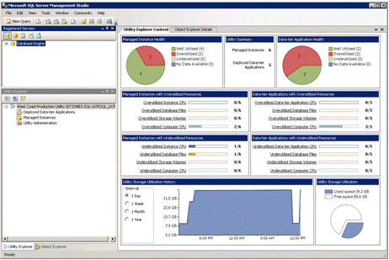

Slide 21
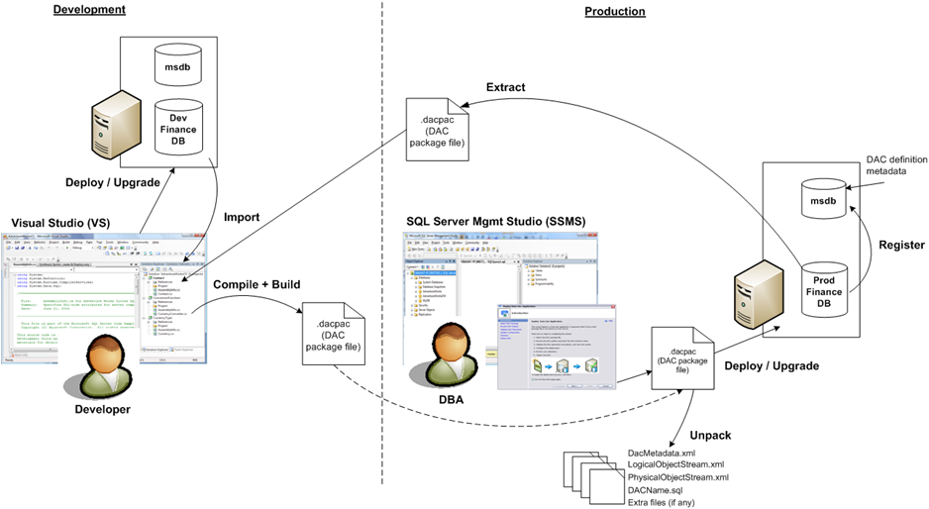
DAC in Action

Slide 22
EDITIONS & LICENSING

Slide 23

What’s new in Enterprise
Top Features in 2008
New Features in R2
Resource Governor
Data Compression
Transparent Data Encryption
Database Mirroring Enhancements
Scale-out BI
Application and Multi-Server Management for up to 25 instances
PowerPivot for SharePoint
Master Data Services
Data Compression with Unicode UCS-2 support
Notes:
Top Features 2008:
* Data Compression
* Res Governor
* TDE
* DB Enhancements
* Scale-out BI

Slide 24

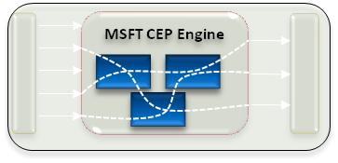
New Edition
Scale-up across workloads
StreamInsight
Unlimited Virtualization
Notes:
Highest OLTP, Analytics scale and Data Center needs
Aligns with Windows Server
Priced by processor, no additional costs for multi-core

Slide 25
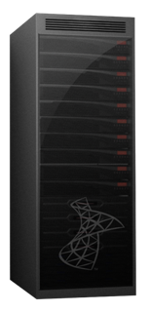









New Edition
New edition for high end data warehousing
Delivering DW appliances in collaboration with key partners
Scale-out
Supports 10s – 100s TB
Parallel Data Warehouse partners
Hardware partners of choice
HP, Dell, Bull, EMC and IBM
Formerly project codenamed “Madison”
Notes:
Bringing low TCO to the high end
Providing flexibility and choice through commodity hardware
Improving business agility and alignment through Hub & Spoke Architecture
Enabling everyone to do Business Intelligence in organizations of any size

Slide 26
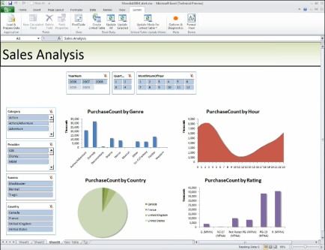
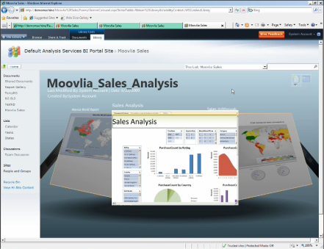
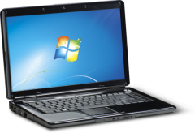




Licensing for PowerPivot
PowerPivot for Excel
PowerPivot for SharePoint
PowerPivot for Excel will be available as a web download (Add-in) for Excel 2010 users.
PowerPivot for SharePoint will require a SQL Server 2008 R2 Enterprise license (Server/CAL or per Processor) and SharePoint Server 2010 Enterprise CAL.
www.powerpivot.com

Slide 27
R2 Feature Changes
What’s new, what’s different
 | Standard | Enterprise | Datacenter
Memory | 64GB RAM | 2TB RAM | OS Max
CPU Support | <4 | <8 | 8< >256
Virtualization Licensing | 1 VM | <4 VM | Unlimited Virtualization
Virtualization Support | Hyper-V Live Migration | Hyper-V Live Migration | Hyper-V Live Migration
OLTP & Multi-Server Mgt. | Backup Compression (new from Enterprise) Can be a managed instance | Unicode UCS-2 Compression Control Point for up to 25 managed instances | Unicode UCS-2 Compression Control Point to manage max. number of instances
Business Intelligence | Componentized Reports (SSRS) Advanced Visualization (maps) | PowerPivot for SharePoint Master Data Services | PowerPivot for SharePoint Master Data Services
Notes:
2 messages to land:
Ulimited Vm is a take back -- SQL Server EE snaps to WS sku lineup
Still have competitive offer than Oracle, we don’t require licensing of all the procs, we support VMware and Hyuper-V
Divide two sections:
Virtualizatoin support
OLTP
BI

Slide 28
Questions

Slide 29

Europe’s Premier
Community
SQL Server Conference

Slide 30
Up and coming events..
November 2009
Tuesday 24th London – Storage and Query Optimisation - www.sqlpass.org.uk
Thursday 26th London – SQL Internals and MS BI – SQLServerFAQ.com
Thursday 26th London – Looking at newsgroups for Info – SQLServerFAQ.com
December 2009
Thursday 3rd Online – PowerUp with SQL Server (see next slide)
Tuesday 8th Cork – Query Optimisation – MTUG.ie
Wednesday 9th Dublin – Query Optimisation – IrishDev.com
Thursday 10th Leeds – Service Broker and Powershell – SQLServerFAQ.com Tuesday 15th Cambridge – Christmas Special down the pub – SQLSocial.com
Thursday 17th Manchester – SQL Server Internals – SQLServerFAQ.com

Slide 31


Time to Power Up with SQL Server within your organization!
Who Should Attend:
Database administrators
Application developers/programmers
Database developers
- IT Professionals responsible for SQL Server management
Sign Up Today at http://tinyurl.com/PowerUpSQLServer
During the day's presentations by SQL Server experts, Greg Low, Javier Loria, and Niels Berglund, you'll get detailed information and time to ask your questions.
Three sessions, directly from your own computer:
- Understanding Query Plan Caching in SQL Server
- SQL Server High Availability
- SQL Server Performance

Slide 32

It’s party time!
Coming up next in the Atrium:
Time to relax and let your hair down.
Rockband
Table football
Air Hockey
and more
Don’t forget speakers and sponsors have drinks vouchers

