Slide 1
Designing High Performance I/O Systems for SQL Server
tkejser@microsoft.com

Slide 2
Agenda
What is an I/O?
Some terminology
Fundamentals of Disk Drives and caches
The Path to the Drives
The Windows Story
Benchmark and Sizing Methodology
SQL Server File Layouts
Workload Specific

Slide 3
Designing High Performance I/O
What is an I/O?

Slide 4
What is an I/O?
Throughput
Measured in MB/sec or IOPs
Performance Monitor: Logical Disk
Disk Read Bytes / Sec
Disk Write Bytes / Sec
Disk Read / Sec
Disk Writes / Sec
Latency
Measured in milliseconds (ms)
Performance Monitor: Logical Disk
Avg. Disk Sec / read
Avg. Disk Sec / write
More on healthy latency values later
Capacity
Measured in GB/TaB
The easy one!

Slide 5
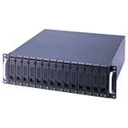
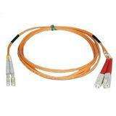
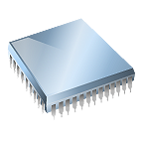
The Full Stack
DB
I/O Controller / HBA
Windows
CPU
PCI Bus
Cabling
Array
Cache
Spindle
SQL Serv.
Key Takeaway: This is NOT going to be easy…

Slide 6
Terminology
JBOD - Just a Bunch of Disks
SAME – Stripe and Mirror Everything
RAID - Redundant Array of Inexpensive Disks
DAS Direct Attached Storage
NAS Network Attached Storage
SAN Storage Area Network
CAS Content Addressable Storage

Slide 7
Designing High Performance I/O
Fundamentals of Disk Drives and Caches

Slide 8
The Traditional Hard Disk Drive
Cover mounting holes
(cover not shown)
Base casting
Spindle
Slider (and head)
Case mounting holes
Actuator arm
Actuator axis
Platters
Actuator
Flex Circuit
(attaches heads
to logic board)
SATA interface
connector
Power connector
Source: Panther Products

Slide 9
Numbers to Remember - Spindles
Traditional Spindle throughput
10K RPM – 100 -130 IOPs at ‘full stroke’
15K RPM – 150-180 IOPs at ‘full stroke’
Can achieve 2x or more when ‘short stroking’ the disks (using less than 20% capacity of the physical spindle)
These are for random 8K I/O
Aggregate throughput when sequential access:
Between 90MB/sec and 125MB/sec for a single drive
If true sequential, any block size over 8K will give you these numbers
Depends on drive form factor, 3.5” drives slightly faster than 2.5”
Approximate latency: 3-5ms

Slide 10
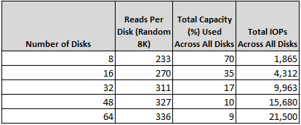
Scaling of Spindle Count - Short vs. Full Stroke
Each 8 disks exposes a single 900GB LUN
RAID Group capacity ~1.1TB
Test data set is fixed at 800GB
Single 800GB for single LUN (8 disks), two 400GB test files across two LUNs, etc…
Lower IOPs per physical disk when more capacity of the physical disks are used (longer seek times)

Slide 11
I/O Weaving
Test setup:
Two Partition on same LUN
Hit both partitions with a sequential 64K read pattern
7200rpm SATA drive
Compare with Random 64K

Slide 12
Sequential worse than Random!
Key takeaway: If tuning for sequential, be careful about I/O weaving

Slide 13
The “New” Hard Disk Drive (SSD)
No moving parts!

Slide 14
SSD - The “New” Hard Disk Drive
SSD is currently used as the name for two different types of storage technology:
NAND based Flash Devices (AKA: EFD, Flash)
Battery backed up DDR
There are ”no moving, mechanical parts”
Only bound by electrical failure
But special considerations apply for NAND
Some big advantages
Power consumption often around 20% of traditional drives
Random = Sequential (for reads)!
Extremely low latency on access
All SSD devices are not create equal
Beware of non-disk related bottlenecks
Service processors, bandwidth between host/array, etc..
Game Changer!

Slide 15
SSD - Battery Backed DRAM
Throughput close to speed of RAM
Typically 10**5 IOPS for a single drive
Drive is essentially DRAM RAM
on a PCI card (example: FusionIO)
...or in a drive enclosure (example: Intel X25)
...or with a fiber interface (example: DSI3400)
Battery backed up to persist storage
Be careful about downtime, how long can drive survive with no power?
As RAM prices drop, these drives are becoming larger
Extremely high throughput, watch the path to the drives

Slide 16
SSD - NAND Flash
Throughput, especially random, much higher than traditional drive
Typically 10**4 IOPS for a single drive
Storage organized into cells of 512KB
Each cell consists of 64 pages, each page 8KB
When a cell need to rewritten, the 512KB Block must first be erased
This is an expensive operation, can take very long
Disk controller will attempt to locate free cells before trying to delete existing ones
Writes can be slow
DDR ”write cache” often used to ”overcome” this limitation
When blocks fill up, NAND becomes slower with use
But only up to a certain level – eventually peaks out
Still MUCH faster than typical drives
Larger NAND devices are typically build by RAID’ing smaller devices together
This happens at the hardware, disk controller level
Invisible to OS and other RAID system

Slide 17
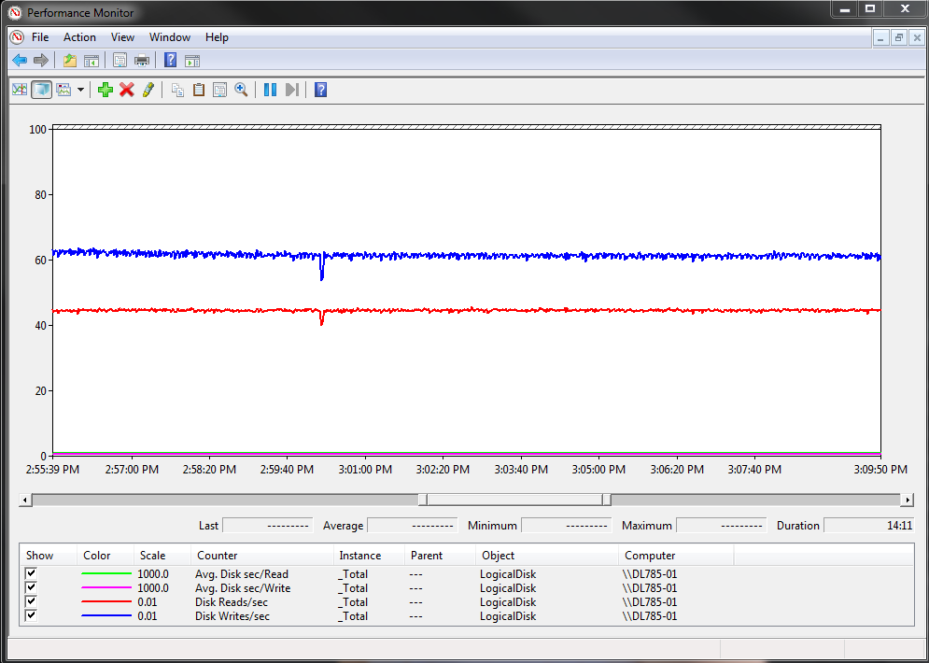
SSD Directly on PCI-X Slot
> 10,000 IOPs
Mixed read/write
Latency < 1ms
PCI bus bottleneck

Slide 18
Storage Selection - General
Number of drives matter
More drives typically yield better speed
True for both SAN and DAS
... Less so for SSD, but still relevant (especially for NAND)
If designing for performance, make sure the topology can handle it
Understand the path to the drives
Best Practice: Validate and compare configurations prior to deployment
More about this in the Benchmarking and Sizing section

Slide 19
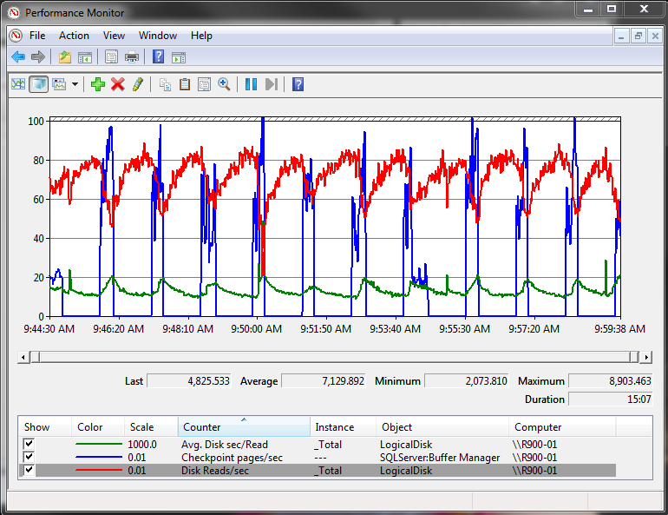
Checkpoint and “The Cache Effect” - 2GB Write Cache
Read I/O’s per second decrease after checkpoint has completed
Reason for drop in read throughput is transparent to host
Array is writing dirty cache pages received during checkpoint impacting reads

Slide 20
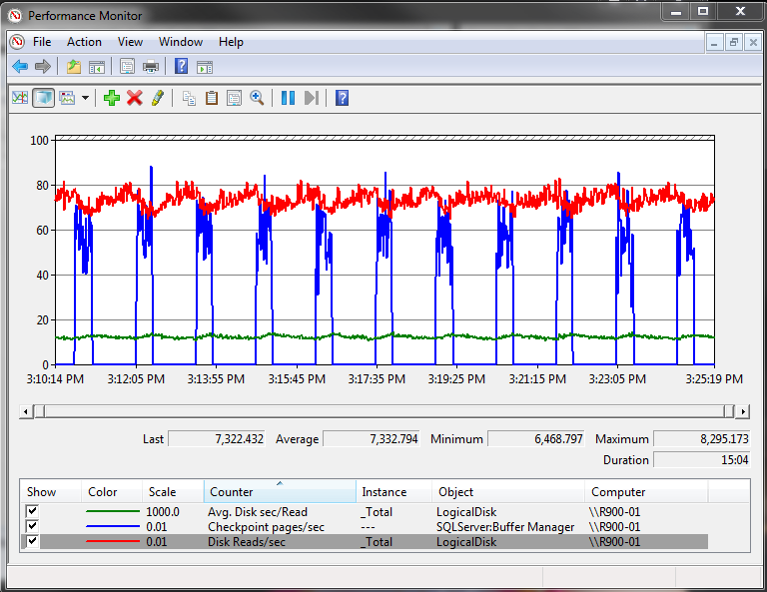
Checkpoint and “The Cache Effect” - Compared to… 8GB Write Cache
Larger cache results in less impact on read throughput
Writes occurring in background do not have to be as “aggressive”
Key Takeaway: Write cache help, up to a certain point

Slide 21
Storage Selection – General Pitfalls
There are organizational barriers between DBA’s and storage administrators
Each needs to understand the others “world”
Share storage environments
At the disk level and other shared components (i.e. service processors, cache, etc…)
Sizing only on “capacity” is a common problem
Key Takeaway: Take latency and throughput requirements (MB/s, IOPs and max latency) into consideration when sizing storage
One size fits all type configurations
Storage vendor should have knowledge of SQL Server and Windows best practices when array is configured
Especially when advanced features are used (snapshots, replication, etc…)

Slide 22
Designing High Performance I/O
The Path to the Drives

Slide 23
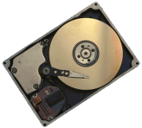
How does the Server Attach to the Storage?
Disk Cabling Topology
Parallel Disk Attachment
SCSI, ATA
Serial Disk Attachment
FC, SATA, SAS
Controller
Dedicated or shared controller
Internal PCI or service processor within the array
Difference is $1k or $60-500K for controller
Network components between disks
and server (Storage Area Network)
Server Remote Attachment
File Access: NAS - SMB, CIFS, NFS
Block Level: iSCSI, Fibre Channel

Slide 24
Understand the path to the drives
The hardware between the CPU and the physical drive is often complex
Different topologies, depending on vendor and technology
Rule of Thumb: The deeper the topology, the more latency
Best Practices:
Understand topology, potential bottlenecks and theorectical throughput of components in the path
Engage storage engineers early in the process
Two major topologies for SQL Server Storage
DAS – Direct Attached Storage
Standards: (SCSI), SAS, SATA
RAID controller in the machine
PCI-X or PCI-E direct access
SAN – Storage Area Networks
Standards: iSCSI or Fibre Channel (FC)
Host Bus Adapters or Network Cards in the machine
Switches / Fabric access to the disk

Slide 25
Path to the Drives - DAS
Shelf
Interface
Controller
Cache
PCI Bus
Shelf
Interface
PCI Bus
Shelf
Interface
Controller
Cache
Shelf
Interface

Slide 26
Path to the Drives – DAS ”on chip”
Controller
PCI Bus
PCI Bus
Controller
Notes:
We will show some performance numbers from such a configuration later in this deck

Slide 27
SQL Server on DAS - Pros
Beware of non disk related bottlenecks
SCSI/SAS controller may not have bandwidth to support disks
PCI bus should be fast enough
Example: Need PCI-X 8x to consume 1GB/sec
Can use Dynamic Disks to stripe LUN’s together
Bigger, more manageable partitions
Often a cheap way to get high performance at low price
Very few skills required to configure

Slide 28
SQL Server on DAS - Cons
Cannot grow storage dynamically
Buy enough capacity from the start
… or plan database layout to support growth
Example: Allocate two files per LUN to allow doubling of capacity by moving half the files
Inexpensive and simple way to create very high performance I/O system
Important: No SAN = No Cluster!
Must rely on other technologies (ex: Database Mirror) for maintaining redundant data copies
Consider requirements for storage specific functionality
Ex: DAS will not do snapshots
Be careful about single points of failure
Example: Loss of single storage controller may cause many drives lost

Slide 29
Numbers to Remember - DAS
SAS Cable speed
Theoretical: 1.5GB/sec
Typical: 1.2GB/sec
PCI-X v1 bus
X4 slot: 750M/sec
X8 slot: 1.5GB/sec
X16 – fast enough, around the 3GB/sec
PCI-X v2 Bus
X4 slot: 1.5 – 1.8GB/sec
X8 slot: 3GB/sec
Be aware that a PCI-X bus may be “v2 compliant” but still run at v1 speeds.

Slide 30
Path to the drives - SAN
Array
Fabric
Switch
Fiber Channel Ports
Cache
Controllers/Processors
PCI Bus
PCI Bus
PCI Bus
PCI Bus
HBA
Switch
Best Practice: Make sure you have the tools to monitor the entire path to the drives. Understand utilization of individual componets
Notes:
A storage network, FC or IP based
Comprised of fabric and end points
What a SAN isn’t, it isn’t an array or frame, it’s all of the components in the network
Array: Contains the front end ports (FC or IP), cache, service processors, disks, etc…

Slide 31
SQL Server on SAN - Pros
SAN often expose useful functionality
Example: Snapshots and Geo Mirrors
Online migrations of data possible
Can dynamically grow storage
But be aware of vendor limitations
Higher utilization of drives
Clustering

Slide 32
SQL Server on SAN – Pitfalls (1/2)
Sizing on capacity instead of performance
Over-estimating the ability of the SAN or array
Overutilization of shared storage
Lack of knowledge about physical configuration and the potential bottlenecks or expected limits of configuration
Makes it hard to tell if performance is reasonable on the configuration
Array controller or bandwidth of the connection is often the bottleneck
Key Takeaway: Bottleneck is not always the disk
One size fits all solutions is probably not optimal for SQL Server
Get the full story, make sure you have SAN vendors tools to measure the path to the drives
Capture counters that provide the entire picture (see benchmarking section)

Slide 33
SQL Server on SAN – Pitfalls (2/2)
Storage technologies are evolving rapidly and traditional best practices may not apply to all configurations
Assuming physical design does not matter on SAN
Over estimating the benefit of array cache
Physical isolation practices become more important at the high end
High volume OLTP, large scale DW
Isolation of HBA to storage ports can yield big benefits
This largely remains true for SAN although some vendors claim it is not needed

Slide 34
Optimizing path to drives - SAN
LUN
LUN
LUN
LUN
HBA
HBA
HBA
HBA
HBA
HBA
HBA
HBA
Switch
Switch
Switch
Switch
Storage
Port
Storage
Port
Storage
Port
Storage
Port
Cache
Cache
Cache
Cache
Notes:
In our first illustration the storage port caches have to coordinate to maintain cache coherency. This spends CPU cycles from the already overloaded storage ports.
By setting a preference from a specific path to the storage port and LUN in MPIO and the SAN configuration utility we were able to more than double throughput of the storage ports.

Slide 35
Numbers to Remember - SAN
HBA speed
4Gbit – Theoretical around 500MB/sec
Realistically: between 350 and 400MB/sec
8Gbit will do twice that
But remember limits of PCI-X bus
An 8Gbit card will require a PCI-X4 v2 slot or faster
Max throughput per storage controller
Varies by SAN vendor, check specifications
Drives are still drives – there is no magic

Slide 36
DAS vs. SAN - Summary
Feature | SAN | DAS
Cost | High - but may be offset by better utilization | Low - But may waste space
Flexibility | Virtualization allows online configuration changes | Better get it right the first time!
Skills required | Steep learning curve, can be complex | Simple and well understood
Additional Features | Snapshots Storage Replication | None
Performance | Contrary to popular belief, SAN is not a performance technology | High performance for small investment
Reliability | Very high reliability | Typically less reliable. - May be offset by higher redundancy on RAID levels
Clustering Support | Yes | No

Slide 37
Designing high performance I/O for SQL Server
Windows View of I/O

Slide 38
Where does an I/O go?
Application
Windows Cache Manager
Windows NT I/O system Interface
CDFS
NTFS
Fat32
FTdisk driver
CDROM class driver
Tape class driver
Disk class driver
Storage Port Driver
SmartArray miniport
Emulex miniport
Qlogic miniport

Slide 39
Perfmon Counters – Explained (?)
Current Disk Queue Length = 64
”in-flight” I/O’s
2
3
4
5
6
7
8
9
10
64
Transfers
1
8
KB
Avg Disk Bytes / Transfer
8
KB
8
KB
8
KB
Disk Bytes / sec
152 KB
64KB
32KB
32KB
64KB
Disk Transfers/sec = IOPs
Time
T = 0
T = 1 sec
Avg. Disk/sec Disk Transfer =
Average amount of time within the unit of measure the I/O takes to complete (Latency)
Notes:
Mike: I like the intention of this slide but it very confusing to me. I don’t think it would be understandable without a live explanation
Thomas: I agree. This was not an easy slide to create and I is actually very hard to visualize it. There will be a lot of pointing and explaining to do here

Slide 40
Logical Disk Counters
Logical Disk Counter | Storage Guy’s term | Description
Disk Reads / Second Disk Writes / Second | IOPS | Measures the Number of I/O’s per second Discuss with vendor sizing of spindles of different type and rotational speeds Impacted by disk head movement (i.e. short stroking the disk will provide more I/O per second capacity)
Average Disk sec / read Average Disk sec / write | Latency | Measures disk latency. Numbers will vary, optimal values for averages over time: 1 - 5 ms for Log (Ideally 1ms or better) 5 - 20 ms for Data (OLTP) (Ideally 10ms or better) <=25-30 ms for Data (DSS)
Average Disk Bytes / Read Average Disk Bytes / Write | Block Size | Measures the size of I/O’s being issued. Larger I/O tend to have higher latency (example: BACKUP/RESTORE)
Avg. / Current Disk Queue Length | Outstanding or waiting IOPS | Should not be used to diagnose good/bad performance. Provides insight into the applications I/O pattern.
Disk Read Bytes/sec Disk Write Bytes/sec | Throughput or Aggregate Throughput | Measure of total disk throughput. Ideally larger block scans should be able to heavily utilize connection bandwidth.

Slide 41
Random or Sequential?
Knowing if your workload is random or sequential in nature can be a hard question to answer
Depends a lot on application design
SQL Server Access Methods can give some insights
High values of Readahead pages/sec indicates a lot of sequential activity
High values of index seeks / sec indicates a lot of random activity
Look at the ratio between the two
Transaction log is always sequential
Best Practice: Isolate transaction log on dedicated drives

Slide 42
Configuring Disks in Windows
Use Disk Alignment at 1024KB
Use GPT if MBR not large enough
Format partitions at 64KB allocation unit size
One partition per LUN
Only use Dynamic Disks when there is a need to stripe LUNs using Windows striping (i.e. Analysis Services workload)
Tools:
Diskpar.exe, DiskPart.exe and DmDiag.exe
Format.exe, fsutil.exe
Disk Manager
Notes:
Note that you can use DiskPart for most operations now. However, you still need DiskPar.exe and DmDiag.exe to get the geometry of the drives and manage dynamic disks. See appendix

Slide 43
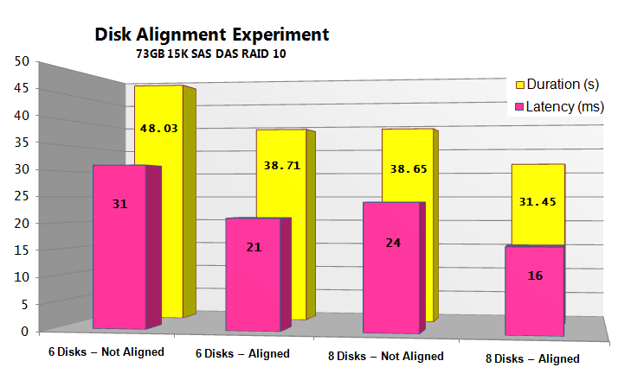
The one Slide Disk Alignment
30%
(Without leaving
your server room)
Notes:
The graph shows a run of a fixed number of IOPS on both 6 and 8 disks – aligned and non-aligned.

Slide 44
A Useful Trick…
Create LUN from the storage system with slightly different sizes
Example: 500.1GB, 500.2GB etc..
This allows you to quickly map between disk manager and the storage system
Can be very hard to map LUN to Windows if not using this trick

Slide 45
Designing high performance I/O for SQL Server
Benchmark and Sizing Methodology

Slide 46
I/O Benchmark Tools
SQLIO.exe
Unsupported tool available through Microsoft
IOMeter
Open source tool, Allows combinations of I/O types to run concurrently against test file
Not meant to exactly simulate SQL Server engine I/O , their purpose is to run a variety of I/O types to
“Shake-out” configuration problems
Determine capacity of the configuration
More details on benchmarking in the Pre-deployment Best Practices Whitepaper

Slide 47
Step 1 - Validate the Path to the Drives
HBA throughput , multi-pathing, etc…
Run sequential I/O against a file that is memory resident in the controller cache
Can throughput “near” theoretical aggregate bandwidth be achieved?
Example: Practical throughput on 4 Gb/s Fiber Channel port = ~ 360 MB/s
This could be the HBA, Switch port, Front end array ports
Test the HBA load balance paths (See later)
Potential Bottlenecks: Connectivity (HBA, Switch,etc), Controller/Service Processor, suboptimal host configuration
Recommended: Use vendor tools to diagnose

Slide 48
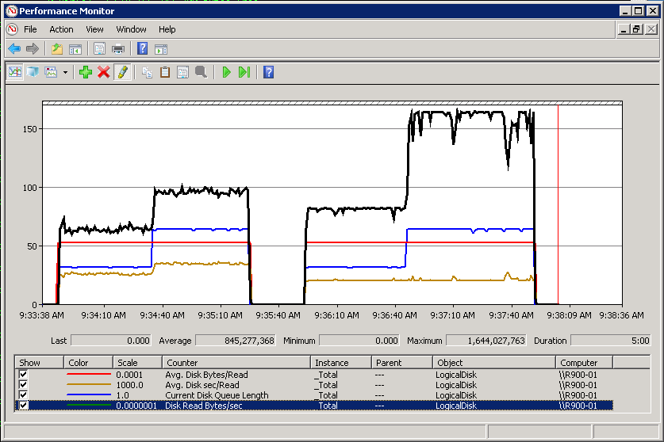
Validating Aggregate Bandwidth - Cached File Method
Two 4Gb/s dual port HBA’s
Theoretical throughput limit ~1.6 GB/s
Two paths to each service processor (~800 MB/s theoretical limit per SP)
First attempt – only ~1.0 GB/s total for both SPs
Second attempt – change load balancing algorithm to round robin

Slide 49
Step 2 -Validate the Disks
To get a true representation of disk performance use test files of approximate size to planned data files – small test files (even if they are larger than cache) may result in smaller seek times due to “short-stroking” and skew results
Use a test file at least 10 x cache size
Fill all drives in LUN to at least 50% space
Test each LUN path individually and then combinations of the I/O paths (scaling up)
Remember IOPs is most important for random access workloads (OLTP), aggregate throughput for scan intensive (DW)
Random reads are good for this as they take cache out of the picture (assuming large test file)
May need to run longer tests with sustained writes; cache will eventually be exhausted give a true representation of “disk speed” for the writes.

Slide 50
Workload Patterns
Test a variety of I/O types and sizes
Run tests for a reasonable period of time
Caching may behave differently after long period of sustained I/O
Relatively short tests are okay for read tests with low read cache
For write-back caches, make sure you run test long enough to measure the de-staging of the cache.
Allow time in between tests to allow the hardware to reset (cache flush)
Keep all of the benchmark data to refer to after the SQL implementation has taken place
Maximum throughput (IOPS or MB/s) has been obtained when latency continues to increase while throughput is near constant

Slide 51
Example patterns to Run
R/W% | Type | Block | Threads / Queue | Simulates
80/20 | Random | 8K | # cores / Files | Typical OLTP data files
0/100 | Sequential | 60K | 1 / 32 | Transaction Log
100/0 | Sequential | 512K | 1 / 16 | Table Scans
0/100 | Sequential | 256K | 1 / 16 | Bulk load
100/0 | Random | 32K | # cores / 1 | SSAS Workload
100/0 | Sequential | 1MB | 1 / 32 | Backup
0/100 | Random | 64K-256K | # cores / Files | Checkpoints
These are minimum runs for a mixed OLTP/DW environment. Take special care on monitoring cache effects and latencies of transaction log for OLTP environments

Slide 52
DB
Designing High Performance I/O systems
SQL Server’s View of I/O

Slide 53
SQL Server I/O tools
Tool | Monitors | Granularity
sys.dm_io_virtual_file_stats | Latency, Number of IO’s, Size, Total Bytes | Database files
sys.dm_os_wait_stats | PAGEIOLATCH, WRITELOG | SQL Server Instance level (cumulative since last start – most useful to analyze deltas over time periods)
sys.dm_io_pending_io_requests | I/O’s currently “in-flight”. | Individual I/O’s occurring in real time. (io_handle can be used to determine file)
sys.dm_exec_query_stats | Number of … Reads (Logical Physical) Number of writes | Query or Batch
sys.dm_db_index_usage_stats | Number of IO’s and type of access (seek, scan, lookup, write) | Index or Table
sys.dm_db_index_operational_stats | I/O latch wait time, Page splits | Index or Table
Xevents | PAGEIOLATCH, Page splits | Query and Database file

Slide 54
PFS/GAM/SGAM Contention
High rate of allocations to any data files can result in scaling issues due to contention on allocation structures
Impacts decision for number of data files per file group
Especially a consideration on servers with many CPU cores
PFS/GAM/SGAM are structures within data file which manage free space
Easily diagnosed by looking for contention on PAGELATCH_UP
Either real time on sys.dm_exec_requests or tracked in sys.dm_os_wait_stats
Resource description in form of DBID:FILEID:PAGEID
Can be cross referenced with sys.dm_os_buffer_descriptors to determine type of page
Notes:
For more details refer to:
http://sqlcat.com/technicalnotes/archive/2008/03/07/How-many-files-should-a-database-have-part-1-olap-workloads.aspx

Slide 55
How Many Data Files Do I Need?
More data files does not necessarily equal better performance
Determined mainly by 1) hardware capacity & 2) access patterns
Number of data files may impact scalability of heavy write workloads
Potential for contention on allocation structures (PFS/GAM/SGAM – more on this later)
Mainly a concern for applications with high rate of page allocations on servers with >= 8 CPU cores
Can be used to maximize # of spindles – Data files can be used to “stripe” database across more physical spindles
Notes:
11/20/2009 2:25 PM
55
© 2006 Microsoft Corporation. All rights reserved. Microsoft, Windows, Windows Vista and other product names are or may be registered trademarks and/or trademarks in the U.S. and/or other countries.
The information herein is for informational purposes only and represents the current view of Microsoft Corporation as of the date of this presentation. Because Microsoft must respond to changing market conditions, it should not be interpreted to be a commitment on the part of Microsoft, and Microsoft cannot guarantee the accuracy of any information provided after the date of this presentation. MICROSOFT MAKES NO WARRANTIES, EXPRESS, IMPLIED OR STATUTORY, AS TO THE INFORMATION IN THIS PRESENTATION.

Slide 56
The Problem with Autogrowth
All files do not fill equally
Causing I/O imbalance
Best practice: Pre-size data/log files, use equal size for files within a single file group and manually grow all files within filegroup at same time (vs. AUTOGROW)
But what if you already HAVE imbalance?
LUN
LUN
LUN

Slide 57
The Problem with SHRINKFILE
DBCC
SHRINK
7
8
5
6
3
4
1
2
LUN 1
LUN 2
LUN 3
LUN 4
Effect: All indexes are now 100% fragmented!
Workaround: Rebuild to new filegroup!

Slide 58
Why Should I Avoid a Single File per Filegroup for Large Databases?
Provides less flexibility with respect to mapping data files into differing storage configurations
Multiple files can be used as a mechanism to stripe data across more physical spindles and/or service processors (applies to many small/mid range arrays)
A single file prevents possible optimizations related to file placement of certain objects (relatively uncommon)
Allocations heavy workloads (PFS contention) may incur waits on allocation structures, which are maintained per file.

Slide 59
Why you should not use the PRIMARY Filegroup to store data
The primary filegroup contains all system objects
These CANNOT be moved to another filegroup
If using file group based backup, you must backup PRIMARY as part of regular backups
If not, you cannot restore!
Primary must be restored before other filegroups
Best Practice:
Allocate at least on additional filegroup and set this to the default.
Do not place objects in Primary

Slide 60
Data Files to LUN mapping – Two worlds
JBOD
SAME
LUN
LUN
LUN
Large LUN
Seq.
Seq.
Seq.
Seq.
Seq.
Seq.
Hard Disk
Hard Disk
Hard Disk
RAID system
File
File
Text File
File
File
File
File
RANDOM I/O
Hard Disk
Hard Disk
Hard Disk
Notes:
Typically, the ”best” solution is somewhere in between the two

Slide 61
TEMPDB – A Special Case
Tempdb placement (dedicated vs. shared spindles)
Generally recommended on separate spindles
However, depends on how well you know your workload use of tempdb
In some cases it may be better to place tempdb on spindles shared with data to utilize more cumulative disks
PFS contention is a bigger problem in tempdb
Best Practice: 1 File per CPU Core
Consider using trace flag -T1118 (disable mixed extends)ss

Slide 62
Designing High Performance I/O systems
Workload Specific

Slide 63
The Quick Guide to I/O Workloads
OLTP (Online Transaction Processing)
Typically, heavy on 8KB random read / writes
Some amount of read-ahead
Size varies – multiples of 8K (see read-ahead slide)
Many “mixed” workloads observed in customer deployments
Rule of Thumb: Optimize for Random I/O (spindle count)
RDW (Relational Data Warehousing)
Typical 64-512KB reads (table and range scan)
128-256KB writes (bulk load)
Rule of Thumb: Optimize for high aggregate throughput I/O
Analysis Services
Up to 64KB random reads, Avg. Blocks often around 32KB
Highly random and often fragmented data
Rule of Thumb: Optimize for Random, 32KB blocks

Slide 64
OLTP Workloads
I/O patterns generally random in nature
Selective reads
Writes to data files through periodic checkpoint operations
Random in nature with heavy bursts of writes
Can issue a large amount of outstanding I/O
Steady writes to transaction log
Many ”OLTP” deployments consist of ”mixed” workload with some amount of online reporting
Will result in larger block I/O that is sequential in nature to happen concurrent with small block (~8K) I/O
Can make sizing more challenging

Slide 65
I/O Sizing for SQL Server - OLTP
Do: Base sizing on spindle count needed to support the IOPs requirements with healthy latencies
Don’t: Size on capacity
Consider short stroking to get more IOPS / spindle
Remember the RAID level impact on writes (2x RAID 10, 4x RAID 5)
Cache hit rates or ability of cache to absorb writes may improve these numbers
RAID 5 may benefit from larger I/O sizes
Important: Critical to ensure low I/O latency on transaction log writes
Log response impacts transaction reponse times
High end systems should seek to keep latency <1ms
Important: Test the effects of a CHECKPOINT operation.
Often good idea to have enough write-cache to absorb it

Slide 66
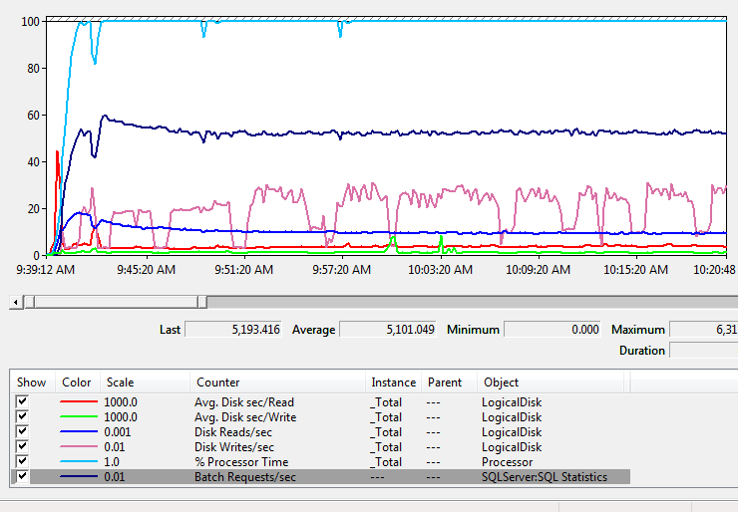
SQL Server on SSD
EMC DMX-4 Array
RAID5 - 3+1
4 physical devices
Log/Data on same physical devices
Database size (~300GB)
Random read and write for checkpoints / sequential log writes
16 core server completely CPU bound
Sustained 12K IOPs
Counter | Average
Avg Disk/sec Read (total) | 0.004
Disk Reads/sec (total) | 10100
Avg Disk/sec Write (total) | 0.001
Writes/sec (total) | 1944
Processor Time | 97
Batches/sec | 5100

Slide 67
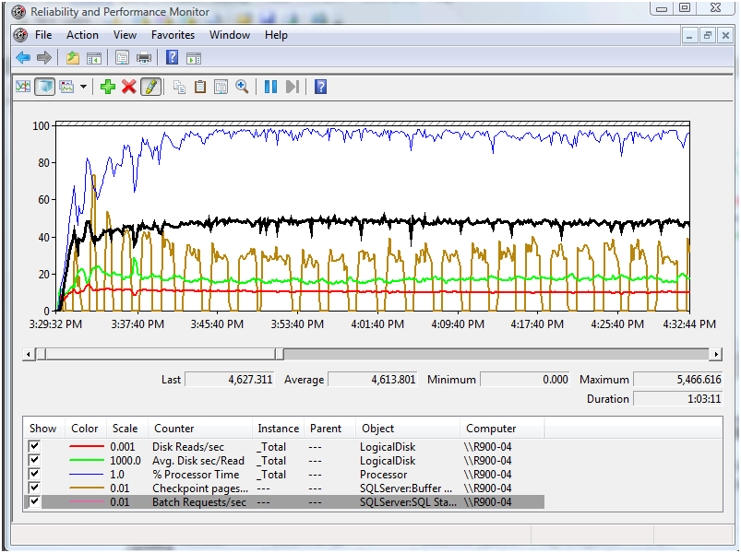
… Comparing with spinning media
EMC DMX4 Array
RAID 1+0
34 Physical Devices Data
4 Physical Devices Log
Same workload/database as SSD configuration (OLTP)
Nearly same sustained IO’s with ~10x number of spindles
Higher latency
Slightly lower throughput
“Short stroking” the spinning media
Counter | Average
Avg Disk/sec Read (total) | 0.017
Disk Reads/sec (total) | 10259
Avg Disk/sec Write (total) | 0.002
Writes/sec (total) | 2103
Processor Time | 90
Batches/sec | 4613

Slide 68
Keep in mind when comparing
Number of writes at the physical level are different than reported by perfmon due to RAID level
Physical IO is much higher on RAID 5 SSD’s
Traditional HDD is being ‘short-stoked’ resulting in more IOPs capacity for each physical drive
More information on these tests
http://www.emc.com/collateral/hardware/white-papers/h6018-symmetrix-dmx-enterprise-flash-with-sql-server-databases-wp.pdf
Disks | Total Logical I/O | Total Physical I/O (RAID Adjusted) | IOPS Per Device
SSD (RAID5) | 12,044 | 17,876 | 4,469
Traditional HDD (RAID10) | 12,362 | 14,465 | 380

Slide 69
I/O Sizing for SQL Server - DW
Do: Size on the aggregate throughput requirements
Don’t: Only consider the number of spindles needed for this – other components are often the bottleneck (controllers, switches, HBA’s, etc…)
Ensure there is adequate bandwidth (very important for sequential I/O workloads)
Know the limits of your path (HBA’s, switch ports, array ports)
320-360 MB/s Observed/practical throughput (per 4 Gb/s HBA)
Consider aggregate connectivity limits (host -> switch -> array)
Consider service processor or controller limits
Often, disabling read cache or using it for readahead gives best performance

Slide 70
Example Layout, DAS at Large Bank
File Group
File 0
Part 0
Dynamic Disk Stripe
LUN 0
LUN 1
File 2
File 3
Part 1
Part 2
Part 3
Dynamic Disk Stripe
Dynamic Disk Stripe
Dynamic Disk Stripe
LUN 2
LUN 3
LUN 4
LUN 6
File 1
LUN 5
LUN 7
HP SmartArray P600
HP SmartArray P600
HP SmartArray P600
HP SmartArray P600
HP SmartArray P600
HP SmartArray P600
HP SmartArray P600
HP SmartArray P600

Slide 71
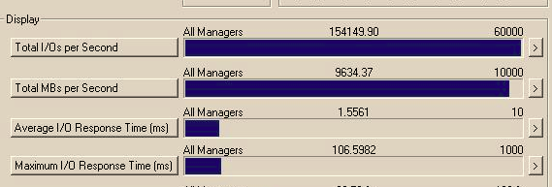
Example – DAS Layout - I/O Validation
Each P600 controller has a single, MSA 70 shelf
Each shelf can deliver around 1.2 GB/sec sequential read 64KB
Controller bandwidth limit on single channel
Controller has two channels, but we are only using one (others for backup SATA drives)
IOMeter test:

Slide 72
Analysis Services
Best Practice: Dedicate a single LUN for cubes
Store nothing else there (Fragmentation)
Typical characteristics:
Reads MUCH more than it writes – write once, read many
High Compression on subset of data
Cubes are small compared to relational source
Redudant Scale-out servers can be configured
Can also use scaled out servers for high availability
Strong synergy with SSD technology

Slide 73
Backup / Restore
Backup and restore operations utilize internal buffers for the data being read/written
Number of buffers is determined by:
The number of data file volumes
The number of backup devices
Or by explicitly setting BUFFERCOUNT
If database files are spread across a few (or a single) logical volume(s), and there are a few (or a single) output device(s) optimal performance may not be achievable with default BACKUP without BUFFERCOUNT parameter
Tuning can be achieved by using the BUFFERCOUNT parameter for BACKUP / RESTORE
More information in Tuning Backup Compression Part 1 & Part 2 Whitepapers

Slide 75
Appendix – Additional Reading

Slide 76
Additional Resources
SQL Server I/O Basics
http://www.microsoft.com/technet/prodtechnol/sql/2000/maintain/sqlIObasics.mspx
http://www.microsoft.com/technet/prodtechnol/sql/2005/iobasics.mspx
SQL Server PreDeployment Best Practices
http://sqlcat.com/whitepapers/archive/2007/11/21/predeployment-i-o-best-practices.aspx
Disk Partition Alignment Best Practices for SQL Server
http://sqlcat.com/whitepapers/archive/2009/05/11/disk-partition-alignment-best-practices-for-sql-server.aspx

Slide 77
Tools
Diskpar.exe
Windows 2000 Companion CD
http://www.microsoft.com/windows2000/techinfo/reskit/en-us/default.asp?url=/windows2000/techinfo/reskit/en-us/prork/pree_exa_oori.asp
SQLIO
Used to stress an I/O subsystem – Test a configuration’s performance
http://www.microsoft.com/downloads/details.aspx?FamilyId=9A8B005B-84E4-4F24-8D65-CB53442D9E19&displaylang=en
SQLIOSim
Simulates SQL Server I/O – Used to isolate hardware issues
231619 HOW TO: Use the SQLIOStress Utility to Stress a Disk Subsystem http://support.microsoft.com/?id=231619
Fiber Channel Information Tool
Command line tool which provides configuration information (Host/HBA)
http://www.microsoft.com/downloads/details.aspx?FamilyID=73d7b879-55b2-4629-8734-b0698096d3b1&displaylang=en

Slide 78
KB Articles
KB 824190 Troubleshooting Storage Area Network (SAN) Issues
http://support.microsoft.com/?id=824190
KB 304415: Support for Multiple Clusters Attached to the Same SAN Device
http://support.microsoft.com/?id=304415
KB 280297: How to Configure Volume Mount Points on a Clustered Server
http://support.microsoft.com/?id=280297
KB 819546: SQL Server support for mounted volumes
http://support.microsoft.com/?id=819546
KB 304736: How to Extend the Partition of a Cluster Shared Disk
http://support.microsoft.com/?id=304736
KB 325590: How to Use Diskpart.exe to Extend a Data Volume
http://support.microsoft.com/?id=325590
KB 328551: Concurrency enhancements for the tempdb database
http://support.microsoft.com/?id=328551
KB 304261: Support for Network Database Files
http://support.microsoft.com/?id=304261

Slide 79
General Storage References
Microsoft Windows Clustering: Storage Area Networks
http://www.microsoft.com/windowsserver2003/techinfo/overview/san.mspx
StorPort in Windows Server 2003: Improving Manageability and Performance in Hardware RAID and Storage Area Networks
http://www.microsoft.com/windowsserversystem/wss2003/techinfo/plandeploy/storportwp.mspx
Virtual Device Interface Specification
http://www.microsoft.com/downloads/details.aspx?FamilyID=416f8a51-65a3-4e8e-a4c8-adfe15e850fc&DisplayLang=en
Windows Server System Storage Home
http://www.microsoft.com/windowsserversystem/storage/default.mspx
Microsoft Storage Technologies – Multipath I/O
http://www.microsoft.com/windowsserversystem/storage/technologies/mpio/default.mspx
Storage Top 10 Best Practices
http://sqlcat.com/top10lists/archive/2007/11/21/storage-top-10-best-practices.aspx

Slide 80
SQL Server Storage References
SQL Server Consolidation on the 64-Bit Platform
http://www.microsoft.com/technet/prodtechnol/sql/2000/deploy/64bitconsolidation.mspx
SQL Server Consolidation on the 32-Bit Platform using a Clustered Environment
http://www.microsoft.com/technet/prodtechnol/sql/2000/deploy/32bitconsolidation.mspx
SQL Server 2000/2005 I/O Basics on TechNet
http://www.microsoft.com/technet/prodtechnol/sql/2000/maintain/sqlIObasics.mspx
http://www.microsoft.com/technet/prodtechnol/sql/2005/iobasics.mspx
Microsoft SQL Server I/O subsystem requirements for the tempdb database
http://support.microsoft.com/kb/917047
SQL Server AlwaysOn Partner program
http://www.microsoft.com/sql/alwayson/default.mspx
SQL Server PreDeployment Best Practices
http://www.microsoft.com/technet/prodtechnol/sql/bestpractice/pdpliobp.mspx
Scalability and VLDB Resources on Microsoft.com
http://www.microsoft.com/sql/techinfo/administration/2000/scalability.asp

Slide 81
Appendix – SQL Server I/O Patterns

Slide 82
Checkpoint / Lazy Writer
Workload Description
Pattern / Monitoring
Heavy bursts of random writes flushing dirty pages from buffer pool
Types of Checkpoints
Background/automatic checkpoints: Triggered by log volume or recovery interval and performed by the checkpoint thread
User-initiated checkpoints: Initiated by the T-SQL CHECKPOINT command.
Reflexive checkpoints: Automatically performed as part of some larger operation, such as recovery, restore, snapshot creation, etc.
Random, but SQL Server will attempt to find adjacent pages
Up to 256KB in a single I/O request
Performance Monitor
MSSQL:Buffer Manager
Checkpoint pages / sec
Lazy Writes / sec

Slide 83
Checkpoint (continued)
Checkpoint Throttling
Checkpoint measures I/O latency impact and automatically adjusts checkpoint I/O to keep the overall latency from being unduly affected
CHECKPOINT [checkpoint_duration]
CHECKPOINT now allows an optional numeric argument, which specifies the number of seconds the checkpoint should take
Checkpoint makes a “best effort” to perform in the time specified
If specified time is too low it runs at full speed
NUMA systems spread the checkpoints to writers on each node

Slide 84
Index Seeks
Workload Description
Pattern / Monitoring
Query plans performing loop joins will typically do many index seeks
Single row lookups in index
Traverse the B-Tree of the index, retrieve single page / row
OLTP workloads typically heavy on these
Random I/O
8 KB Block Sizes
dm_db_index_usage_stats
user_seeks
user_lookups
Performance Monitor:
MSSQL:Access Methods
Index Seeks / Sec
PAGEIOLATCH

Slide 85
Log Writes
Workload Description
Pattern / Monitoring
Threads fill log buffers & requests log manager to flush all records up to certain LSN
log manager thread writes the buffers to disk
Log manager throughput considerations
SQL Server 2005 SP1 or later
Limit of 8 (32-bit) or 32 (64-bit) outstanding log writes
No more than 480K “in-flight” for either
SQL Server 2008 increases “in-flight” per log to 3840K (factor of 8)
SQL Server 2000 SP4 & SQL Server 2005 RTM
Limit log writes to 8 outstanding (per database)
Sequential I/O
Write size varies
Depends on nature of transaction
Transaction “Commit” forces log buffer to be flushed to disk
Up to 60KB
SQL Server Wait Stats
WRITELOG, LOGBUFFER, LOGMGR
Performance Monitor:
MSSQL: Databases
Log Bytes Flushed/sec
Log Flushes/sec
Avg. Bytes per Flush
= (Log Bytes Flushed/sec) / (Log Flushes/sec)
Wait per Flush
= (Log Flush Wait Time) / (Log Flushes / sec)

Slide 86
Bulk Load
Workload Description
Pattern / Monitoring
Occurs when a bulk load operation is performed
Typical for DW workloads
I/O Depends on Data recovery mode
SIMPLE / BULK LOGGED mode writes to database
FULL writes to transaction log and flush to database
Sequential I/O
64KB-256 KB
Block sizes depend on database file layout
SQL Server Wait Stats
WRITELOG / LOGBUFFER
PAGEIOLATCH_EX
IMPROVIO_WAIT

Slide 87
Table / Range Scan
Workload Description
Pattern / Monitoring
Query plans doing hash and merge joining
Aggregation Queries
Typical for DW workloads
SQL Server may perform read-ahead
Dynamically adjust size of I/O based on page continuity
Standard Edition: Up to 128 pages in queue
Enterprise Edition: Up to 512 pages in queue
Sequential in nature I/O
Up to 512KB Block Sizes
SQL Server Wait Stats
PAGEIOLATCH
dm_db_index_usage_stats
user_scans
Performance Monitor:
MSSQL:Access Methods
Range Scans / Sec
Table Scans / Sec
MSSQL:Buffer Manager
Readahead Pages / sec

Slide 88
Analysis Services – I/O Pattern
I/O pattern
Random
Block sizes: 32-64KB
Low latency is advantageous
Fragmentation of disk is often high
Analysis Services cannot use data files to stripe
Can selectively place partition on multiple volumes

Slide 89
FILESTREAM
Writes to varbinary(max) will go through the buffer pool and are flushed during checkpoint
Reads & Writes to FILESTEAM data does not go through the buffer pool (either T-SQL or Win32)
T-SQL uses buffered access to read & write data
Win32 can use either buffered or non-buffered
Depends on application use of APIs
FileStream I/O is not tracked via sys.dm_io_virtual_file_stats
Best practice to separate on to separate logical volume for monitoring purposes
Writes/Generates to FILESTREAM generates less transaction log volume than varbinary(max)
Actual FILESTREAM data is not logged
FILESTREAM data is captured as part of database backup and transaction log backup
May increase throughput capacity of the transaction log
http://sqlcat.com/technicalnotes/archive/2008/12/09/diagnosing-transaction-log-performance-issues-and-limits-of-the-log-manager.aspx
Notes:
Thomas: I suggest we put this in appendix

Slide 90
TEMPDB – Understanding Usage
Many underlying technologies within SQL Server utilize tempdb (index rebuild with sort in tempdb, RCSI, etc..)
SQLServer:Transactions: Free Space in Tempdb (KB)
Version Store counters
Related DMVs
sys.dm_db_session_space_usage
sys.dm_db_task_space_usage, sys.dm_exec_requests
Remember certain SQL features will utlize tempdb (it’s not just used by temporary objects from T-SQL)
Sevice Broker, RCSI, internal objects (hash tables), online index rebuild, etc…

Slide 91
Appendix – Configuring Partitions and Disks

Slide 92
A Higher Level – Disks and LUNs
Each Disk Maps to a LUN
Mapping can be discovered with Diskpart.exe
A LUN abstracts the physical disks below it
Understand the physical characteristics of each LUN
Windows cannot “see” how the LUN is build
Use vendors tool for this!
Best Practice: Make sure you learn how to use that tool!
Two types of basic disk
MBR (Default) – Limited to 2TB
GPT – In theory limit of 4 Exabyte
You can convert an MBR to GPT using Disk Manager but only before the partitions are created
Basic Disk = LUN

Slide 93
LUN, Volume / Partitions
Each LUN may contain more than one Volumes / Partitions
Partitions are formatted using a file system
NTFS or FAT
Best Practise: Use NTFS
If the partition is not the last partition, it can be dynamically extended
Best Practise: One partition per disk/LUN
Partition / Volume
Extendable space

Slide 94
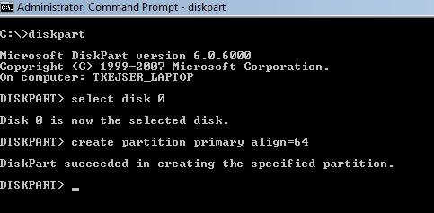
Creating and Formatting Partitions
Disk Partition Align new partitions at creation time
Boundary should align with stripe size of the RAID configuration
Rule of Thumb: Use 1024KB (Win2008 default)
Sector alignment cannot be controlled using Windows Disk Manager
Windows 2000 Server
DISKPAR (note the missing T) can be used to create ‘aligned’ partitions
Available as part of the Windows 2000 Resource Kit
Windows 2003 Server Service Pack 1
DISKPART.EXE contains a new /ALIGN option eliminating the need for DISKPAR.EXE
create partition primary align=1024
Windows 2008 Server
Sector aligning done automatically at 1024KB boundary
NTFS Allocation Unit Size
Best Practice: 64KB for SQL Server
For Analysis Services, may benefit from 32KB

Slide 95
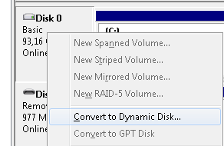
Dynamic Disks – A Special Case
Using Disk Manager, you can convert a basic disk to a Dynamic Disk
Dynamic Disks allows you to create software RAID
Options:
RAID0 (striped Volume)
RAID1 (mirrored Volume)
RAID5 (striped with parity)
Typical usage:
Stripe (RAID0) multiple LUN togethers
Can be used to work around storage array limitations
Limitations / considerations:
Cannot be used in clusters
Cannot grow Stripes or RAID-5 dynamically
Cannot be aligned
Use dmdiag.exe to discover information about the dynamic drives

Slide 96
Dynamic Disk vs. Basic Disks
Feature | Basic Disk | Dynamic Disk
Cluster Support | Yes | No
Mount point in cluster | Yes | No
Software Stripe Support | No | Yes
Software Mirror Support | No, must use abilities of I/O sub system | Yes
Dynamic Growth | Yes | Only non-striped disks
Supports alignment | Yes | No
Tool to view alignment | Diskpar or Diskpart | dmdiag

