Slide 1
Column Store Index and Batch Mode Scalability

Slide 2
About me . . .
An independent SQL Consultant
A user of SQL Server from version 2000 onwards with 12+ years experience.

Slide 3

The scalability challenges we face . . . . Slides borrowed from Thomas Kejser with his kind permission

Slide 4
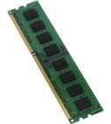
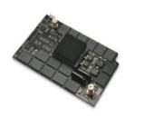






CPU Cache, Memory and IO Subsystem Latency
Core
L1
L2
L3
Core
L1
L2
Core
L1
L2
Core
L1
L2
1ns
10ns
100ns
10us
100us
10ms
Notes:
Note the difference in latency between accessing the on CPU cache and main memory, accessing main memory incurs a large penalty in terms of lost CPU cycles, this is important and one of the drivers behind the new optimizer mode that was introduced in SQL Server 2012 in order to support column store indexes.

Slide 5
C The “Cache out” Curve
Throughput
Every time we drop out of a cache and use the next slower one down, we pay a big throughput penalty
CPU Cache
TLB
NUMA
Remote
Storage
Touched
Data Size
Notes:
This slide follows on from the previous one and quantifies what we lose in terms of throughput as we drop out of the different caches and IO sub systems in the cache / memory / IO sub system hierarchy.

Slide 6
C Sequential Versus Random Page CPU Cache Throughput
CPCaches
Service Time + Wait Time

Slide 7
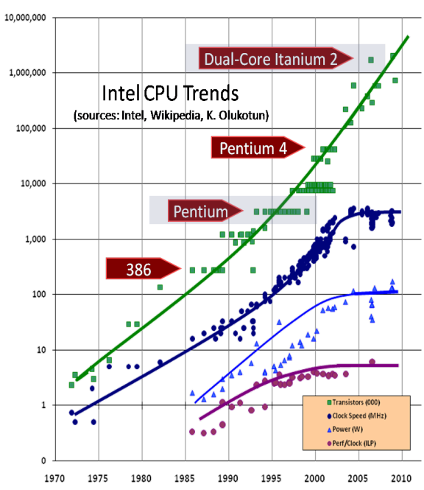
Moores Law Vs. Advancements In Disk Technology
“Transistors per square inch on integrated circuits has doubled every two years since the integrated circuit was invented”
Spinning disk state of play
Interfaces have evolved
Aerial density has increased
Rotation speed has peaked at 15K RPM
Not much else . . .
Up until NAND flash, disk based IO sub systems have not kept pace with CPU advancements.
With next generation storage ( resistance ram etc) CPUs and storage may follow the same curve.

Slide 8
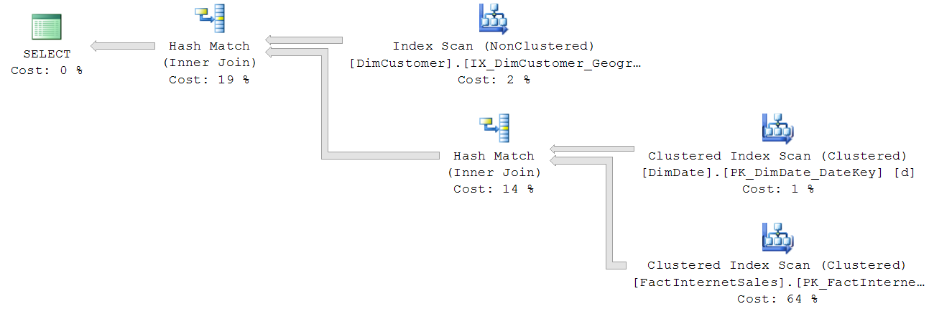
How Execution Plans Run
Control flow
Row by row
Row by row
Row by row
Row by row
How do rows travel between
Iterators ?
Data Flow
Notes:
Each operator has an open(), close(), next() method. An operator pulls data through the plan by calling the next() method on the next operator down. The ‘Root’ operator drives the control flow for the whole plan. Data is moved row by row throughout the entire plan; inefficient in terms of CPU instructions per row and prone to expensive CPU cache misses.

Slide 9

What Is Required
Query execution which leverages CPU caches.
Break through levels of compression to bridge the performance gap between IO subsystems and modern processors.
Better query execution scalability as the degree of parallelism increase.

Slide 10
Optimizer Batch Mode
First introduced in SQL Server 2012, greatly enhanced in 2014
A batch is roughly 1000 rows in size and it is designed to fit into the L2/3 cache of the CPU, remember the slide on latency.
Moving batches around is very efficient*:
One test showed that regular row-mode hash join consumed about
600 instructions per row while the batch-mode hash join needed about 85 instructions per row and in the best case (small, dense join domain) was a low as 16 instructions per row.
* From: Enhancements To SQL Server Column Stores Microsoft Research

Slide 11
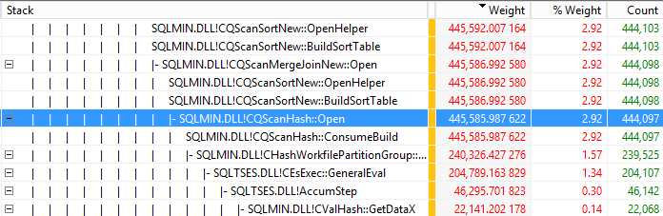
Stack Walking The Database Engine
xperf –on base –stackwalk profile
SELECT p.EnglishProductName
,SUM([OrderQuantity])
,SUM([UnitPrice])
,SUM([ExtendedAmount])
,SUM([UnitPriceDiscountPct])
,SUM([DiscountAmount])
,SUM([ProductStandardCost])
,SUM([TotalProductCost])
,SUM([SalesAmount])
,SUM([TaxAmt])
,SUM([Freight])
FROM [dbo].[FactInternetSales] f
JOIN [dbo].[DimProduct] p
ON f.ProductKey = p.ProductKey
GOUP BY p.EnglishProductName
xperfview stackwalk.etl
xperf –d stackwalk.etl
Notes:
Xperf can provide deep insights into the database engine that other tools cannot, in this case we can walk the stack associated with query execution and observe the total CPU consumption up to any point in the stack in milliseconds

Slide 12

How do we squeeze an entire column store index into a CPU L2/3 cache ?
Answer Its pipelined into the CPU

Slide 13
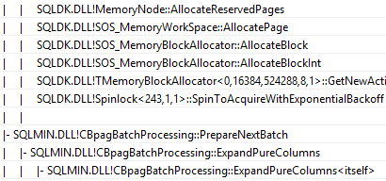
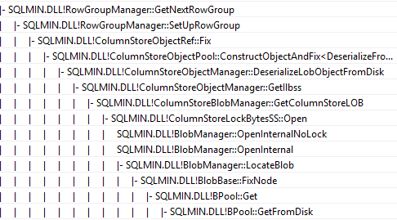
Conceptual View . . .
. . and whats happening in the call stack
Break blobs into batches and pipeline them into CPU cache
CPU
Load
segments
into
blob
cache
Lob cache
Notes:
According to the Microsoft research paper on improvements made to column store indexes and batch mode in SQL 2014, the large object cache is new and it stores blob data contiguously in memory without any page breaks. The reason for this is that sequential page access for a CPU cache gives twice the throughput compared to single page access. Refer to slide 73 of “Super Scaling SQL Server Diagnosing and Fixing Hard Problems” by Thomas Kejser.

Slide 14
What Difference Does Batch Mode Make ?
x12
at DOP 2
Notes:
The slides on cache, memory and disk latency and “The cache out curve” have been building up to this one particular slide. It is the leveraging the on die CPU cache that make this speed up possible. The one big takeaway of using column store indexes in on this slide, the fact that based on two logical CPUs alone, there are tremendous performance improvements to be had through batch mode.

Slide 15
What Are The Pre-Requisites For Batch Mode ?
Feature | SQL Server 2012 | SQL Server 2014
Presence of column store indexes | Yes | Yes
Parallel execution plan | Yes | Yes
No outer joins, NOT Ins or UNION ALLs | Yes | No
Hash joins do not spill from memory | Yes | No
Scalar aggregates cannot be used | Yes | No
Notes:
Not much difference, why ?. Column stores do not store data in sorted order, however the encoding and compression process can reorder data in order to help achieve better levels of compression.

Slide 16

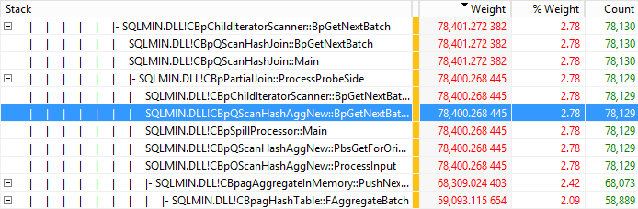
Row mode
Hash Match
Aggregate
445,585 ms*
Vs.
Batch mode
Hash Match
Aggregate
78,400 ms*
* Timings are a statistical estimate
Notes:
This slide illustrates the efficiency of the batch mode hash aggregate versus its row mode counterpart, also consider that the time of 78,400 ms is split across two logical CPUs ( schedulers ).

Slide 17
Optimizing Serial Scan Performance
Dictionary
Lookup ID | Label
1 | Red
2 | Blue
3 | Green
Compressing data going down the column is far superior to compressing data going across the row, also we only retrieve the column data that is of interest.
Run length compression is used in order to achieve this.
SQL Server 2012 introduces column store compression . . ., SQL Server 2014 adds more features to this.
Colour
Red
Red
Blue
Blue
Green
Green
Green
Segment
Lookup ID | Run Length
1 | 2
2 | 2
3 | 3
Notes:
Run length compression is a generic term that pre-dates the column store functionality in SQL Server, it alludes to the techniques of compressing data by converting sequences of values into encoded “Run lengths”. The database engine scans down a column and stores each unique value it encounters in a dictionary, this can be local to a segment, ( the basic column store unit of storage; containing roughly 1 million rows ) and / or the dictionary can be global to the column store. Where sequences of values are found these are stored as encoded run lengths. In the example above the sequence of two red values is stored as 1, 2 etc . . .

Slide 18
SQL Server 2014 Column Store Storage Internals
Row
Groups
A B C
< 102,400 rows
Encode & Compress
Store
Delta stores
Encode and Compress
Columns
Segments
Blobs
Notes:
Delta stores are new to SQL Server 2014 and they provide the means via which existing column stores can be inserted into. SQL Server 2014 also introduces column store archive compression. Writes to blobs, which row groups are stored as, are sequential in nature, for trickle inserts the presence of a delta store (b-tree) to act as a buffer mitigates against this. Updates take place by the deletion bit map for the column store being set and a new row being inserted into the column store via a delta store.

Slide 19
Column Store Index Split Personality
Global dictionary
Deletion Bitmap
Local Dictionary
Inserts of 102,400 rows and over
Inserts less than 102,400 rows and updates
update = insert into delta store + insert to the deletion bit map
Tuple mover
Delta store B-tree
Column store segments
Notes:
The state of row groups and delta stores can be obtained through sys.column_store_row_groups.

Slide 20
What Levels Of Compression Are Achievable ? Our ‘Big’ FactInternetSales Table
SELECT [ProductKey]
,[OrderDateKey]
,[DueDateKey]
,[ShipDateKey]
,[CustomerKey]
,[PromotionKey]
,[CurrencyKey]
.
.
INTO FactInternetSalesBig
FROM [dbo].[FactInternetSales]
CROSS JOIN master..spt_values AS a
CROSS JOIN master..spt_values AS b
WHERE a.type = 'p'
AND b.type = 'p'
AND a.number <= 80
AND b.number <= 100
Size (Mb)
57 %
74 %
92 %
94 %
494,116,038 rows

Slide 21
What Levels Of Compression Are Achievable ? Stack Exchange Posts* Table
53 %
59 %
64 %
72 %
* Posts tables from the four largest stack exchanges combined ( superuser, serverfault, maths and Ubuntu )

Slide 22
SQL Server 2012 / 2014 Column Store Comparison
Feature | SQL Server 2012 | SQL Server 2014
Column store indexes | Yes | Yes
Clustered column store indexes | No | Yes
Updateable column store indexes | No | Yes
Column store archive compression | No | Yes
Columns in a column store index can be dropped | No | Yes
Support for GUID, binary, datetimeoffset precision > 2, numeric precision > 18. | No | Yes
Enhanced compression by storing short strings natively ( instead of 32 bit IDs ) | No | Yes
Bookmark support ( row_group_id:tuple_id) | No | Yes
Mixed row / batch mode execution | No | Yes
Optimized hash build and join in a single iterator | No | Yes
Hash memory spills cause row mode execution | No | Yes
Iterators supported | Scan, filter, project, hash (inner) join and (local) hash aggregate | Yes

Slide 23

Column Store Index and Batch Mode Test Drive
Disclaimer: your own mileage may vary depending on your data, hardware and queries

Slide 24
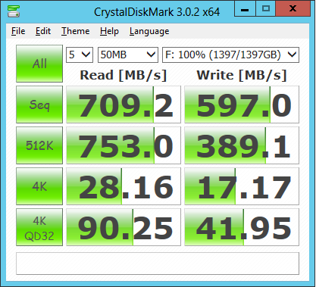
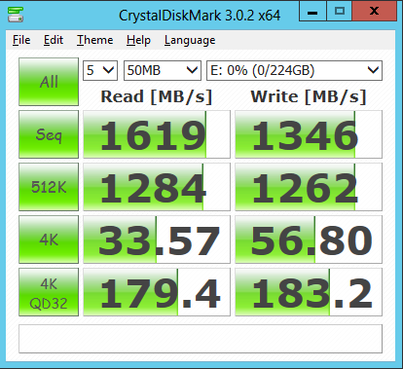
Test Set Up
Hardware
2 x 2.0 Ghz 6 core Xeon CPUs
Hyper threading enabled
22 GB memory
Raid 0: 6 x 250 GB SATA III HD 10K RPM
Raid 0: 3 x 80 GB Fusion IO
Software
Windows server 2012
SQL Server 2014 CTP 2
AdventureWorksDW DimProductTable
Enlarged FactInternetSales table

Slide 25

Sequential Scan Performance
SELECT SUM([OrderQuantity])
,SUM([UnitPrice])
,SUM([ExtendedAmount])
,SUM([UnitPriceDiscountPct])
,SUM([DiscountAmount])
,SUM([ProductStandardCost])
,SUM([TotalProductCost])
,SUM([SalesAmount])
,SUM([TaxAmt])
,SUM([Freight])
FROM [dbo].[FactInternetSalesBig]
2050Mb/s 678Mb/s 256Mb/s 85% CPU 98% CPU 98% CPU
Notes:
Something on this slide, specifically around compression on flash requires further investigation. As the level of compression goes up on flash, IO throughput goes down and CPU consumption goes up, hypothesis: the flash throughput is so high that the CPU resources required to perform the decompression becomes a factor and throttles IO throughput back, the net effect being that elapsed execution time is longer.

Slide 26
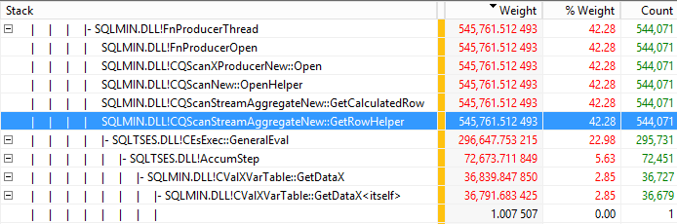
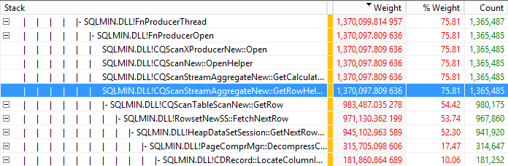
No compression
545,761 ms*
Vs.
Page compression
1,340,097 ms*
All stack trace timings are a statistical estimate

Slide 27
52 Mb/s 27 Mb/s
99% CPU 56% CPU
Notes:
This is subtly different to the scenario we had with row and page compression, the hypothesis for sustained CPU consumption going down when column store archive compression is used, is that column store archive decompression does not scale that well across multiple schedulers and / or the process of decompression individual segments is single threaded in nature.

Slide 28
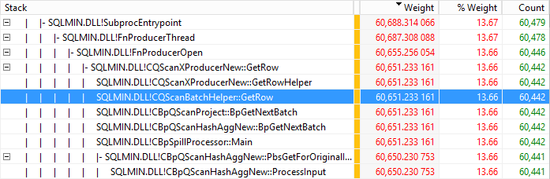
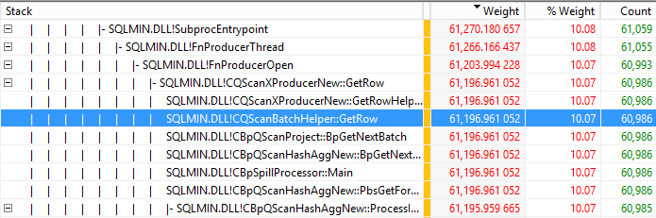
Clustered column store index
60,651 ms
Vs.
Clustered column store index with archive compression
61,196 ms

Slide 29


Takeaways
What most people tend to have
CPU
CPU used for IO consumption + CPU used for decompression < total CPU capacity
Compression works for you ☺
Notes:
If your IO sub system does not have enough throughput to keep you processors busy, there is value to be had in using compression. On the other hand, if your IO sub system can keep up with your CPUs and then some, the use of compression can send performance backwards.

Slide 30
Takeaways
CPU
CPU used for IO consumption + CPU used for decompression > total CPU capacity
Compression works against you ☹
CPU used for IO consumption + CPU used for decompression = total CPU capacity
Nothing to be gained or lost from using compression
Notes:
If your IO sub system does not have enough throughput to keep you processors busy, there is value to be had in using compression. On the other hand, if your IO sub system can keep up with your CPUs and then some, the use of compression can send performance backwards.

Slide 31
Testing Join Scalability
We will look at the best we can do without column store indexes:
Partitioned heap fact table with page compression for spinning disk
Partitioned heap fact table without any compression our flash storage
Non partitioned column store indexes on both types of store with and without archive compression.
SELECT p.EnglishProductName
,SUM([OrderQuantity])
,SUM([UnitPrice])
,SUM([ExtendedAmount])
,SUM([UnitPriceDiscountPct])
,SUM([DiscountAmount])
,SUM([ProductStandardCost])
,SUM([TotalProductCost])
,SUM([SalesAmount])
,SUM([TaxAmt])
,SUM([Freight])
FROM [dbo].[FactInternetSalesBig] f
JOIN [dbo].[DimProduct] p
ON f.ProductKey = p.ProductKey
GROUP BY p.EnglishProductName

Slide 32
Time (ms)
Join Scalability DOP / Time (ms)
Degree of parallelism
Notes:
Something strange happens around a DOP of 10 which I have not had the chance to investigate as yet.

Slide 33
Join Scalability DOP / Time (ms)
Notes:
With the flash clustered column store index ( with/ / without archive compression ) we get reasonable scalability up to a DOP of 10, with the partitioned table on the previous slide, we only got to a DOP of 8, before we started getting diminishing returns.

Slide 34
Takeaways
A simple join between a dimension and fact table using batch mode is an order of magnitude faster than the row mode equivalent.
For flash, the cost of decompressing the column store is more than offset by:
CPU cycle savings made by moving rows around in batches.
CPU cycles savings made through the reduction of cache misses.

Slide 35

Diving Deeper into Batch Mode Scalability

Slide 36
Average CPU Utilisation and Elapsed Time (ms) / Degree of Parallelism
2 4 6 8 10 12 14 16 18 20 22 24
Notes:
Elapsed time should decrease in a linear fashion as CPU consumption increases in a linear manner, the obvious explanation for this is that we are burning CPU cycles in a non production manner.

Slide 37
Wait and Spinlock Analysis At 100 CPU Utilisation
Wait Wait_S Resource_S Signal_S Waits Percentage
------------------------- -------- ----------- -------- ------ -------------------
HTBUILD 0.490000 0.477000 0.013000 138 55.3047404063205411
SOS_SCHEDULER_YIELD 0.245000 0.050000 0.195000 46131 27.6523702031602702
QUERY_TASK_ENQUEUE_MUTEX 0.079000 0.053000 0.026000 23 8.9164785553047403
LATCH_EX 0.036000 0.034000 0.002000 89 4.0632054176072234
HTDELETE 0.024000 0.011000 0.013000 138 2.7088036117381485
Total spinlock spins = 554397
Hypothesis: could main memory not being able to keep up ?

Slide 38
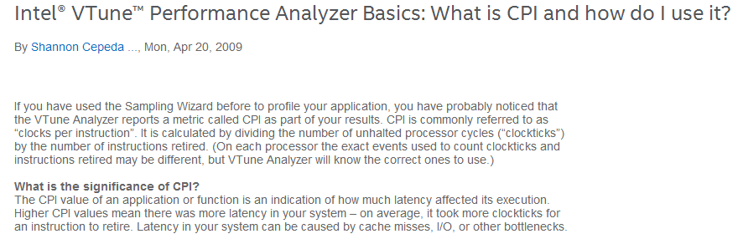

Slide 39
Going past one memory channel per physical core
2 4 6 8 10 12 14 16 18 20 22 24

Slide 40

Takeaway
Memory bandwidth
Function of:
Memory channels
Number of DIMMS
DIMM speed
=
Total CPU core consumption capacity

Slide 41

Further Reading
Enhancements To Column Store Indexes (SQL Server 2014 ) Microsoft Research
SQL Server Clustered Columnstore Tuple Mover Remus Rasanu
SQL Server Columnstore Indexes at Teched 2013 Remus Rasanu
The Effect of CPU Caches and Memory Access Patterns Thomas Kejser

Slide 42

Thanks To My Reviewer and Contributor
Thomas Kejser
Former SQL CAT member and CTO of Livedrive

Slide 43



Contact Details
chris1adkin@yahoo.co.uk
http://uk.linkedin.com/in/wollatondba
ChrisAdkin8

Slide 44
Questions ?

