Slide 1

Fasten your seatbelt and listen to the (Data) Steward
Jean-Pierre Riehl
Florian Eiden
http://blog.djeepy1.net | @djeepy1
http://fleid.net | @fleid_BI

Slide 2






Who are we ?
Florian Eiden
Managing Consultant, Data & Analytics - Cellenza
MVP SQL Server
Board Member at GUSS
Jean-Pierre Riehl
Practice Manager Data & BI – AZEO
MVP SQL Server
President at GUSS

Slide 3





.Pro
GUSS : PASS France chapter
Webcasts, Conferences, Afterworks
Next event :
SQLSaturday Paris 2014
September 13th
Tour Montparnasse, Paris
English-speaking track

Slide 4
The Context

Slide 5
Self-Service BI
Corporate BI
Team BI
Self-Service BI
Managed
Company-wide
Shared
Department-wide
Quick & Easy
Personal data
Document-centric
DatawareHouse
Models

Slide 6

Empower Users
Release Data, Release usages

Slide 7
Governance noun.
« Leading the conduct of things or persons »

Slide 8
The Issues

Slide 9

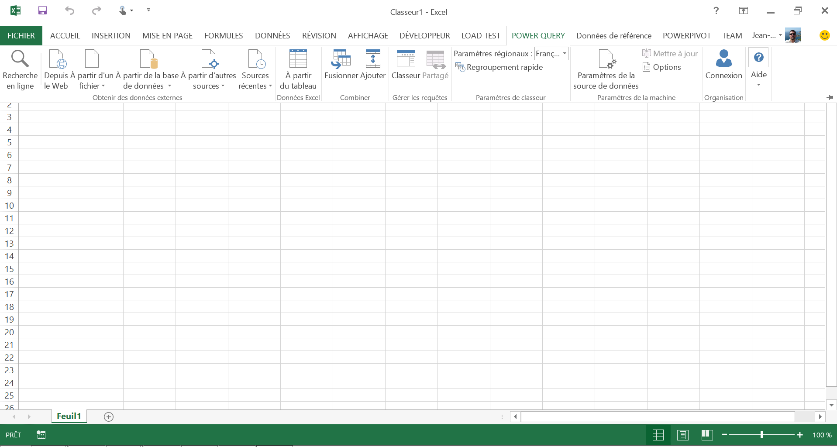
Issue #1
Writer’s block
also known as
White Worksheet Syndrom
?

Slide 10

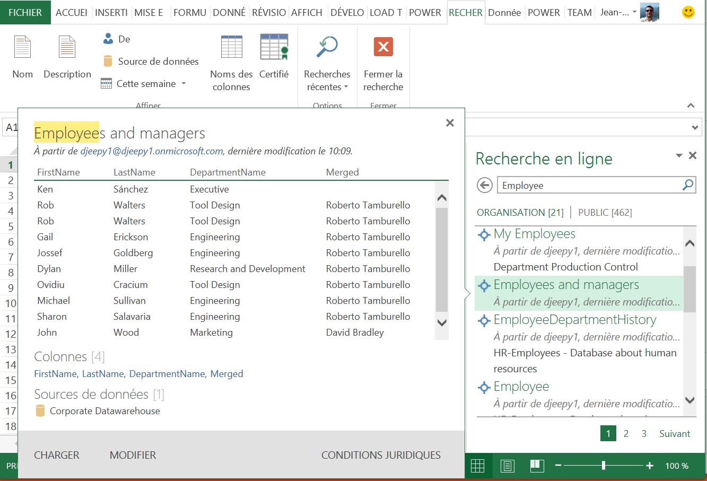
Issue #2
Too much Data !
« I want the Employee’s List »
Duplicates
Wrong sources
Bad Data
Poor or Bad description
Etc.

Slide 11

Issue #3
Compliance
Security
Encryption
Anonymization

Slide 12

How does it scale ?

Slide 13
Power BI
The Microsoft Way

Slide 14

Features and tools
Insights in Excel
Collaborate in Office 365
Discover
Search, access, and transform public and internal data sources with Power Query
Share
Share datasets and workbooks refreshable from on-premises and cloud based data sources, with Power BI Sites
Analyze
Easy data modeling and lightning fast in-memory analytics with Power Pivot
Question
Ask questions and get immediate answers with natural language query
Q&A
Visualize
Bold new interactive data visualizations with Power View and Power Map
Mobility
Mobile access through HTML5 and touch optimized apps
Scalable | Manageable | Trusted

Slide 15

Power BI - Big Picture
Data Refresh
External Data
Power BI O365 Tenant
SQL
Oracle
…
Q&A
Power BI Admin Center
Data Catalog
Excel
Power BI Sites
Power Query
Power Pivot
Power Query
Power View
Power Map
Index
Search
Cloud
Cloud
On-Prem
Data Management Gateway

Slide 16
Ideas of costs
Acquire Data
Visualize
Excel 2010* (with limitations)
Excel 2013
Sharing in SharePoint On-Prem
0€
Modelize
Geo-Reporting
Share
Collaborate
Natural
Langage
Base on SharePoint Online (O365 Tenant)
Possible de ne partager que les métadonnées
360€
by user / year
Q&A
Search
Mobility
Rendre opérationnel
Data Refresh : ouverture de flux
450€
by user / year
All Inclusive
(ie. including Office 2013 ProPlus Licences)

Slide 17
Power BI vs. On-Prem
There was some SSBI before Power BI
 | Power BI* | On-Prem
Data Sources | Gateways & Data Sources | Shared Data Sources (SSRS) Office Data Connection
Datasets | Queries | Shared Datasets (SSRS) Power Pivot for SharePoint
Models | Power Pivot Data Management Gateway | Power Pivot for SharePoint
Dashboards | Power View | Power View (BISM) SSRS over Power Pivot
* Many more features to come

Slide 19
If all you have is hammer…
Tools are only a part of the solution
Good formula : People + Processes + Tools
« Data governance is between 80 and 95% communication » - Dec 2006 Data Governance Conference
We have the tools, let’s talk about the rest…

Slide 20
The Data Steward

Slide 21

A Steward?
Wikipedia: Stewardship is an ethic that embodies the responsible planning and management of resources.
Data Steward of Gondor…
Not our idea, see Matthew Roche for complaints

Slide 22
My pretty typical organization
Business Divisions
Functional Units
Armors & Shield
Finance
HR
Legal
Bludgeoning items
Piercing items
IT : Information Technology
Slashing items

Slide 23
Where are stewards needed in the org?
Business Divisions
Functional Units
Armors & Shield
Finance
HR
Legal
Bludgeoning items
Piercing items
IT : Information Technology
Slashing items

Slide 24

My organization : actual perception
Business Divisions
Functional Units
Armors & Shield
Finance
HR
Legal
Bludgeoning items
Piercing items
IT
Slashing items

Slide 25







Well, let’s be honest about what it looks like
Business Divisions
Functional Units
Armors & Shield
Finance
HR
Legal
Bludgeoning items
Piercing items
IT
Slashing items

Slide 26


For maximum results: local initiatives
Business Divisions
Functional Units
Armors & Shield
Finance
HR
Legal
Bludgeoning items
Piercing items
IT
Slashing items

Slide 27



A warning : difficult places to start
Business Divisions
Functional Units
Armors & Shield
Finance
HR
Legal
Bludgeoning items
Piercing items
IT
Slashing items

Slide 28

Let’s get back to our steward
Slashing items
Why :
Specific to your company, to be defined in your master plan
How :
“Responsible planning and management of resources”
What :
Elect data stewards that will enable, teach, police

Slide 29



Required skills
Skills
Interpersonal skills
Good personal organization
Data-awareness
Data lifecycle specific to the company
General understanding of BI/data technologies
Data merging, cleaning, metadata maintenance
Training in tools used in the company
A chosen career path
It’s an actual job, usually part time
But not just an additional task in the schedule!

Slide 30

The Journey of a Data Steward

Slide 31

The Journey of a Data Steward
Help to find data
Manage the Data Lake
Create Data Sources
Facilitate exploration
Manage metadata

Slide 32
The Journey of a Data Steward
Manage new data
Find new Data Sources
Find new Datasets
Verify new datasets
Check for Accuracy
Check for duplicates
Fix sources and queries
Use of Workflows

Slide 33



Data Workflows
Data Steward
Sandox
Create
Derive
Publish
Approve
Enhance
Analyst
Data Hub
Models, OData, Reports, DWH, MDM, etc.
Discovery
Developer

Slide 34
The Journey of a Data Steward
Certify
Ensure Corporate Policies
Train & Teach
Help for modeling
Help for analysis

Slide 36


Importance of relations
Data Steward
Business
Users
IT
Developers
Information Management Platform
Tools
Tools
Tools

Slide 37
And reality is more complex
Sales
Mktg
Production
IT
Information Management Platform

Slide 38
Data(source) Lifecycle Management

Slide 39
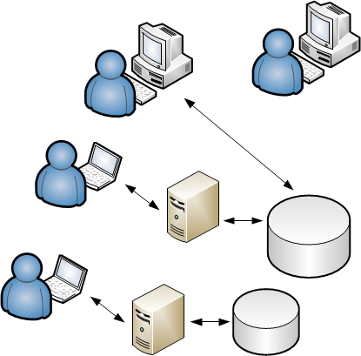
Data Lifecycle Management

Slide 40

Data Lifecycle Management

Slide 41
Data Lifecycle Management

Slide 42

Data Lifecycle Management

Slide 43
Data Source Lifecycle Management
Manage, enable
Teach, assist
Analyse, merge
Data
Steward

Slide 44
Data Source Lifecycle Management
Applied to : data artifacts
Data sets
Files: CSV, XLSX
Metadata
Data Models
Documentation
Data sources
Queries
…
Data asset administration
Create, Delete
Update, Maintain
Give/revoke access
Refresh schedule
Monitor
…
Business metadata understanding
Data manipulation

Slide 45
Conclusion

Slide 46
A matter of governance
Tools are nothing without people and processes
Governance is different in every company
Decided and sponsored by the executives, inscribed in a global strategy
Adapted to your organization
The Data Steward as the local implementation of it

Slide 47
How to start tomorrow ?
Build an Information Management Platform
Identify your processes & Org Chart
Write the Data Steward « Job Profile »
Identify the right people for the job
Leverage Self-Service BI
Ask your local experts

Slide 48
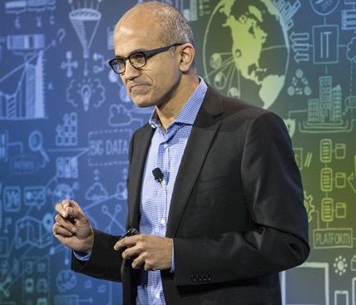
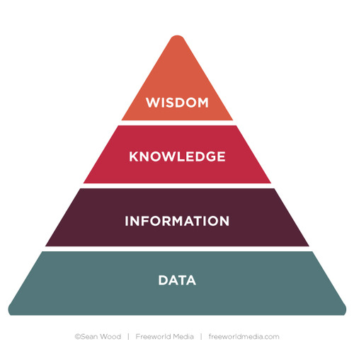
All this for what?
A Data Culture
See Satya Nadella
April 15th 2015 presentation in SF
To at last step up in the knowledge pyramid!
Machine learning \o/

Slide 49

Thank You !
Any questions ?

