Slide 1
Understanding Parameter Sniffing
Benjamin Nevarez
Blog: benjaminnevarez.com
Twitter: @BenjaminNevarez

Slide 2
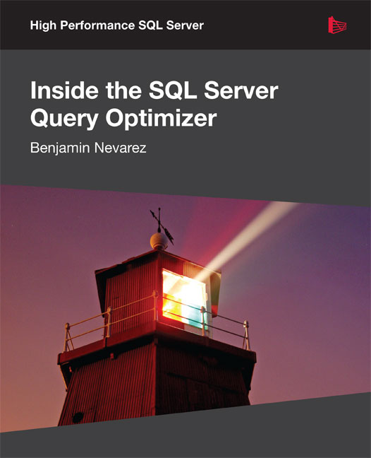
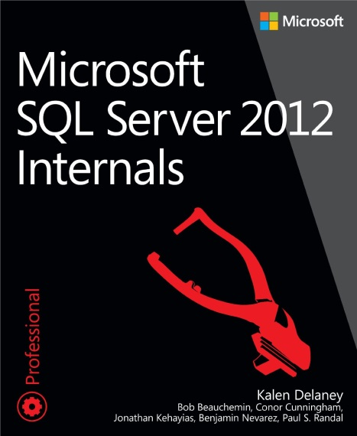
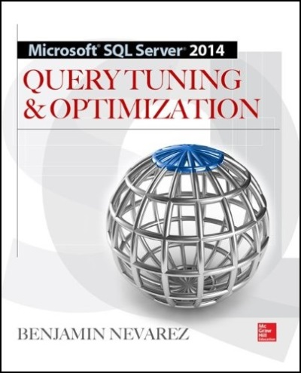
About the Speaker Benjamin Nevarez
Author of “Inside the
SQL Server Query
Optimizer” and “SQL
Server 2014 Query
Tuning & Optimization”
Working with SQL Server for
15 years
2

Slide 3
Query Optimizer - purpose
It analyzes a number of candidate execution plans for a given query, estimates the cost of each of these plans, and selects the plan with the lowest cost of the choices considered.
Requires a lot of resources (mostly CPU, optimization time)

Slide 4
Procedure Cache - purpose
Cache query plans and allow for their reuse
Minimize compile/optimization time
4

Slide 5
Parameterization
Parameterized queries: query plan can be reused many times even if the parameter value changes
Query not explicitly parameterized: in most cases plan can only be reused with the exact parameter value
5

Slide 6
Parameterization
Explicit Parameterization: application is written to separate parameters from the query text
sp_executesql, stored procedures
ADO, OLE DB, and ODBC
Implicit Parameterization: Application do not explicitly uses parameters
Simple Parameterization
Forced Parameterization
6

Slide 7
Explicit Parameterization
Application is written to separate parameters from the query text
CREATE PROCEDURE test (@pid int)
AS
SELECT * FROM Sales.SalesOrderDetail
WHERE ProductID = @pid
7

Slide 8
Implicit Parameterization
Application do not explicitly uses parameters
Forced Parameterization
Requires ALTER DATABASE … PARAMETERIZATION FORCED
Simple Parameterization (autoparameterization)
Very conservative policy
8

Slide 9
Parameterization
Demo
9

Slide 10
Parameter Sniffing
It is a very good thing: getting an execution
plan tailored to the current parameters of a query naturally improves the performance
of your applications.
However, some performance problems can occasionally appear
10

Slide 11
Parameter Sniffing
Given that the Query Optimizer can produce different execution plans for syntactically identical queries, depending on their parameters, caching and reusing only one of these plans may create a performance issue for alternative instances of this query which would benefit from a better plan
11

Slide 12
Parameter Sniffing
Demo
Using the statistics histogram
Producing two distinct plans for the same query
12

Slide 13
Optimize for a typical parameter
Most of the executions of a query use the same plan
Avoid an ongoing optimization cost
ALTER PROCEDURE test (@pid int)
AS
SELECT * FROM Sales.SalesOrderDetail
WHERE ProductID = @pid
OPTION (OPTIMIZE FOR (@pid = 897))
13

Slide 14
Optimize for a typical parameter
Demo
14

Slide 15
Optimize on every execution
Best execution plan for every query
You end up paying for the optimization cost
ALTER PROCEDURE test (@pid int)
AS
SELECT * FROM Sales.SalesOrderDetail
WHERE ProductID = @pid
OPTION (RECOMPILE)
15

Slide 16
Optimize on every execution
Demo
16

Slide 17
OPTIMIZE FOR UNKNOWN and Local Variables
Disables parameter sniffing
Query Optimizer uses the density information of the statistics object (instead of the histogram)
Ignore parameters, uses the same plan
17

Slide 18
OPTIMIZE FOR UNKNOWN and Local Variables
ALTER PROCEDURE test (@pid int)
AS
SELECT * FROM Sales.SalesOrderDetail
WHERE ProductID = @pid
OPTION (OPTIMIZE FOR UNKNOWN)
18

Slide 19
OPTIMIZE FOR UNKNOWN and Local Variables
Demo
OPTIMIZE FOR UNKNOWN
Local Variables
Using the statistics density
19

Slide 20
Query plan caching and various SET options
Some SET options are plan-reuse-affecting
ANSI_NULL_DFLT_OFF
ANSI_NULL_DFLT_ON
ANSI_NULLS
ANSI_PADDING
ANSI_WARNINGS
ARITHABORT
CONCAT_NULL_YIELDS_NULL
DATEFIRST
DATEFORMAT
FORCEPLAN
LANGUAGE
NO_BROWSETABLE
NUMERIC_ROUNDABORT
QUOTED_IDENTIFIER
20

Slide 21
Query plan caching and various SET options
Finding the bad plan is more complicated
Some SET options are plan-reuse-affecting
21

Slide 22
Query plan caching and various SET options
Demo
Finding Plans with different SET options
Finding plans using Profiler/SQL trace
22

