Slide 1
SAN Eye for the SQL Girl/Guy
Hue Holleran
Notes:
Today, you’ll see a running, configured SAN that will be torn-down and re-built in-front of your eyes! We’ll configure the dedicated SAN network that we’ll use iSCSI to connect guests to the SAN and we’ll provision a Windows file-system on two separate VMs to explore all the steps to provision on the SAN and bring iSCSI devices to Windows guests.

Slide 2
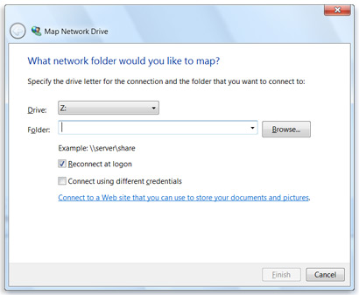
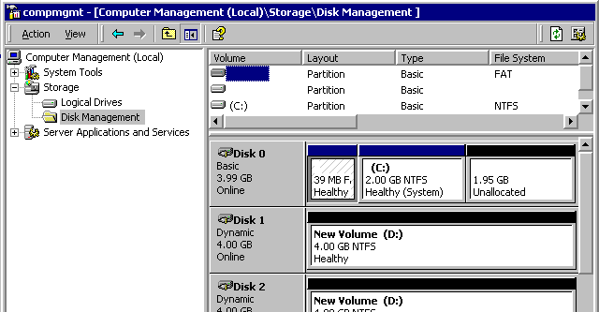
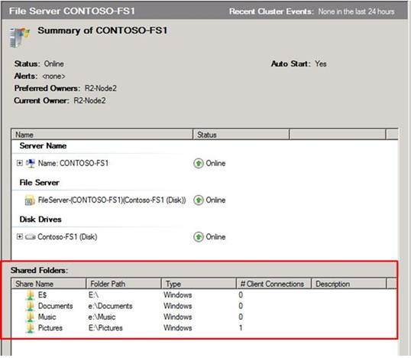
Block Access versus File Share Access
Block Access
File Share Access
Notes:
More familiar to those with a *nix background maybe . . . Block devices versus File Share access. Block devices (‘disks’) are visible in Storage Management and need a file system created on them to be usable; whereas remote File Shares already have a file system created on them on another server and provide pre-backed storage to create files and folders.

Slide 3
SAN versus NAS versus DAS
SAN Storage Area Network
Block Access
X × £10,000s -to- £100,000s
NAS Network Attached Storage
Shared (General Network)
X × £1,000s
DAS Directly Attached Storage
Dedicated to One OR Limited Hosts
Block Access
File Share Access
Shared (Dedicated Network)
X × £1,000s
Block Access
File Share Access
Notes:
Traditionally, a SAN exposed only ‘Block’ devices over iSCSI or FC Fibre Channel; whereas a NAS traditionally exposed only File Share access over the network. Over time, SANs added functionality to expose pre-baked shares from some of their volumes; and NASs added support for exposing block devices usually over iSCSI. DAS is largely obsolete as it provides (usually SCSI) block access through a dedicated plug-in ‘HBA’ card to only one or two servers; DAS has completely been supplanted by NAS exposing block devices OR lower-end SAN; we’ll see a lower-end SAN in the demonstration in a moment . . .
So, if SANs and NASs have similar features why pay all the extra cost for a SAN over just using a NAS? SANs provides MUCH higher throughput, extra monitoring and notification capabilities and redundancy features such as multiple, independent network interfaces; multiple power supplies; and multiple internal storage processors. Even the disks supplied in SANs are optimised to tolerate extra vibration and to delegate error handling to the SAN (ie. so that the SAN can hot-replace a disk if it starts showing issues). SANs also have additional sophisticated capabilities to ‘tier’ the data, viz: tune the physical location of data on disk OR use a mixture of very fast solid state SSD storage and traditional hard disks to provide fastest access to the ‘hottest’ data.

Slide 4
’(Storage) Pools’ and ’LUNs’
~7.2TB RAID5 ‘pool’ 12× ‘active’ disks (20%=3 ‘lost’ due to RAID5)
12× 600GB = ~7.2TB
LUN#1
LUN#2
~4.8TB RAID10 ‘pool’ 8× ‘active’ disks (50%=8 ‘lost’ due to RAID10)
8× 600GB = ~4.8TB
LUN#1
LUN#2
LUN#3
eg. 16×Disks
Created 1st (Storage) Pool defines RAID level and which physical disks
eg. 15×Disks
RAID10
RAID5
Notes:
Vendors use a variety of terminology BUT we will just use ‘(Storage) Pool’ AND ‘LUN’ that satisfies discussing in broad terms:
Firstly, we must create a ‘Pool’ (Storage Pool/Disk Group(ing)/RAID Pool/Storage Group/etc.) and this defines the exact disks we will use AND the RAID level to produce a ‘pool’ of storage. The RAID level chosen will determine the resultant available storage, viz: in RAID10 (stripe of mirrors) we ‘lose’ 50% of the disks; for RAID5 approximately 1 disk in 5 is lost (varies by vendor).
Some vendors refer to arrays with multiples of the basic building block at a RAID level (eg. 4-8 disks for RAID10; 5 disks for RAID5) as ‘aggregate’ pools. Vendors may offer additional RAID levels (RAID Z; ‘Super’RAID; etc.) with claimed additional benefits over the standard RAID levels, eg. dynamic resize; better resilience when disks are lost; improved performance for certain workloads etc. NB: for database workloads we typically favour RAID10 due to its absence of write penalty (see: http://theithollow.com/2012/03/understanding-raid-penalty/)
LUNs: Once the ‘pool’ has been created, ‘LUNs’ are then allocated from this pool, and typically multiple LUNs are allocated from a pool, usually to different servers and workloads – this sharing of the underlying disks by multiple LUNs may be one reason that poor OR unpredictable performance is seen for a workload.
Initially a small LUN may be allocated to produce a block of storage to be allocated to a server and extended/concatenated later by adding extra (non-contiguous) LUN space (or again a vendor may call this ‘aggregated’ LUNs – good ol’ vendor-specific terminology!).

Slide 5
Soup2nuts Demo: Configure a SAN
Notes:
In this demo we see a SAN with some LUNs allocated and we’ll drop the LUNs’ server allocations; drop the LUNs; then drop the underlying Pools. (on the EMC SAN we are using ‘pools’ are called Storage Pools and LUNs are called ‘Virtual Disks’).
We are using a SAN on a dedicated network connected to a VMware ESXi server via a Gigabit switch; we’ll use a wireless access point to ‘tap-into’ the SAN network – this is NOT a recommended thing to do on a production environment BUT is great way to see the SAN iSCSI traffic for demonstration! We just allocate an IP Address on the 10.60.X.X (SAN) Network and we investigate the SAN traffic from our laptop.
We now select some 300GB disks and create a RAID10 Pool #1; then we select some 600GB disks and create another RAID10 Pool #2. Via the webcam onto the SAN disks we can see the activity from the underlying disks in the array.
From Pool #1 we cut 3× LUNs of 10GB; 2GB and 500MB (in real production we would use MUCH bigger LUN, of course) and we immediately see disk activity on Pool #1 via the webcam; From Pool #2 we cut 1× LUN of 5GB. We observe that the LUN on Pool #2 begins creating immediately BUT the two later LUNs on Pool #1 do NOT begin creating until the first LUN on Pool #1 has completed – the SAN intelligently serialises access to shared devices.
With our LUNs created we use the Microsoft iSCSI initiator on a VM to contact the SAN. After authorising the VM we turn this LUN into a Windows block device and we create a filesystem on this new device. We do the same on the second VM with another volume on the same Pool #1.
In a longer demonstration we would now proceed to run an SQL Server workload on one LUN and a ‘noisy’ disruptive workload on another LUN and observe the negative impact and erratic response from the LUN – one way that poor OR erratic behaviour can be observed from a SAN.
You’ve now seen a complete SAN torn-down and re-built from scratch in just-over 30 minutes and then storage provisioned and allocated to Windows servers . . . so when your SAN admin claims it’s ‘gonna take 3 weeks’ you can ask for more detail on why it will actually take so long!

Slide 6
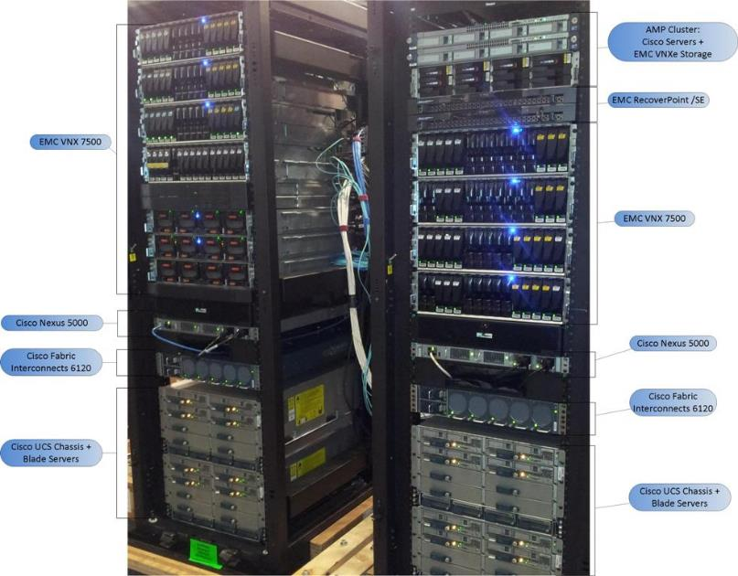
Our day-to-day SAN ☺
Notes:
In reality, SANs are usually have MANY more disks than our demonstration SAN – here is the SAN we use for performance testing that has over 150×disks as opposed to the 12×disks we have here.

Slide 7
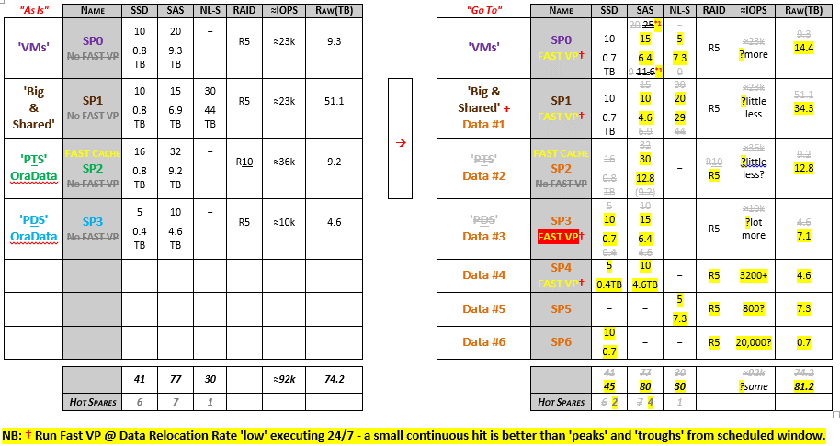
The big re-org . . .
Notes:
It is possible to re-structure a SAN once it has been created – here’s how we decided recently to re-structure our SAN to move from 4 to 7 Pools and to create special-purpose pools, eg. SSD-only pools and pools of lower-performance SATA (NL-SAS) disks for mimicking a lower-end SAN . . . it seemed like a good idea to re-structure this at one time!

Slide 8
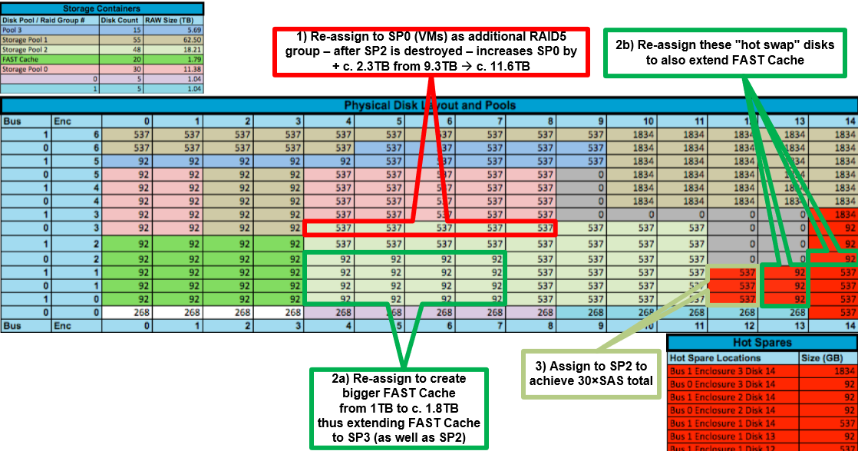
The big re-org . . . whose idea was this??
Notes:
In reality, we have to define exactly how each disk will be allocated to the pools . . . each block here is an SSD, an SAS HDD –or- a SATA HDD and the colour groupings define the pool to which the disk belongs. In this diagram we define which disks and how their allocation will change.
Your SAN administrator will maintain a similar diagram to that shown here.

Slide 9
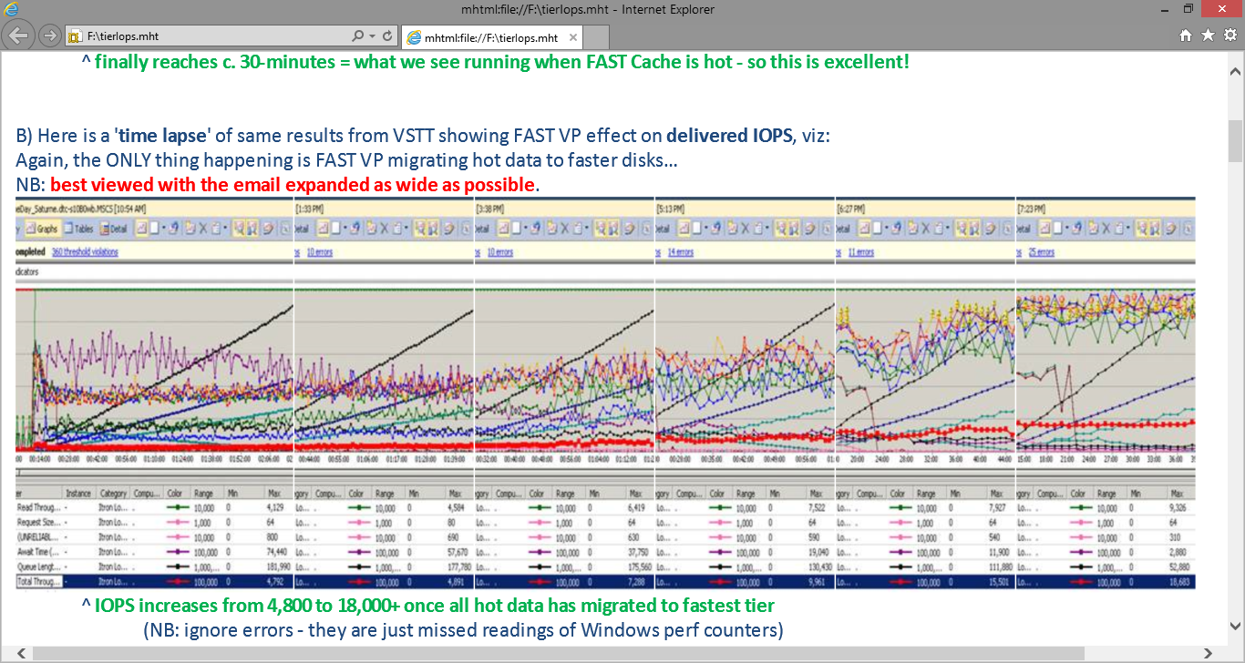
Effect of data tiering
Notes:
Many vendors now support ‘(data) tiering’ – ie. mixed pools of solid state (SSD) mixed-in with traditional HDDs and this can give great results to suitable workloads. Here is an example whereby a workload that was taken over 1.5hrs reduced to 30mins as the array moved the ‘hot’ data to faster disks over the period of several hours (top graph on slide).
The metrics below show the IOPS increasing from a 4,000 to nearly 18,000 IOPS as more and more hot data got moved to the faster disks – without making any other changes to the application – purely based-on the SAN learning the workload! Treat all vendor additional cost licenced features with suspicion (OR ask them to prove that they help) – BUT they can be helpful for some workloads - as seen here.

Slide 10
Useful Resources
Please support the SQLBits sponsors – who make this conference possible
http://www.freenas.org/ ^ a really nice, simple NAS (with iSCSI) that can be deployed trivially in a VM
http://techhead.co/emc-vnx-and-celerra-virtual-storage-appliance-vsa-free-download-link/ ^ these are downloadable VMs of working EMC SANs in a box with lots of disks allocated – perfect if you want to hone skills OR try a large SAN for yourself – can allocated LUNs to VMs
http://www.rainiersolutions.com/RainierLibrary/iSCSI%20SAN%20Performance.pdf ^ really interesting article on getting most from iSCSI – BUT has great background info too
http://www.wmarow.com/strcalc/ ^ online IOPS calculator for SAN pools of different RAID and disks
Contact me @hueholleran OR hueholleran.com
Notes:
If you want to replicate what I’ve done here today – then grab FreeNAS and create a VM – this can trivially expose LUNs over iSCSI.
To experience a high-end SAN yourself . . . grab the EMC deployable VMs that mimic a high-end SAN (with lots of disks already provisioned). This VM can even expose LUNs to other VMs. There are limitations, though – only the Celerra download has iSCSI provided.
The iSCSI article gives really nice background info on how iSCSI is optimised for real production workloads. Nowadays 1GBit iSCSI is obsolete and 10GBit is normal; OR even iSCSI over Infiniband (40GBit+) – BUT the article is still very useful nonetheless due to the background info.
The online IOPS calculator can give you an indication once you know your underlying SAN disks to calculate what IOPS and latency you should be getting from your SAN.
Feel free to contact me on twitter OR visit my blog at www.hueholleran.com – look forward to seeing you soon and hope you enjoyed the session!

