Slide 1
Europe’s Premier Community
SQL Server Conference
#SQLBITS

Slide 2
The “Black Art” of Processing SSAS Multidimensional Databases
Dr. John Tunnicliffe Decision Analytics
Independent BI Architect & Hands-On Developer
Mobile: 07771 818770
john@decision-analytics.co.uk

Slide 3
Agenda
Dimension Processing
Partition Processing
Improving Processing Performance
Implementation Options
AMO and XMLA etc.
Do’s and Don’ts

Slide 4
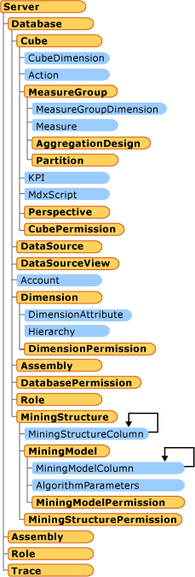
Implementation Details: SSAS Object Model
“Processing” loads data
Builds indexes and aggregations
Objects to Process Include
Database
Dimension
Cube
Measure Group
Partition
Exposed via AMO

Slide 5
Relational Database Issues
Relational data integrity is key
Foreign key relationships offer tremendous benefits!
Ignore the “performance overhead” critics
Perform inserts, not updates, so no re-writing of clustered indexes
Do not attempt to impose data integrity during cube processing
MUST be able to identify
New dimensional members
New fact rows

Slide 6
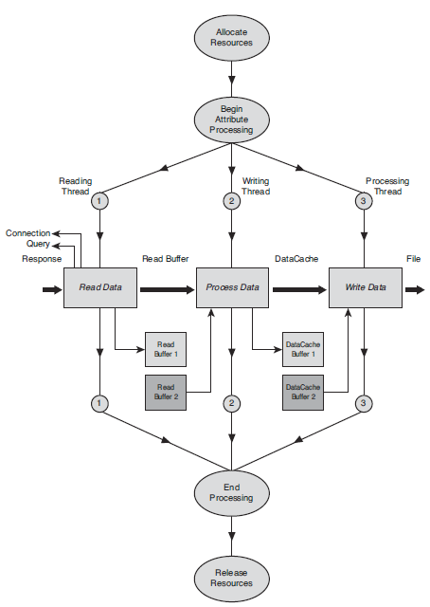
Dimension Processing: Four Main Phases
Attribute Processing
Read data from relational
Process data
Generate DataIDs
Write data
Analyse & Compress
Build Hierarchies
Sort members
Build Decoding Tables
Build Indexes

Slide 7
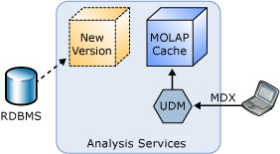
Dimension Processing Options
ProcessFull – best avoided
Drops data in all related partitions
ProcessUpdate
Compares dimensional data with results of
If relationships change, will drop indexes on related partitions
Follow with ProcessIndexes or set ProcessAffectedObjects flag
Will find processing takes a long time – more than ProcessFull !!!
ProcessAdd – best practice
Have to build XMLA or use AMO
SQL query to return only new members
Set error configuration KeyDuplicate=IgnoreError

Slide 8
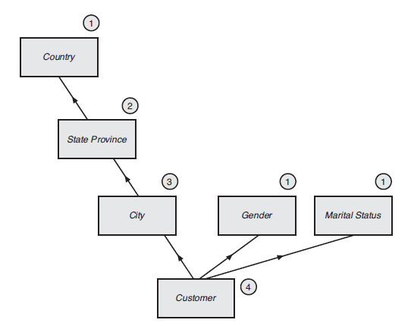
Dimension Processing: Attribute Processing Order
Attribute processing order determined by relationships
Relationships can be defined as rigid (unchanging) or flexible
No relationships = least efficient processing

Slide 9
Dimension Processing: Flexible vs. Rigid Relationships
Rigid = unchanging
Issue: dimension processing can fail if SQL query returns unexpected results
Flexible = open to change
Issue: ProcessUpdate on dimension invalidates indexes for all associated partitions – if relationship changed
Therefore requires ProcessIndex (or ProcessRelatedObjects=true) which increases overall processing time

Slide 10
Why Partition?
Divide measure groups into physical storage groups
Enhance query performance
Improve processing performance
Facilitate data management

Slide 11
Enhanced Query Performance: Partition Elimination
Only partitions containing relevant data are queried
Other partitions eliminated based on partition slice
Auto-Slice
SSAS sets auto-slice based on DataIDs found during processing
However, if DataIDs cover range, auto-slice can have unpredictable results
Manual slice – must set for ROLAP
MDX tuple defining content of partition
Directly related to partitioning strategy

Slide 12
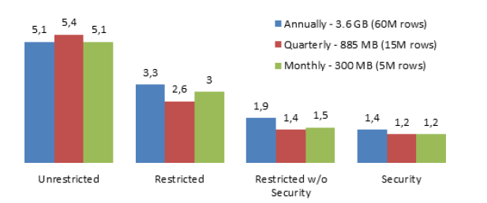
Partition Strategy: Partition Size
200MB to 3GB range (approx. 4 to 50 million rows)
Query performance not impacted by size

Slide 13
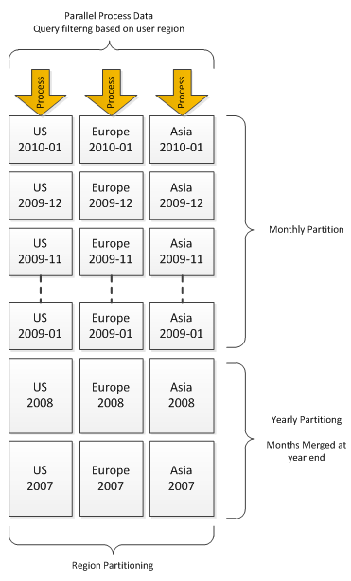
Partition Strategy: Partitioning Criteria
Partition by Date
Matrix Partitioning
By date and some other factor
Relational Database
Reflect OLAP partitioning
Partition by date and clustered index on other factor
Keep #partitions in low thousands
As increases cube metadata overhead

Slide 14
Partition Strategy: Partition Storage Modes
MOLAP
Proactive Caching
Trace Events
Scheduled Polling
Client Initiated
Process via external application
HOLAP
Builds indexes and aggregations
ROLAP
Data read directly from source database
Issue: Query cache can become ‘stale’

Slide 15
MOLAP Proactive Caching Options: Three notification mechanisms
Trace events
SQL Server raises notification events on a per-transaction basis
Issue: requires MsSqlServerOlapService to run as system admin
Scheduled Polling
Can rebuild or incrementally update the cache
Queries database to check if data has changed
Issue: “cache thrash” caused by incorrect settings
Client Initiated
Send a NotifyTableChange XMLA command to SSAS
General issue: does not create new partitions

Slide 16
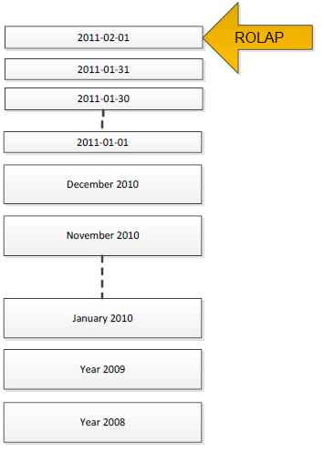
Partition Strategy: ROLAP + MOLAP
ROLAP
frequently updated current data
MOLAP
historical data

Slide 17
Partition Strategy: ROLAP Considerations
MUST set a partition slice
Avoid measures with nullable fields
Avoid many-to-many dimensions
Avoid parent-child dimensions
Don’t use ROLAP dimensions
Use direct table bindings
Avoid JOINs in the query
Use separate table for each cube partition
reading partitioned table does not work

Slide 18
Partition Strategy: Partition Processing Options
ProcessFull
Clears existing data and reloads
Partition swapped in once fully processed
Best practice – use ProcessData + ProcessIndexes
ProcessAdd
Incrementally update a partition
SQL query to return new rows only
SSAS actually creates new partition containing only new rows and merges new partition with old
During processing, key/value pairs for all dimensions loaded into memory
Large dimensions can cause SSAS to process in multiple passes

Slide 19
Partition Strategy: Handling Inserts, Updates and Deletes
ProcessFull – caters for them all
Handling Inserts with ProcessAdd
SQL query that adds new rows
Handling Updates with ProcessAdd
SQL query that negates old rows and adds new rows
Handling Deletes with ProcessAdd
SQL query that negates old rows

Slide 20
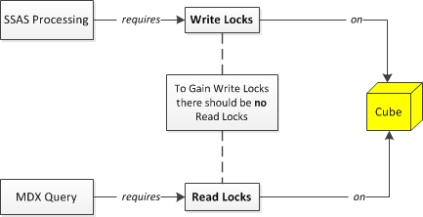
SSAS Locking Issues
Queries compete with processing for locks

Slide 21
Improving Processing Performance: Dimensions
Delete extraneous attributes
Design cascading user hierarchies
add attribute relationships
Disable ordering on dimensional attributes
AttributeHierarchyOrdered=false
Turn off attribute hierarchy (i.e. make a property)
AttributeHierarchyEnabled=false
Especially for attributes provided for sorting
Remove bit-map indexes on high-cardinality attributes
AttributeHierarchyOptimized=NotOptimized

Slide 22
Improving Processing Performance: Dimensions
Check if ByTable processing improves performance
ProcessingGroup=ByTable
Must set error config so KeyDuplicate=IgnoreError
If dimension derived from multiple tables, MUST use a view
Optimise SQL source queries
Use a view
Use NOLOCK hint in the view
Remove JOINs
Build indexes
Plus numerous other techniques….

Slide 23
Improving Processing Performance: Use efficient data types
Surrogate keys use integers (tinyint, smallint, int, bigint)
Hold dates as integers in format yyyyMMdd
Integer measures use integers (tinyint, smallint, int, bigint)
Numeric measures use smallmoney, money, real, float
Note that decimal and vardecimal require more CPU power to process than money and float types
Money data types are more efficient for SSIS to load into table as not converted into strings

Slide 24
Improving Processing Performance: Partition Processing
Processing each partition uses 2 CPUs
So add more CPUs to process more partitions in parallel !!
Parallel process partitions from the same measure group
Serialize partition processing from different measure groups
Typical throughput – into one partition
50k records per second = good
100k records per second = optimized

Slide 25
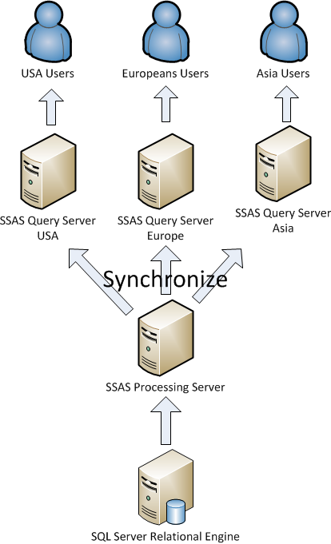
Improving Processing Performance: Front-End Servers
Multiple front-end SSAS query servers
Takes query load off processing server
Reduces locking conflicts
Dedicated SSAS processing server
Synchronize using
XMLA Synchronize
RoboCopy etc.

Slide 26
Improving Processing Performance: Infrastructure
Increase network bandwidth
Bigger pipes
Use jumbo frames
Set packet size to 32767 bytes
Increase number of database connections
multiple dimensions or partitions can be processed in parallel
Warning: too many can swamp database
Co-host SQL Server relational and SSAS
Can then set database connection to use in-memory transfer

Slide 27
Implementation Details: Implementation Options
XMLA Scripts
SQL Server Management Studio (SSMS)
SQL Server Agent Job
Ascmd command-line utility
SSIS Analysis Services Execute DDL Task
SSIS Analysis Services Processing Task
C# script task in SSIS using AMO and XMLA
C# using AMO and XMLA
PowerShell using AMO and XMLA

Slide 28
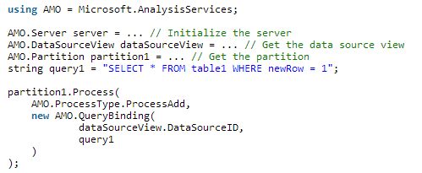
Implementation Details: Processing using AMO

Slide 29
Implementation Details: Log Warnings and Errors
Parallel Execution
oServer.CaptureXml = true;
… processing commands …
oServer.CaptureXml = false;
XmlaResultCollection oResults = oServer.ExecuteCaptureLog(true, true, false);
// Log warning and error messages
foreach (AMO.XmlaResult oResult in oResults)
{
foreach (AMO.XmlaMessage oMessage in oResult.Messages)
{
LogMsg(oMessage.GetType().Name, oMessage.Source, oMessage.Description);
}
}

Slide 30
Implementation Details: XMLA Batch Command
<Batch Transaction="Boolean" ProcessAffectedObjects="Boolean">
<Bindings>...</Bindings>
<DataSource>...</DataSource>
<DataSourceView>...</DataSourceView>
<ErrorConfiguration>...</ErrorConfiguration>
<Parallel>
<!-- One or more XMLA Process commands -->
</Parallel>
</Batch>

Slide 31
Implementation Details: Setting Error Configuration
Can set Error Configuration during design
OLAP database, Dimension, Cube, Measure Group, Partition
Overridden by Error Configuration in process command
Set KeyErrorLogFile
Writes errors to file in log folder when no path specified
Logging errors is costly
Log errors during design, not production
Stop logging key errors after finite number recorded
Takes time for other threads to notice error

Slide 32
Implementation Details: Processing Status Tables
Create a set of tables to hold cube processing metadata
Last updated timestamp for each:
Dimension
Partition
Table structure needs to support
Multiple OLAP servers with multiple OLAP databases
Multiple cubes in each database
Multiple dimensions
Multiple partitions in multiple measure groups
Record both ID and Name of OLAP objects

Slide 33
Implementation Details: Incremental Dimension Processing
For each dimension, compare timestamps cube to SQL
If dimension needs updating then
Alter SQL query where clause
Generate own XMLA with out-of-line binding
Perform ProcessAdd on the Dimension

Slide 34
Implementation Details: Design Template and Dev Partitions
During development need to deploy on regular basis
So create two partitions in each measure group
Template partition used as template for new partitions
Aggregation Design
Disabled by adding “WHERE 1=0”
Dev partition used for ‘quick’ deployment
WHERE clause changed to return small data set
C# code checks for presence of dev partition
Avoids overlap

Slide 35
Do
Base cube on views
Match relational and cube partitioning
Set the partition slice for ROLAP partitions
Ignore Visual Studio warning that partition size should not exceed 20 million rows

Slide 36
Don’t
Use ROLAP dimensions
Use HOLAP partitions
Use LasyAggregrations on fast changing cubes
Issue processing commands in from multiple processes running in parallel (i.e. multi-threaded ETL)
SSAS database locks will cause some threads to error
SSAS is entirely multi-threaded and uses sophisticated algorithms to work out how best to optimise parallel execution using its own processing dependency list

Slide 37
Review
Dimension Processing
Partition Processing
Improving Processing Performance
Implementation Options
AMO and XMLA etc.
Do’s and Don’ts

Slide 38
The “Black Art” of Processing SSAS Multidimensional Databases
Dr. John Tunnicliffe Decision Analytics
Independent BI Architect & Hands-On Developer
Mobile: 07771 818770
john@decision-analytics.co.uk

