Slide 1
Lets go more functional - F# WHAT , WHY and BI Level 400
Ashwani Roy MVP – SQL SERVER
Thanks to Don Syme of MSR Labs Cambridge

Slide 2
Agenda
What are we going to talk about
About me
What is F#
Why F#
F# and BI
Question

Slide 3
Relax and Enjoy!!
Major Takeaway
Know about a new language
Power of using F#
Let keyword
|> the pipeline operator
seq
My thoughts on this new language
A bit of Fun

Slide 4
About Me
SQL Server MVP and Senior Consultant with IMGROUP www.imgroup.com
Specialising in Data Modelling , SSIS and SSAS ,Performance tuning (SQL,MDX) , ADO.NET ENTITY FRAMEWORK , ASP.NET ,C# AND DESIGN PATTERNS
Community Participations
Speaker at various Community events including SQL Bits www.sqlbits.com
Answerer on http://social.msdn.microsoft.com/Forums/en-US/sqlanalysisservices
Member of Authoring Team – SQL Server 2008 MCP exams 70-451 Questions
Blogger on www.sqlkit.com , http://ashwaniroy.spaces.live.com , http://csentities.wordpress.com
I Tweet @ http://twitter.com/ashwani_roy

Slide 5
Information Management Group
Winners of Microsoft’s Worldwide Partner of the Year Award in Business Intelligence and Data Management for four consecutive years
Leaders and innovators in Business Intelligence with many high profile projects like
Global Data Mining Solution for a Top Investment Bank
Risk analysis Engine for a Top Investment Bank
ISO – 9001 Certified Company with more than a decade of experience in
Implementation of High performance Terabyte Data warehouses
Information management and content management systems using SharePoint, ASP.NET,MS CRM and SQL Server
Hundreds of successful information management projects in the private and public sectors

Slide 6
WHAT is F#

Slide 7
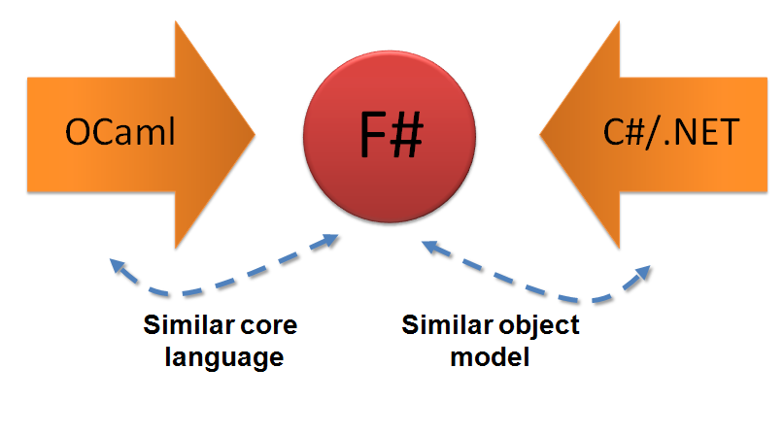
WHAT is F#
F# is a typed functional programming language for the .NET Framework

Slide 8
F# - Language Features
Supports tuples, lists, options, function values, local function definitions, pattern matching and sequence expressions.
object-oriented programming and includes support for type-inferred
allows types and values in an F# program to be accessed from other .NET languages in a predictable and friendly way.
F# includes support for a form of meta-programming, inspired by LINQ.
F# fully supports .NET generics
F# supports advanced language and runtime features such as Unicode strings, dynamic linking, pre-emptive multithreading

Slide 9
F#- Developer’s Point
Interactive environment fsi.exe supports top-level development and exploration of the dynamics of your code and environment.
The command line compiler fsc.exe supports separate compilation, debug information and optimization.
Visual Studio integration supports features such as an integrated build/debug environment, graphical debugging, interactive syntax highlighting, parsing and type checking, IntelliSense, Method Tips and a project system
F# comes with an ML compatibility library that approximates the OCaml 3.06 libraries. This means you don't have to use .NET libraries if it is not appropriate.

Slide 10
WHY F#

Slide 11
What do some think

Slide 12
Why F#
Why is Microsoft Investing in this Language
Simplicity in writing code
High Performance
Easy to do mathematical modelling
Functional Programming on DotNet Platform
Fun – if you think writing code is fun ☺

Slide 13
Simplicity in writing code
A sample application
//F#
open System
let a = 2
Console.WriteLine a
//C#
using System;
namespace ConsoleApplication1
{
class Program
{
static int a()
{
return 2;
}
static void Main(string[] args)
{
Console.WriteLine(a);
}
}
}
More Noise
Than Signal!

Slide 14
Now lets write some code
DEMO

Slide 15
An Open Arena
Business Intelligence and F#

Slide 16
What do I think.
Modelling complex algorithms into f# dlls and using it
In SSAS as analysis service SPs
In SSIS as external reference assemblies
Data mining add-ins
Pretty much anywhere where C# can be used and mathematics is involved.
Explore the new world of possibilities

Slide 17
Now lets write some Real Code using F#
Code for Fun ☺

Slide 18
Create a SOLAR SYETEM
Add reference to required namespaces
Create a form and Color the backgroup
Add a Planet Class
Start the simulation
Run the Demo

Slide 19
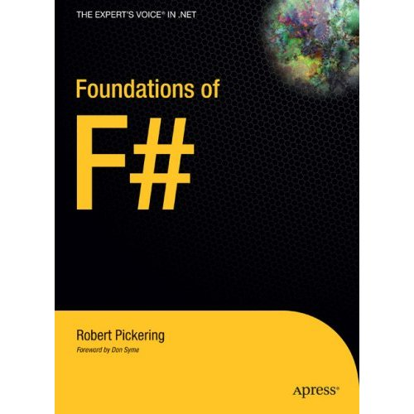
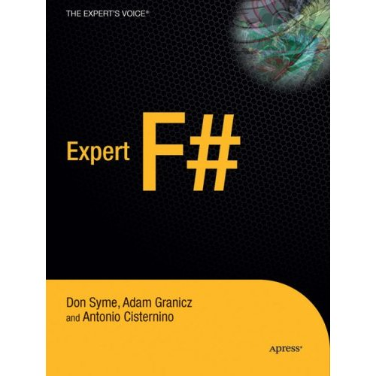
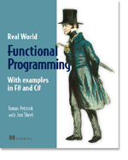
Books about F#
Visit www.fsharp.net

Slide 20
Questions

