Slide 1
An introduction to Master Data Services
Ian Marritt
Altius Consulting
ian.marritt@altiusconsulting.com
Notes:
10 years BI & DW
Managing information
Experience with master data

Slide 2
Agenda
What is master data?
Why you need to manage it?
How to do it
Master Data Services
Let’s see it
Questions

Slide 3
What is Master Data?
The information about objects that are used within your business
Non transactional and slowly changing
Physical
Customers, products, regions
Virtual
Account hierarchies, cost centres
Core business objects shared across applications

Slide 4
Examples of Master Data
Things
Products
Parts
Assets
Suppliers
People
Customers Employees
Sales people
Places
Offices
Region
Stores
Time
Virtual
Accounts
Metrics
Contracts

Slide 5
And lots of detail…
Title
Author
Publisher
RRP
Size
Cost
Business & Computing
ISBN
Databases
Microsoft
SQL Server
Head of Book
Buying
Computing Buying Manager
Database Buyer
Non Fiction Manager
Imprint
Weight
Height
Depth
Width
Notes:
This detail changes and may differ between different systems, where does it come from how is it maintained

Slide 6
Why do we need master data?
Analytical accuracy
Need to compare across an organisation
Whose report is right?
Need additional filtering in reports
Desire to better understand the reasons behind the data
Operational efficiency
Which customer?
Is a third party a customer?
Which author?
Notes:
Are hierarchies the same – is the SQL 2008 certification book under databases or certification?
Filter by age
Is there a relationship between age and computer book sales
Has your current account customer got a mortgage already

Slide 7
Where does it come from?
Originally in Line of Business (LOB) systems
Copies in multiple systems
External data feeds
Mergers & Acquisitions
Excel, Access etc
Notes:
CDI – Customer Data Integration
PIM – Product Information Management

Slide 8
Who Owns Master Data?
The IT department?
The Business?
Not really sure?

Slide 9
Agenda
What is master data?
Why you need to manage it?
How to do it
Master Data Services
Let’s see it
Questions

Slide 10
Master Data Management
From Wikipedia:
‘MDM comprises a set of processes and tools that consistently defines and manages the non-transactional data entities of an organisation’
Notes:
Not just software – more about people and processes
Not necessarily what IT is good at
Cross organisational projects
stakeholders

Slide 11
Living Data
Data changes over time
It decays as the world changes it doesn’t
It becomes corrupt – as people make changes
It conflicts with what should be the same information in other systems
Problems grow exponentially with scale and complexity
Notes:
Decay:
Deaths
Mergers
Marriages
Divorce
Bankruptcy
Births
Legislation
Conflict:
Mergers, data silos
Scale:
Number of geographies / governments
Number of entities / customers / products
Number of applications

Slide 12
Integrating Data
SOA – Integration can make things worse!
Data isn’t cleaned but just moved around
Can be worse than silos
Mergers and Acquisitions
Multiple systems doing the same sort of thing
Data Warehouses
Typically load and clean from many sources
Creating another – better but sometimes just different version
Notes:
Service Orientated Architecture

Slide 13
Data Governance
Continually increasing levels of transparency, accountability and auditing are required
Can you track changes?
Do you know who made changes?
When those changes were made?
What did it look like in June last year?
Do the right people have access?
How are different versions managed?

Slide 14
Business Benefits
Improved customer retention
Professionalism
Selling on through better analysis
Understanding and knowing your customer
Is the third party also a customer?
Targeted mailings – reduce duplicates
Identify changes that cause dissatisfaction
Data protection and other business specific legal requirements
Notes:
Letters to the dead etc
Understand who buys what
Smooth claims process if all parties are customers

Slide 15
Business Benefits
Accurate reporting
A single version of the truth – at every level in a hierarchy
Consistent management and external reporting
Better forecasting
Better decision making
Clarity when comparing like with like
Additional information for analysis – create a superset of product or customer information. e.g. How does age influence sales behaviour?
Often valuable information isn’t really stored anywhere e.g. store opening hours
Notes:
More detailed information
Higher trust levels

Slide 16
Business Benefits
Reduce Costs
Reduce rework
Happier more productive staff
Detecting and correcting issues
Penalties and overpayments
Recovering from public embarrassment
Minimise process times and workloads
Take advantage of new opportunities
Sales, mergers etc
Understanding your business reduces risk
Integration, regulations, system development, staying profitable
Notes:
Greater trust!

Slide 17
Agenda
What is master data?
Why you need to manage it?
How to do it
Master Data Services
Let’s see it
Questions

Slide 18
4 Ps of MDM
Politics
Policies
Budgeting
Data Entry Processes
Practices
Products
Data Profiling,
Data Quality, Workflow
Data Monitoring, Auditing,
Data Validation, Lineage
Change Management
Version Control, Role Based
Thin/Thick Client Management
Impact Analysis, Alerts
Business Rules Repository
Service Oriented Architecture
Business Rules Discovery
Business Rules Management
Transform and Enrich
Conform and Canonicalize
Connect and Populate
Data Governance Support
Command Line Capable
Data Model Management
Role Based Security
Integrated Security
Match and Merge
Incentives/Disincentives
Process Reviews
Employee Training Programs
Legacy System Reviews
Statistical Sampling &
Auditing
Data Stewardship
Data Strategy
Data Security
Turf Wars
Executive
Sponsorship
Cross Team
Dynamics
Program Governance

Slide 19
Architectural Approaches
Four main styles (Gartner)
Consolidation
Registry
Centralised
Co-existence

Slide 20
Consolidation
Typically used in BI
Data is copied and merged from source systems
Source data not cleaned
Cleaned and consolidated data not published

Slide 21
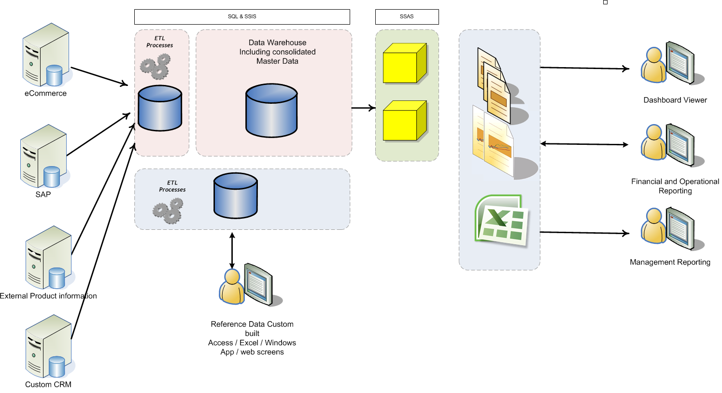
Consolidation Data Flow

Slide 22
Registry
Central register of global identifiers
Links to master data in source systems
Transformation rules metadata
Creates a point in time consolidated view
Analogous to a federated data warehouse

Slide 23
Centralised
Central repository for storing, validating, modifying master data
Forces changes to source systems
Transactional – source systems modify and retrieve master data on demand
‘Ideal’ – but costly approach

Slide 24
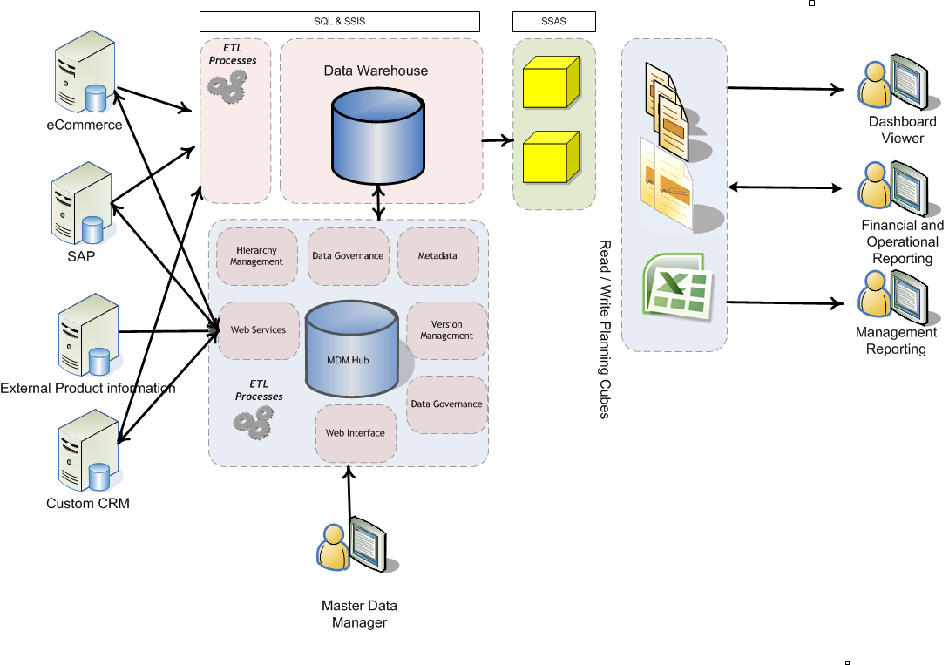
Centralised Data Flow

Slide 25
Co-Existence
A combination of styles where data lives in many places is replicated, merged and different properties can have different rules
Notes:
When data is moved different rules can apply

Slide 26
Agenda
What is master data?
Why you need to manage it?
How to do it
Master Data Services
Let’s see it
Questions

Slide 27
Microsoft Approach
Multi-domain hub
Open interfaces
Incremental implementation
Analytical and operational MDM two uses for the same data
Partner for domain-specific solutions
Use existing integration capabilities
Tight integration with Microsoft products
Hierarchy management – a critical capability
Data stewardship – a key success factor
Notes:
Multi domain as opposed to separate CDI – Customer Data Integration and PIM – Product Information Management

Slide 28
Models
Models are the highest level of data organisation in Master Data Services.
Product, Customer, Account or Geography models may exist
A model contains the following objects:
Entities
Attributes and attribute groups
Hierarchies (derived and explicit)
Collections
You can create copies of models as different versions

Slide 29
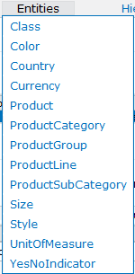
Entities
Entities are container objects that define how members and their attributes are held
They group similar objects together – like a database table
Product, Category and sub category entities may exist in a product model
There can be many in a model each having equal importance
An entity contains attributes

Slide 30
Attributes
Attributes describe the items and are similar to columns in a table
Product name, code and category are attributes
Road – 150, BK R-150 and Road Bikes are attribute values

Slide 31
Members
Members are the master data items and are similar to rows in a table
Product name, code and category are attributes
Road – 150, BK R-150 and Road Bikes are attribute values for the member
Notes:
There are two types of members:
Leaf members are the default type of members in an entity.
Consolidated members are used in explicit hierarchies only. Unless an entity is explicit hierarchy and collection enabled, consolidated members do not exist for the entity.

Slide 32
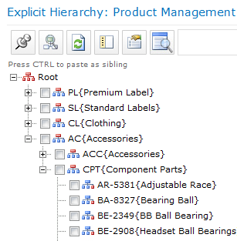
Hierarchies
A natural way to view the master data objects within your organisation
A tree structure useful to group similar items
Used for reporting and analysis to group lower level information into aggregated values
Without a master data approach hierarchies often become out of sync in different systems.
Notes:
Items move around a hierarchy so aggregated values will be wrong at different levels of a hierarchy.

Slide 33
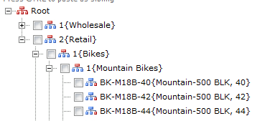
Derived Hierarchies
Derived hierarchies are created from attributes within the data
Created and managed with no effect on underlying data
e.g. Retail, Bikes and Mountain bikes are all attribute values of the bike BK-M18B and used within the hierarchy
Notes:
Items move around a hierarchy so aggregated values will be wrong at different levels of a hierarchy without MDS

Slide 34
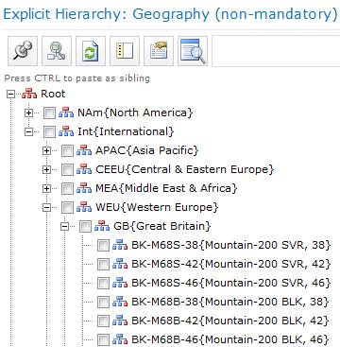
Explicit Hierarchies
Non leaf level members created just to for the purposes of the hierarchy – these are known as consolidated members
i.e. Great Britain isn’t a property of a bike but bikes are sold there
Members must be unique (consolidated or leaf)
Notes:
Can be ragged

Slide 35
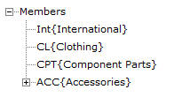
Collections
A collection is a grouping created from explicit hierarchies and other collections
Useful for analysing information in a consistent manner
Notes:
Demo?

Slide 36
Versions
A version makes a copy of the model so that you can maintain an auditable record
Prevent changes while validating data
Testing
Provide a consistent output
Very slowly changing dimensions
Notes:
Consistent output for a period – not creating a removing that fact that you are creating master data.

Slide 37
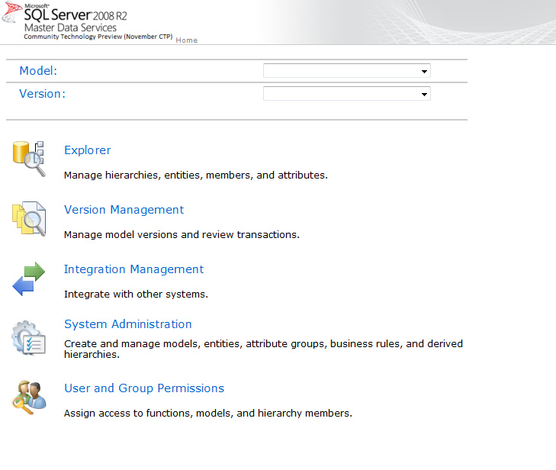
Let’s see it!
Notes:
View entity > product
Edit member, tabs
Hiarchies, moving etc
Export to View

Slide 38
Exporting Data
Master Data Services creates a database view so that you can customise the data you want to extract.
This would be a source for whatever system you wanted to export data.
It includes last changed version numbers and last changed and entered time

Slide 39
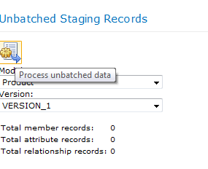
Importing Data
Import into three staging tables
Members, attributes and hierarchies
Populate these tables using SQL or SSIS
Run the ‘Process Unbatched data’ button in Integration Management

Slide 40
Web Services
Available to provide full functionality from programmatic control
Allows Line of Business systems to add and modify master data

Slide 41
Summary
What is Master Data?
Why do I want to manage it?
What does MDS look like?
Due out first half 2010 with SQL 2008 R2

Slide 42
An introduction to Master Data Services
Ian Marritt
Altius Consulting
ian.marritt@altiusconsulting.com
Notes:
10 years BI & DW
Managing information
Experience with master data

