Slide 1
My pain with
NHibernate
Open Source Object Relational Mapping (ORM)
Framework
@Ben_Hall Ben@BenHall.me.uk Blog.BenHall.me.uk

Slide 2
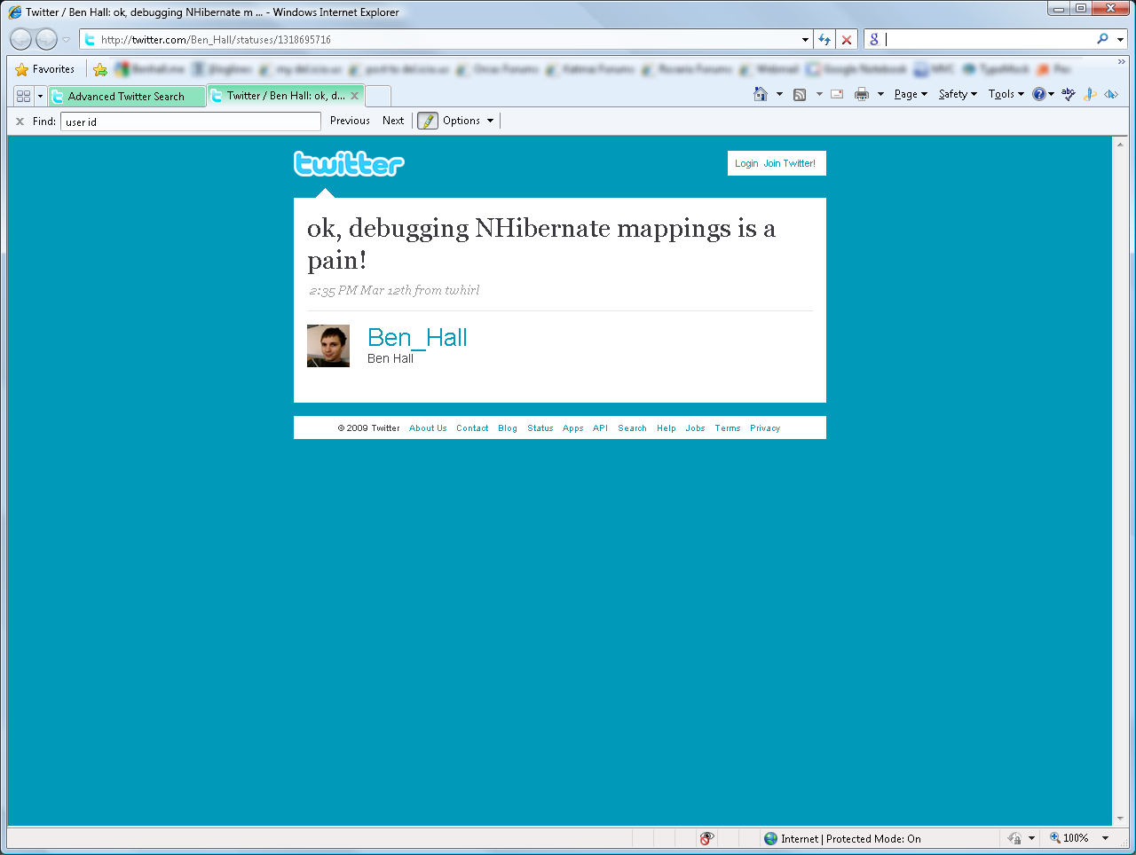

Slide 3
Learning Curve

Slide 4
Agenda
Querying
Mapping
Relationships
‘Real’ application
Castle’s Active Record

Slide 5
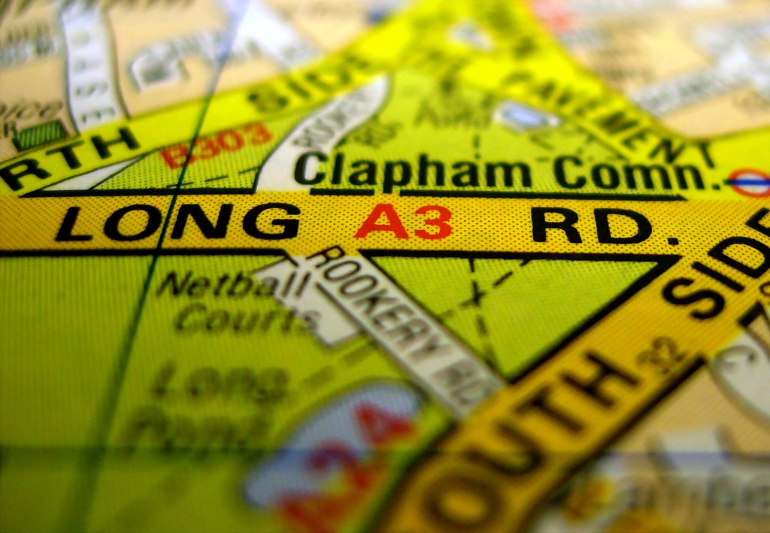
What is ORM?
Notes:
http://www.flickr.com/photos/twenty_questions/2261331590/

Slide 6
Mapping between objects and database

Slide 7
Objects vs Tables

Slide 8
ORM allows us to talk in our own language

Slide 9
Developers vs DBAs
Notes:
http://www.flickr.com/photos/kaibara/2920616863/

Slide 11
Personal Choice

Slide 12
My choice is NHibernate

Slide 13
Notes:
http://www.flickr.com/photos/mag3737/1914076277/

Slide 16
http://sourceforge.net/projects/nhibernate http://teamcity.codebetter.com/overview.html

Slide 17
Querying the database
DEMO

Slide 18
Create, update, delete
DEMO

Slide 19
relationships
DEMO

Slide 20
Notes:
http://www.flickr.com/photos/zen/2273186263/

Slide 21
Stored procedures
DEMO

Slide 22
But I like linq
DEMO

Slide 23
The Real World
Notes:
http://www.flickr.com/search/?q=fog+forest&l=4&page=2
http://www.flickr.com/photos/frielp/6829509/

Slide 24
Testing ASP.net Web Applications
www.TestingASPnet.com

Slide 25
Wrox pizza
DEMO

Slide 26
Sharp Architecture
http://code.google.com/p/sharp-architecture/

Slide 27
Active Record
Notes:
http://www.flickr.com/photos/e_phots/2345645865/

Slide 28
Active record
DEMO

Slide 29
In summary...
Notes:
http://www.flickr.com/photos/leon_homan/2856628778/

Slide 30
Summary
NHibernate has a learning curve
After the initial hit, easy to continue
A lot more powerful than I have shown today
Fluent NHibernate over XML Mapping
Active Record has an improved out-the-box experience

Slide 31
Thank you
Ben Hall Ben@BenHall.me.uk Blog.BenHall.me.uk

Slide 32
Resources
http://Blog.BenHall.me.uk
http://www.TestingASPnet.com
http://sourceforge.net/projects/nhibernate
http://teamcity.codebetter.com/overview.html
http://nhforge.org
http://www.castleproject.org/ActiveRecord/
http://code.google.com/p/sharp-architecture/

Slide 33
Flickr Images
http://www.flickr.com/photos/twenty_questions/2261331590/
http://www.flickr.com/photos/kaibara/2920616863/
http://www.flickr.com/photos/mag3737/1914076277/
http://www.flickr.com/photos/zen/2273186263/
http://www.flickr.com/photos/frielp/6829509/
http://www.flickr.com/photos/e_phots/2345645865/
http://www.flickr.com/photos/leon_homan/2856628778/
http://www.wordle.net

