Slide 1
DATA WAREHOUSE DATA MODELLING
SQLbits IV
Manchester
28th March 2009
Vincent Rainardi
Notes:
Copyright 2009, All Rights Reserved

Slide 2
2
Vincent Rainardi
Data warehousing & BI
Data warehousing book on SQL Server
Data warehousing articles in SQLServerCentral.com
vrainardi@gmail.com
About you
Data warehousing
Data modelling
Dimensional modelling

Slide 3
Data Warehouse Data Modelling
What is it
Why is it important
How to do it (case study)
Miscellaneous topics (time permitting)
Questions

Slide 4
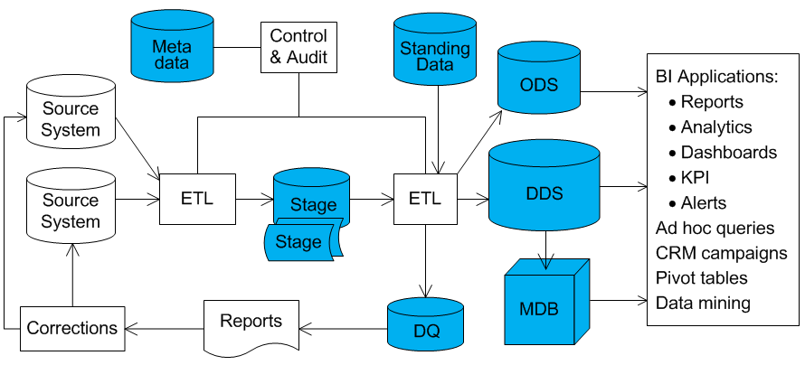
Data Warehouse
A data warehouse is a system that retrieves and consolidates data periodically from source systems into a dimensional or normalized data store. It usually keeps years of history and is queried for business intelligence or other analytical activities. It is typically updated in batch not every time a transaction happens in the source system.

Slide 5
Data Store
Flat files
Cubes
Database
Stage
Operational Data Store (ODS)
Normalized Data Store (NDS)
Dimensional Data Store (DDS)
Multi-dimensional Database (MDB)
Metadata
Data Quality
Standing Data
Relational
Normalised
Denormalised
Dimensional
Flat

Slide 6
Data Model
Defines how the data is arranged within the data store
Defines relationship between entities (elements)
The data model most appropriate for a data store depends on the function of the data store.
Stage
Dimensional?
Normalised?
ODS
Dimensional?
Flat?
Dimensional
Particular business events
Query oriented
Large data packets
Multiple versions
Analytics
Normalised
All business events
Efficient to update
Small data packets
Single version
Operational

Slide 7
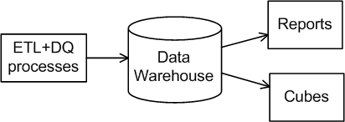
Why is it important
Functionality: it defines the data warehouse
what’s available and what’s not
Foundation on which ETL, DQ, reports, cubes are built
costly to rectify
Performance
loading and query
DQ
cube
ETL
report
Data Model

Slide 8
Case Study: Valerie Media Group
Publish and send newsletters, articles, white papers, news alerts
Daily, weekly, monthly
IT, travel, health care, consumer retail (Business Unit)
Email, RSS, text, web site
Publications are managed by business units.
Customers subscribe via agencies.
The business needs to analyze subscription by:
customer demographic, publication type, media and cost

Slide 9
Business Events
Event 1: A customer subscribes via an agent to a publication issued by a business unit to be delivered via a certain media
Event 2: A business unit sends a certain edition of a publication to 2M subscribers via certain network, on a certain media
Other events: customer payment/refund, renewal, publish a new pub, deactivate/reactivate a pub, change email address, agency payment, cancel subscription, ...

Slide 10
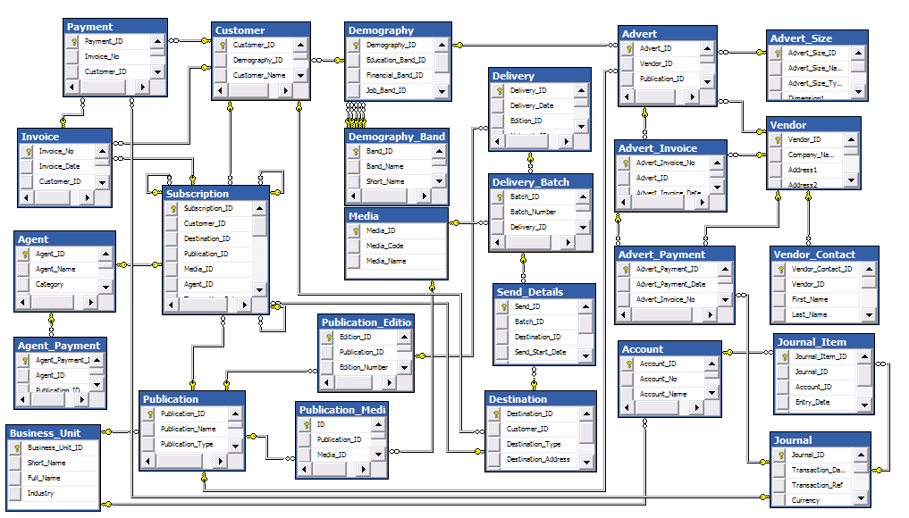
Source System

Slide 11
Star Schema
dimension
dimension
fact
dimension
dimension
dimension
dimension
Dimensional Model aka Kimball method
Query performance (OLAP) and flexibility

Slide 12
Steps
Identify event, dimensions, measures
Define grain
Add attributes and measures
Add natural keys
Add surrogate keys
Add role-playing dimensions
Add degenerate dimensions
Add junk dimensions
Add fact key

Slide 13
Event, Dimension, Measure
Subscription Event
Event: a point in the business process
A customer subscribes via an agent to a publication
issued by a business unit to be delivered via a certain media
Dimension: party/object involved in the event
The who, what, whom
customer, publication, BU, media, agent
(+ when, where)
Measure: the amount in the event
unit, fee, discount, paid

Slide 14
Dimensions
Date
Customer
Subscription
Media
Agent
Business Unit
Publication
Grain: a row in this fact table correspond to ...
A customer subscribes to a publication

Slide 15
Attributes & Measures
Customer
Date
Customer Name
Address
Email Address
Registration Date
...
Date
Month
Year
...
Media
Subscription
Agent
Media Code
Media Name
Format
...
Unit
Fee
Discount
Paid
Agent Name
Category
Fee Type
Active Subscribers
...
Business Unit
Publication
Short Name
Industry
Manager
...
Publication Title
Frequency
Editor
First Edition Date
...
Grain: a customer subscribes to a publication

Slide 16
Natural Key
Customer
Date
Customer ID
Customer Name
Address
Email Address
Registration Date
Date
Month
Year
Media
Subscription
Agent
Media Code
Media Name
Format
Unit
Fee
Discount
Paid
Agent ID
Agent Name
Category
Fee Type
Active Subscribers
Business Unit
Publication
Business Unit ID
Short Name
Industry
Manager
Publication ID
Publication Title
Frequency
Editor
First Edition Date
The primary key in the source system

Slide 17
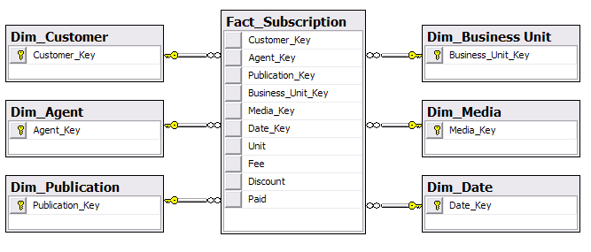
Surrogate Keys
Multiple sources
Change of natural key
Maintain history
Unknown, N/A, Late Arriving
Performance
Integer
Identity
0, -1
Dim PK
Clustered index

Slide 18
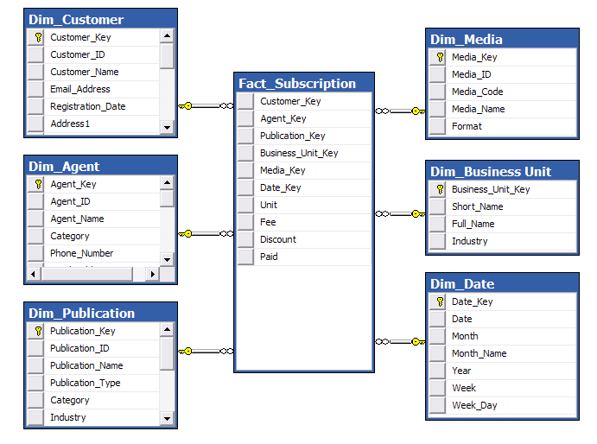
Result

Slide 19
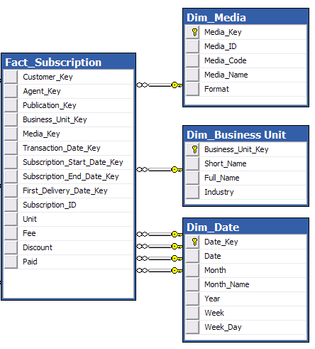
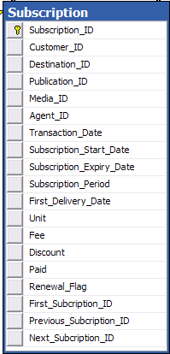
What Date?
Role-playing dimension

Slide 20
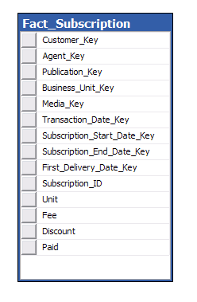
Degenerate Dimension
The identifier (PK) of a transaction table

Slide 21
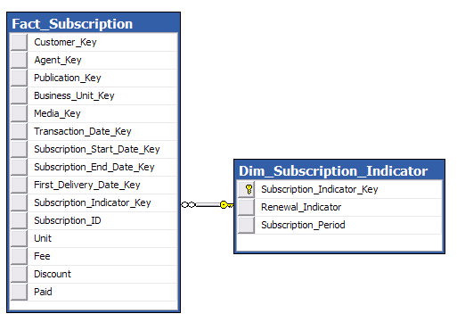
Junk Dimension
Low cardinality

Slide 22
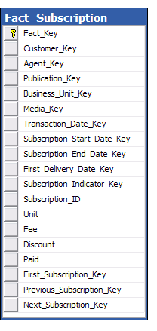
Fact Key
To enable referring to a fact table row
SQL Server: clustered index
Identity
Bigint

Slide 23
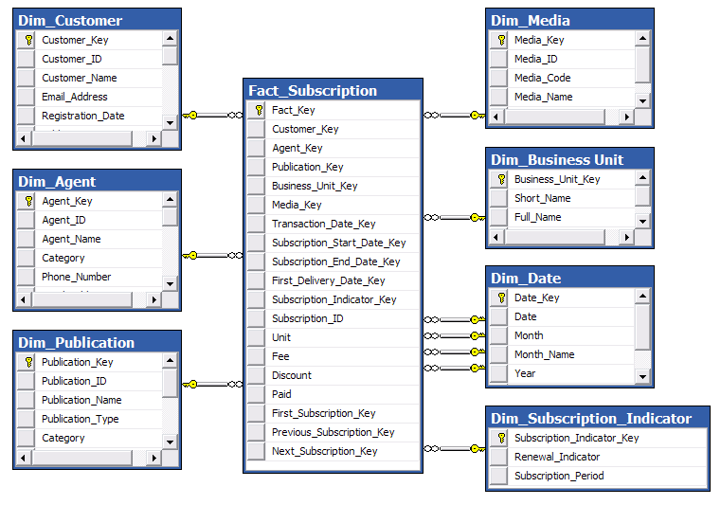
Result

Slide 24
So Far
Event, Dimensions, Measures
Grain
Attributes & Measures
Natural Keys
Surrogate Keys
Role-playing Dimension
Degenerate Dimension
Junk Dimension
Fact Key
Next
Slowly Changing Dimension
Snowflake

Slide 25
Slowly Changing Dimension
Type 1: Overwrite old values
Before:
After:
Key Name Email
1 Andy andy@a.com
Key Name Email
1 Andy andy@b.com
Type 2: Create a new row (keep old values)
Before:
After:
Key Name Email
1 Andy andy@a.com
Key Name Email
Andy andy@a.com
Andy andy@b.com
Type 3: Put old values in another column
Before:
After:
Key Name Email
1 Andy andy@a.com
Key Name Email Previous Email
Andy andy@b.com andy@a.com

Slide 26
Slowly Changing Dimension Type 2
Key Name Email Valid From Valid To Current
Andy andy@a.com 1900-01-01 2009-03-27 N
Andy andy@b.com 2009-03-28 9999-12-31 Y
Valid From & Valid To (a.k.a. Effective Date & Expiry Date) To put the right surrogate key in the fact table Datetime (not date)
Current Flag: to query the current version
Not all attributes are type 2:
Attribute 1,2,3: type 1 (update)
Attribute 4,5,6: type 2 (new row)

Slide 27
Snowflake
dimension
dimension
dimension
dimension
main
dimension
main
dimension
dimension
dimension
dimension
fact
dimension
main
dimension
main
dimension
dimension
dimension
dimension
dimension
main
dimension
main
dimension
dimension
dimension
dimension
dimension

Slide 28
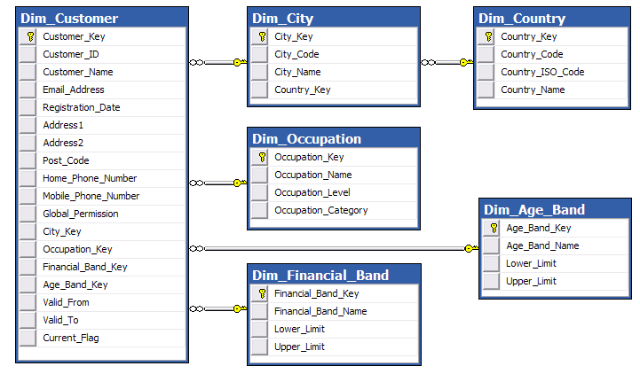
Snowflake
Product, product group, product category

Slide 29
Miscellaneous Topics
What is it
Why is it important
How to do it
Miscellaneous topics
Smart Date Key
Dimensional Grain
Real Time Fact Table
Questions

Slide 30
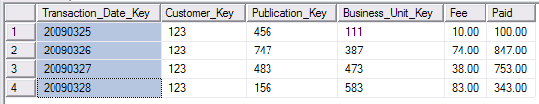
Smart Date Key
8 digit integer YYYYMMDD
Why use Smart Date Key?
Why not?
Fact table partitioning
Reference dimension
Measure group partition
No lookup (everywhere)
Multiple sources X
Change of natural key X
Maintain history X
Unknown, N/A, Late Arriving X
Performance X
Unknown date?

Slide 31
Dimension Grain
Dim Product Line: 2 attributes, product_key
Dim Product: 10 attributes, product_grp_key
Dim Product Group: 5 attributes
Combine into 1 dimension?
Snowflake
Star
2
10
5
Fact 1
PL
P
PG
Fact 1
PL
17
Fact 2
P
PG
Fact 2
P
15
Fact 3
PG
Fact 3
PG
5
3 tables:
3 tables, linked FK-PK
Different surrogate keys
More flexible (attributes)
1 table with 3 views:
Same surrogate keys
Simpler load

Slide 32
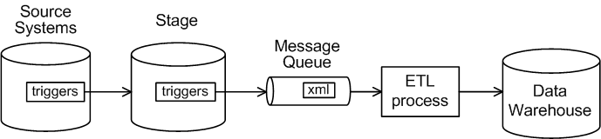
Real Time Fact Table
Updated every time a transaction happens in the source system
Today’s transactions only
Stored in surrogate keys
Limited dim updates -> unknown SK
Heap
Union with main fact table on query
Depends on frequency: telco, retail, insurance, utilities, CRM
1-2 fact table only transactional, narrow table
Stored in natural keys look up SK on query

Slide 33
Questions
Event, dimensions, measures
Grain
Attributes and measures
Natural keys
Surrogate keys
Role-playing dimensions
Degenerate dimensions
Junk dimensions
Fact key
Slowly Changing Dimension
Snowflake
Smart Date Key
Dimensional Grain
Real Time Fact Table

Slide 34
Further Resources
Kimball & Ross: Data Warehouse Toolkit
Imhoff, Galemmo, Geiger: Mastering Data Warehouse Design
Kimball Group’s articles: www.kimballgroup.com
Kimball Forum: forum.kimballgroup.com

