Slide 1
Data Mining and SSIS
A marriage made in heaven
(or Redmond at least)
Allan Mitchell
SQL Server MVP

Slide 2
Who am I
SQL Server MVP
SQL Server Consultant
Joint author on Wrox Professional SSIS book
Worked with SQL Server since version 6.5
www.SQLDTS.com and www.SQLIS.com
Partner of SQL Know How

Slide 3
Today’s Schedule
I only have 30 minutes !
Why do they go well together
How do they do it?

Slide 4
Why do they go well together?
Easy
  SSIS moves and cleans data
  SSIS can manipulate heterogeneous data
  Data Mining requires clean data (duh!)
  Data Mining requires a given structure for the data

Slide 5
What do you get?
Tasks
  Analysis Services Execute DDL Task
  Analysis Services Processing Task
  Data Mining Query Task
Transformation
  Data Mining Query Transformation
  Term Extraction Transform
  Term Lookup Transform
Destination
  Data Mining Model Training Destination

Slide 6
Analysis Services Execute DDL Task
Allows you to run DDL statements against SSAS
Includes Dropping, Creating, Altering DM objects

Slide 7
Analysis Services Processing Task
Process objects on SSAS
This includes your Mining Structures and models

Slide 8
Data Mining Query Task
Query one or more mining models/structures
Return singleton or flattened cellset
Store results to table (OLE DB) or variable.

Slide 9
Data Mining Query Transform
Perform a DM query against a model
Return result into the pipeline

Slide 10
Text Mining Transforms
Perform text based extractions/lookups against pipeline data
Uses Clustering and NLP underneath to do this

Slide 11
Mining Model Training Destination
Take data from the pipeline and use it to train a mining model.

Slide 12
Demos

Slide 13
Resources
http://www.SQLServerDataMining.com
http://www.bogdancrivat.net/dm/
http://blogs.msdn.com/jamiemac/
http://social.msdn.microsoft.com/Forums/en-US/sqldatamining/threads/

Slide 14
Contact Details
allan.mitchell@konesans.com

Slide 15

Europe’s Premier
Community
SQL Server Conference

Slide 16
Up and coming events..
April 2009
Saturday/4-Belfast: DDD-Belfast
Tuesday/14-Glasgow: Two DBAs walk in to a room of Developers
Thursday/16–London: Using Spatial Data in SQL Server and Virtual Earth
Saturday/18-Reading: WebDD '09
Thursday/30-London: Compress your database with Hyperbac
May 2009
Saturday/2-Glasgow: Developer Day Scotland 2009
Thursday/21–London: SQL Server in the Cloud
Saturday/23-Taunton: DDD-South West
See SQLServerFAQ.com for more details

Slide 17
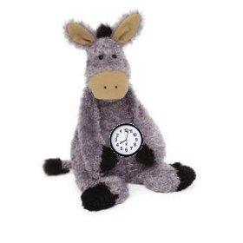
Don’t forget
The clocks go forward tonight!

Slide 18
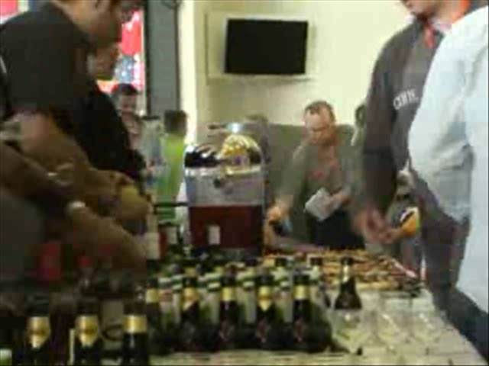
Its party time!
Coming up next in the Atrium:
Time to relax and let your hair down.
Rockband
Table football
Air Hockey
and more

Slide 19
We hope you had a great conference!
See you at the next one in the Autumn
Thank you

