Slide 1
Useful Sql Stuff wot I learned
Chris Hay
Roskakori Limited
http://silverlightuk.blogspot.com

Slide 2
About Me
.NET Developer
Not a SQL Developer
Worked on loads of large data projects
Co-Run NxtGenUG Cambridge
http://silverlightuk.blogspot.com
www.nxtgenug.net

Slide 3
Agenda
Know your Data
Heaps
Pages + Page Caching
DBCC
STATISTICS
Execution Plans
Indexes
Clustered
Non Clustered
Selectivity
Stored Procs + Cached Query Plans
Dynamic Sorting
SQL Profiler
Dynamic Filtering
Hierarchies
Caching

Slide 4
Know your Data
Always use a representative data set
A query against 10 rows of data will be fast
Same query against 1,000,000 rows may not be fast
Don’t need real data, use a data generation script
Or use Red Gates SQL Data Loader Tool
Pick correct data size (tinyint, smallint, int, bigint)
7MB difference between bigint & int for 1,000,000 rows

Slide 5
No Indexes (Heap)
A Table with no Indexes
Data is stored unordered
All queries are slow
Performs a Table Scan
Reads every row in the table
Alert – Avoid at all costs
Notes:
Explain High Selectivity
Explain Low Selectivity
Explain the term table scan

Slide 6
Demo (Heap Queries)
Caching
Clearing Cache
Execution Plan
Statistics
Notes:
Drop Indexes
Explain Table + Database
Run Query
Show Uncached
Show Cached
Clear Cache + Run Again
Display Estimated Execution Plan
Include Actual Execution Plan
Show Table Scan
Show Statistics
Explain Pages, Logical Reads, Physical Reads, Read Ahead Reads

Slide 7
Pages
Different Types of Pages (Data, Indexes etc)
Data is held in a Data Page
A Page is 8Kb
8Kb * 8871 = 70968 (69.3Mb)
SQL Server reads in pages
Can’t load just 1 row must load the page
Notes:
Right Click on the Customers Tablw

Slide 8
Cached Pages
Everytime a page is read from disk it is cached
Future reads are quicker as there is no disk cost
Larger the Memory = Larger the Cache
With a table scan all pages are cached
Bad Table Scan fills up nice cache with stuff we don’t want
Bad Table Scan, Bad Bad Table Scan

Slide 9
Clear Cached Pages
DBCC DROPCLEANBUFFERS
Lovely in Dev Environments
Could make you unpopular in production environments

Slide 10
Reduce Cached Pages
Split out infrequently accessed data
Especially large data e.g varchar(max)

Slide 11
Statistics
IO Statistics
SET STATISTICS IO ON
SET STATISTICS IO OFF
Time Statistics
SET STATISTICS TIME ON
SET STATISTICS TIME OFF

Slide 12
Statistics
High CPU Time is Bad
High Logical Reads is Bad
Physical Reads are Bad
Read Ahead Reads are Bad

Slide 13
No Indexes (Heap)
A Table with no Indexes
Data is stored unordered
All queries are slow
High and Low Selectivity irrelevant
Data position in table irrelevant
Performs a Table Scan
Reads every row in the table
Alert – Avoid at all costs
Notes:
Explain High Selectivity
Explain Low Selectivity
Explain the term table scan

Slide 14
Run away from Heaps + Table Scans

Slide 15
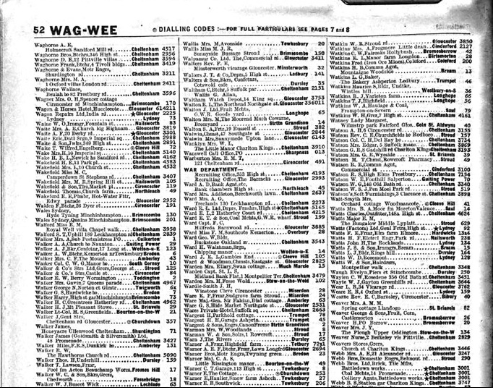
Clustered Index
Light 1

Slide 16
Clustered Index
My Favourite Index ☺
Once found item in Index you have data
Generally use where possible
Superfast for range searches
Low selectivity

Slide 17
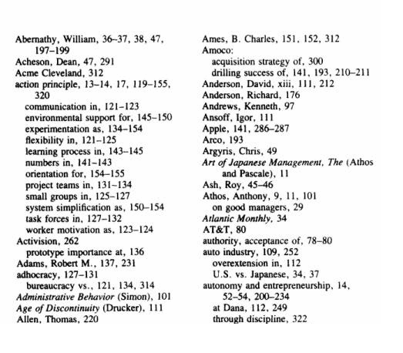
Non Clustered Index

Slide 18
Non Clustered Index
Once found item in Index, needs additional lookup to get data
Superfast for highly selective searches
Comparable to clustered index
Slow for range searches (low selectivity)
Due to lookup
Doesn’t need lookup if only columns in index
Just as faster as the clustered index

Slide 19
Selectivity
High Selectivity
A query which returns a small number of rows
Low Selectivity
A query which returns a large number of rows
Calculate Selectivity
DBCC SHOW_STATISTICS (N'dbo.Customers', IX_Customers)

Slide 20
Stored Procs - prefixing
DO - exec dbo.MyStoredProcName
DON’T - exec MyStoredProcName
If not supplied
Looks up users default schema
Looks in dbo.schema
Slight Performance Gain
Do for all new development

Slide 21
Stored Procs – Cached Query Plans
Query plan determines type of Joins / Indexes etc
SQL Server calculates best plan based on statistics
New Statement = New Query Plan
Cached at a statement level
Query Plans are reusable

Slide 22
Stored Procs - DBCC FREEPROCCACHE
Clears all Cached Query Plans in the Database
Should use when Performance Tuning
Dangerous to use in Production

Slide 23
Stored Procs – With Recompile
Stored Procedure Level Recompilation
Good for multi statement stored procs
Mark up Stored proc WITH RECOMPILE

Slide 24
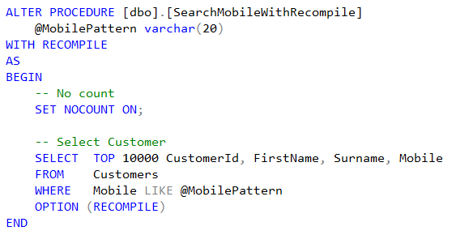
Stored Procs – With Recompile

Slide 25
Stored Procs - Option Recompile
Statement Level Recompilation Only
Good for multi statement stored procs

Slide 26
Stored Procs - OPTIMIZE
Statement Level
Optimizes Query Plan for parameter
Ignores actual passed parameter

Slide 27
Dynamic Sorting
Avoiding sorting if possible
Sometimes need the ability to change sort column / order
E.g. Grid in a Web Application

Slide 28
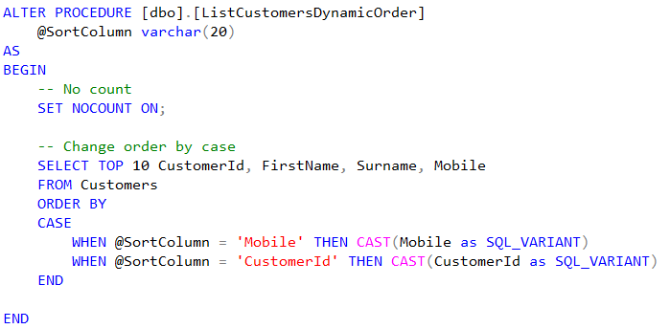
Dynamic Sorting – Bad Example
Alert – Avoid if possible

Slide 29
Dynamic Sorting
DEMO – Optimal Plans
DEMO – Case Stored Proc

Slide 30
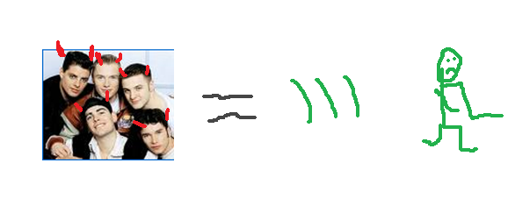
Dynamic Sorting – Case is Bad
Generates a non optimal query plan

Slide 31
Dynamic Sorting - Solutions
Lots of Static Stored Procs
ListCustomersByCustomerId
ListCustomersByMobile
Query Plan Cached
Unwieldy + High Maintenance Cost

Slide 32
Dynamic Sorting – Dynamic SQL
Dynamic SQL
Query Plan Cached
Security / SQL Injection Concerns
Options
Manual (be very careful, SQL Injection)
LINQ2SQL (SQL Injection protected)
ADO Entity Framework (SQL Injection protected)

Slide 33
Dynamic Sorting – Dynamic SQL
DEMO – Dynamic SQL
DEMO – LINQ2SQL

Slide 34
SQL Profiler
Should always run whilst developing
View query with parameters
View actual statistics
Careful running in production
DEMO – SQL Profiler

Slide 35
Application Name
Can filter your connections in profiler
Useful with shared dev databases
DEMO – Application Name

Slide 36
Dynamic Filtering
Usual Solution (Very Bad)
Same solutions as Dynamic Sorting
Lots of static stored procedures
Dynamic SQL
LINQ 2 SQL
ADO .NET Entity Framework

Slide 37
Hierarchies
Parent / Child Relationships
Managers / Employees
Categories / Sub Categories

Slide 38
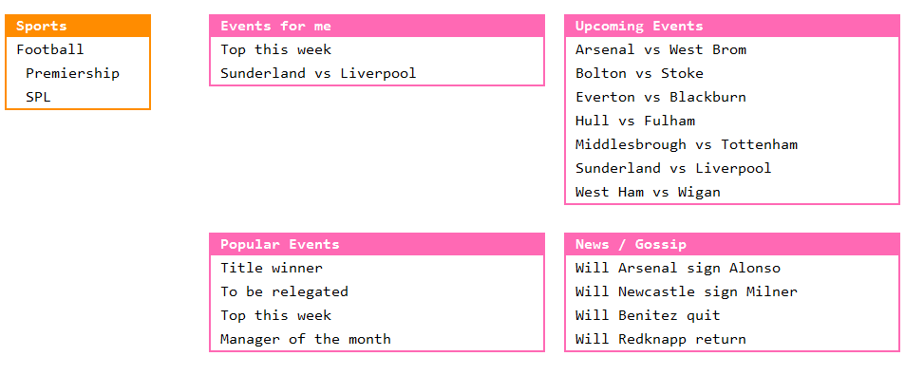
Hierarchies

Slide 39
Hierarchies
SQL 2000 – Very messy code to do
SQL 2005 / 2008 – Very easy
Recursive Common Table Expression (CTE)

Slide 40
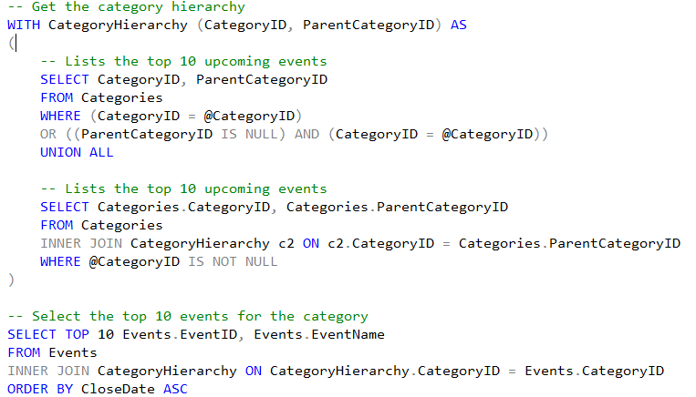
Hierarchies

Slide 41
Caching
Database is always application bottleneck
Cache Data wherever possible
Demo: Caching (VoxPeeps)
alert: Do when ever possible

Slide 42
Wot we covered
Know your data
Heaps
Pages + Page Caching
DBCC
STATISTICS
Execution Plans
Indexes
Clustered
Non Clustered
Selectivity
Stored Procs + Cached Query Plans
Dynamic Sorting
SQL Profiler
Dynamic Filtering
Hierarchies
Caching
Notes:
Explain High Selectivity
Explain Low Selectivity
Explain the term table scan

Slide 43
Useful Sql Stuff wot I learned
Chris Hay
Roskakori Limited
http://silverlightuk.blogspot.com

