Slide 1
System Center Advisor - Deep Dive
Experiment: download these slides!
http://bit.ly/SCAatSQLBITSX
Paul Mestemaker
Sr. Program Manager
Microsoft System Center Advisor
@PaulMest / #SCAdvisor
Notes:
Download available at: http://paulmestemaker.com/2012/03/31/system-center-advisor-at-sqlbitsx

Slide 2
Session Objectives and Takeaways
Session Objective(s):
Learn about the benefits of Advisor
Understand Advisor’s high-level architecture to understand data security, privacy, and control
Learn how to diagnose and troubleshoot Advisor deployments
Key Takeaways:
System Center Advisor is a new online manageability service that just became commercially available (Jan 2012)
System Center Advisor is available at no additional charge if you have SA for Windows Servers and Server Workloads (e.g. SQL, Exchange, SharePoint)

Slide 3
The Wisdom of the Cloud
SERVER CONFIGURATIONS
Microsoft Customer Service and Support
RECOMMENDED CHANGES
Knowledge Base

Slide 4
System Center Advisor Benefits and Features
Proactively avoid problems
Resolve issues faster
Reduce downtime
Alerts for unpatched, misconfigured, or unsupported configurations
Regular assessment of server configuration
Remote access to portal
Access current and historical configuration data
Share configuration data with internal or Microsoft support staff
Get instant access to guidance
SQL Server and Windows Server knowledge
Compare with best practices
Access centralized configuration data
Available as Software Assurance benefit

Slide 5
A Brief Look at System Center Advisor
demo

Slide 6
Watch this demo on-demand
3-minute narrated demo of Advisor
http://www.microsoft.com/en-us/showcase/details.aspx?uuid=32e32209-71c4-43d2-b2ae-015598bf5b7d
http://bit.ly/SCA3MinDemo

Slide 7
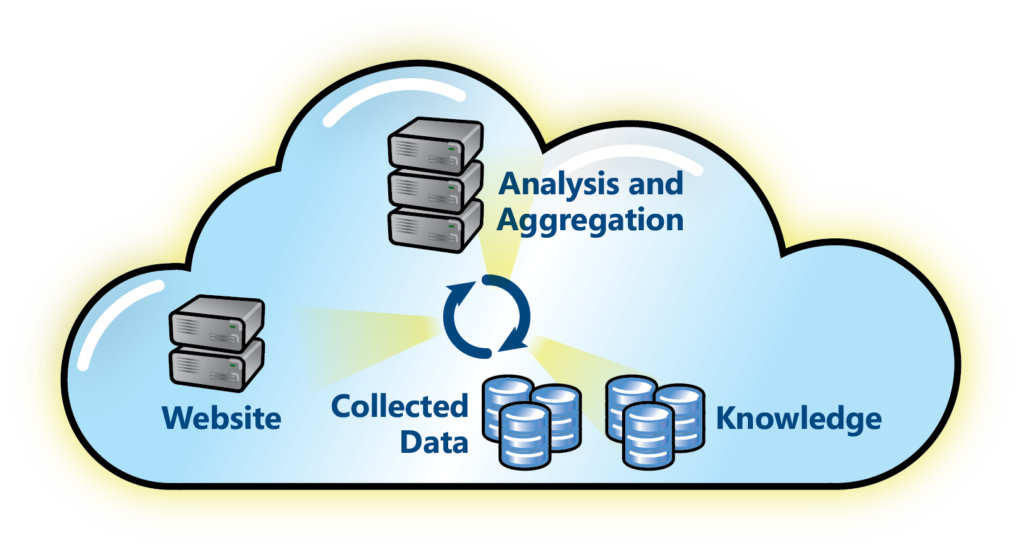
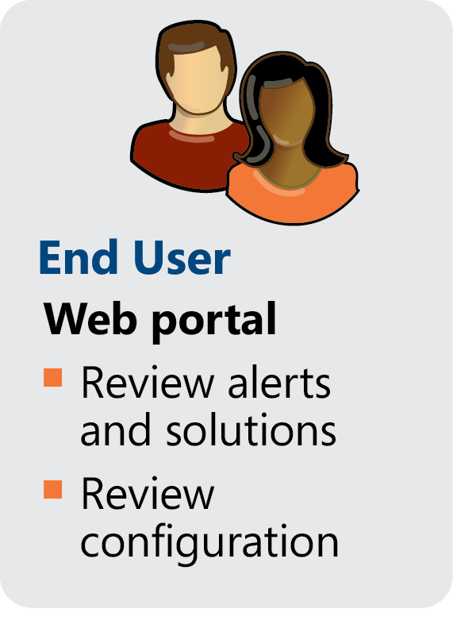
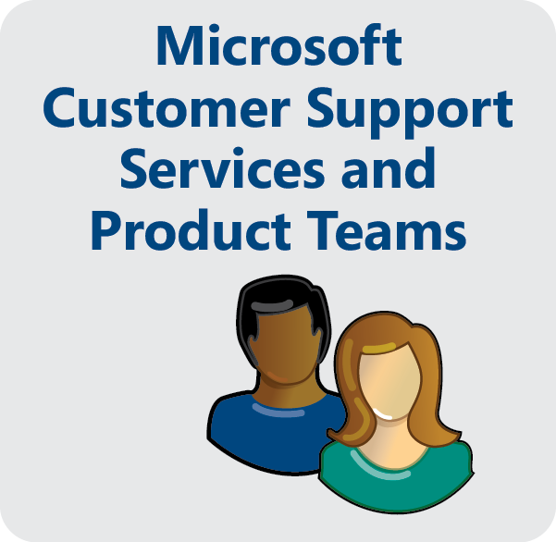
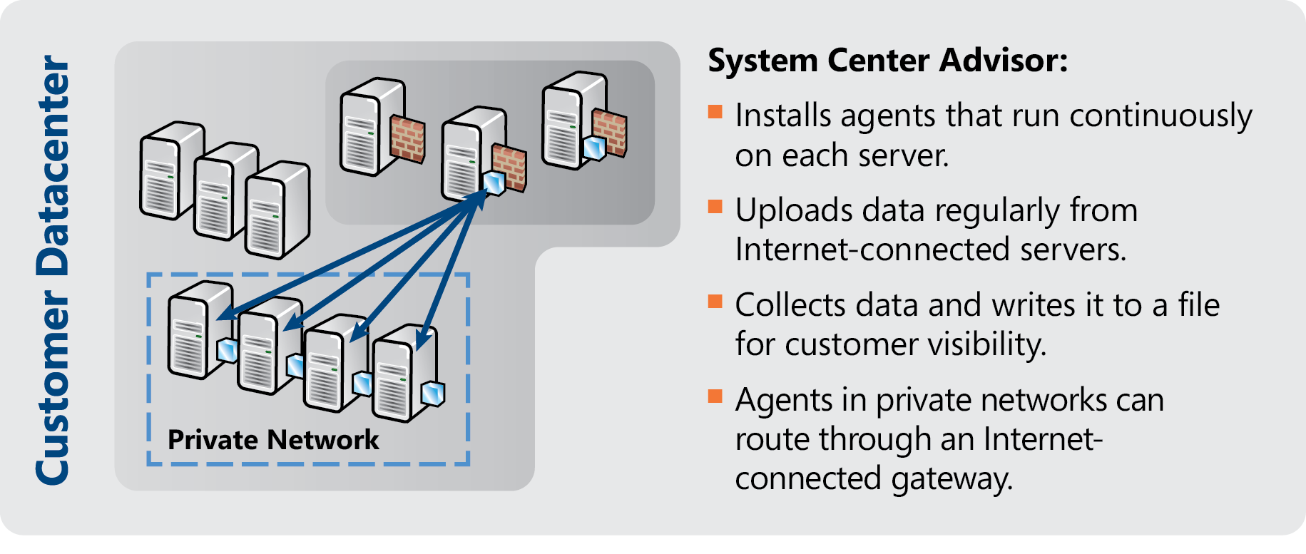
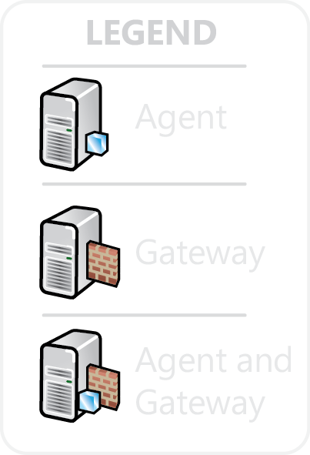
System Center Advisor: How It Works

Slide 8
Commercial Availability
announcing

Slide 9
Advisor and Software Assurance
Advisor is offered as a new SA benefit
Ongoing value to the SA program
Licensing
You must have an active SA license for the workload being monitored by Advisor (SA for Windows Server or SQL Server)
As additional workloads are added, SA licenses for those workloads will be honored
60 Day free trial for simple barrier free onboarding
There is no requirement to enter your Microsoft agreement number

Slide 10
Global availability
announcing

Slide 11
Global Availability
Details
Geographies
Commercial availability in the following geographies
English only at launch
Localized versions and list of languages is still TBD
Australia
Austria
Belgium
Brazil
Canada
Denmark
Finland
France
Germany
Hong Kong
Iceland
India
Ireland
Italy
Japan
Luxembourg
Netherlands
New Zealand
Norway
Portugal
Singapore
Spain
Sweden
Switzerland
United Kingdom
United States

Slide 12
New workloads:
Exchange 2010
SharePoint 2010
SQL Server 2012
announcing

Slide 13
Advisor Workloads
Exchange
SharePoint
Support for Exchange 2010 SP1+
Support for SharePoint 2010
SQL Server
Windows
Support for SQL 2008 & 2008 R2
Support for SQL Server 2012
Support for WinSvr 2008 & 2008 R2
Note: Focus on AD, Hyper-V, and Core OS

Slide 14
Setting up Advisor for the First Time
demo

Slide 15
Preparing Your Environment
Setting up your environment takes 5 minutes of work, but can take a day in elapsed time with default settings
TIP: Upload now commands available here…
http://onlinehelp.microsoft.com/en-us/advisor/gg697803.aspx

Slide 16
Choose your path
More demos?
Collaboration
Workload opt-out
Persistent filters
Troubleshooting the agent/gateway
Providing feedback
Closing account
…
More slides?
Top problems with Advisor
Deployment recommendations
Advisor & SCOM
…

Slide 17
Tour of the not so well-known features of Advisor
demo

Slide 18
Learn from the mistakes of others :-)
Lessons Learned

Slide 19
Usage Statistics
Popularity and Reach
6000+ customers registered
Deployments
Largest: 200+ servers
Most of our customers have SQL Server

Slide 20
Top Supportability Issues
Clock Skew
Recommendation: Make sure server’s clocks are synced with internet time
Cannot download registration certificate due to secure IE on Windows Server
Recommendation: Download setup and certificate on a client OS
Work-around: Uncheck “do not save encrypted pages to disk” in Internet Explorer Properties
Agent cannot talk to gateway in workgroups
Recommendation: have a gateway on each non-domain joined server

Slide 21
Topology Recommendations
Domain-joined servers
Recommendation: 1 agent/server
Recommendation: 1 gateway/N servers
Non-domain joined servers
Recommendation: 1 agent/server
Recommendation: 1 gateway/server
Problem: Agents/Gateways on separate servers could not communicate over machine boundaries through WCF

Slide 22
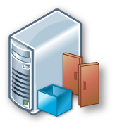
Topology Example #1 – Domain Environment
Advisor
Service
Legend
Agent
Gateway
Agent & Gateway
S1
S2
…
SN
SN + 1

Slide 23
Topology Example #2 – Workgroup Environment
Advisor
Service
Legend
Agent
Gateway
Agent & Gateway
S1
S2
…
SN
SN + 1

Slide 24
How is this different than Operations Manager?
Top Question

Slide 25
Advisor and Your Management Solution
Advisor is not a real-time monitoring solution
Advisor leverages SCOM 2007 R2 Agent and Management Pack technology
Note: Advisor does not require SCOM, but can work side-by-side with SCOM via multi-homing
Note: Advisor does not work side-by-side with SCOM 2012 … yet!
Reusing SCOM technology will enable…
Future better-together scenarios with Microsoft’s management platform investments (e.g. Operations Manager, Configuration Manager, Service Manager)
Minimize duplication of data collection

Slide 26
Wouldn’t having both be too much overhead for my server?
Top Question

Slide 27
Advisor Data Collection Details
Low overhead
Agent CPU: < 1% average, occasional spikes
Agent Memory: < 75 MB
Gateway Upload: ~100KB/server/day
Server management data only
Diagnostic data (configuration settings, error logs)
Utilization (CPU, IO, Available Memory, etc.) [*]
Workload throughput (transactions/day, GB served/day) [*]
No customer data or custom workload data

Slide 28
Isn’t sending data outside of my environment bad?
Top Question

Slide 29
Data Privacy & Handling Sensitive Data
Complete Privacy Statement available
Advisor only has visibility into servers with Agents deployed on them (+ data queried from Active Directory about objects associated with that server)
Uploads are archived on-premise (5 days by default) for audit trail and to enable you to inspect the data
Upload time is configurable; you can stop uploading at any time
You can close your account and request to remove data from Advisor servers (account cleanup happens within 30 days)
Your organization will be the only non-Microsoft party who will have access to your individual organization’s data
Microsoft will not use this data for sales/licensing validation

Slide 30
Why Try Advisor?
You can prevent problems in your environment that customers similar to you have already experienced
It only takes 5 minutes to try it out
If you have SA, you can get this at no additional cost
You can easily provision others to see information about your environment without giving them access to your servers (e.g. consultants/TAMs)

Slide 31
In review: Session Objectives and Takeaways
Session Objective(s):
Learn about the benefits of Advisor
Understand Advisor’s high-level architecture to understand data security, privacy, and control
Learn how to diagnose and troubleshoot Advisor deployments
Key Takeaways:
System Center Advisor is a new online manageability service that just became commercially available (Jan 2012)
System Center Advisor is available at no additional cost if you have SA for Windows Servers and Server Workloads (e.g. SQL, Exchange, SharePoint)

Slide 32
Related Content
On-Demand Content
http://channel9.msdn.com/Events/TechEd/NorthAmerica/2011/SIM349 (60 minute web cast)
http://www.microsoft.com/en-us/showcase/details.aspx?uuid=32e32209-71c4-43d2-b2ae-015598bf5b7d (3 minute demo)
Notes:
Speakers should use this slide to identify content, related to their presentation, being offered in other sessions or labs at TechReady.
Your Track PM can provide a full listing of all of the sessions, webcasts, hands-on labs and instructor-led labs in your track, as well as the other tracks.
If there is additional content available that attendees should know about, please add a section for Additional Resources to the slide. In this section you can call out whitepapers or websites that you and your team have created.
Track PMs are listed below:
Track Name, Acronym and Track PM
Architecture (ARC) – Miha Kralj, Terra Suddarth
Business Intelligence (BIN) – Peter Sprague
Business Solutions (MSDY) - Pattie Grimm, Scarlet Leung
Database (DB) –Dandy Weyn, Kevin Ashby, Maxine Coo
Development Tools & Technologies (DEV) – Bijan Javidi
Exchange and Lync (EXL) – Lauren Horgan, Navin Chand, Becki Culbert
IT Service Management (ITSM) - Bebe Acciavatti
Middleware and Integration (MWI) – Tony Meleg, Joe Klug
Management, Operations and Deployment (MOD) – Aurora Santiago, Juliet Hossman
Office 365 (OFC) - Mike Naughton, Lori Skinner-Studley
Office and SharePoint (OSP) – Olaf Hubel, Hila Grinberger, Andy O’Donald, Monica Watson, Lita Spratt
Optimization (OPT) – Yoav Land, Angela Earley
ReadyTech (RT) - Joe Culp, KariLynne Gratzer
Security, Identity & Privacy (SIP) – Christopher Pelletier, Aurora Santiago, Juliet Hossman
Virtualization (VIR) – Aurora Santiago, Juliet Hossman
Windows Azure platform (AZR) - Vikram Rana, Terri Slade
Windows Client (CLI) – Jean Taylor, Angie Nelson, Lisa Puchosic
Windows Phone (WP) – Tim McAfee, Rob Tiffany
Windows Server (SVR) – Aurora Santiago, Juliet Hossman
Cross Track Coverage
Application Platform – APS/DB/AZR/ARC Solution Accelerators – Michelle Arney, Michelle Walls
Compete – Mike Brevard Trustworthy Computing – Christopher Pelletier
Next Web – Olga Londer User Experience – Alison Clark
Private Cloud – Aurora Santiago Windows Embedded – Olivier Bloch

Slide 33
Questions?
Reminder: download these slides…
http://bit.ly/SCAatSQLBITSX
Feel free to tweet:
@PaulMest
#SCAdvisor

