Slide 1
Computing Buzzwords De-Mystified
(Doesn’t “cloud” mean that you’ve made it harder to understand?)
Notes:
Big Data, Cloud, and other Marketing Buzzwords De-mystified
When your boss sends you to a conference, she expects you to learn something useful. Like all of the buzzwords she has to explain to her boss. Make it worth her while (and budget) and bring back the info she craves. Buck Woody, who is surprised that he still is employed by Microsoft, explains them all in one presentation. You’ll laugh, you’ll cry, you’ll be moved by the tales of cloud derring-do (look it up), “Hadoop”, and all kinds of other children-stuffed-toy-named-technologies. You’ll find that learning can be fun, if not dangerous, and along the way you’ll pick up useful information you can use to not only impress your boss, friends and family – but also things you can use to get actual work done.
Cloud
Big Data
Functional Programming
Machine Learning and Vision

Slide 2
Cloud
NIST Definition
Simpler Definition:
Performing some or all of your computing somewhere else
The AS’s
IaaS – You write/buy code; we run the VM’s; you Manage and Monitor them
PaaS - You write code; we run it
SaaS – You log on, use it and log off; we run everything else
Other AS’s

Slide 3
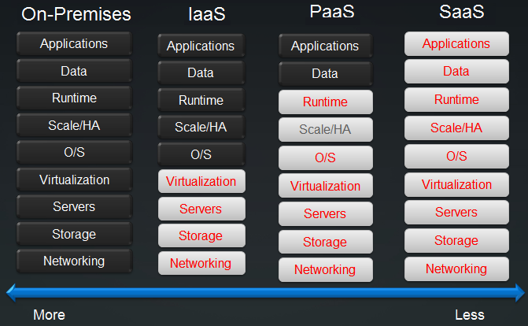
Cloud

Slide 4
Big Data
NIST Definition
Simpler Definition:
Data that you can’t get an answer from in an acceptable period of time with your current technology
Stages
Source and Ingress
Store and Process
Analyze
Present

Slide 5
Big Data – Supervised Learning
Source: Elements of Statistical Learning, Trevor Hastie, et. Al.
Inferred Rule:
if (%george < 0.6) & (%you > 1.5) then spam; else email

Slide 6
Big Data
In-Line
StreamInsight
Windows Azure
Service Bus
Ingress
BCP
SSIS
Sqoop
APIs
Store and Process
RDBMS
Analysis Services
PDW
Windows
HPC Server
Analyze
T-SQL
MDX
Nexus Queries
HiveQL
PigLatin
Excel
APIs
HPC Jobs
Present and Navigate
Reporting Services
Power View
Power Pivot

Slide 7
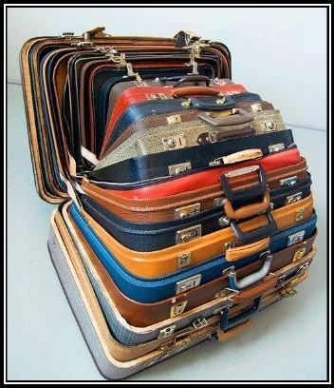
Functional Programming
Computing Definition
Simpler Definition:
"I was just interviewed by Rolling Stone." – Mick Jagger
Features
Operates by passing functions
Immutability – No side-effects
Stateless (in pure form)
Easily Testable
Hybrids – Like F# - now available
Notes:
http://en.wikipedia.org/wiki/Comparison_of_programming_paradigms

Slide 8
Functional Programming
Notes:
http://en.wikipedia.org/wiki/Comparison_of_programming_paradigms

Slide 9
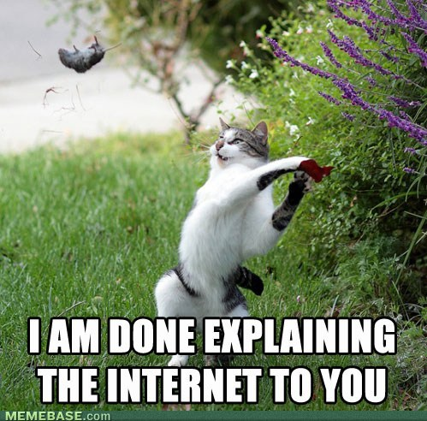
A little something for the boss

