Slide 1
IDLC All – Hands - 2009 Zoomix – SSDQS => A.K.A. DQ SQL Sever Data Quality

Slide 2
The Problem:
Bad Business
The Reason:
Bad Data
The Scenario:
Improved Data Quality
The Persona:
Jude our Data Steward
B u t, h o w ?
It takes so much time & $$$ …

Slide 3
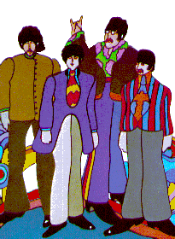
Look at Jude – He’s so sad – He needs Help
1
2
3
SSDQS is Here

Slide 4
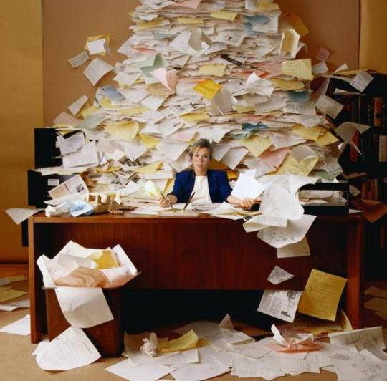
Hey Jude,
don’t be so sad. We’ll take your data
and make it better

Slide 5
We learn
from every step that you make. And constantly,
we make it better

Slide 6
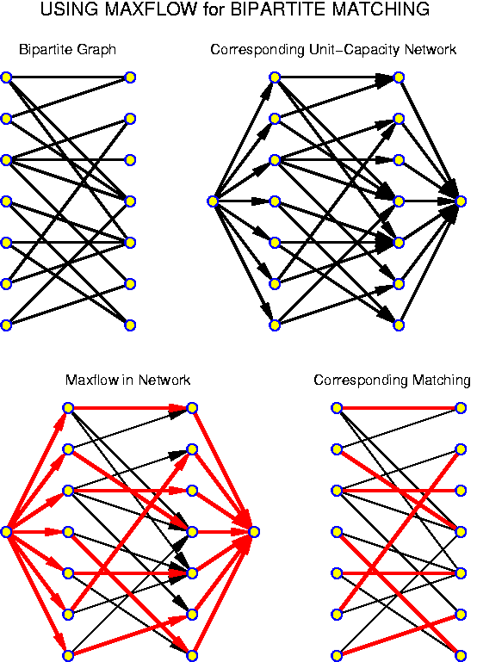
Hey Jude,
You’ll have it all
Profile, matching
and yes semantics

Slide 7
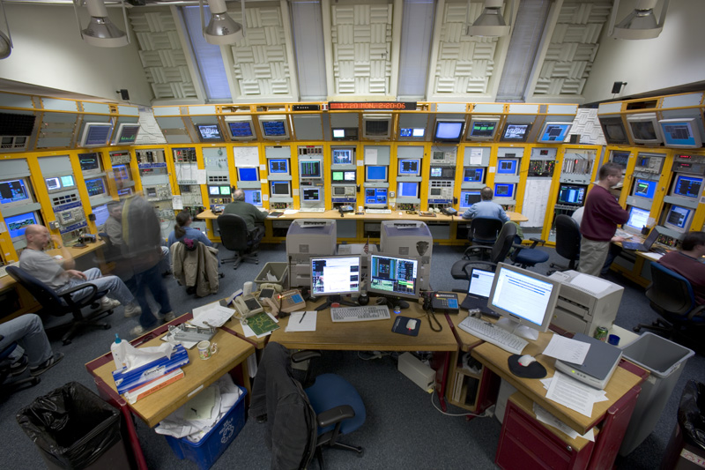
The data
Is absolutely controlled
And monitored
By your data experts

Slide 8
And now it’s over with the pain
Hey Jude, be Glad.
Your Data is kept
In perfect order

Slide 9
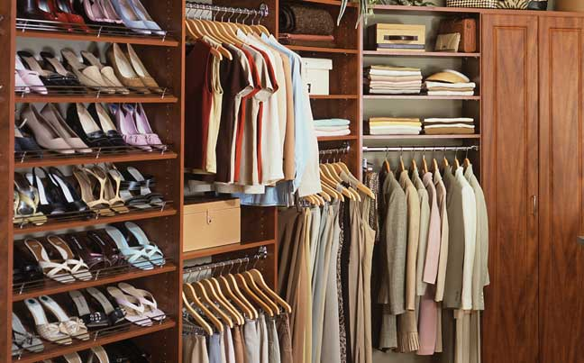
It’s clean and clear and so complete.
And finally fits
Your business needs,
that’s what you’ve asked for

Slide 10
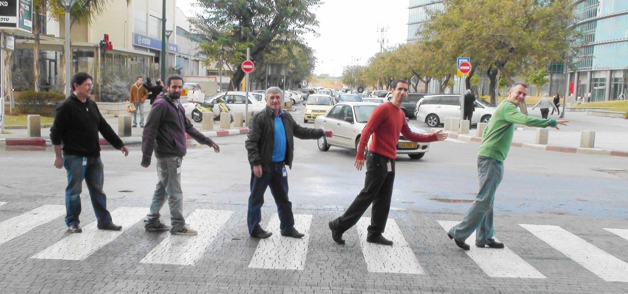
Nah, nah, nah,
naaaah, naaaah
nah, nah, naaaah, naaaah

Slide 11
Hey Jude,
It’s not a dream
It’s all planned for SQL 11

Slide 12
We promise
To bring it into your firm
With high quality
And almost bug free

Slide 13
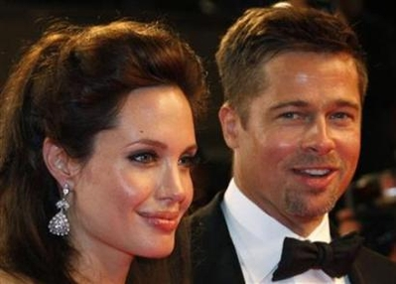
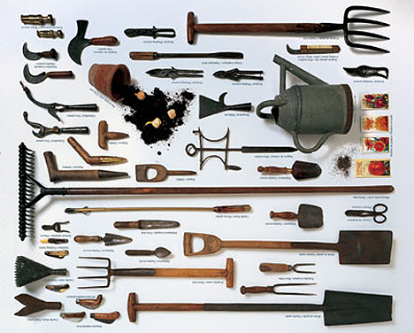
You’ll see it’s easy
And it’s cool
With friendly tools
Including an open integration
Cool !!!

Slide 14
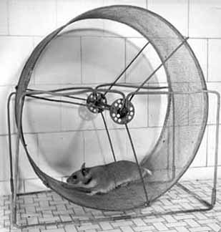
For you to use at anytime
And anywhere
To help your business
Run much better

Slide 15
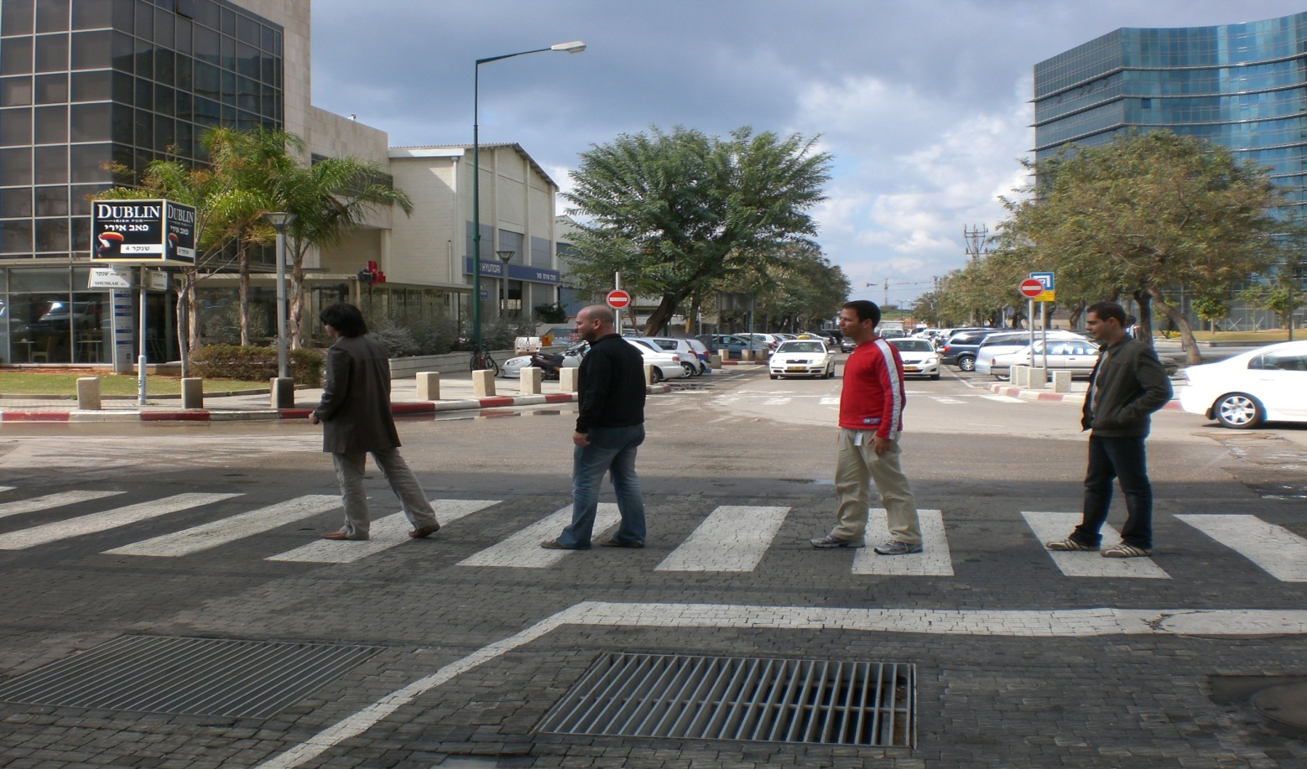
Nah, nah, nah,
naaaah, naaaah
nah, nah, naaaah, naaaah

Slide 16
Hey Jude,
we know you’re glad Now it’s different
And it’s forever

Slide 17
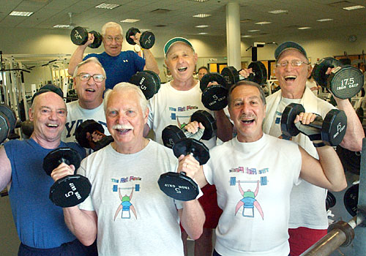
The data
That started dirty and wrong
Is in fine shape
And getting much …

Slide 18
B e t t e r
Aaaaaaaaaaaaaaa…..

Slide 19
( Naaah, nah, nah,
nah,nah,nah,naaaah
nah,nah,nah,naaaah
DQ (=Data Quality)
x 5

