Slide 1
Building a BI Portal for the Tabular Model
Cathy Dumas, Business Intelligence Consultant http://cathydumas.com

Slide 2
Agenda
Introduction to the tabular model
Survey of visualization tools
Excel
Power View
Reporting Services
PerformancePoint
Putting the pieces together – integrating the visualizations into a unified BI portal

Slide 3
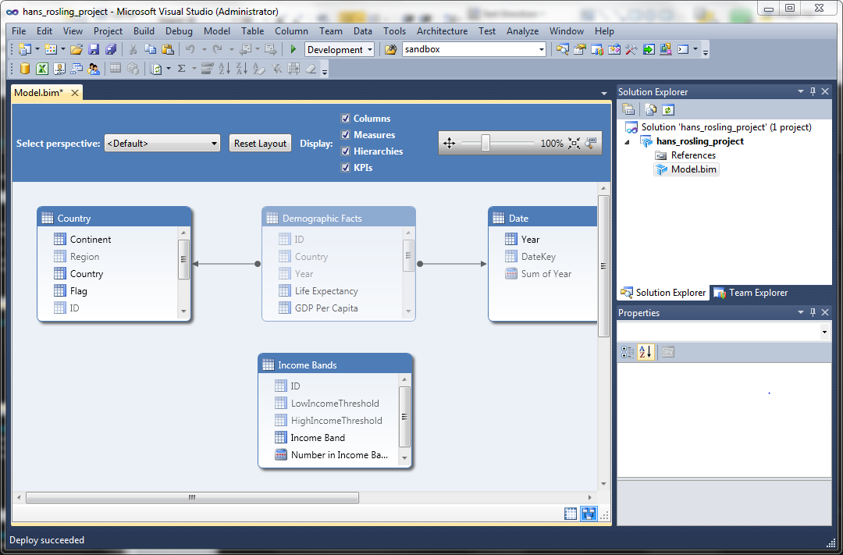
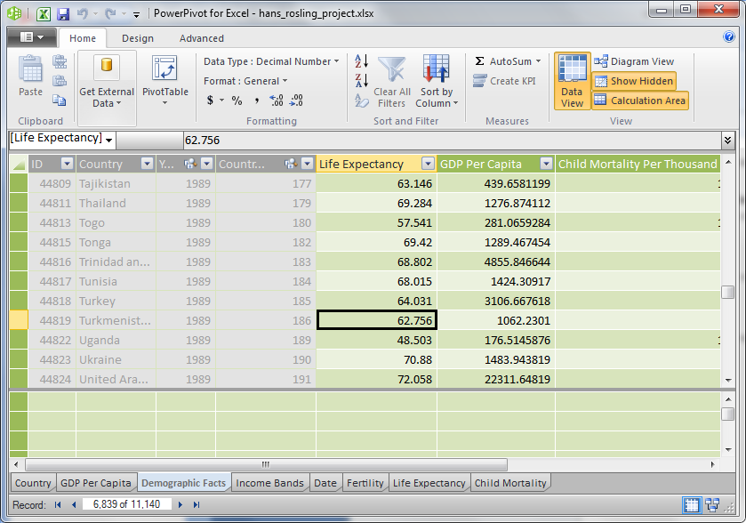
The tabular model

Slide 4
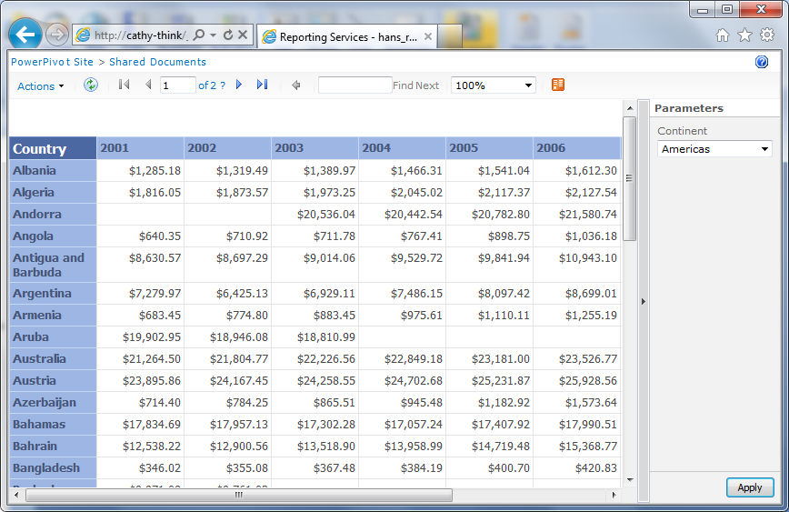
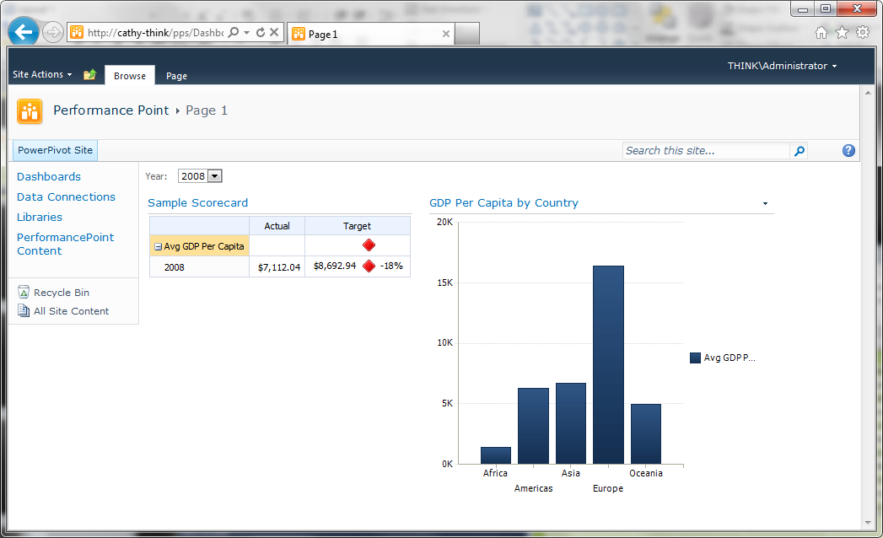
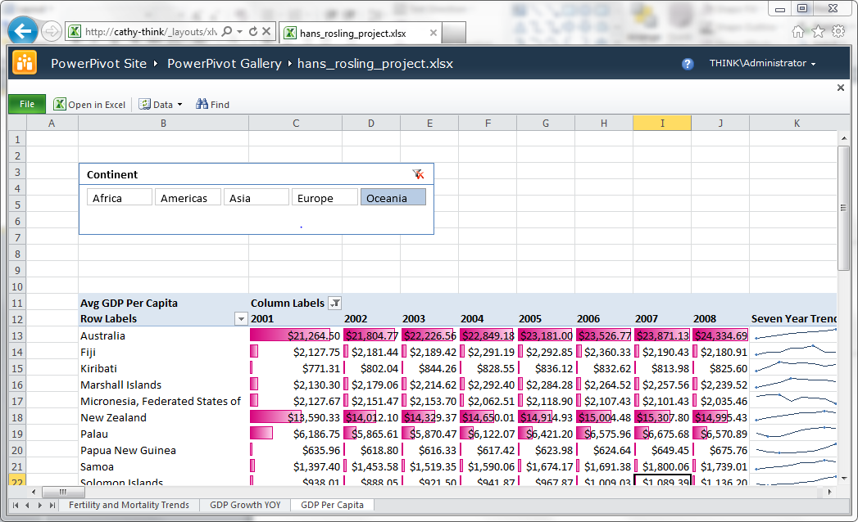
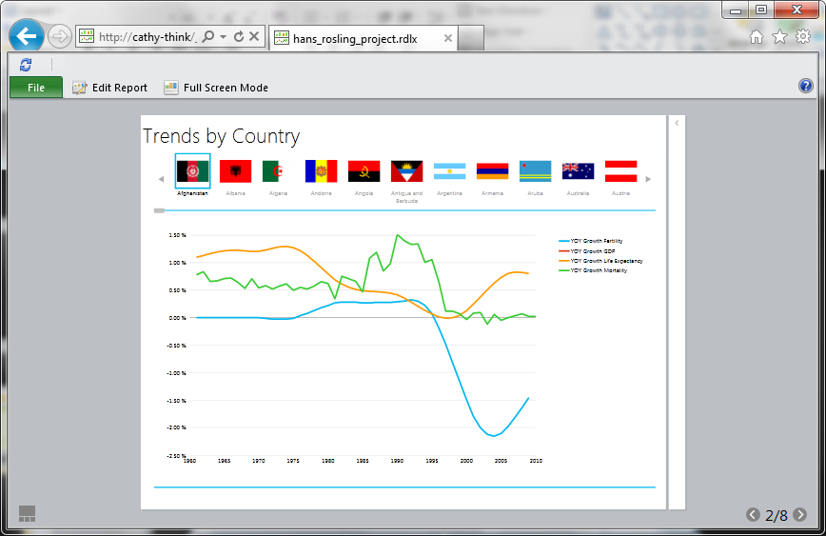
The big four visualization tools

Slide 5
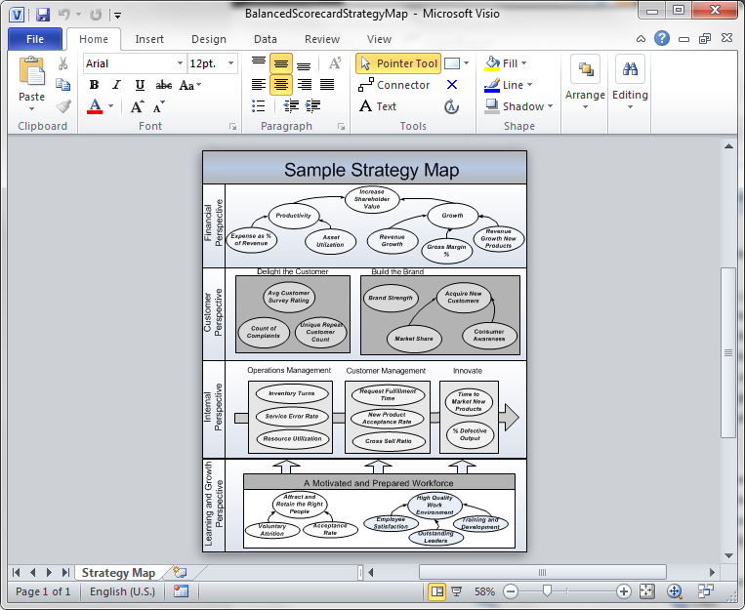
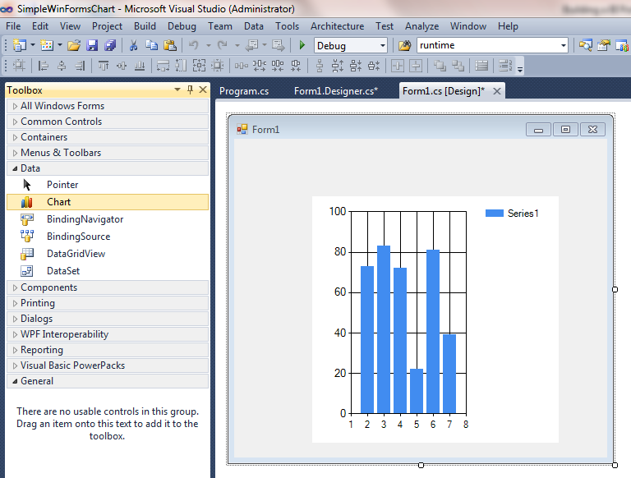
And the others…

Slide 6
Technology requirements

Slide 7
SharePoint
Excel
Power View
Reporting Services
PerformancePoint

Slide 8
Silverlight
Excel
Power View
Reporting Services
PerformancePoint

Slide 9
Mobile support
Excel
Power View
Reporting Services
PerformancePoint

Slide 10
Post deployment customizability
 | Ad hoc reporting | Maintainable by business users
Excel
Power View
Reporting Services
PerformancePoint

Slide 11
Visualization requirements

Slide 12
Charts and tables
Excel | Bar, line, pie, column, area, scatter, bubble, radar, surface, doughnut, stock
Power View | Bar, line, column, scatter, bubble
Reporting Services | Bar, line, pie, column, area
PerformancePoint | Bar, line, pie

Slide 13
Advanced charting and visualization features
Excel | Trend lines, plotting series on multiple axes, error bars, spark lines, data bars
Power View | Contact card, image display
Reporting Services | Plotting series on multiple axes, customizable tool tip display, spark lines, data bars, gauges
PerformancePoint | Decomposition tree, gauges, Visio Services integration

Slide 14
Interactivity
Excel | Slicers, basic filter controls
Power View | Slicers, user-friendly filter controls, interactive filtering by clicking visualizations, play axis, tiles
Reporting Services | Basic filter controls
PerformancePoint | Basic filter controls, cross filtering across web parts

Slide 15
Tabular features
 | KPIs | Hierarchies | Perspectives | Drill Through | Real Time
Excel
Power View
Reporting Services
PerformancePoint

Slide 16
Custom colour, logo, and fonts
Excel
Power View
Reporting Services
PerformancePoint

Slide 17
Maps
Excel
Power View
Reporting Services
PerformancePoint

Slide 18
Futures

Slide 19
Conclusions
SharePoint – here to stay
Power View – adds new features, but does not replace any existing tools in the tool chain
Excel is a perfectly good dashboarding tool
PerformancePoint is not dead - still useful for balanced scorecards
Making an excellent dashboard just got harder with Power View – integrating stunning visualizations with core dashboarding functionality is a challenge requiring good design skills and imagination

